Slide 1
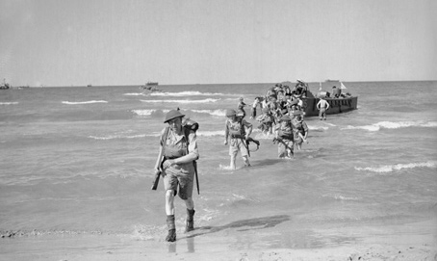
Chapter 17-Section 2-The War for Europe and North Africa

Slide 2
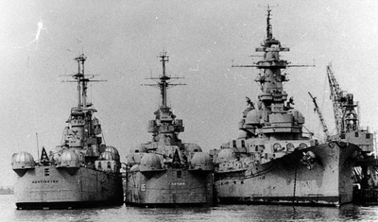
Great Britain and the U.S. Join Forces
War Plans-Winston Churchill convinces FDR that in order to win the Allies must strike first against Hitler and worry about Japan later
The Battle of the Atlantic-
  Hitler orders submarines to attacks British supply ships
    German submarines known as “wolf packs” destroy hundreds of British ships in 1942
  Allies organize convoys of cargo ships with naval escort: We send destroyers equipped with sonar and planes with radar
  We also increase the rate of production for constructing of Liberty ships (cargo carriers) making the amount of ships launched far above the amount sunk

Slide 3
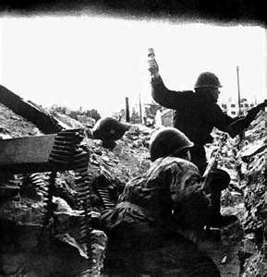
Eastern Front
Russia had been fighting against Germany since 1941
  Hitler went after Russian Oil and Industry
  Moscow and Leningrad were with in Hitler’s reach and the Russians were losing ground until the winter
The Battle of Stalingrad-
    After a brutal winter campaign and four weeks of fighting the Germans are forced to begin retreating
      Roughly 230,000 Germans died during this conflict along with 1.1 million Soviet soldiers
      The Russian defeat of the Germans marked the turning point of the war as the Soviet Army begins pushing the Nazi’s back towards Germany

Slide 4
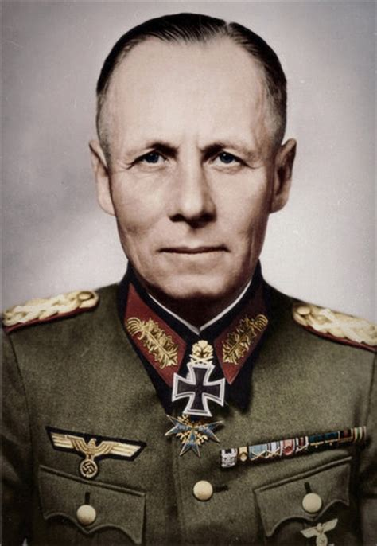
North African Front
Operation Torch-
  In 1942 the Allies under the command of General Dwight D. Eisenhower commands the invasion of North Africa
  German Afrika Korps, led by respected General Erwin Rommel (he was known as the desert fox) engaged in heavy tank battles until their surrender in May 1943
  By the summer 1943 of the Allies were “Masters of North African Shores”

Slide 5
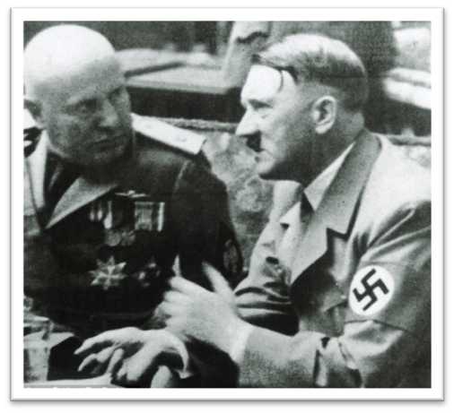
Italian Campaign
As they met in the city of Casablanca FDR and Churchill decide that the only real solution in ending the war is to accept unconditional surrender from the Axis powers
  They are going to start by attacking Italy
In the summer of 1943, the Allies capture the Italian capital of Sicily and force Mussolini to resign
1944-Allies win the battle of “Bloody Anzio” loosing nearly 30,000 Allied men
  Although after this battle the Germans still continue to put up strong resistance

Slide 6
Heroes in Combat
African Americans-
  Tuskegee Airmen-A highly decorated unit of comprised completely of African-American airmen
    99th Pursuit Squadron did not lose a single bomber during the war
  92nd Infantry
    Nicknamed the Buffaloes they ended up receiving seven Legion of Merit awards , sixty-five Silver Stars and one hundred sixty-two Bronze Stars
Mexican-Americans-
  During WWII seventeen Mexican-American soldiers received the Congressional Metals of Honor
  141st Regiment, 36th Division became one of the most decorated units to serve in WWII
Japanese-Americans-
  Due to their success the 100th Battalion comprised of Japanese-American soldiers became known as the “Purple heart Battalion”
    The 442nd Battalion also received a number of accolades as well

Slide 7
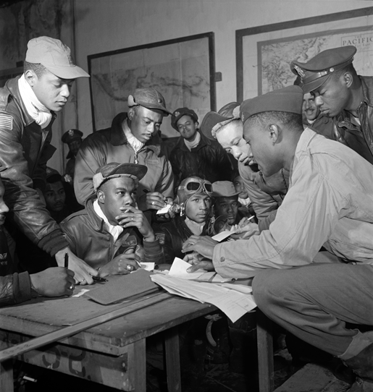
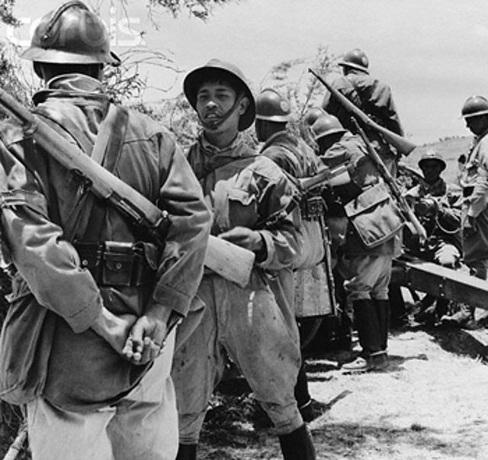
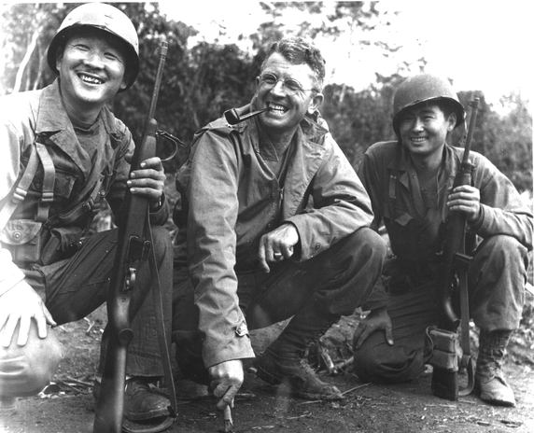
Heroes in Combat
Japanese-American
442nd Division
African-American
Tuskegee Airmen
Mexican-American
141st Regiment 36th Division

Slide 8
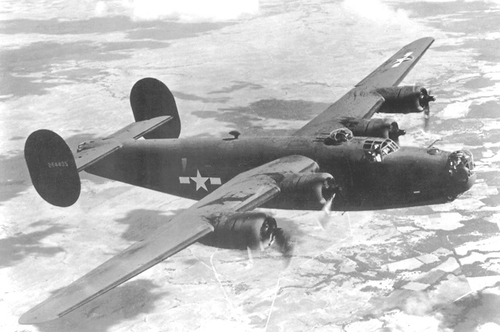

Slide 9
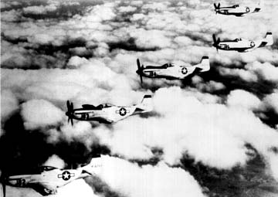

Slide 10
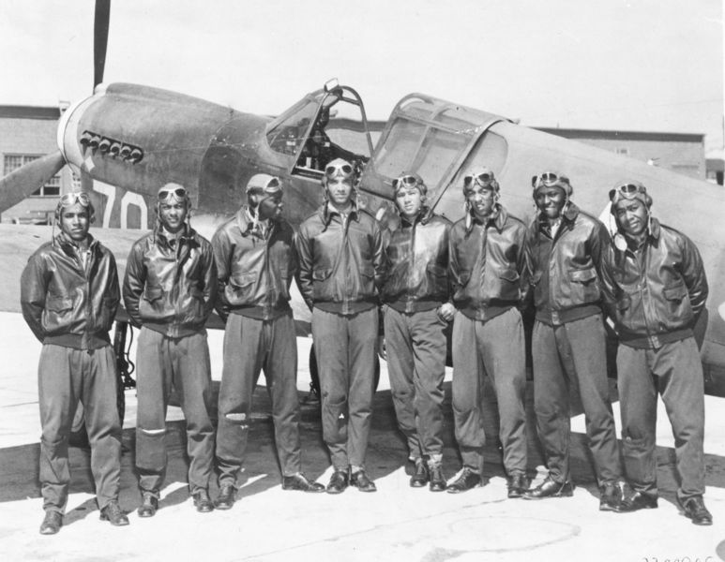

Slide 11
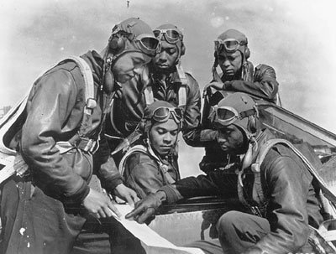

Slide 12
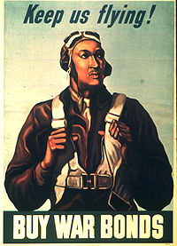

Slide 13
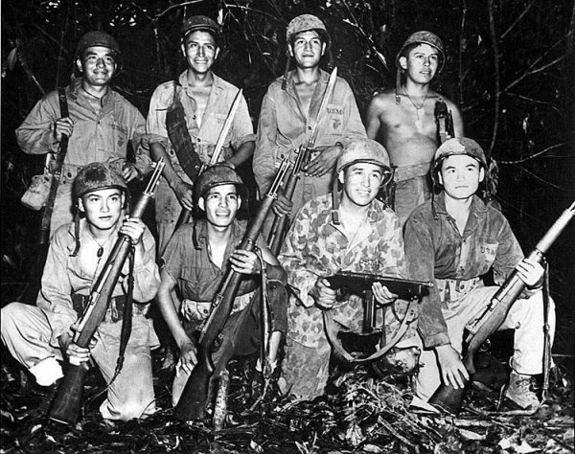

Slide 14
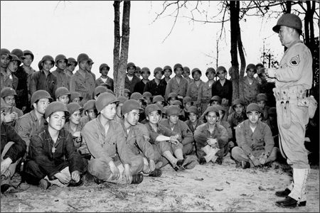

Slide 15
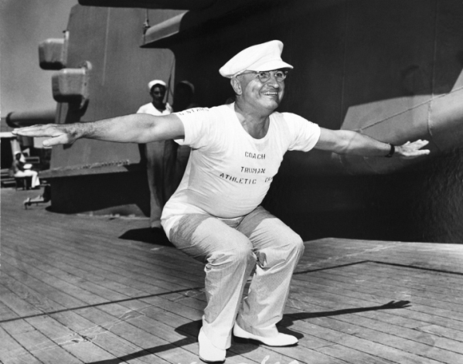
Liberation of Europe
June 6th, 1944 the United States launches our key invasion of Europe officially known as Operation Overlord (Code named D-Day)
  3 million allied troops launch this offensive
  There were a large amount of casualties and some major mistakes are made
  By the end of September, 1944 France was liberated
  In 1944 FDR is re-elected for 4th term
    Truman becomes his Vice President

Slide 16
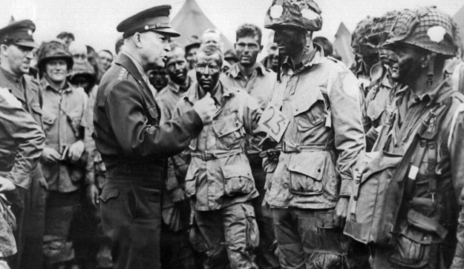

Slide 17
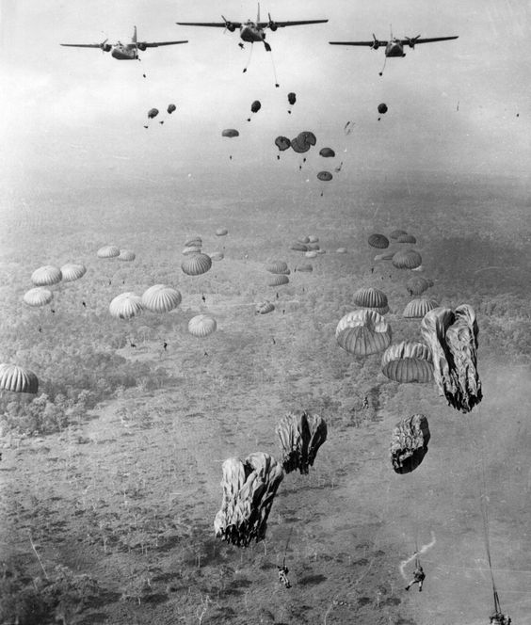

Slide 18
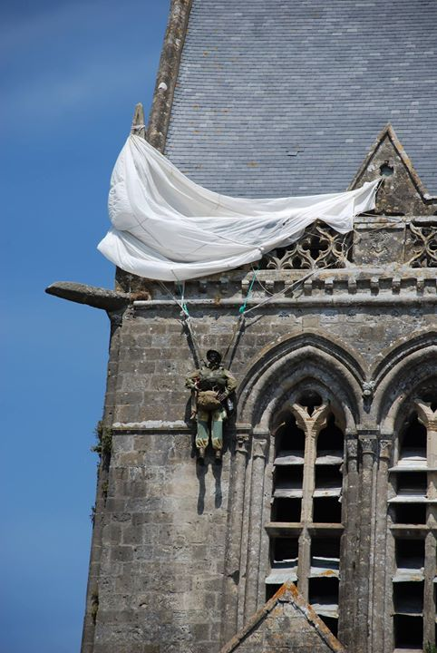

Slide 19
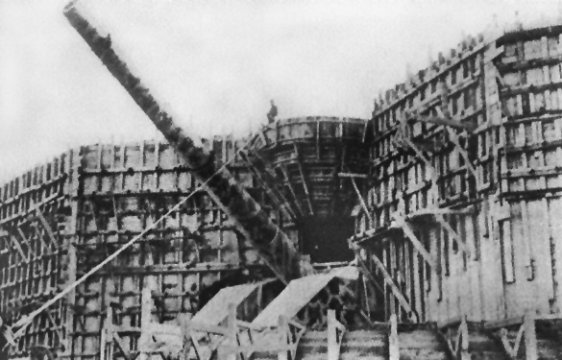

Slide 20
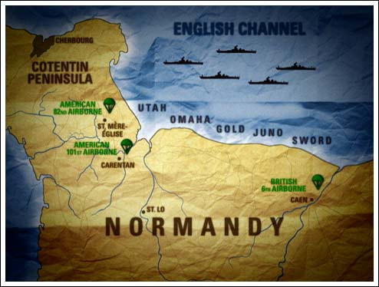

Slide 21
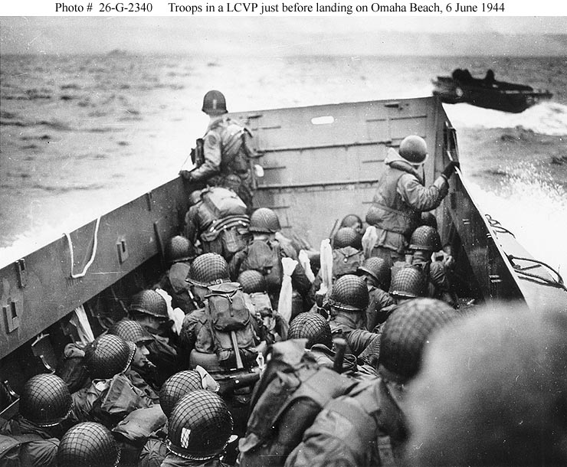

Slide 22
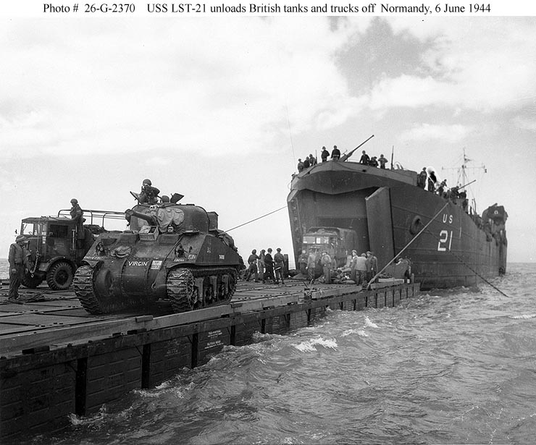

Slide 23
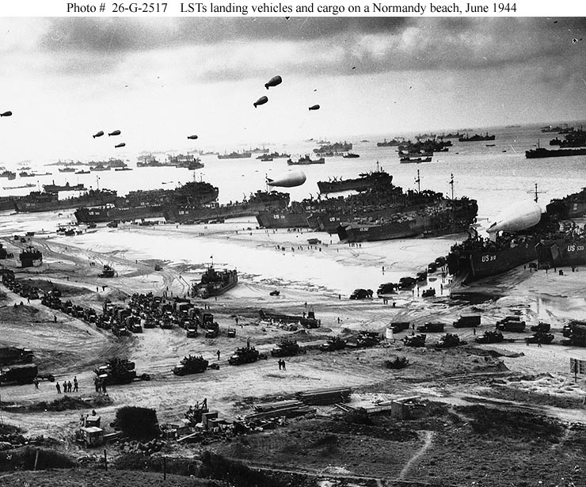

Slide 24
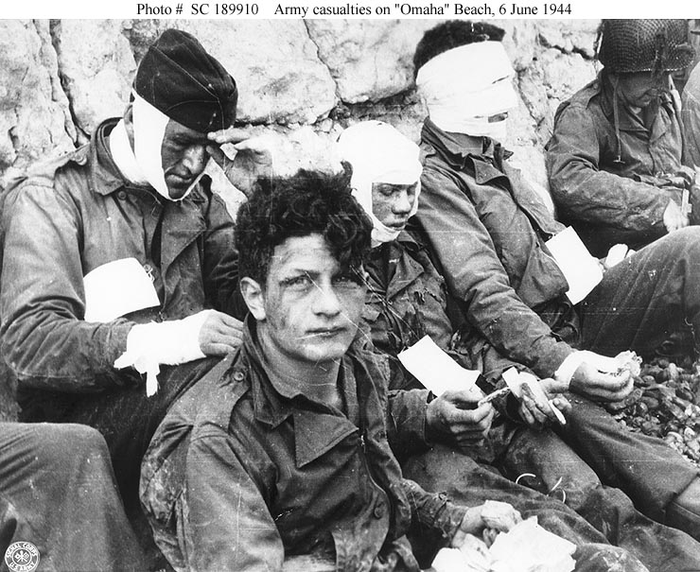

Slide 25
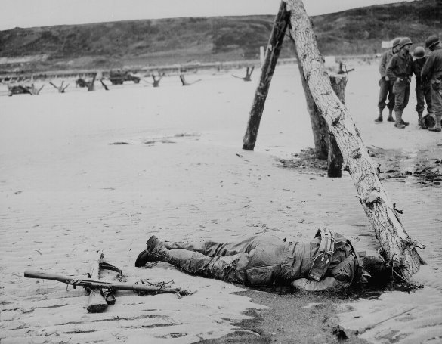

Slide 26
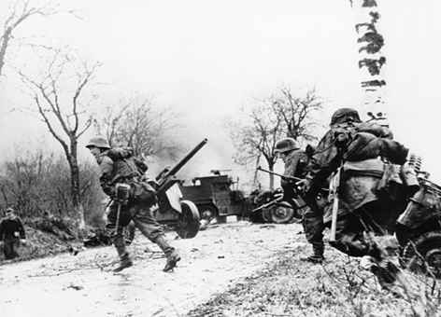
Battle of the Bulge
The Battle of the Bulge-
  In October 1944, Allies capture first German town, Aachen
In December 1944 German tank divisions drove sixty miles into the Allied lines but fail to break it
  This failure marks the end of the German offensive
Nazi forces are push back toward Germany and suffer irreplaceable losses

Slide 27
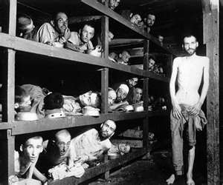
Liberation of Camps
U.S. was pushing Germany inland to the west while Russia was pushing them towards the East
Liberation of the Death Camps-
  Allies in Germany, Soviets in Poland liberate concentration camps finding starving prisoners, corpses, evidence of killing

Slide 28
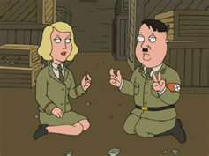
Liberation of the Camps
On April 29, 1945 Hitler married Eva Braun as the Soviets were marching into Berlin, Germany
  Decided they were going to commit suicide
    Killed themselves the next day
May 1945 marks V-E Day (Victory in Europe Day)
  Sadly, FDR never got to see the end of the war.
    On April 12, 1945 while in Warm Springs Georgia he died following a stroke.
    Following his death Harry S. Truman is named the 33rd President of the United States

