Slide 1
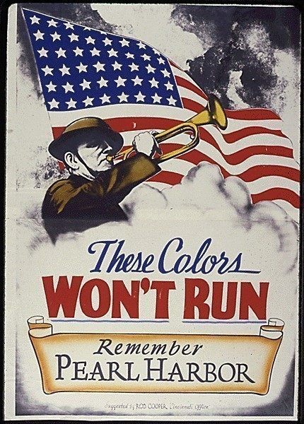
Chapter 17-Section 1-Mobilizing for Defense

Slide 2
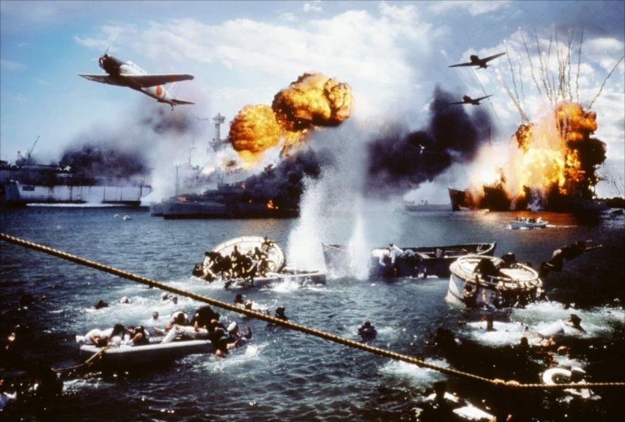
Americans Join the War Effort
Japan felt that we would shrink after the attack on Pearl Harbor, but the opposite happened
America prepares for war

Slide 3
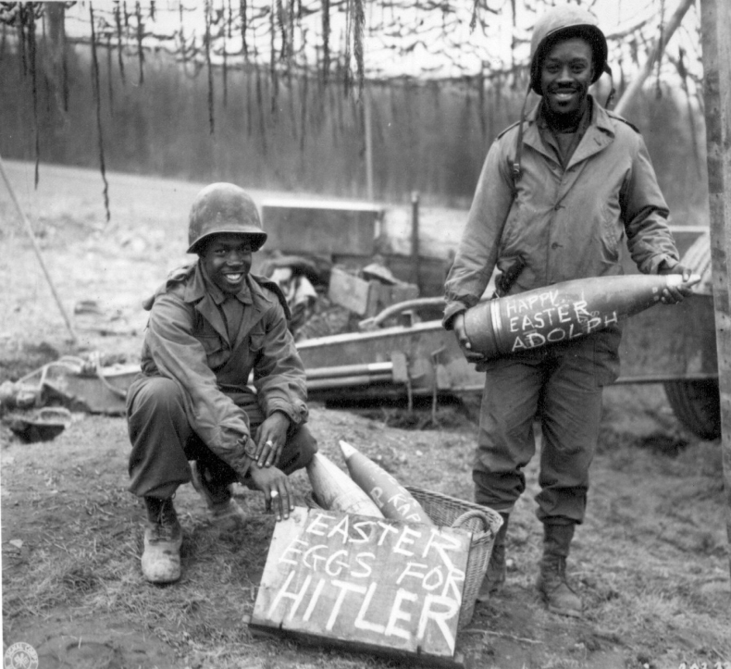
Americans Join the War Effort
Selective Service Act: Ten million additional soldiers added to the military
  Rushed basic training to get them ready
  Everyone was included which created racial tension.
  Why should African Americans fight for country that will not give them rights?

Slide 4
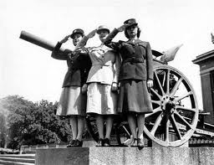
Americans Join the War Effort
Expanding the Military
  Effort headed by General George Marshall
    Included women: Women’s Auxiliary Army Corps (WAAC)
      Nurses, ambulance drivers, noncombat

Slide 5
Americans Join the War Effort
Dramatic Contributions
    Many people sacrificed everything to defend their country
    Even with discrimination, many went
      Asians, Mexicans, African-American’s
    Not always treated fairly in military, but were extremely important to war effort.

Slide 6
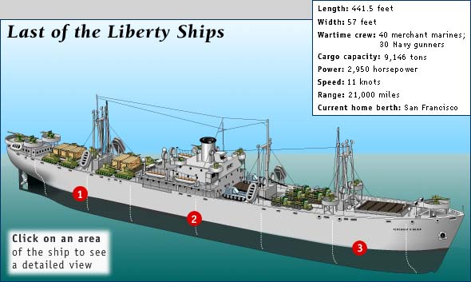
A Production Miracle
Production Miracle:
    Everyone had a part to play in the war
    1942-The last car was produced for private use
      Didn’t even have chrome
    Plants remodeled to make war goods
    Soda pop companies, filled shells
    Henry Kaiser: Invented a faster way to build navy ships
      One every four days

Slide 7
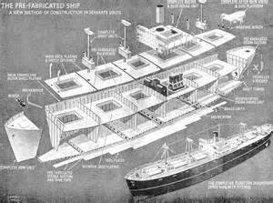

Slide 8
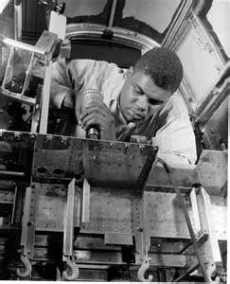
A Production Miracle
Labor’s Contribution:
  18 million in factories
  6 million women
    Out preformed everyone's expectations
Over two million minority workers helped drive the war effort
  Factories at first wouldn't hire African Americans

Slide 9
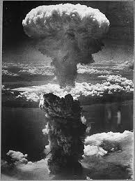
A Production Miracle
Mobilization of Science:
  Office of Scientific Research and Development
    Radar
    Sonar
    Improving the health of soldiers in battle
    Penicillin
    Development of Atomic Bomb
      Manhattan Project

Slide 10
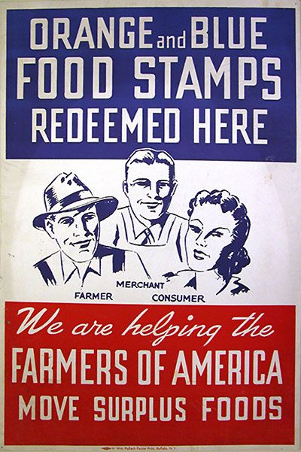
The Federal Government Takes Control
Federal Government Takes Control:
  Had to control economics
  Office of Price Administration
    Price freezes
    Raise income tax
    Workers don’t have a lot of money to spend
    If people had money, the government wanted them to buy war bonds

Slide 11
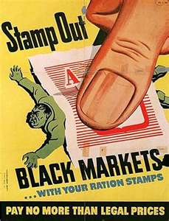
The Federal Government Takes Control
War Production Board
  Helped to get factories ready for war
  Organized drives to get metal
Rationing
  Most saw it as a necessary sacrifice
    Black market items increased
  The idea was to tighten our belts and if possible give more

Slide 12
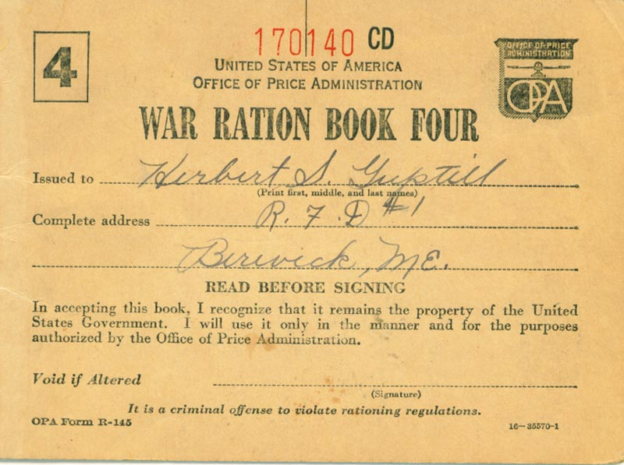

Slide 13
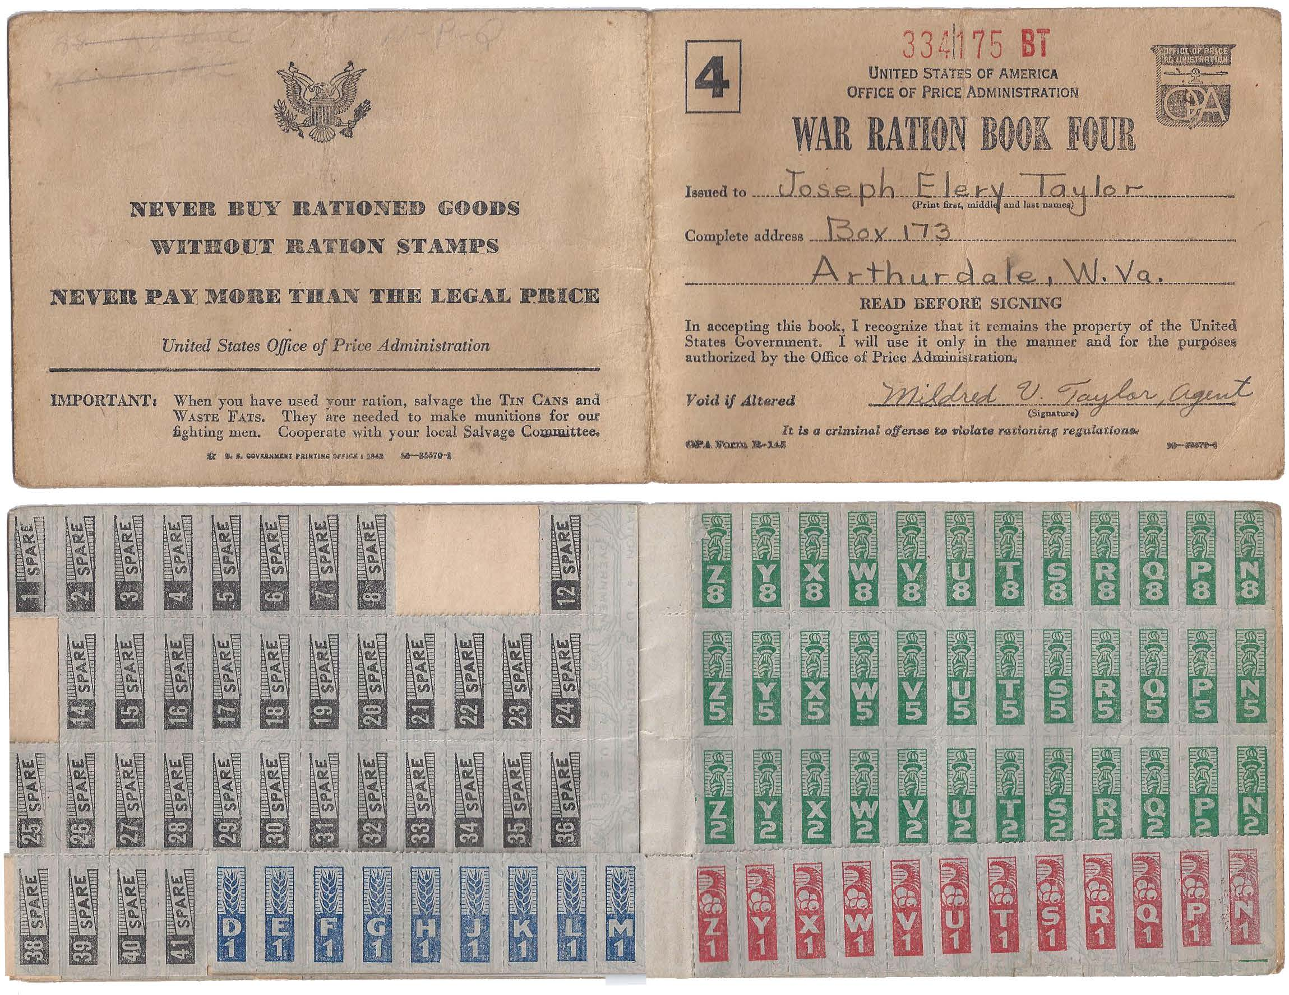

Slide 14
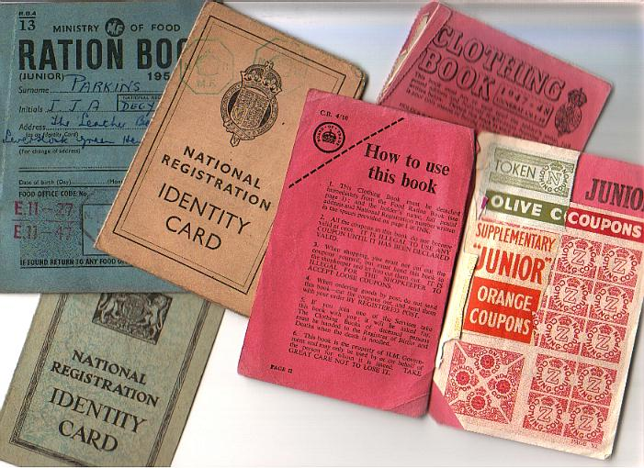

Slide 15
Items Rationed During WWII
Rationed Items
  Tires
  Cars
  Bicycles
  Gasoline
  Stoves
  Sugar
  Coffee
  Processed Foods
  Canned fish and meat
  Cheese, canned milk, fats
Rationing Duration
  January 1942 to December 1945
  February 1942 to October 1945
  July 1942 to September 1945
  May 1942 to August 1945
  December 1942 to August 1945
  May 1942 to early 1947
  November 1942 to July 1943
  March 1943 to November 1945
  May 1942 to late 1947

