Slide 1
The Nations Sick Economy
Chapter 14 Section 1

Slide 2
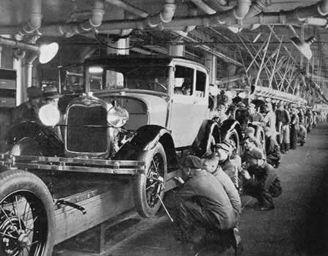
Economic Troubles on the Horizon
1920’s seemed prosperous, but there were hidden problems
Both wealthy and lower classes grew
Industries struggled and farmers were in trouble
Industries in Trouble:
Mining and lumbering, railroads, radio, steel and automobiles were among the industries who struggled
All of these industrial weaknesses signaled a declining economy

Slide 3
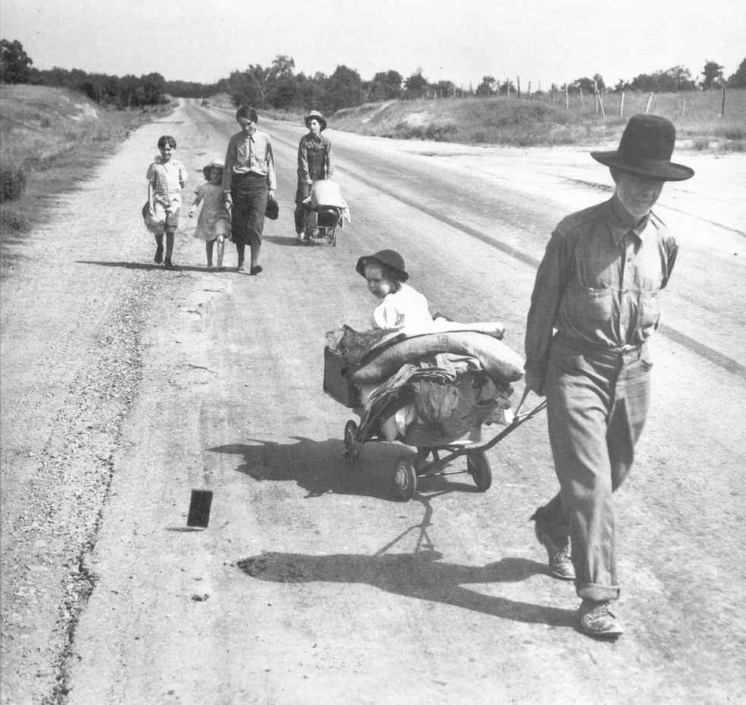
Agriculture and the Farmers
Prices for crops had been at an all-time high during WWI
Farmers had planted more and taken out more loans to buy more equipment
Government was buying food from the farmers at a very high rate and cost
After the war prices dropped by over 50%
A lot of farmers were unable to repay their loans and lost their farms

Slide 4
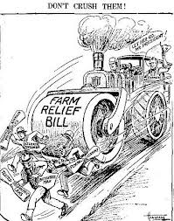
Agriculture and the Farmers
Banks begin to fail because farmers couldn’t repay their loans
McNary-Haugen Bill
An attempt by Congress to help farmers
Price-Supports-The government would buy surplus crops at guaranteed priced and sell them on the international market
This bill was vetoed twice by President Coolidge

Slide 5
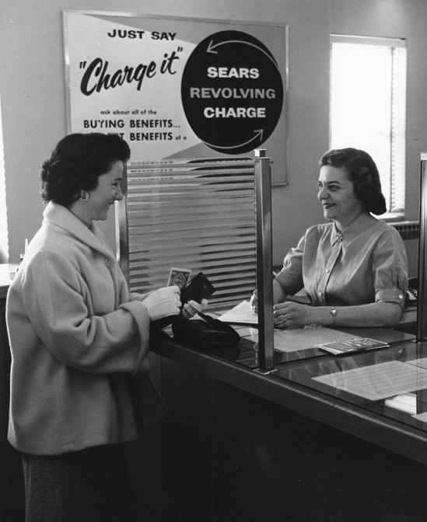
Living on Credit
Credit-Buy now pay later – usually with high interest rates
Seemed prosperous because people were buying with money they did not have
Later when faced with rising debt, many consumers started cutting back on their spending
This cutback slowed the economy

Slide 6
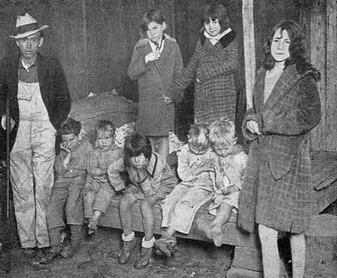
Uneven Distribution of Income
More than 71% of the population earned less than $2,500 per year
Most people could only afford one new set of clothes a year and many most did not have electricity or a furnace
Only 1 in 10 American’s had a refrigerator
Unfortunately, the rich were getting richer and the poor were getting poorer

Slide 7
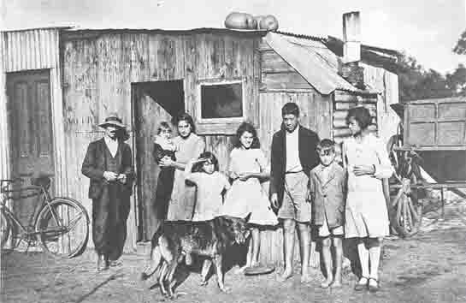

Slide 8
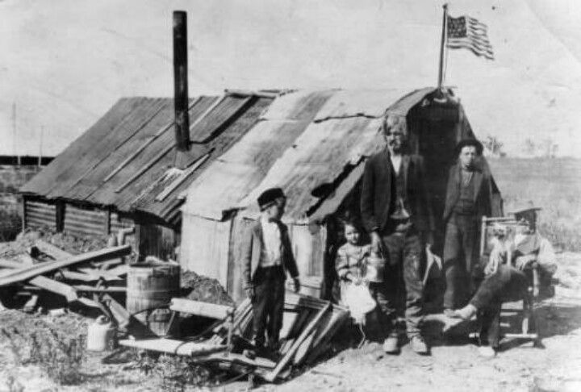

Slide 9
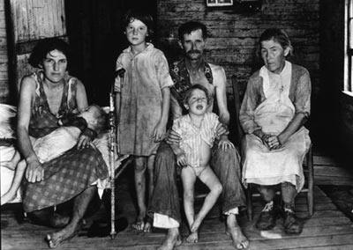

Slide 10
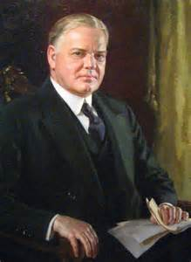
Hoover Takes the Nation
Election of 1928
Herbert Hoover (R) v. Alfred E. Smith (D)
Hoover wins the election easily and becomes the 31st president of the United States

Slide 11
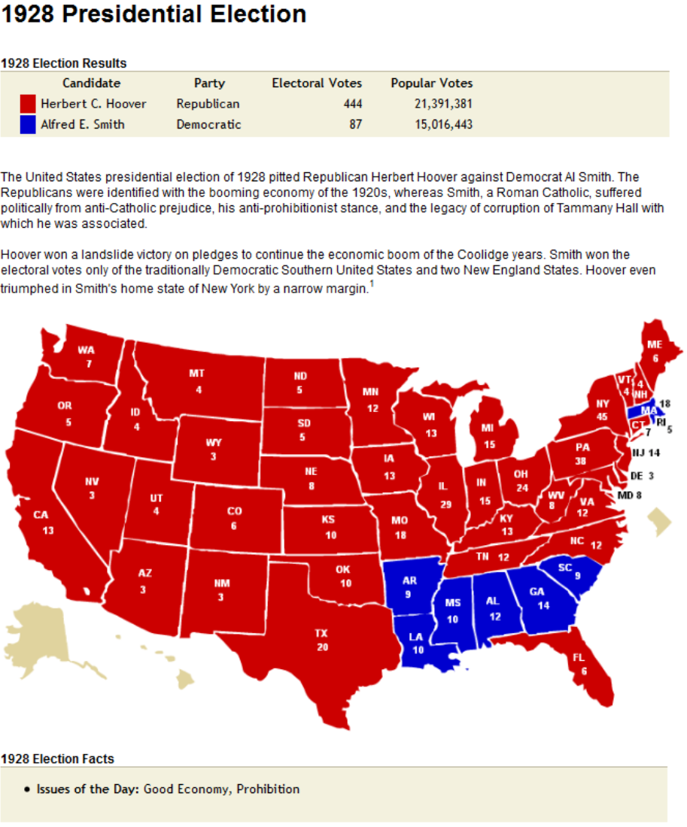

Slide 12
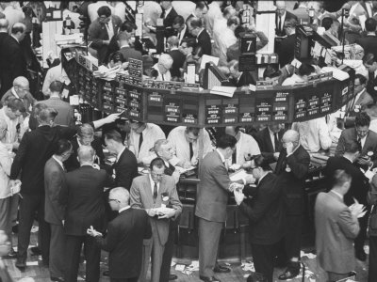
Stock Market
Americans who could afford it (and some who couldn’t) invested in the market
Dow Jones Industrial Average-Most widely used barometer of the stock market’s health
Measure based on the prices of stocks from twenty large companies

Slide 13
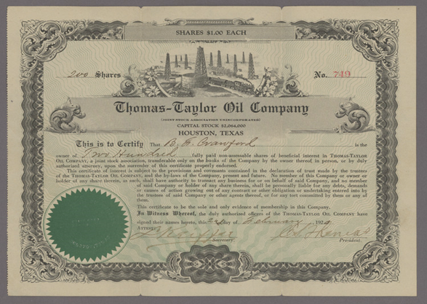
Stock Market
Speculation-People were buying stocks and bonds on the chance of a quick profit while ignoring risks
Buying on margin-paying a small percentage of a stock’s price as a down payment and borrowing the rest
Both speculation and buying on margin caused stock prices to rise
They caused over-investment because people bought more than they could pay for

Slide 14
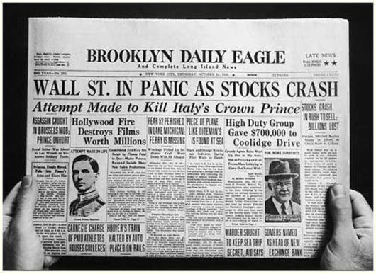
The Stock Market Crashes
Black Tuesday-
October 29, 1929
A record 16.5 million shares were sold
Millions more could not find buyers
People who had bought stock with loans were stuck with huge debt and unable to pay

Slide 15
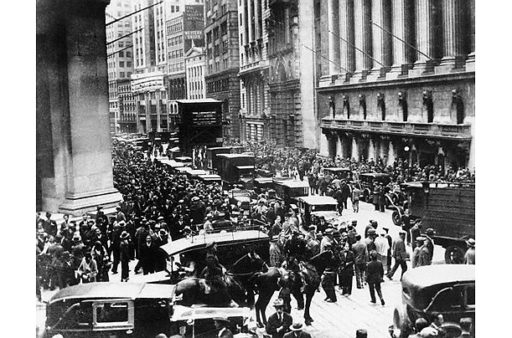
Financial Collapse
The stock market crash was the first sign of the Great Depression
Period between 1929 and 1940 in which the economy plummeted and unemployment skyrocketed
The Great Depression was not just isolated to America – it was felt around the world

Slide 16
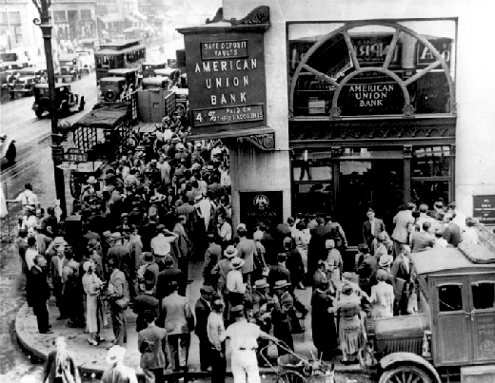
Bank and Business Failures
Banks also invested in the stock market – and they too lost their money
In 1929 around 600 banks closed–people could not get their money from the bank
By 1933 11,000 of the nation’s 25,000 banks had failed and lost their money
Millions of Americans lost all they had

Slide 17
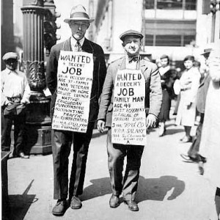
Unemployment
One out of every four Americans did not have a job by 1933
Those who did have a job were working for very little money with very little hours

Slide 18
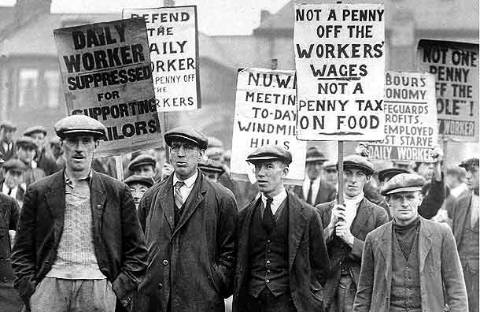
Hawley-Smoot Tariff
In 1930, Congress passed the Hawley-Smoot Tariff
Established the highest protective tariff in United States history
Designed to protect American farmers and manufacturers from foreign competition
But had the opposite effect…..

Slide 19
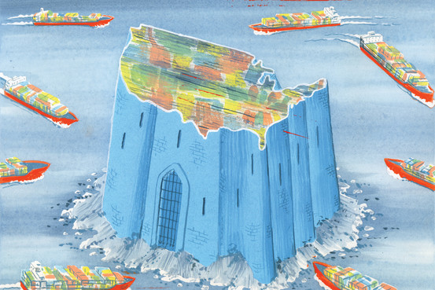
Hawley-Smoot Tariff
By reducing the flow of goods in to the U.S. other countries lost revenue – which they were using to repay their loans to the United States
Also caused unemployment rates to increase
World trade declined by almost 50%

Slide 20
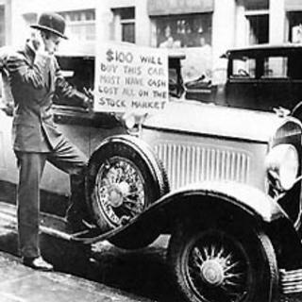
Causes of the Great Depression
Tariffs and war debt policies
Crises in the farm sector
Availability of easy credit
Unequal distribution of income

