Slide 1
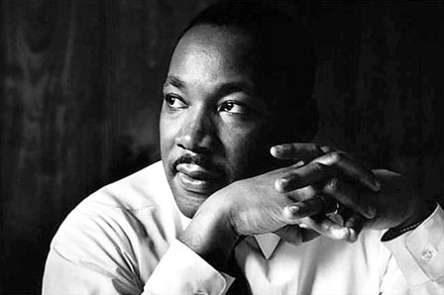
Section 3-Suffrage and Civil Rights

Slide 2
Gerrymandering
Gerrymandering-The process of drawing electoral district lines in order to limit the voting strength of a particular group or party.
  It’s a method that helps political parties gain seats in the House of Reps
There are two main styles of gerrymandering:
  Packing: Putting as many members of one party into one district to limit the amount of seats they win
  Cracking: Splitting voters of the opposing party into two different districts

Slide 3
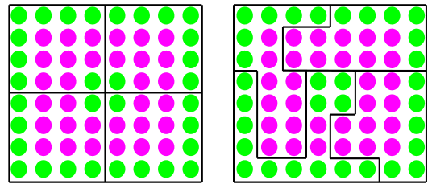
Gerrymandering Example Diagram
Left: Four districts of even “Red” and “Green” party voters, 8 from each party.
Right: Redrawing the balanced electoral districts in this example creates only one packed district of 14 green voters.
The remaining 18 green voters are cracked across the 3 other districts. The result is a 3-to-1 advantage for the “Red” party.

Slide 4
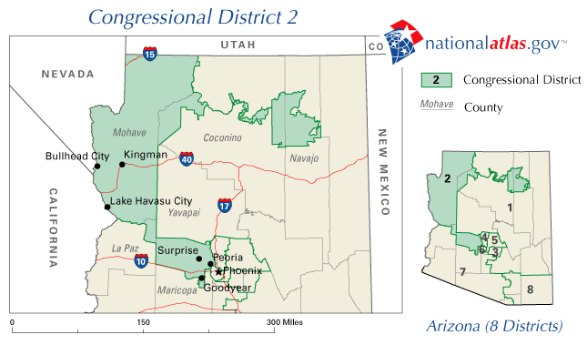
Gerrymandering Example:
Arizona's 2nd Congressional district
The unusual division was not drawn to favor politicians, but to separate the Hopi and the Navajo tribes, due to historic tensions.
Since the Hopi reservation is completely surrounded by the Navajo reservation, and in order to comply with current Arizona redistricting laws, some means of connection was required that avoided including large portions of Navajo land, hence the narrow Colorado River connection.

Slide 5
White Primaries
White Primaries-White primaries were primary elections held in the Southern states in which only white voters were permitted to participate.
  White primaries were established by the state Democratic Party units or by state legislatures in many Southern states after 1890.
The Supreme Court outlawed white primaries through the case of Smith v. Allwright (1944)
  They ruled that political nominations are an integral part of election process which makes it beholden to the 15th Amendment

Slide 6
Fifteenth Amendment
How did the U.S. fulfill the promise of the 15th Amendment?
  After many years, Congress passed a series of federal civil rights and voting acts, most of them adopted in the 1960s.
  These laws outlawed practices such as:
    Blocking African American voter registration
    Levying poll taxes
    Requiring voter examinations.

Slide 7
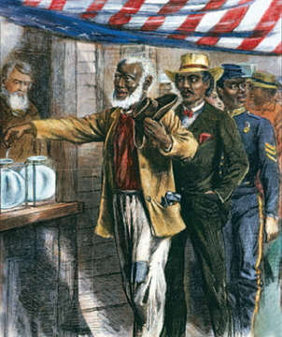
15th Amendment
In 1870, the ratification of the 15th Amendment gave African Americans, mostly former slaves living in the South, the right to vote.
However, this principle had no effect if Congress failed to enforce it.
  This is why literacy tests and poll taxes existed

Slide 8
Civil Rights Acts
Pressure from the civil rights movement led Congress to act.
The Civil Rights Act of 1957 created the U.S. Commission on Civil Rights, which investigated voter discrimination.
The Civil Rights Act of 1960 allowed federal voting referees to help qualified people register and vote in federal elections wherever federal courts found voter discrimination.

Slide 9
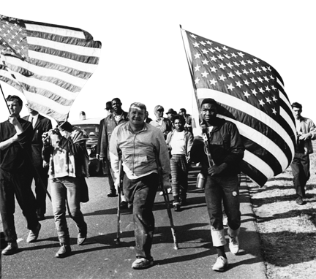
Civil Rights Acts
The Civil Rights Act of 1964 outlawed racial discrimination in job related-matters and banned unfair voter registration practices and literacy requirements.
Federal court orders were used to enforce these provisions

Slide 10
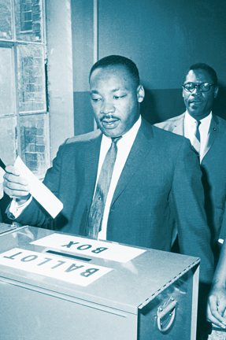
Civil Rights Act
In 1965, Dr. Martin Luther King, Jr. led a voter registration drive in Selma, Alabama.
National television showed peaceful civil rights marchers being attacked by State police, shocking the country.

Slide 11
Voting Rights Act of 1965
The Voting Rights Act of 1965 protects African Americans against various tactics intended to prevent them from voting.
It led to State poll taxes being overturned in the federal courts.
This Act applies to all elections: federal, State, and local.

Slide 12
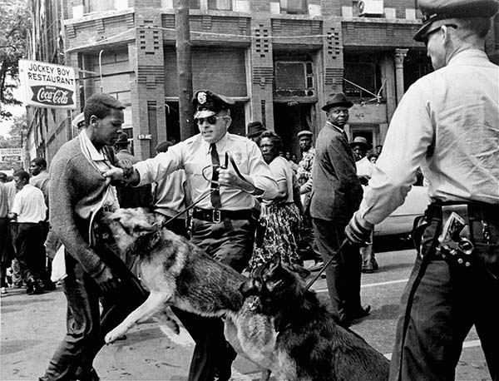

Slide 13
Checkpoint: Voting Rights Act
What provision about literacy tests was in the Voting Rights Act of 1965?
  The Act ended the use of literacy tests in places where less than half the eligible electorate had registered or voted in 1964.
  It also allowed federal voting examiners to oversee elections and register voters in these areas.

Slide 14
Preclearance
No new or changed election laws can take effect in a state where less than half the eligible electorate had registered or voted in 1964, unless first approved by the Department of Justice.
Preclearance has led to many court cases.
Often involve changes to the location of polling places, the boundaries of election districts, election deadlines, qualifications of candidates, or shifts from district elections to at-large elections.

Slide 15
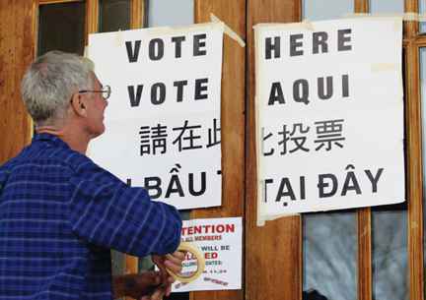
Amendments to the Act
The voter-examiner and preclearance provisions now apply to every community with a minority language population of 10,000 or more.
In these areas, ballots and other official election materials must be printed in English and the languages of the minorities involved.

Slide 16
Amendments to the Act
The ban on literacy tests now applies to all elections.
Some States and counties have been removed from the law’s coverage through the bail-out process.
  To be removed, a State or county must show that it has not applied any voting procedures in a discriminatory way for at least 10 years.
  Today the law still applies to everywhere in eight States, as well as parts of eight others.

