Slide 1
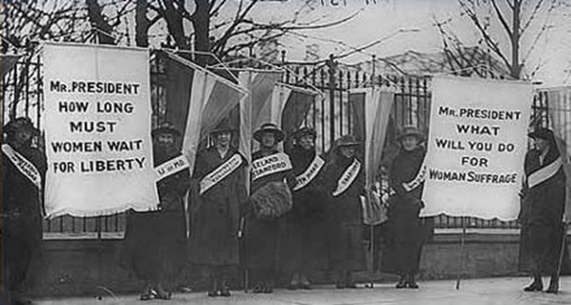
Chapter 9: The Progressive Era

Slide 2
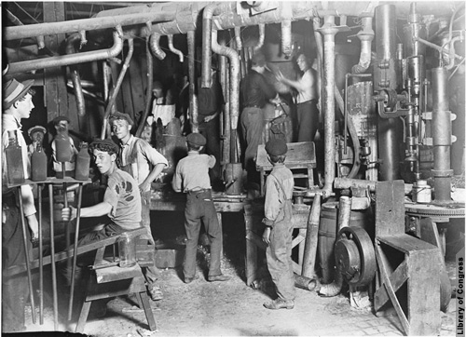
Section 1: The Origins of Progressivism

Slide 3
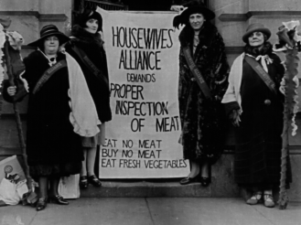
The Progressive Movement
In the late 1800’s many Americans began calling for sweeping changes across the nation
This voice mainly came from the rapidly growing middle class
Shared a belief that industrialization and urbanization had created troubling social and political problems
Wanted to bring about reforms that would correct these problems and injustices through logic and reason
Chapter 9 Section 1

Slide 4
Progressives Target a Variety of Other Problems
Political Reform-
The vote was the primary goal of many woman
Honest Government-
Targeted political officials who build corrupt organizations, called political machines
Wretched living conditions caused by inadequate services
Big Business-
Wanted greater economic opportunities for smaller businesses
Class System-
Wanted to reduce growing gap between rich and poor
Attacked harsh working and living conditions
Wanted social welfare laws for children
Wanted government regulations to aid workers and consumers

Slide 5
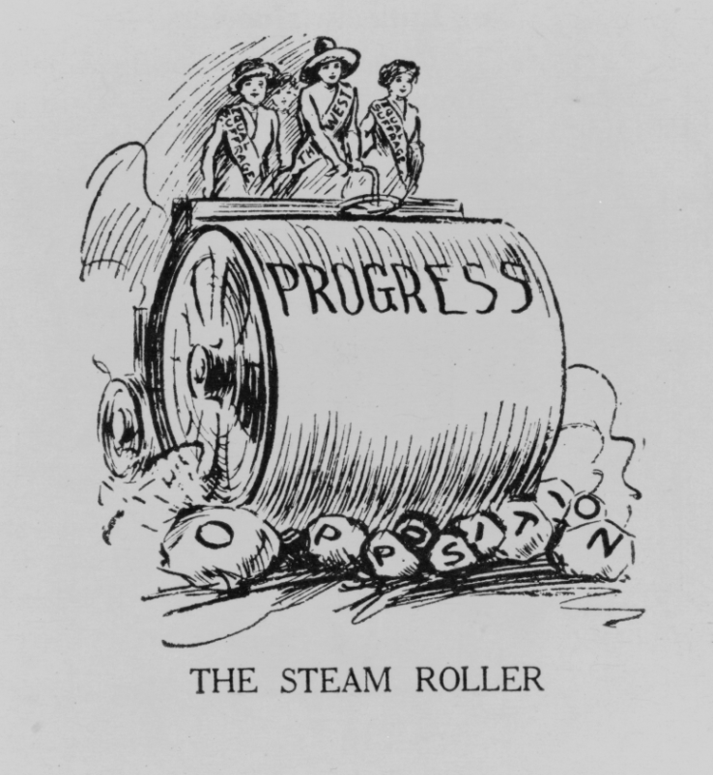
The Progressive Movement
The Progressive Movement-A movement to restore economic opportunities and correct injustices in American life
The Progressive Movement had four main goals:
Protecting Social Welfare
Promoting Moral Improvement
Creating Economic Reform
Fostering Efficiency

Slide 6
The Four Goals of the Progressive Movement
Four Goals:
Protecting Social Welfare-Provided financial help and services for poor.
Ex. YMCA activities, education, community centers, social services.
Promoting Moral Improvement-Improvement in personal behavior and morals.
Prohibition (ban of alcohol) and the Woman’s Christian Temperance Union (WCTU).
Sponsor schools, visit inmates, work for suffrage.
Creating Economic Reform- Muckrakers expose corruption in business and public life
Fostering Efficiency-Performing in the best possible manner with the least waste of time and effort.
Shorter work hours, higher pay, assembly lines.

Slide 7
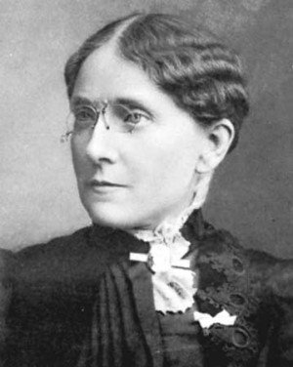
Protecting Social Welfare
During the late 1800’s social welfare reformers worked to soften the harsh conditions resulting from rapid industrialization
Social Gospel and settlement house movements worked with community centers and local churches to help the poor through social service programs
The Young Men’s Christian Association (YMCA) opened libraries, sponsored classes, built along with organizing activities like handball and building swimming pools
Florence Kelly was influential in helping pass the Illinois Factory Act of 1893.
This act prohibited child labor and limited the hours a woman would be forced to work

Slide 8
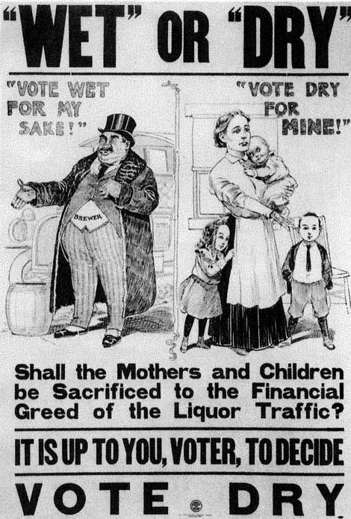
Promoting Moral Improvement
While protecting social welfare was important many felt that the key to reform was an improved sense of morality.
These reformers wanted immigrants and poor city dwellers to help themselves by improving their personal behavior
One solution was adopting prohibition
Prohibition-The movement to ban alcoholic beverages for the preservation of American morals and values

Slide 9
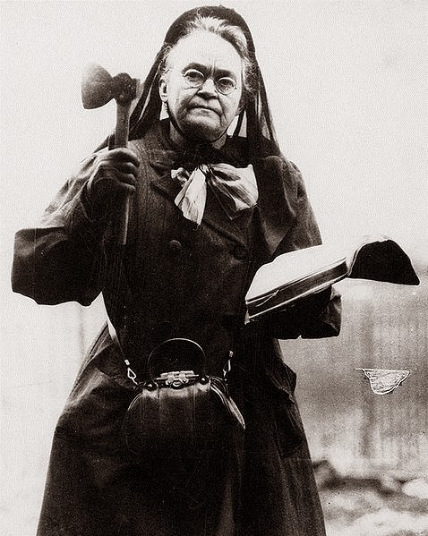
Promoting Moral Improvement
Crusade against alcohol led by Women’s Christian Temperance Union (WCTU) and the Anti- Saloon League
Supported prohibition
Laws that would ban making or selling of alcohol
Opposed alcohol for moral and social reasons
18th Amendment: The Prohibition Law: Ratified in 1919

Slide 10
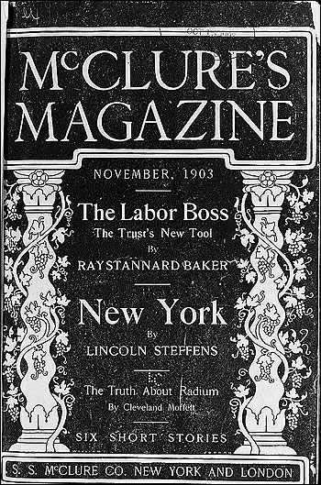
Muckrakers
Socially conscious journalists/writers who uncovered a wide range of ills afflicting America in the early 1900s
Name coined by Theodore Roosevelt, who thought they were too focused on the ugly side of things
Muckrake is a tool used to clean manure and hay out of animals’ stables
Articles appeared in newspapers and magazines which were widely read by American families, many of whom were horrified by what they read

Slide 11
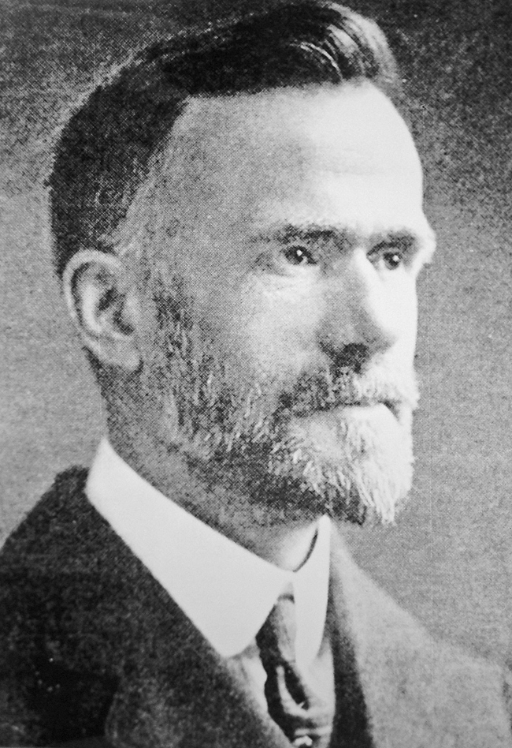
Social Gospel
Many people thought Christianity should be the basis for social reform
Walter Rauschenbusch
Baptist minister who combined German socialism and American Progressivism to form the Social Gospel
Taught that people could make society the kingdom of God
Inspired a push against child labor and for a shorter work week, as well as a push for a limitation of power for corruption and trusts

Slide 12
Settlement House
Settlement House- community center that provided social services to the urban poor
Used to improve the lives of poor people
Settlement House Workers:
Taught women childcare
English to immigrants
Ran nursery schools and kindergartens
Theatre/art/dance programs for adults

Slide 13
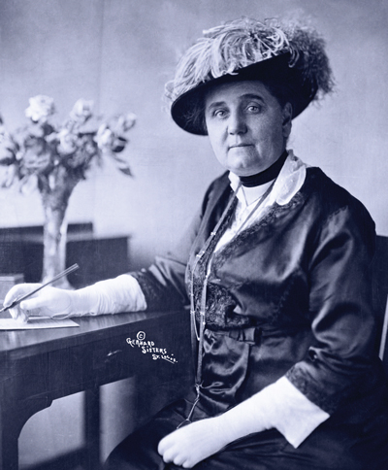
Jane Addams
Jane Addams- Leader in the settlement house movement
Inspired by work at “Toynbee Hall” (settlement house in London)
Opened Hull House in Chicago
“Hull House”
The number of settlement houses greatly increased over the years
Success inspired college-educated, middle class women to become social workers

Slide 14
Florence Kelley’s Contribution
Lawyer Florence Kelley was a leading reform figure
Protecting children and their education
Efforts to ban child labor in Illinois
“National Child Labor Committee”: Successfully promoted the national government to create the U.S. Children’s Bureau
Protected the health and welfare of children

Slide 15
Triangle Shirtwaist Factory
Triangle Shirtwaist Factory Fire (1911) :
Caused large-scale casualties
Fire that rose awareness to protect the workers
Progressives called for reform to protect factory workers
New York passed laws to protect workers and other states followed the suit
Other states passed compensation laws
Prevented the previous dangers of factory workers (long hours/poor ventilation/hazardous fumes/dangerous machinery etc.)
Funded workers who were hurt on the job

Slide 16
Child Labor-Reforming the Workplace
By 1912, nearly 40 states passed child-labor laws, but states didn’t strictly enforce the laws and many children still worked.
Businesses fought labor laws in the Supreme Court, which ruled on several cases in the early 1900s concerning workday length.
Issues with Child Labor and Children’s Rights
No work place regulations
Very few public schools
Cotton fields, factories and coal mines
Most of the children working were immigrants, working class poor and southerners

Slide 17
Labor Law in the Supreme Court
Lochner v. New York
1905: The Court refused to uphold a law limiting bakers to a 10-hour workday.
The Court said it denied workers the right to make contracts with their employers.
This was a blow to progressives, as the Court sided with business owners.
Muller v. Oregon
1908: The Court upheld a state law establishing a 10-hour workday for women in laundries and factories.
Louis D. Brandeis was the attorney for the state of Oregon and a future Supreme Court Justice.
He argued that evidence proved long hours harmed women’s health.
Bunting v. Oregon
1917: Brandeis’ case, or the Brandeis brief, as his defense was called, became a model for similar cases.
Using the tactics of its case for women, in Bunting v. Oregon the state led the Court to uphold a law that extended the protection of a 10-hour workday to men working in mills and factories.

