Slide 1
Chapter 9-Section 3-Teddy Roosevelt’s Square Deal

Slide 2
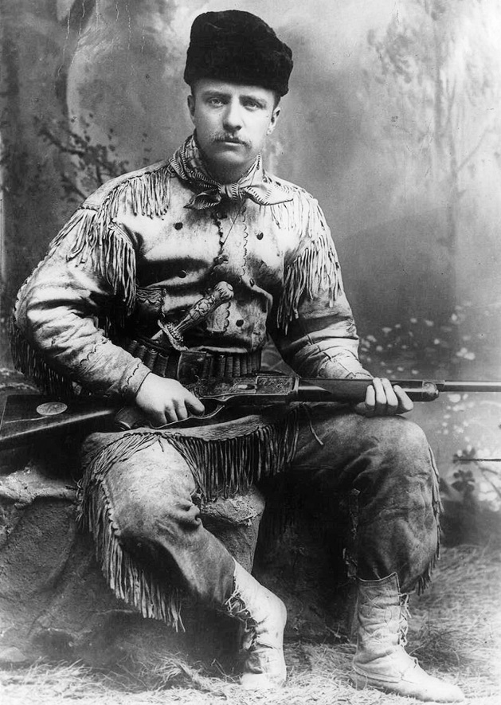
A Rough-Riding President
Roosevelt’s Rise
  Theodore Roosevelt has sickly childhood, but develops a love of fitness and athletics
  Is ambitious, rises through New York politics to become governor
  New York political bosses cannot control him, urge run for vice-president

Slide 3
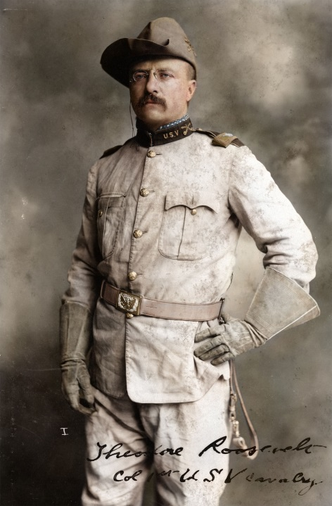
A Rough-Riding President
The Modern Presidency
  President McKinley is assassinated in 1901; Vice President Teddy Roosevelt is sworn in and becomes the youngest President in history at that time
    He was forty-two years old
  His leadership, publicity campaigns and aggressive style help create modern presidency
  Supports federal government intervention when states do not solve problems in a timely manner
  Massively supports the conservation of natural resources

Slide 4
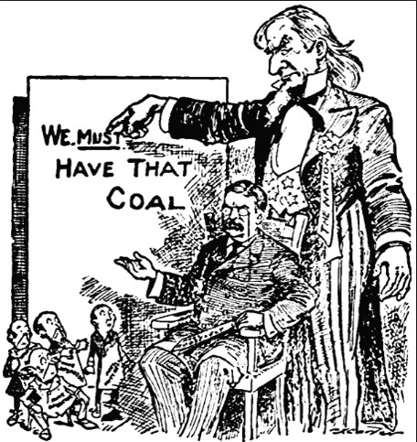
Using Federal Power
Square Deal-A term describing the various progressive reforms sponsored by the Roosevelt administration
Trustbusting-
  By 1900, trusts control about 4/5ths of U.S. industries
  Roosevelt wants to curb trusts that hurt public interest and under Sherman Antitrust Act he is accomplish some of this.
Coal Strike of 1902-
  Coal reserves low; forces miners, operators to accept arbitration
  Sets principle of federal intervention when strike threatens public

Slide 5
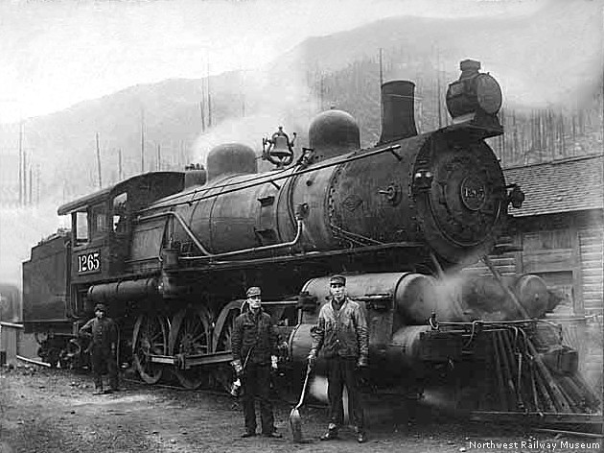
Using Federal Power
Railroad Regulation-
  Roosevelt pushes for federal regulation to control abuses:
    The Elkins Act (1903)- A federal law that amended the Interstate Commerce Act of 1887.
      The Act authorized the ICC to impose heavy fines on railroads that offered rebates, and upon the shippers that accepted these rebates. As a result the railroad companies were no longer permitted to offer rebates.
    The Hepburn Act (1906)- A federal law that gave the (ICC) the power to set maximum railroad rates and extend its jurisdiction.
        This led to the discontinuation of free passes to loyal shippers.
        In addition, the ICC could view the railroads' financial records, a task simplified by standardized bookkeeping systems.

Slide 6
Health and the Environment
Regulating Foods and Drugs-
The Jungle (1906)-A novel written by the American journalist and novelist Upton Sinclair (1878–1968). Sinclair wrote the novel to portray the harsh conditions in meatpacking factories and exploited lives of immigrants in Chicago and similar industrialized cities.
As a result President Roosevelt puts together a special commission to investigate Sinclair’s claims
  The committees finding support Sinclair
The Federal Meat Inspection Act of 1906 (FMIA)- A Congressional Act designed to prevent adulterated or misbranded meat and meat products from being sold as food and to ensure that meat and meat products are slaughtered and processed under sanitary conditions.
  These requirements also apply to imported meat products, which must be inspected under equivalent foreign standards.

Slide 7

Health and the Environment
Pure Food and Drug Act (1906)-Halts the sale of contaminated food, medicine to the public
  This act required companies to truthfully label their products

Slide 8
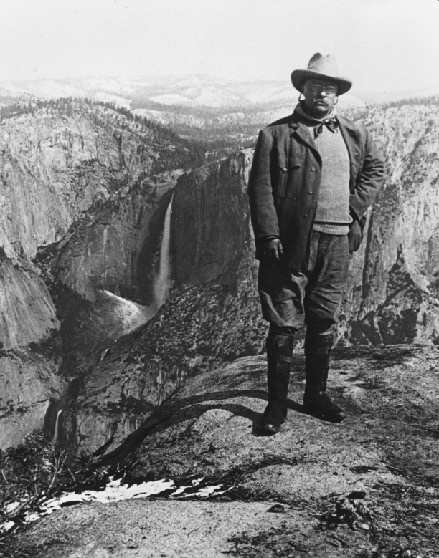
Health and the Environment
Conservation and Natural Resources-
The U.S. Forest Bureau established in 1887
  They are in charge of managing roughly forty-five million acres
Conservation Measures-
Roosevelt sets aside forest reserves, sanctuaries and creates new national parks
He believes that the best use of this land is to conserve/preserve part of this land while developing the rest for public use

Slide 9
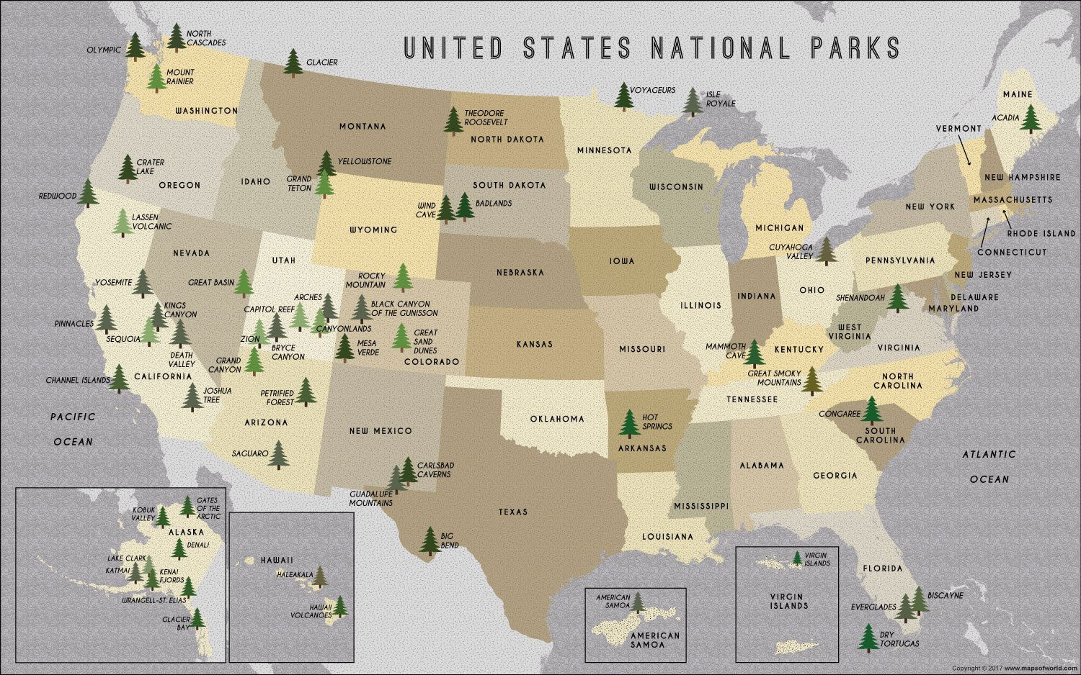

Slide 10
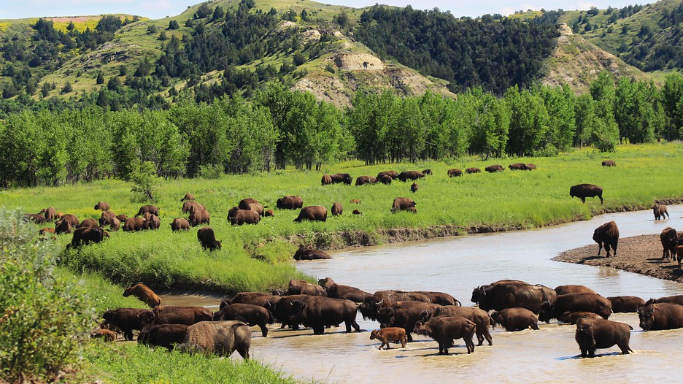

Slide 11
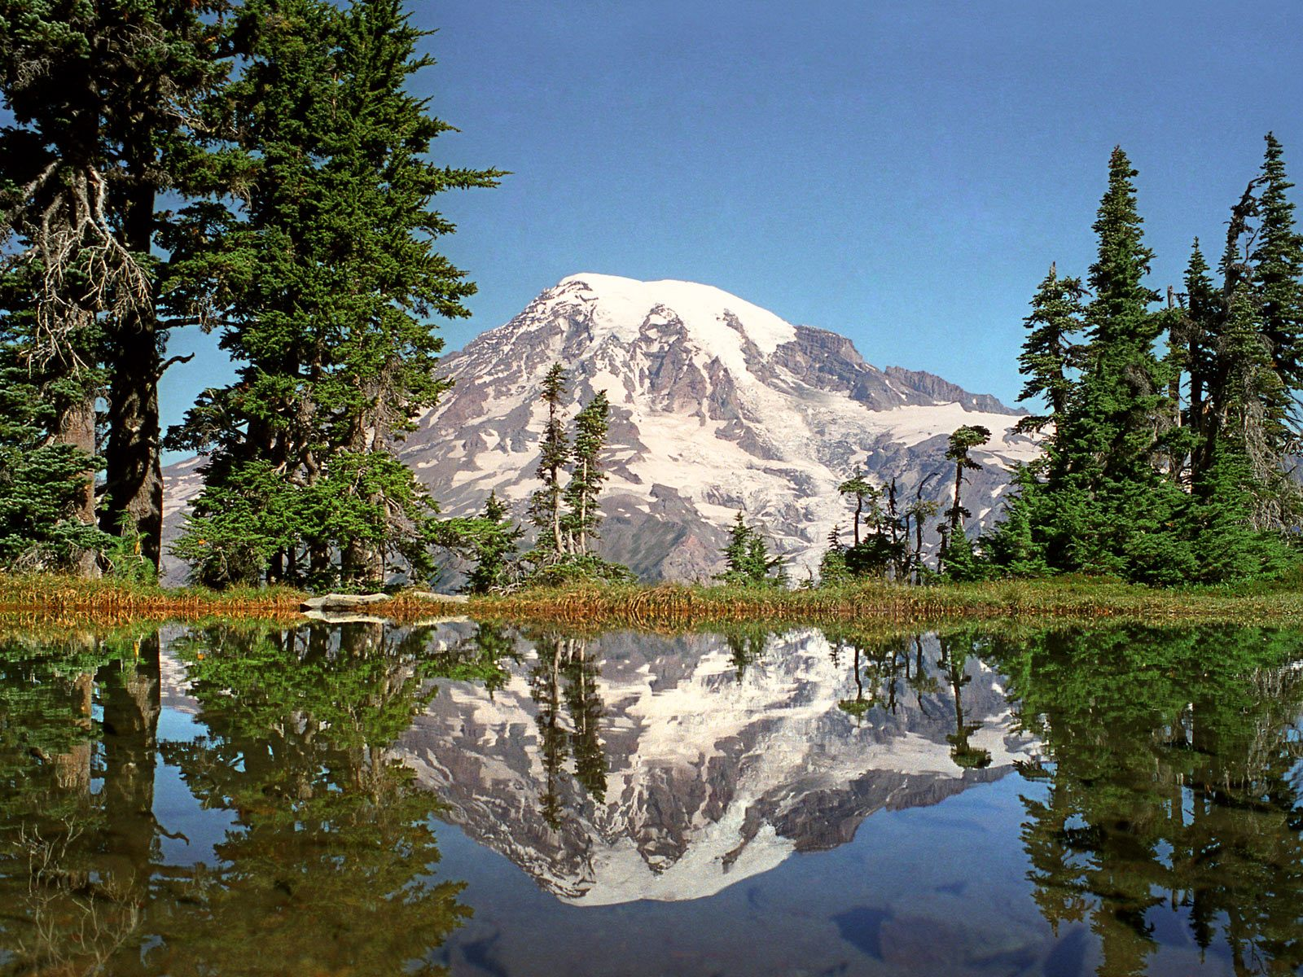

Slide 12


Slide 13


Slide 14


Slide 15
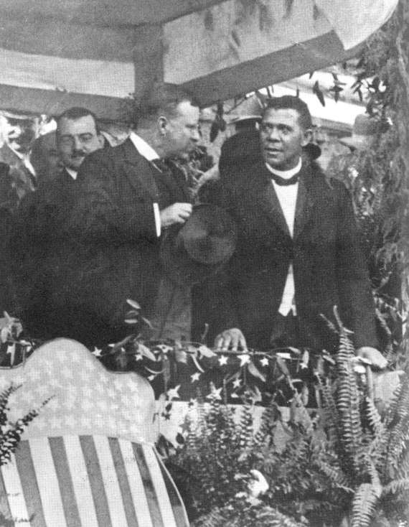
Roosevelt and Civil Rights
Civil Rights at the Turn of the 20th Century
Roosevelt does not support civil rights for African Americans
Supports individual African Americans in civil service
  He invites Booker T. Washington to White House
National Association for the Advancement of Colored People (NAACP)-Founded in 1909, by W. E. B. Du Bois and black, white reformers this group fought for full equality for among the races

