Slide 1
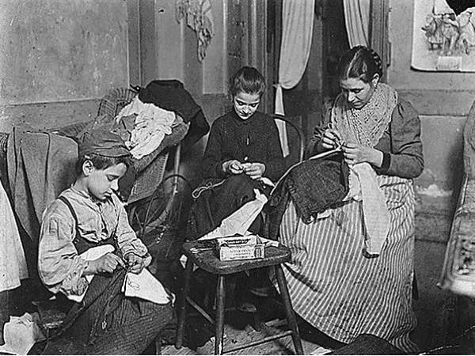
Chapter 9-Section 2: Women in Public Life

Slide 2
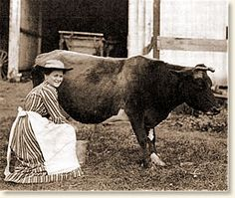
Women in the Work Force
Changing Patterns of Living
Due to women in poor families having to work along with their husbands, only middle-class and upper-class women had the luxury of staying home full on a full time basis
Farm Women
On Midwestern and Southern farms, women remained an integral part of the farms success
Perform household tasks, raise livestock, help with crops

Slide 3
Women in the Work Force
Women in Industry
After 1900, roughly one in every five women hold jobs
25% of these women work in manufacturing
50% industrial workers made a living in the garment trade
But sadly, they only earn about half of what a man earns at the time
Domestic Workers
By 1870, 70% of employed women work in domestic settings
For many African-American and immigrant women this is their only option for employment
Often married immigrants take on sewing jobs or caring for boarders in their homes

Slide 4
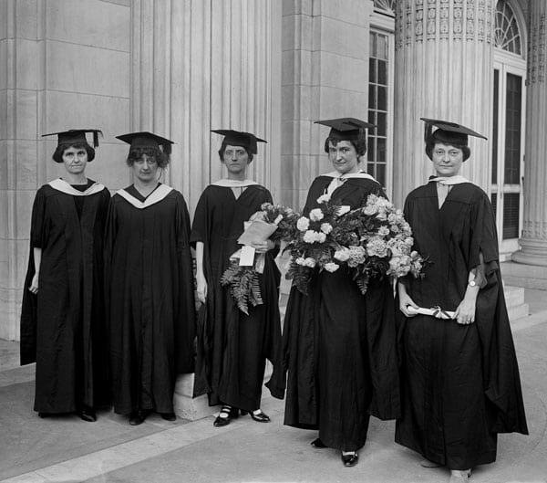
Women Lead Reform
Preparing Women for the Work Force
Jobs in offices, stores, and classrooms require a high school education
Business schools would train women as bookkeepers, stenographers, and typists
Women in Higher Education
Many women active in public life have attended new women’s colleges
50% college-educated women never marry; many work on social reforms

Slide 5
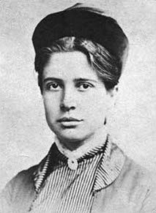
Women Lead Reform
Florence Kelly-(1859-1932) An advocator for women that believed that women were hurt by the unfair prices of goods they had to buy to run their homes
In 1899, she helped establish the National Consumers League
One of their major accomplishments was pushing stores to label goods in a way that was fairly priced
She also helped form Women’s Trade Union League (WTUL) who tried to improve female working conditions, pushed for minimum wage, and 8-hour work day

Slide 6
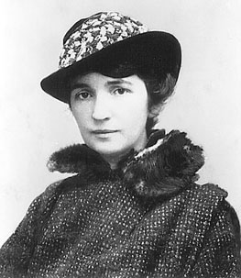
Women Lead Reform
Margaret Sanger-(1879-1966) Was a nurse, social activist, sex educator, and writer who thought that family life and women’s health would improve if women had fewer children and had access to birth control
In 1916, she opened first birth-control clinic in Brooklyn, New York
In 1921, she helped create the American Birth Control League to make this information available to more women
She also helped form an organization that evolved into the Planned Parenthood Federation of America.
Eventually Federal courts agreed with her fforts saying that doctors could give out this information about “family planning”

Slide 7
Women Lead Reform
National Consumer’s League (NCL)-A group organized in 1899 to investigate conditions under which goods were made and sold and to promote safe working conditions and a minimum wage
They helped develop special labels that identified products that were produced under “fair, safe, and healthy working conditions”
They also pushed for additional reforms that would ensure that the government inspected meatpacking plants, made workplaces safer, along with providing unemployment funds

Slide 8
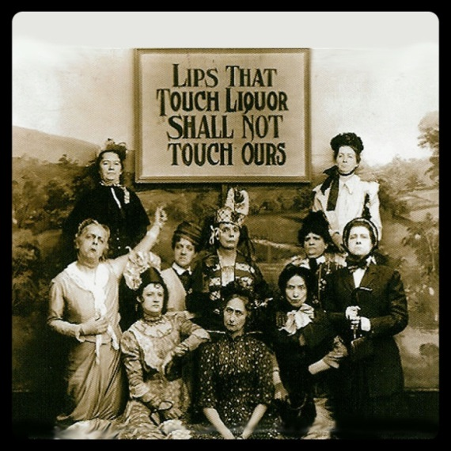
Women Lead Reform
Women’s Christian Temperance Union (WCTU)-Founded in Cleveland, Ohio in 1874.
The WCTU became one of the largest and most influential women’s groups of the 19th century by expanding its platform to campaign for labor laws, prison reform and suffrage.
It also promoted temperance “practice of never drinking alcohol” or at a minimum moderate use
They believed alcohol use led men to neglect their families, abuse their wives, and spend majority of money on liquor
This led to the passage of the 18th Amendment which outlawed production and sale of alcohol

Slide 9
Women in Public Life
Women and Reform
Women reformers target workplace, housing, education, food, drugs
National Association of Colored Women (NACW)—child care, education
Susan B. Anthony of National American Woman Suffrage Association (NAWSA) works for woman suffrage, or right to vote
A Three-Part Strategy for Suffrage
Convince state legislatures to give women right to vote
They attempted to test the constitutionality of the 14th Amendment which offered equal protection under the law to all citizens
Push for constitutional amendment to give women the vote

Slide 10
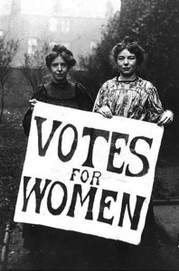
Suffering for Suffrage
Suffrage-A movement beginning in the late 1800’s with the goal of achieving voting rights for women
Suffrage was a key goal of Progressive women
They felt that the only way to make sure government would protect children, foster education, and support family life is to allow everyone an equal say in the political process
Reformers like Susan B. Anthony and Elizabeth Cady Stanton succeeded at state level in Wyoming and Colorado by end of 1890s

Slide 11
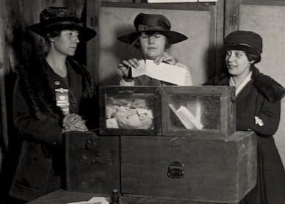
Nineteenth Amendment
The 19th Amendment-Ratified on August 18, 1920, granted American women the right to vote.
It states that the right to vote “shall not be denied on account of sex”
Ironically, the Tennessee State House of Representatives passed the amendment in their state by only one vote

