Slide 1
Chapter 1:Principles of Government

Slide 2
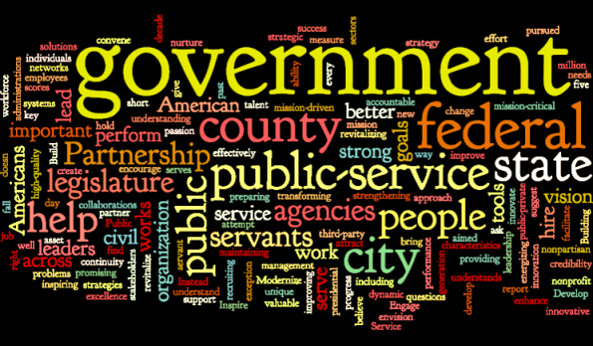
Section 1-Government and the State

Slide 3
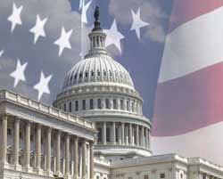
What is government?
Government is the institution through which a society makes and enforces its public policies.
“Government by its very existence is an institution; politics is a process.”
For a state (country) to exist there are four basic elements they must contain:
  Population
  Territory
  Sovereignty
  Government

Slide 4
The Four Characteristics of a State
Population A state must have people in order to exist There is no minimum or maximum number required | Territory A state must be comprised of land/territory with clear recognized boundaries
Sovereignty Every state is considered sovereign if it is free and independent from any form of outside rule. A sovereign state has supreme power to decide how to govern within it’s own territory as well as how it will conduct foreign it’s policies | Government Every state must establish a politically organized (and hopefully stable) form of government

Slide 5
Origins of the State
Force Theory-
  The force theory states that one person or a small group took control of an area and forced all within it to submit to that person’s or group’s rule.
Evolutionary Theory-
  The evolutionary theory argues that the state evolved naturally out of the early family.
Divine Right Theory-
  The theory of divine right holds that God created the state and that God gives those of royal birth a “divine right” to rule.
Social Contract Theory-
  The social contract theory argues that the state arose out of a voluntary act of free people.

Slide 6
The Purpose of Government
The main purposes of government are described in the Preamble of the Constitution of the United States:
“We the People of the United States, in Order to form a more perfect Union, establish Justice, insure domestic Tranquility, provide for the common defense, promote the general Welfare, and secure the Blessings of Liberty to ourselves and our Posterity, do ordain and establish this Constitution for the United States of America.”

Slide 7
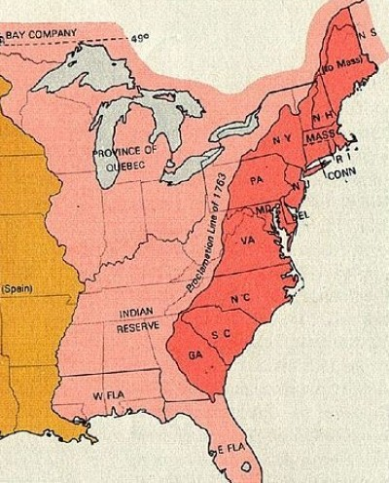
I. Form A More Perfect Union
Following the failure of the Articles of Confederation (1781) which created a weak central government our current Constitution was created (1787) in order to link the states together under the idea that “unity is our greatest strength”

Slide 8
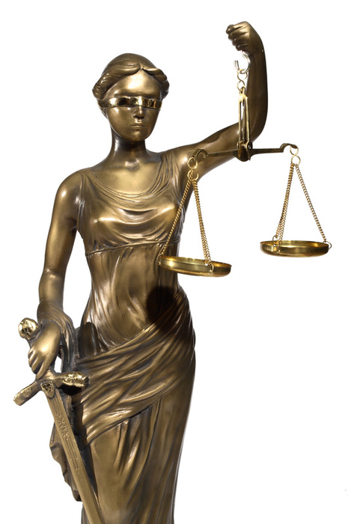
II. Establish Justice
Thomas Jefferson felt that providing justice is “the most sacred of the duties of government”
What does that mean:
  The law in both it’s administration and content must be reasonable, fair and impartial”

Slide 9
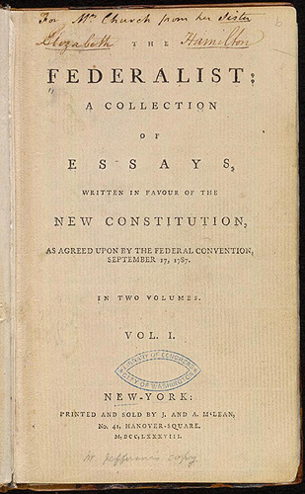
III. Insure Domestic Tranquility
The key to maintaining peace within our nation is establishing order. This is the prime function of government.
James Madison said in The Federalist Papers No. 51 that “If men were angels, no government would be necessary”

Slide 10
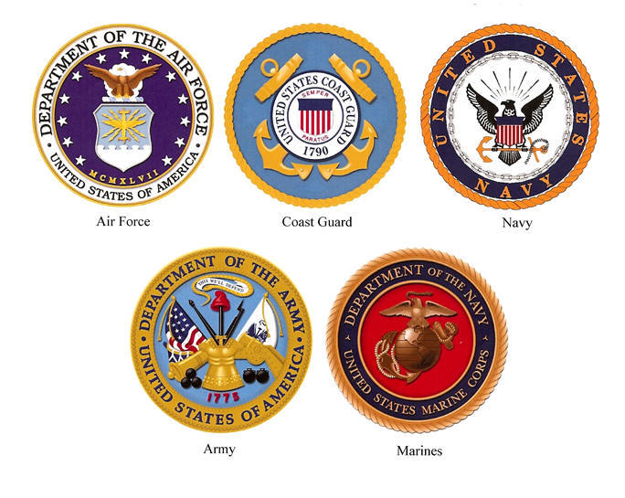
IV. Provide for the Common Defense
Defending our nation from attacks both foreign and domestic has always been one of our government's chief responsibilities.
In order to maintain our safety our nation maintains an army, navy, air force and coast guard.
While the department of Homeland Security keeps watch for threats entering our country.

Slide 11
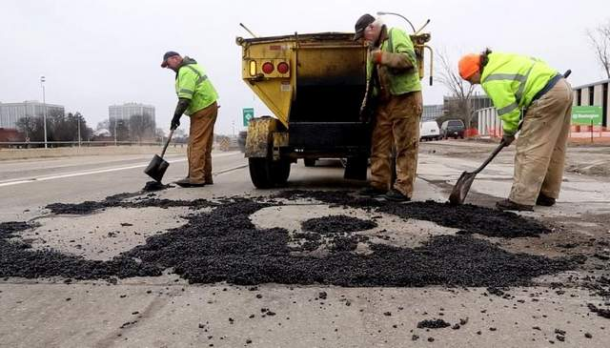
V. Promote the General Welfare
The services our government provides are designed to benefit all or most of our citizens.
  Some examples are:
    Improving education
    Improving Roads
    Lowering Taxes
    Welfare
    Disability
    Social Security

Slide 12
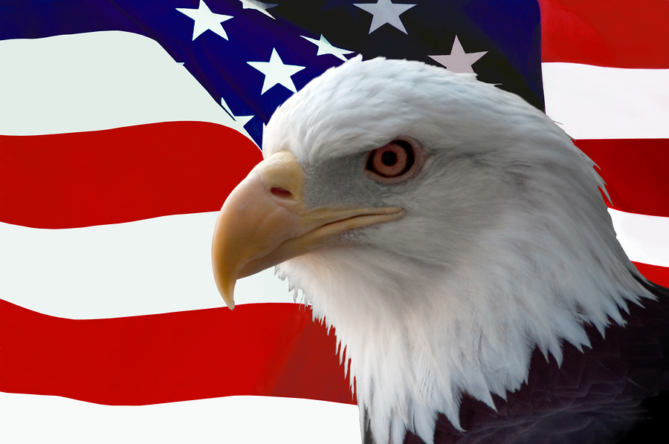
VI. Secure the Blessing of Liberty
Although a high priority for our government is the ideas of freedom and liberty they are not considered absolute but relative.
  People can not be free to do whatever they want because that would infringe on the freedom of others.
Both Federal and State Constitutions define the rights and liberties of for those living in our country.

