Slide 1
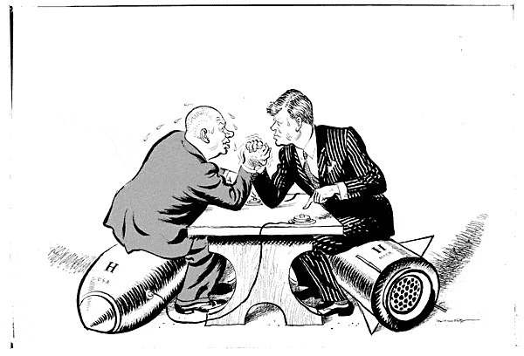
Chapter 20-Section 1-Kennedy and the Cold War

Slide 2
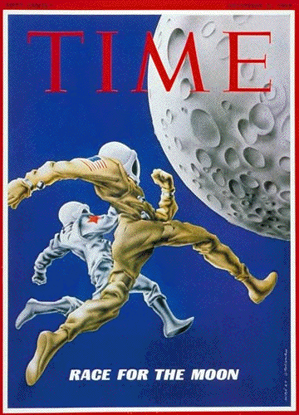
The Election of 1960
President Eisenhower’s term comes to an end in 1959
The country was in a recession and ready for a change
Issues with Eisenhower’s Presidency
We lost the race to space
U-2 was shot down
All of these things led to an anti-republican backlash

Slide 3
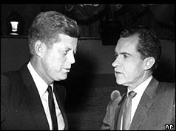
The Election of 1960
Democrats: JFK
John Fitzgerald Kennedy was a rich, young, Catholic, senator who was well regarded as a WWII hero
Republicans: Nixon
Richard Nixon was also a WWII vet, looked old compared to Kennedy
Seemed shady b/c of past problems
1960 Election was first broadcast election
Those who heard it on the radio felt Nixon won but those who watched the televised debates felt Kennedy won
T.V. debates pushed the election in Kennedy favor

Slide 4
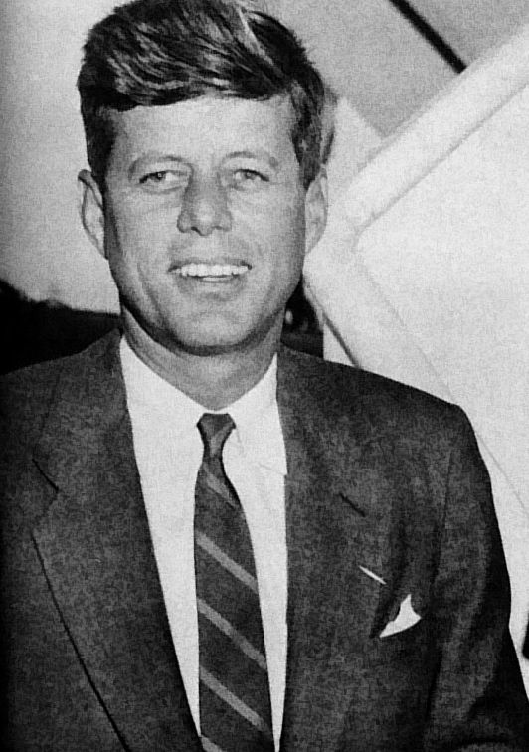
The Election of 1960
The Presidential Election of 1960- Considered one of the closest elections in American history.
John F. Kennedy won 303 Electoral College votes compared to Nixon’s 219 Electoral College
Kennedy won the popular vote by only 112,827 votes a margin of 0.17%.
Richard Nixon won more individual states than Kennedy, but it was Kennedy who prevailed by winning key states with a larger amount of electoral votes.
This was also the first election in which all fifty states participated (Alaska became a State in 1958 and Hawaii in 1959) as well as the first election in which an incumbent president was ineligible to run for another term due to the Twenty-second Amendment (which limit’s a President to serving only two terms).

Slide 5
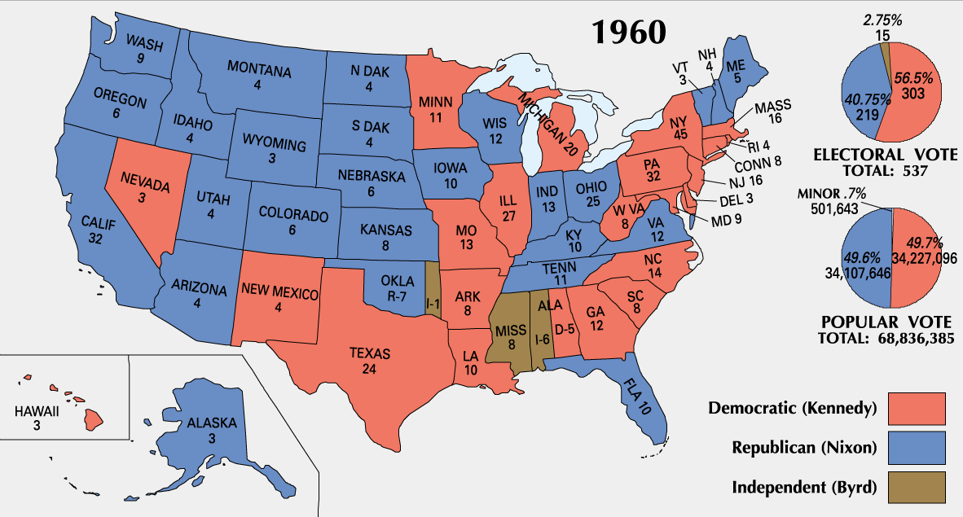
The Election of 1960

Slide 6
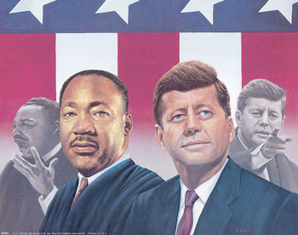
The Election of 1960
Following the Election of 1960 Civil Rights remained a major issue that needed to be addressed
Kennedy was supportive of the movement which gained him a large portion of the African-American vote
When Martin Luther was arrested for protesting in Birmingham, Alabama Kennedy calls Dr. King’s wife to offer support while Attorney General Bobby Kennedy helps secure his release from jail

Slide 7
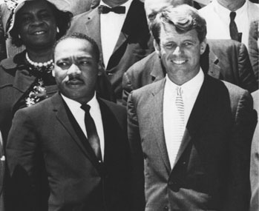
The Election of 1960
Following his victory in the 1960 Election President Kennedy chose the “Best and the Brightest” minds he could find to fill his Presidential cabinet
National Security Advisor-McGeorge Bundy was the former dean of Harvard University, Secretary of Defense-Robert McNamara the former President of Ford Motor Company, Secretary of State-Dean Rusk President of Rockefeller Foundation and Attorney General Robert Kennedy who was JFK’s younger brother

Slide 8
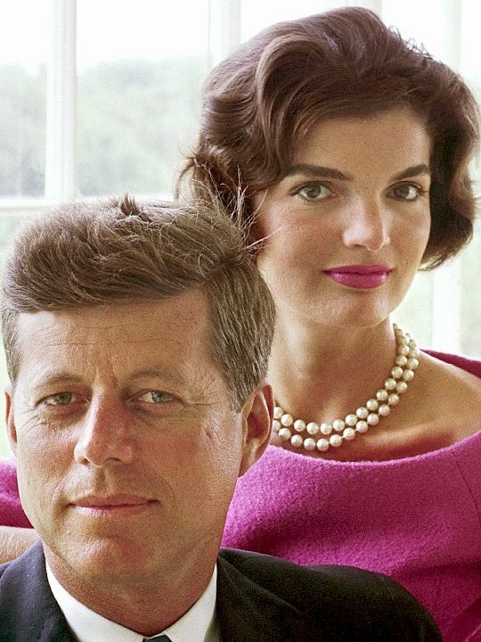
The Camelot Years
As a President the image JFK portrayed regarding his personal life gave hope and excitement to many American’s
The Kennedy’s were a young, attractive, fashion forward couple with children who many American’s felt they could relate to and idolize
The Camelot Years-A Description of the Kennedy ‘mystique’ in the White House based on the image of Camelot which was the mythical court of King Arthur
Four days after his burial Jackie Kennedy in an interview with Life magazine said that, "There will be great presidents again, but there will never be another Camelot."

Slide 9
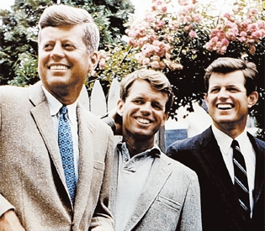

Slide 10
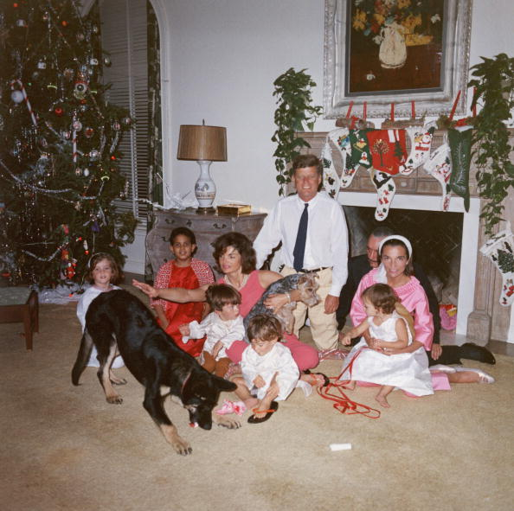

Slide 11
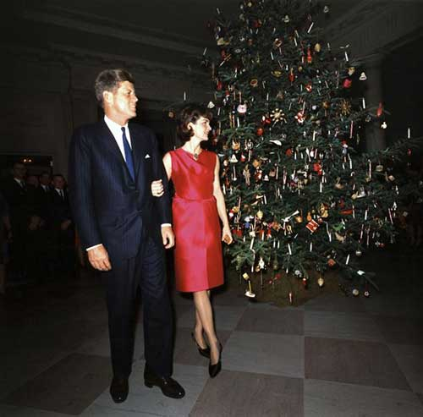

Slide 12
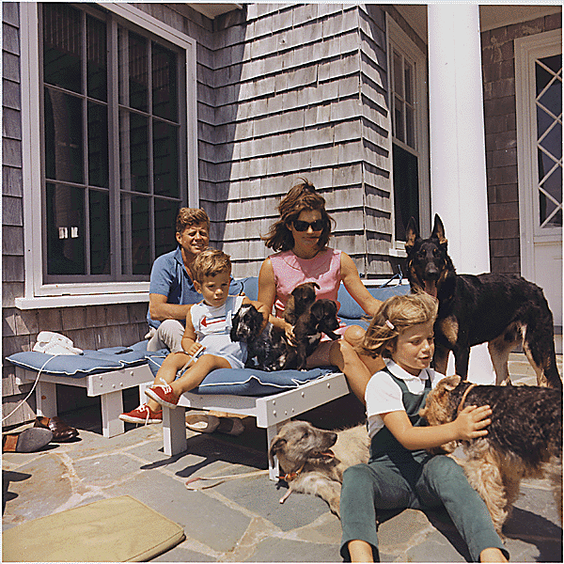

Slide 13
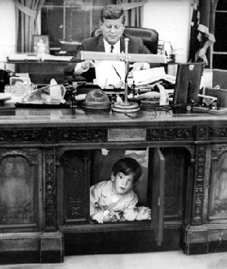
A New Military Policy
Kennedy felt that Eisenhower’s Administration had not done enough to deal with the Soviets
He felt that Eisenhower’s lack of action had allowed the Soviets to gain friends worldwide
Especially Cuba which was right on America’s doorstep
Kennedy’s New Military Policy-
Flexible Response-
The U.S. began to develop many new military policies during the Kennedy administration.
Key policies focused on preparing for a variety of military responses to international crises rather than always threatening the use of nuclear attacks

Slide 14
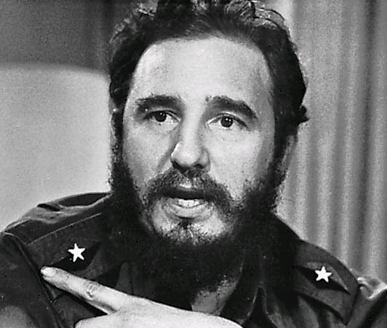
Crisis Over Cuba
Fidel Castro-
In 1959 this Cuban revolutionary leader takes control from former leader Fulgencio Batista
He says that “Revolutionaries are not born, they are made by poverty, inequality, and dictatorship” (Fidel Castro)
Kennedy’s problems with Castro-
Since he favored communism he was viewed as a Soviet sympathizer
He seized oil refineries in Cuba, confiscated American owned homes and businesses as well as breaking up commercial farms

Slide 15
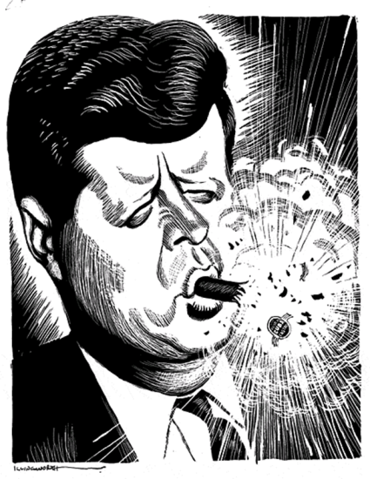
Crisis Over Cuba
Bay of Pigs Invasion-
A covert American invasion of Cuba that had actually began under Eisenhower took place on April 17th, 1961
The mission was designed to encourage an uprising in Cuba that would oust Fidel Castro as their leader
The result of the invasion was a complete disaster
Military interventions and plans did not work
Made Americans look like fools
Embarrassed Kennedy
End Result-
U.S. pays $53 million ransom for return of surviving commandos
Castro was pushed towards an alliance with the Soviet Union creating a permanent communist threat in the Western Hemisphere only ninety miles away

Slide 16
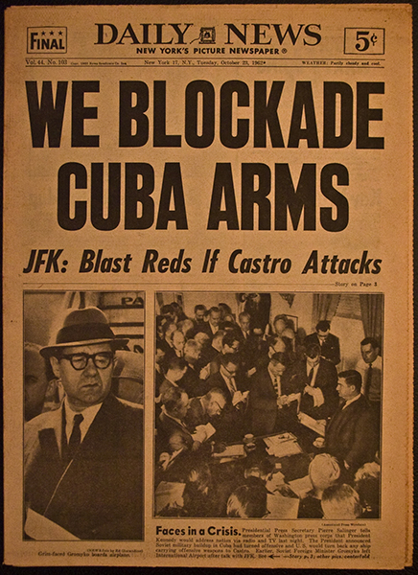
Crisis Over Cuba
Cuban Missile Crisis-
Khrushchev promises to defend Cuba from U.S. advances and begins placing Nuclear Warheads there
Our U2 planes spots Soviet missiles which leads America to takes action
Quarantine of Cuba: 1962 uses U.S. naval ships to create a blockade around Cuba
100,000 U.S. troops on standby
End Results: The Soviets agree to remove their missiles from Cuba while we agree to remove our missiles from Turkey and promise not to invade Cuba
We realized how close we came to another war

Slide 17
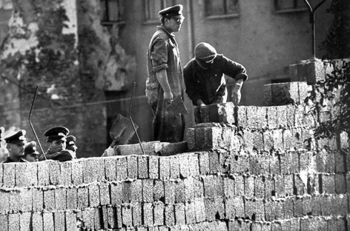
Crisis Over Berlin
East Berlin had lost twenty percent of their population to West Berlin during the decade following the Berlin Airlift which had showed the ineffectiveness of communist rule in East Berlin
Khruschev threatened to close all access to West Berlin
Kennedy refused to give up access to West Berlin
Commenting that Berlin is… “the great testing place of Western courage and will.” (Kennedy)
Due to Kennedy’s unwillingness to back down Khruschev begins constructing the Berlin Wall
Construction on the Berlin Wall begins on Aug. 13, 1961
This will serve as symbol of communist oppression until its demolition in 1989

Slide 18
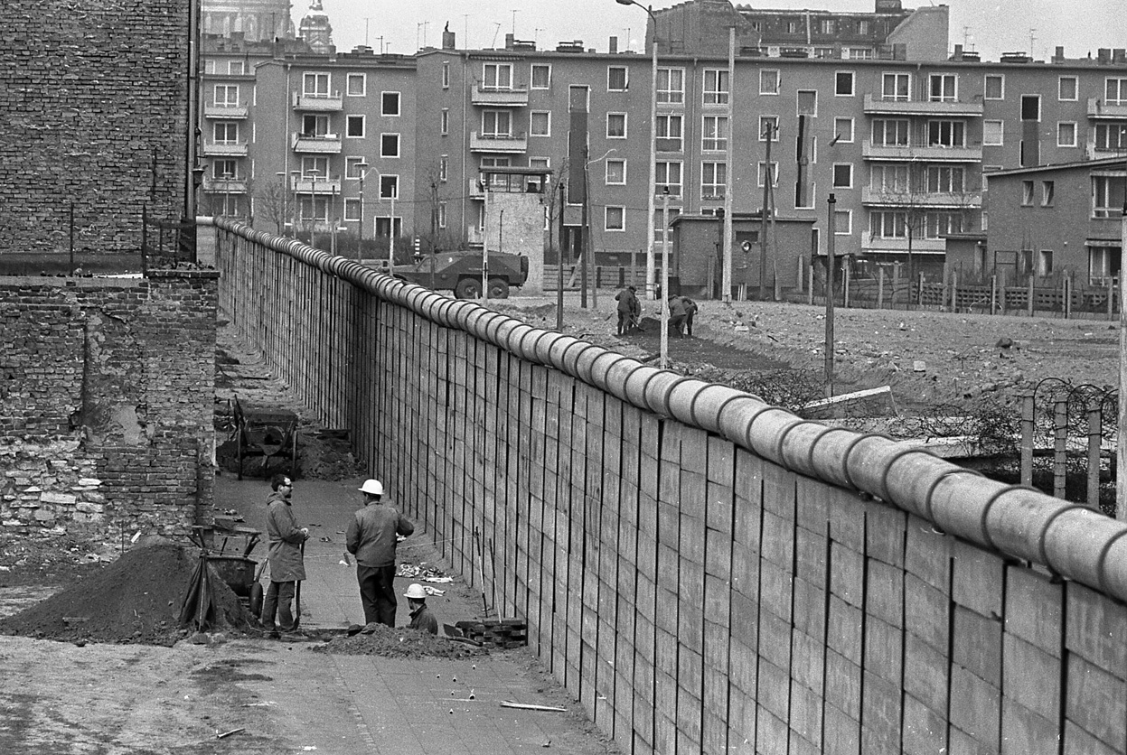

Slide 19
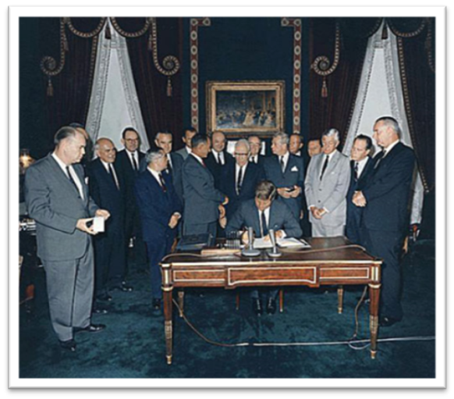
Crisis Over Berlin
Close Calls
The 1960’s were full of close calls and both sides realized that there was a need for more rational solitons than all out war
The “Hot Line” was a special phone line developed between the White House and the Kremlin that allowed both sides to communicate immediately in the event of a crisis
Limited Test Ban Treaty-Was an agreement between the U.S. and Soviets that banned nuclear testing in the atmosphere

