Slide 1
The Implied Powers
Chapter 11- Section 3

Slide 2
The Necessary and Proper Clause
It is the final clause in the lengthy Section 8 of Article I in the Constitution, give to Congress its expressed powers.
Known as the “Elastic Clause”
To make all Laws which shall be necessary and proper for carrying into Execution the forgoing Powers and all other Powers vested by this Constitution in the Government of the United States, or in any Department or Officer thereof.
Clause 18 of the Constitution

Slide 3
Necessary and Proper Clause
Much of the adaptability and vitality come from this
Allows Congress to choose the means “for carrying into execution”
Powers given it by the Constitution
Along with supporting decisions from Supreme Court

Slide 4
Strict Constructionists
Strict Constructionists led by Thomas Jefferson thought Congress could only exercise
1. Its expressed powers
2. Only those implied powers absolutely necessary to carry out its expressed powers
State should keep as much power as possible

Slide 5
Strict Constructionists
They did want to protect interstate trade
Need for strong defense
Feared consequences of a strong government
Argued only states not the far off Government could protect-and preserve those differing interests

Slide 6
Liberal Constructionists
Demands of the people for more services
People like a broader Constitution not a narrow one
Consensus-A general agreement

Slide 7
Basis of Implied powers
Every exercise of implied powers must be based on expressed powers
Basis for exercise of implied powers:
1. The commerce power
2. Its power to tax and spend
3. The war powers

Slide 8
Commerce Clause
Under the Commerce Clause Congress Can:
Regulate manufacturing
Wages and hours
Labor and Management relations
Food and drugs
Air travel
Building interstate highways
Consumer and environmental protection

Slide 9
Limits on Commerce Power
Congress places four explicit limitations
Congress cannot pass a law solely on the grounds that a measure will somehow promote “the General Welfare of the United States”

Slide 10
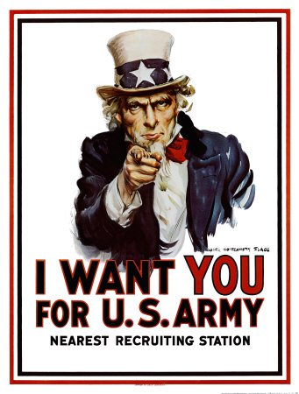
War Powers
War Powers
Article 1 section 8 gives expressed power to raise and support armies and to provide and maintain a navy
Supreme Court upheld the draft in cases challenging selective service in 1917

Slide 11
Section 4- The Non-legislative Powers
Chapter 11-Section 4

Slide 12
Constitutional Amendments and Electoral Duties
Constitutional Amendments
Article V gives Congress the power to propose amendments by a two-thirds vote in each house.
Electoral Duties
In certain circumstances, the Constitution gives Congress special electoral duties.
If no candidate for President receives a majority in the electoral college, the House decides the election.
If no candidate for Vice President receives a majority in the electoral college, the Senate decides the election.
Also, if the vice presidency is vacated, the President selects a successor, who faces congressional approval by a majority vote in both houses.

Slide 13
Impeachment Power
The Constitution grants Congress the power of removing the President, Vice President, or other civil officers from their office through impeachment.
The House has the sole power to impeach, or bring charges against the individual.
There is then a trial in the Senate.
A two-thirds vote of the senators present is needed for conviction.
The penalty for conviction is removal from office.

Slide 14
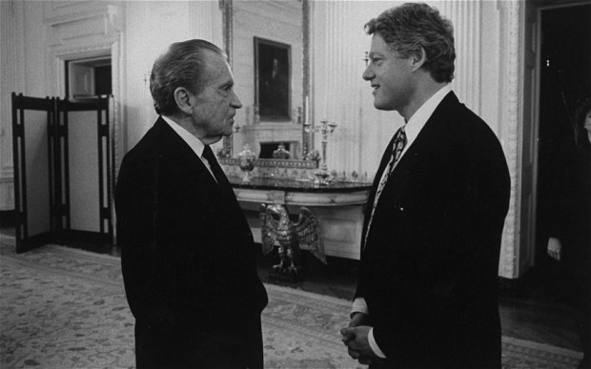
Impeachment Power
Andrew Johnson (1867)
Violated the Tenure of Office Act
He felt it was unconstitutional
Acquitted by one vote
Richard Nixon (1974)
Watergate Scandal
Resigned before impeachment
Bill Clinton (1998)
Clinton lied under oath and obstructed justice
He lied about a relationship with White House intern
Acquitted on both charges

Slide 15
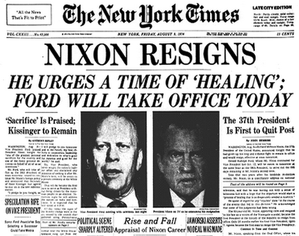

Slide 16
Executive Powers
Treaties
The President makes treaties “by and with the Advice and Consent of the Senate,... provided two thirds of the Senators present concur.”
Presently, the President often consults members of the Senate Foreign Relations Committee.
Appointments
All major appointments made by the President must be confirmed by the Senate by majority vote.
Only 12 of 600 Cabinet appointments to date have been declined.
“Senatorial courtesy” is the practice in which the Senate will turn down an appointment if it is opposed by a senator of the President’s party from the State involved.

Slide 17
Investigatory Power
Congress may choose to conduct investigations through its standing committees for several reasons:
To gather information useful to Congress in the making of some legislation
To oversee the operations of various executive branch agencies
To focus public attention on a particular subject
To expose the questionable activities of public officials or private persons
To promote the particular interests of some members of Congress.

