Slide 1
Chapter 10: Congress

Slide 2
Chapter 10, Section 1
The National Legislature

Slide 3
Who are They?

Slide 4
Quiz
1) Name two of the three reasons that the book identifies for why the Constitution establishes a bicameral legislature?
2) How many sessions of Congress are there in one year?
3) The 20th Amendment states that the Congress should begin its session on which day (although frequently it convenes a few days/weeks later)?
4) When does the Constitution give the President the power to prorogue a congressional session?

Slide 5
Key Terms
Bicameral
Term
Session
Convene
Adjourn
Recess
Prorogue
Special Session

Slide 6
Bicameral Legislature
Three reasons that the Constitution established a bicameral legislature?
Historically, it is modeled on the two houses of the British Parliament and colonial legislatures.
Practically, two houses were adopted as part of the Great Compromise, which solved the dispute between large and small states at the Constitutional Convention over how they would be represented in the national legislature.
Theoretically, having two house of Congress means that one house can check the powers of the other.

Slide 7
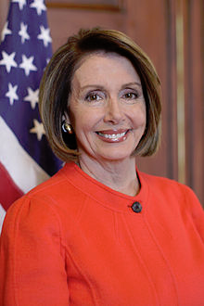
National Legislature
Congress turns the will of the people into public policy by passing laws.
Framers originally believed that Congress would be the most powerful branch of federal government
Constitution spends more space detailing powers and structure of Congress than any other branch

Slide 8
Is Congress Admired?
“Suppose you were an idiot. And suppose you were a member of Congress. But I repeat myself.”

Slide 9
Congress and Federalism
Federalism involves the division of power between the central government and the state governments.
The different roles taken by the members of Congress are examples of federalism in the national government.
Act of interests of the people of that state as well as address issues of national importance

Slide 10
Representation
Each state is equally represented in the Senate and represented by population in the House.
Some critics argue that this structure gives too much power to the smallest states.

Slide 11
Congressional Terms
Beginning in 1789, Congress has met for two-year terms.
Originally congressional terms began and ended in March. This start date was changed to January 3rd of every odd-numbered year by the 20th Amendment.

Slide 12
Adjourning Congress
During a session, Congress can choose to adjourn, or suspend its operations, until the next session.
Though Congress meets for most of the year, each house typically has a few recesses, or breaks, in a session.
Neither house can officially end a session without the approval of the other house.
The President can end a session of Congress, but only if both houses cannot agree on a date to adjourn. This power has never been used.

Slide 13
Special Sessions
The President can call one or both houses of Congress into a special session to deal with an emergency situation.
Only 27 joint special sessions have been called. The Senate has been called out alone 46 times, while the House has never been called out alone.
Special sessions are rarely called today since Congress meets for most for the year.
The President may threaten to call a special session if Congress has not acted on a measure important to the presidency.

Slide 14
ALEC
https://www.youtube.com/watch?v=azSUHpAb_E4

Slide 15
Chapter 10, Section 2
House of Representatives

Slide 16
Key Terms
Apportion
Reapportion
Off-Year Election
Single-Member District
At-large
Gerrymander
Incumbent

Slide 17
Size of the House
For many years the number of seats in the House increased as the country grew in population and new states were added.
The Reapportionment Act of 1929 fixed the size of the House at 435 members.
Congress can change this number if it wishes
Arbitrary number

Slide 18
Census
Every 10 years the Census Bureau counts the national population.
The Census figures are then used to decide how many representatives each state will have until the next Census is taken.
Currently, each seat in the House represents about 700,000 people.

Slide 20
Congressional Elections
There are no limits on how many two year terms representatives can serve
Each state holds elections in November of even-numbered years
Off-year elections: elections held in nonpresidential years
Usually party that holds presidency loses seats in off-year elections
Why?

Slide 21
Congressional Districts
Representatives are elected from single-member congressional districts.
Westberry v. Sanders (1964): requires each district in a state to have similar-sized populations.
High population states have more districts than small population states.
Seven states have only one representative, so their district consists of the entire state.

Slide 22
Gerrymandering
What is gerrymandering and what are its purpose and result?
Gerrymandering involves drawing the borders of districts to favor one political party.
Tactics include clustering the opposing party’s voters in a few districts or spreading them out thinly over many districts.
Due to gerrymandering, only a few congressional districts (about 40) in any election are actually at risk to switch their support from one party to the other.

Slide 25
Formal Qualifications
Custom requires representatives to live in the districts they represent.
Representatives must:
Be at least 25 years old
Have been a U.S. citizen for at least 7 years
Be an inhabitant of the state from which he or she is elected.
The House has the power to refuse to seat an elected member, to punish members, and to expel them.

Slide 26
Informal Qualifications
What “informal qualifications” affect a candidate’s electability?
They include factors such as gender, ethnicity, political experience, name recognition, and party affiliation.
Being an incumbent is a big advantage—more than 90 percent of those seeking reelection to the House win.
Being able to raise money is also a key. In 2008 the average cost of running a winning campaign for a seat in the House was over $1 million.

Slide 27
Chapter 10, Section 3
The Senate

Slide 28
Key Terms
Continuous Body
Constituency
Extralegal
“Disorderly Behavior”

Slide 29
How does the Senate differ from the House?
The Senate has only 100 members, two from each state.
Members are elected to six-year terms.
Senators must be at least 30 years old, have been a U.S. citizen for at least nine years, and reside in the state they represent.
Senators are often seen as less subject to public pressure and more concerned about national issues than members of the House.

Slide 30
Structure of the Senate
The size of the Senate changes as new states are admitted to the Union.
The Senate began with 22 members in 1789.
Senators tend to represent a much larger and broader range of citizens than representatives.
Each Senator represents his or her entire state, while only seven representatives are elected at large from their entire state as opposed to a congressional district.

Slide 31
17th Amendment
How were senators chosen before and after the passage of the 17th Amendment?
In 1913, the 17th amendment changed the way Senators were elected.
Senators are now elected by popular vote in statewide elections.
Only one senator is elected from a state during any given election.

Slide 32
“The Millionaires’ Club”
The size of the Senate changes as new states are admitted to the Union.
The Senate began with 22 members in 1789.
Senators tend to represent a much larger and broader range of citizens than representatives.
Before the coming of popular election, State legislatures often picked senators through political maneuvering → led to people calling the Senate a “Millionaires’ Club”

Slide 33
Senate Terms
There are no limits on how many six-year terms a Senator can serve.
Senate terms are staggered so that one third of them expire every two years.
All the seats in the Senate are never up for election at the same time → continuous body
If a senator dies, resigns, or is expelled, they are typically replaced by a person appointed by the governor of their state until a special election can be held.

Slide 34
A Unique Role
Senators are thought of as being more focused on national issues and are more likely to be seen as national political leaders than members of the House. Why?
Due to their longer terms in office, Senators are seen as less susceptible than representatives to the pressures of public opinion
Senators represent larger and more diverse constituencies than representatives in the House, and can champion public policies that appeal to many Americans.

Slide 35
National Recognition
Senators receive more national and home state media exposure than members of the House,
Senators often use this publicity to help them launch presidential campaigns.

Slide 36
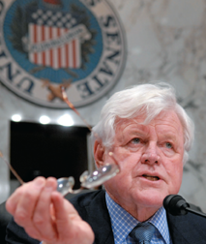
Qualifications
Senators must meet a stricter set of requirements for office than members of the House of Representatives.
At least 30 years of age
Citizen for at least 9 years
Inhabitant of state
The Framers set these requirements, as well as the longer terms in office, because they wanted the Senate to be a more enlightened and responsible legislative body than the House.

Slide 37
Informal Qualifications
To be electable, senators must also meet informal qualifications.
These can include party affiliation, gender, ethnicity, name recognition, and being an incumbent.
Fundraising is also vital for successful senate campaigns.

Slide 38
Senate Discipline
The Senate has the power to discipline its members or refuse to seat an elected member.
The Senate can expel a member with a two thirds vote or punish them with a majority vote.
The Senate has expelled 15 members, most of them senators who supported secession during the Civil War.
The threat of expulsion or the embarrassment of being publicly denounced by the Ethics Committee has led some senators to resign.

Slide 39
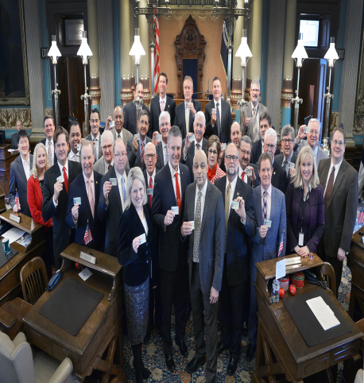
The Members of Congress
Section 4

Slide 40
Key Terms
Delegate
Trustee
Partisan
Politico
Bills
Floor Consideration
Oversight Function
Franking Privilege

Slide 41
Roles & Functions
Members of Congress have five major roles in which they can fill:
Legislators
Representatives of their constituents
Committee members
Servants of their constituents
Politicians
Michigan Senator-Gary Peters (D)

Slide 42
Overview of Members
Demographics of Congress-
Most of the 535 members of Congress are married white men aged 50 or older who have college degrees and who identify themselves as Christians.
Most tend to be upper-middle-class citizens
Congress currently has 88 women, 42 African Americans, 24 Hispanics, eight Asian Americans, one Native American, and one Native Hawaiian.
The typical Senator is serving a second term, while the average member of the House of Representative has served four terms.

Slide 43
Ways in Which Congress Represents their Constituents
There are four broad ways in which lawmakers choose to represent the people when they vote.
Delegates-They believe they should vote however their constituents want them to, even if it means going against the delegate’s personal views or those of his or her party.
Trustees-They are most often guided by their personal views on each specific issue, even if it may mean voting differently than their constituents might want
Partisans-Place their loyalty to their political party first when deciding how to vote. They support the party platform and party leaders.
Politicos-Try to balance the other three approaches—personal views, party loyalty, and the wishes of constituents—when deciding how to vote.
Any of these approaches can place a congressperson in a difficult situation because it’s hard to make everyone happy.

Slide 44
Ways in Which Congress Represents their Constituents

Slide 45
Committee Members
Members of Congress do much of their work in committees.
Committee members must decide which bills will die in committee and which ones will move ahead to be voted on.
Committee members also provide oversight of executive branch agencies, making sure that they carry out the public policies set by law.

Slide 46
Serving the People
Members of Congress and their staffs help citizens of their districts and states deal with the federal bureaucracy.
There are many kinds of request for aid from constituents. Some involve finding information or submitting it through proper channels, while many requests involve putting in a good word or recommendation on behalf of a constituent.
Failing to fulfill such requests can cost members votes in the next election.
Michigan House of Representatives Member-Brenda Lawrence (D)

Slide 47
Fringe Benefits
“Fringe Benefits” for members of Congress often include:
Access to inexpensive health care, fine dining, free parking, travel and generous retirement pensions.
Members receive funds to hire staff and run their rent-free offices.
They can mail letters and other materials without postage, print items for free, and produce radio or television tapes at low cost.

Slide 48
Privileges of Membership
Members of Congress cannot be arrested for civil crimes while taking part in congressional business.
Members of Congress cannot be charged with libel or slander for anything they say while conducting official business in Congress.
This protects the freedom of discussion and debate in Congress.
Members can still be punished for simply making false accusations against people verbally or in writing.

