Slide 1
Congress
Chapter 10

Slide 2
The National Legislature
Chapter 10-Section 1

Slide 3
The National Legislature
In theory we live in a democracy
What does this mean?
In a democracy, the people rule
However, we more accurately live in a “Representative Democracy”
This is because you do not personally make laws, conduct foreign policy, collect taxes or arrest criminals you elect people to do that for you
James Madison thought the legislature was the most important branch

Slide 4
A Bicameral Congress
Bicameral Legislature—Means we have two houses in Congress
Senate and the House of Representatives
The founders of our Constitution created a bicameral legislature for three reasons:
1.) Historical Reasons:
The British Parliament has consisted of two houses since the 1300’s
Most colonial and state assemblies consisted of two houses
Today forty-nine out of our fifty states have bicameral legislatures
Only Nebraska has a unicameral legislature

Slide 5
A Bicameral Congress
2.) Practical Reasons:
Bicameralism is a reflection of federalism
Adopting a Bicameral legislature settled the conflict between the Virginia Plan and New Jersey Plan in 1787
The Connecticut Plan created a Senate that was equal in representation and a House of Representatives based on proportional representation

Slide 6
A Bicameral Congress
3.) Theoretical Reasons:
The Framers favored a bicameral Congress in order that one house should act as a check on the other
Ex. In the Senate even though California has 37 million residents it still has the same amount of representatives (two Senators) as Wyoming who has only 500,000 residents

Slide 7
Terms and Sessions
Terms of Congress
Traditionally since 1789—Congress meets in two year terms
Each term is numbered consecutively
The first national Congress met on March 4, 1789 and ended two years later on March 4, 1791
The 20th Amendment changed the start date for Congress which now starts on the 3rd day of January at 12:00 noon EST of every odd-numbered year
115th Congress began on January 3, 2017 at 12:00 EST
116th Congress will begin on January 3, 2019 at 12:00 EST

Slide 8
Terms and Sessions
Sessions
Session—A period of time during which, each year, Congress assembles and conducts business.
Congress adjourns (ends) each session when finished
Session used to last four or five months but now it lasts all year with several short breaks scheduled
One house cannot adjourn for more than three days without the consent of the other.
President has the power to prorogue (end, discontinue) the session if the houses cannot agree on an ending date. (No President has used this power)

Slide 9
Terms and Sessions
Special Session
President may call a special session to deal with some emergency or special issue
Each house can be called into special session separately.
Only twenty-six special sessions have been called in the history of our nation
President Truman called the most recent one in 1948 to deal with anti-inflation and welfare after WWII.
The Senate has been called twenty-six times to consider treaties or presidential appointments
The House has never been called separately

Slide 10
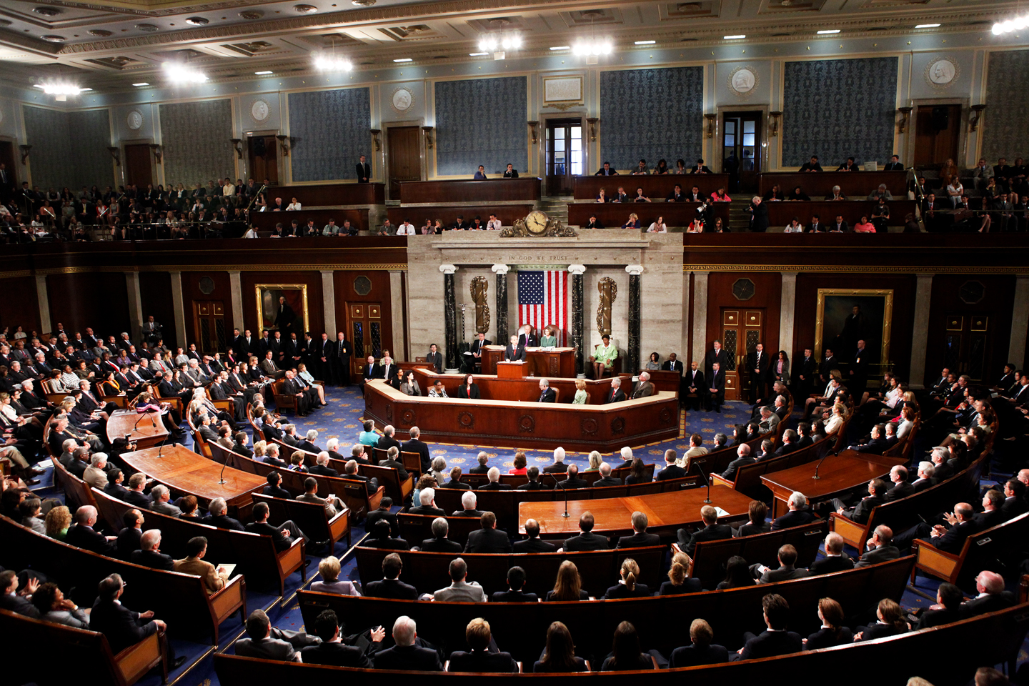
House of Representatives vs. The Senate
Chapter 10-Section 2 and 3

Slide 11
Membership
SENATE
100 members (two per state)
HOUSE
435 members; each state’s delegation is determined by its population

Slide 12
What are the Qualifications?
HOUSE
Need to be at least 25 years old, U.S. citizen for 7 years, resident of the state represented
SENATE
Need to be at least 30 years old, U.S. citizen for 9 years, resident of the state represented

Slide 13
How Long Are the Terms?
HOUSE
2 years, entire House must be elected every two years
SENATE
6 years with staggered elections, 1/3 of the members elected every 2 years

Slide 14
How Are They Elected?
HOUSE
Directly by the voters of a district
SENATE
Directly by the voters of a state (17th amendment), originally, state legislature chose them

Slide 15
Who is the Presiding Officer?
HOUSE
Speaker of the House must be elected every two years
SENATE
Vice-President of the U.S. is assigned by the Constitution to be the “President of the Senate”

Slide 16
Do They Have Any Special Powers?
HOUSE
Brings impeachment charges
May choose the President if there is no majority in the electoral system
Must start all revenue bills
SENATE
Acts as jury in impeachment trials (2/3 vote needed)
May choose the Vice President if there is no majority in the electoral system
Must ratify treaties with foreign nations by 2/3 vote
Must approves Presidential appointments (majority needed)

Slide 17
The Members of Congress
Chapter 10-Section 4

