Slide 1
Congress
Chapter 10

Slide 2
The National Legislature
Chapter 10-Section 1

Slide 3
The National Legislature
In theory we live in a democracy
What does this mean?
In a democracy, the people rule
However, we more accurately live in a “Representative Democracy”
This is because you do not personally make laws, conduct foreign policy, collect taxes or arrest criminals you elect people to do that for you
James Madison thought the legislature was the most important branch

Slide 4
A Bicameral Congress
Bicameral Legislature—Means we have two houses in Congress
Senate and the House of Representatives
The founders of our Constitution created a bicameral legislature for three reasons:
1.) Historical Reasons:
The British Parliament has consisted of two houses since the 1300’s
Most colonial and state assemblies consisted of two houses
Today forty-nine out of our fifty states have bicameral legislatures
Only Nebraska has a unicameral legislature

Slide 5
A Bicameral Congress
2.) Practical Reasons:
Bicameralism is a reflection of federalism
Adopting a Bicameral legislature settled the conflict between the Virginia Plan and New Jersey Plan in 1787
The Connecticut Plan created a Senate that was equal in representation and a House of Representatives based on proportional representation

Slide 6
A Bicameral Congress
3.) Theoretical Reasons:
The Framers favored a bicameral Congress in order that one house should act as a check on the other
Ex. In the Senate even though California has 37 million residents it still has the same amount of representatives (two Senators) as Wyoming who has only 500,000 residents

Slide 7
Terms and Sessions
Terms of Congress
Traditionally since 1789—Congress meets in two year terms
Each term is numbered consecutively
The first national Congress met on March 4, 1789 and ended two years later on March 4, 1791
The 20th Amendment changed the start date for Congress which now starts on the 3rd day of January at 12:00 noon EST of every odd-numbered year
115th Congress began on January 3, 2017 at 12:00 EST
116th Congress will begin on January 3, 2019 at 12:00 EST

Slide 8
Terms and Sessions
Sessions
Session—A period of time during which, each year, Congress assembles and conducts business.
Congress adjourns (ends) each session when finished
Session used to last four or five months but now it lasts all year with several short breaks scheduled
One house cannot adjourn for more than three days without the consent of the other.
President has the power to prorogue (end, discontinue) the session if the houses cannot agree on an ending date. (No President has used this power)

Slide 9
Terms and Sessions
Special Session
President may call a special session to deal with some emergency or special issue
Each house can be called into special session separately.
Only twenty-six special sessions have been called in the history of our nation
President Truman called the most recent one in 1948 to deal with anti-inflation and welfare after WWII.
The Senate has been called twenty-six times to consider treaties or presidential appointments
The House has never been called separately

Slide 10
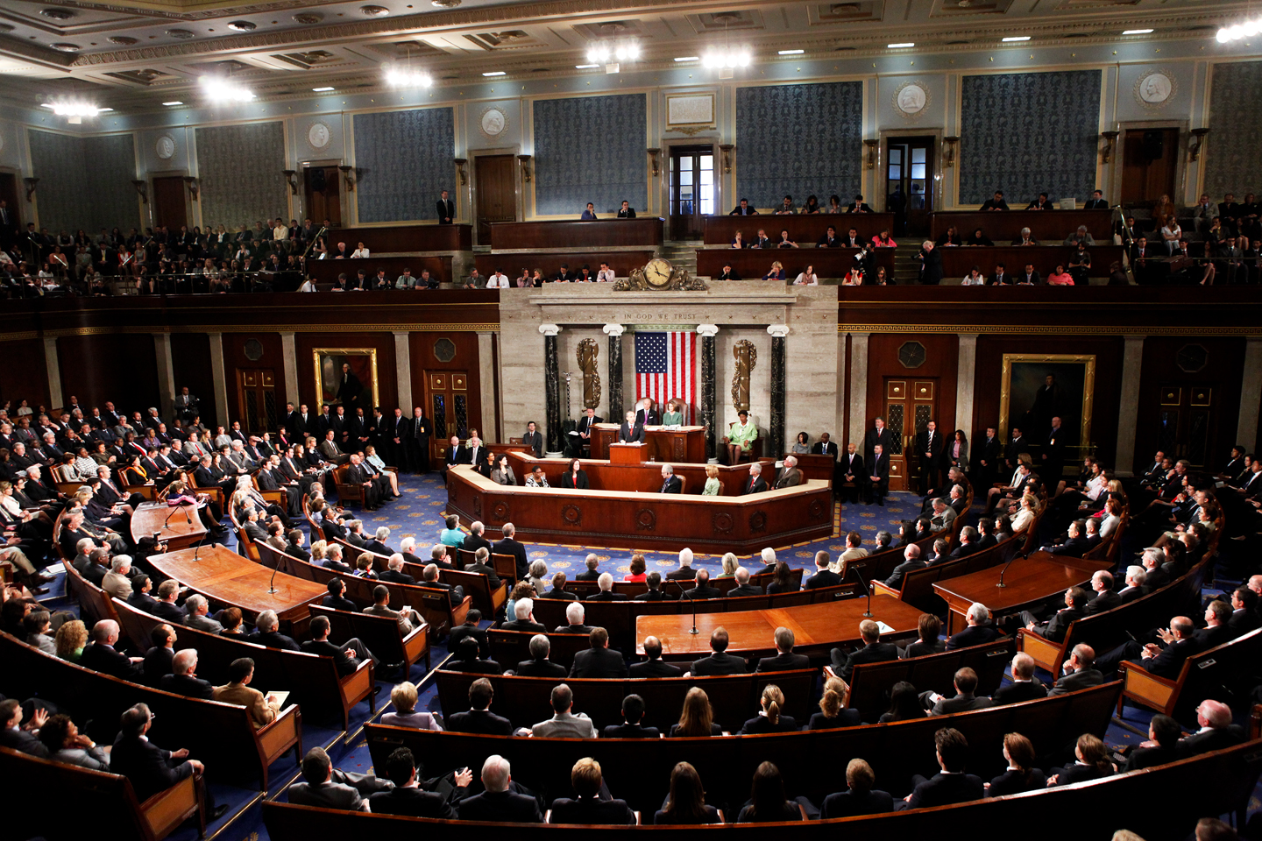
House of Representatives vs. The Senate
Chapter 10-Section 2 and 3

Slide 11
Congressional Elections
The Constitution sets out that the States are responsible for running the national elections
Since 1872 Congress has required that national elections are held on the same day in all states with the exception of Alaska.
The Tuesday following the first Monday in the November of each even-numbered year.
Congress also calls that representatives be chosen by written or printed ballots.
Voting machines were approved in 1899.
Off-Year Elections-Congressional elections that occur in the non-presidential years, that is, between presidential elections known as Mid-term elections.
More often than not, the party in power that holds the presidency loses seats in the off-year elections.

Slide 12
Congressional Districts
The 435 members of the House are chosen by the voters in 435 separate congressional districts.
7 states have only one representative.
There are 428 congressional districts in the other 43 States.
The Constitution makes no mention of Congressional districts, and until 1842 each state was allowed to decide how they would elect their own members to the House.

Slide 13
Congressional Districts
Types of Congressional Districts-
I. Single-member District-
Voters in each district elect one of the State’s representatives from a field of candidates running for a seat in the House from that district.
II. At-Large Districts-
The state’s seats are filled by electing them as a whole, rather than from a particular district. Every voter could vote for a candidate for each one of the State’s seats in the House.
This proved to be unfair because a party with a very small plurality of voters statewide could win all of a state’s seats in the House.
Congress did away with this system with a 1842 law. Today all states have to use the single member districts to elect their House members. Only the 7 states with one member can use the at-large system.

Slide 14
What is Gerrymandering?
Around the early 1800’s many States had began to draw Congressional districts in a way that would give an advantage to the political party that controls the state legislature.
The nickname for these odd looking districts was referred to as Gerrymandering named after Governor Elbridge Gerry’s redistricting of Massachusetts in 1812
Gerrymandering takes two main forms-
I. Packing-Which concentrates the opposition’s voters in one or a few districts leaving the others safe for the dominant party.
II. Cracking-Which spreads the opposition as thinly as possible among many districts limiting their ability to win anywhere.
Effects of Gerrymandering-
This produced districts that were different in size that failed to properly represent all of people living in them.

Slide 15
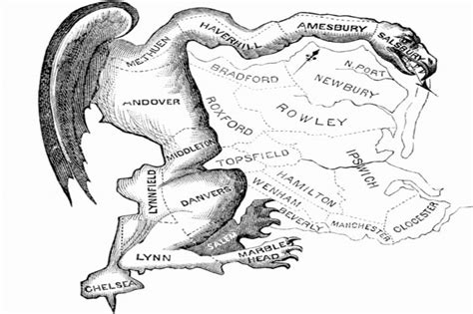

Slide 16
Limiting the Power of Gerrymandering
In 1964 the Supreme Court put limits on Gerrymandering
I. Wesberry v. Sanders (1964)-The population of each district had to be as close as possible to each other or it was a violation of the Constitutions call for “one man one vote”.
II. Gomillion v. Lightfoot (1996)-Could not gerrymander based on race or it would be a violation of the 15th Amendment
III. Bush v. Vera(1999)-Ruled that the drawing of districts could not be based on race
However, the Supreme Court more recently has held while race cannot be the controlling factor in drawing district lines, race can be one of the mix of factors that make those lines.

Slide 17
Membership
SENATE
100 members (two per state)
HOUSE
435 members; each state’s delegation is determined by its population

Slide 18
What are the Qualifications?
HOUSE
Need to be at least 25 years old, U.S. citizen for 7 years, resident of the state represented
SENATE
Need to be at least 30 years old, U.S. citizen for 9 years, resident of the state represented

Slide 19
How Long Are the Terms?
HOUSE
2 years, entire House must be elected every two years
SENATE
6 years with staggered elections, 1/3 of the members elected every 2 years

Slide 20
How Are They Elected?
HOUSE
Directly by the voters of a district
SENATE
Directly by the voters of a state (17th amendment), originally, state legislature chose them

Slide 21
Who is the Presiding Officer?
HOUSE
Speaker of the House must be elected every two years
SENATE
Vice-President of the U.S. is assigned by the Constitution to be the “President of the Senate”

Slide 22
Do They Have Any Special Powers?
HOUSE
Brings impeachment charges
May choose the President if there is no majority in the electoral system
Must start all revenue bills
SENATE
Acts as jury in impeachment trials (2/3 vote needed)
May choose the Vice President if there is no majority in the electoral system
Must ratify treaties with foreign nations by 2/3 vote
Must approves Presidential appointments (majority needed)

Slide 23
The Members of Congress
Chapter 10-Section 4

