Slide 1
Chapter 6 and 7 Test Materials

Slide 2
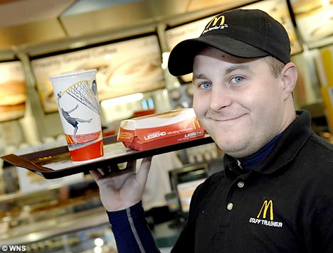
Demographics of a typical non-voter
Non-Voters Tend to Be: (pg. 173)
Younger than 35
Unmarried
Working an unskilled labor job
They tend to live in rural areas or in the South
Men are less likely to vote than women

