Slide 1
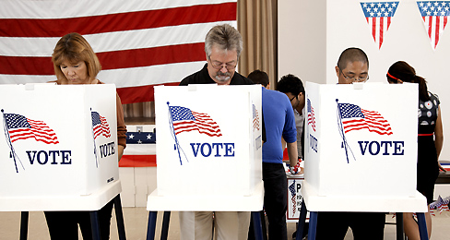
Chapter 6: Voters and Voter Behavior

Slide 2
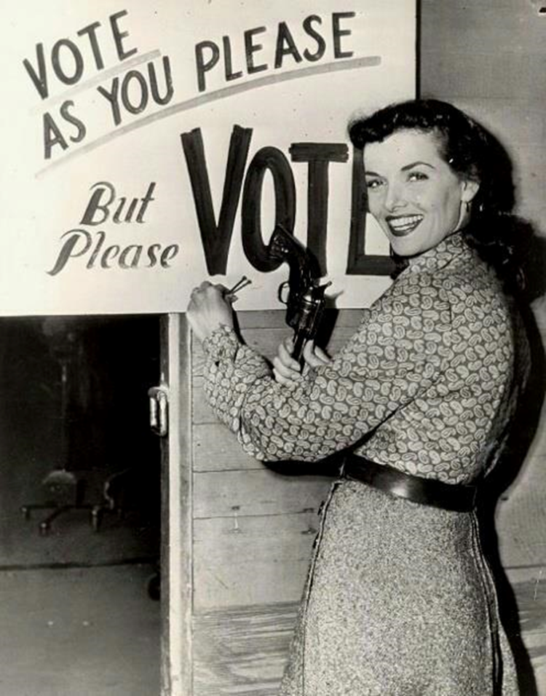
Section One: The Right to Vote (pg. 152-155)

Slide 3
History of Voting Rights
How have voting rights changed over the course of American history?
Over time, voting rights have been extended to more Americans
Previous voting qualifications based on property ownership, religion, race, sex have all been eliminated through federal laws and constitutional amendments
Age requirement for voting has been reduced

Slide 4
The Electorate
The Constitution originally gave the power to decide voter qualifications to the States
Which meant white male property owners
Since 1789, many restrictions to voting rights have been eliminated
Power to decide who has the right to vote has been shifting from the States to the Federal government
This trend can be examined in five stages

Slide 5
Stage One
Religious, property, and tax qualifications begin to disappear in every State
Religious qualifications eliminated by 1810
In early 1800s, gradual elimination of property ownership and tax payment qualifications
By 1860, almost all white males could vote in every State

Slide 6
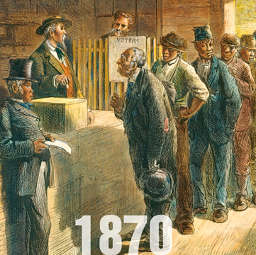
Stage Two
After the Civil War, the 15th Amendment made it illegal to deny any citizen the right to vote based on their color or race
However, African Americans were not given right to vote

Slide 7
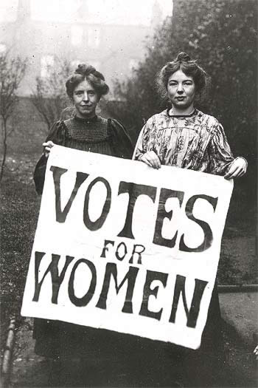
Stage Three
In 1920, the ratification of the 19th Amendment gave women the right to vote
By 1920, more than half the States had already followed the example set by Wyoming in 1869

Slide 8
Women’s Suffrage in 1919

Slide 9
Stage Four & Five
During the 1960s, the civil rights movement led to new protections for African American voting rights.
The Voting Rights Act of 1965 defended racial equality in voting.
The 24th Amendment eliminated the poll tax in federal elections.
In 1971 the 26th Amendment gave those 18 and older the right to vote.

Slide 10
Voting Qualifications
The Constitution sets five restrictions on the ability of the States to set voter qualifications.
Anyone allowed to vote for members of their State legislature must be allowed to vote for members of Congress.
The 15th Amendment bans the States from depriving any person of the right to vote on account of their race, color, or having once been enslaved.

Slide 11
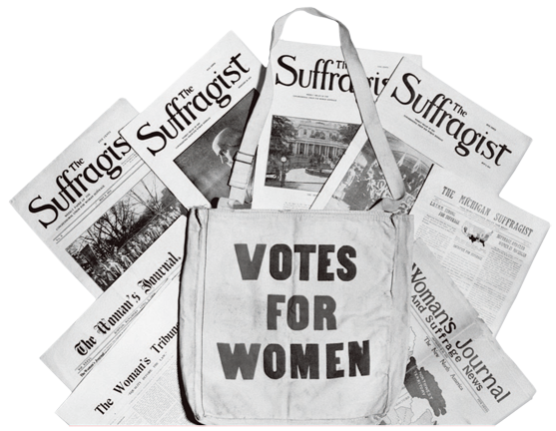
Voting Qualifications
Under the 19th Amendment, no State can deprive any person of the right to vote based on their sex.
No State can levy a tax on the right to vote for President, Vice President, or members of Congress.

Slide 12
Voting Qualifications
Under the 26th Amendment, no State can deprive any person who is at least 18 years of age of the right to vote because of their age.

