Slide 1
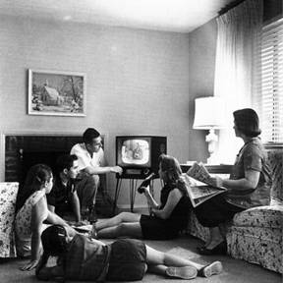
Chapter 19-The Post War Boom
Test Materials

Slide 2
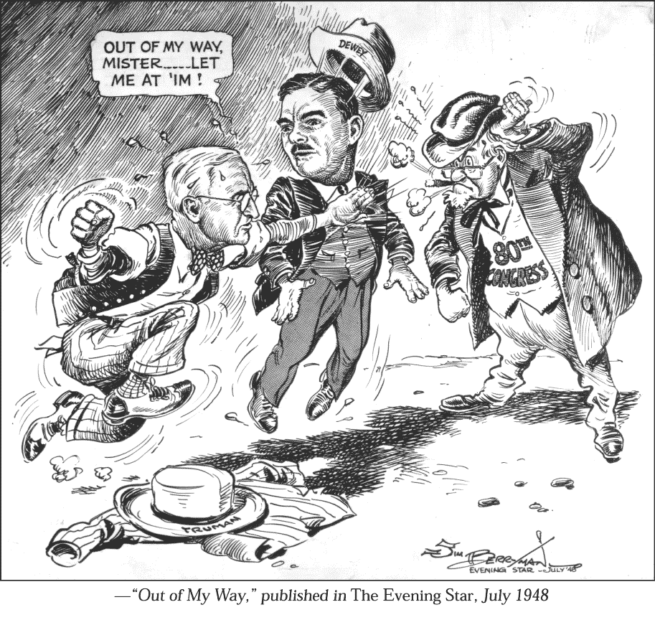

Slide 3
