Slide 1
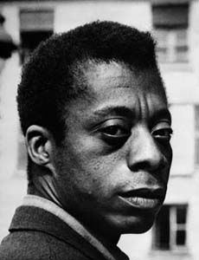
Section 4-The Other America

Slide 2
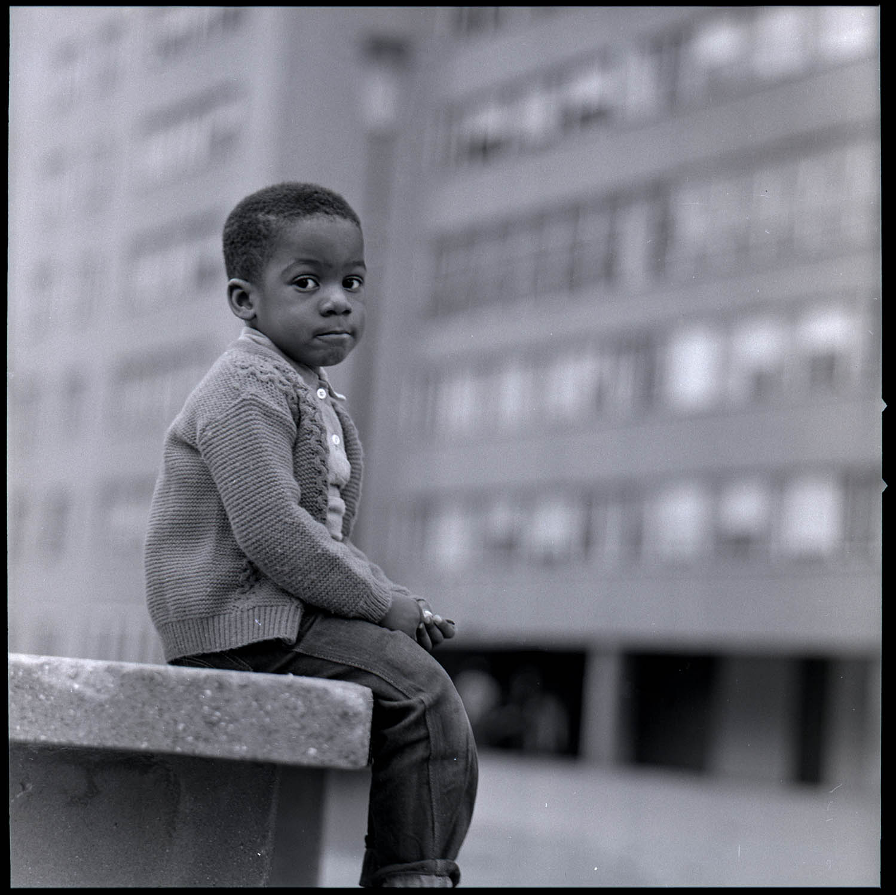
The Urban Poor
Urban Poor-One in every four Americans lived below the poverty level.
Most were elderly, single mothers and minorities
As African Americans moved from the South the presence of white flight in urban areas created a deep racial divide amongst residents of Northern cities
This results in a loss of taxes which leaves city governments unable to improve schools, offer transportation or help their police and fire departments

Slide 3
The Inner Cities
Across the country many suburbanites did not see what was happening in the inner cities
Although the minimum income level in America rose every year but still many minorities living in the inner city lacked the opportunities of suburbanites
Most African Americans, Native Americans and Latinos who lived in these areas were forced into crowded and dirty slums
The Other America-A book written by Michael Harrington addressed the issue of poverty in the United States
Urban Renewal-The National Housing Act of 1949 was passed to provide a “decent home and suitable living environment for every American family”
It created the Department on Urban Development which called for tearing down old rundown neighborhoods like Black Bottom in Detroit that paved the way for I-75

Slide 4
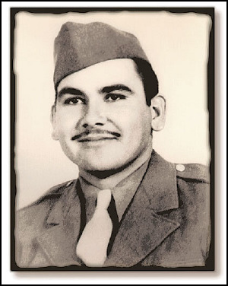
Poverty Leads to Activism
1942-Mexican workers through a program called braceros (hired hands) were allowed into the U.S. to help harvest crops
Many braceros were expected to leave the U.S. after their work was done but many stayed illegally to escape Mexico
Longoria Incident- In 1949, four years after the end of the war Army Pvt. Felix Longoria, a native of the small South Texas town of Three Rivers remains were returned from Luzon, in the Philippines.
His widow, Beatriz, had been denied use of a hometown funeral chapel because the Longorias were Mexican-American and the funeral director feared that the whites in the city “wouldn’t like it” .

Slide 5
Poverty Leads to Activism
Native American Groups also continued to fight for rights and identity during the 1950’s
The Indian Citizenship Act of 1924, also known as the Snyder Act, was proposed by Representative Homer P. Snyder (R) of New York granted full U.S. citizenship to the indigenous peoples of the United States, called "Indians“.
This act finally allowed them to vote.
The Indian Reorganization Act of June 18, 1934, or the Wheeler-Howard Act, was U.S. federal legislation that dealt with the status of Native Americans (known in law as American Indians or Indians).
It was the centerpiece of what has been often called the "Indian New Deal".
The major goal was to reverse the traditional goal of assimilation of Indians into American society and to strengthen, encourage and perpetuate the tribes and their historic traditions and culture.
1944 the United States established the National Congress of American Indians to ensure Native Americans the same civil rights as everyone else enjoyed

Slide 6
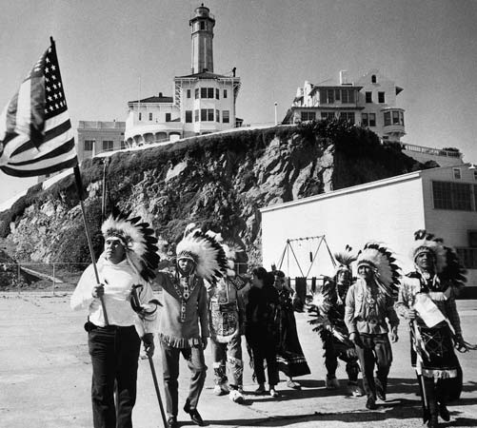
Poverty Leads to Activism
Termination Policy-In 1953, the United States decided to eliminate financial support to Native American’s living on the reservations
The government discontinued the effectiveness of the reservation system eliminating communal living and distributing tribal lands among individual native Americans
The Termination policy was ultimately a was failure
Native Americans were left without medical care, jobs and many of the basic life essentials

