Slide 1
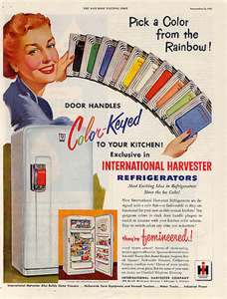
Chapter 19-Section 2-The American Dream in the Fifties

Slide 2
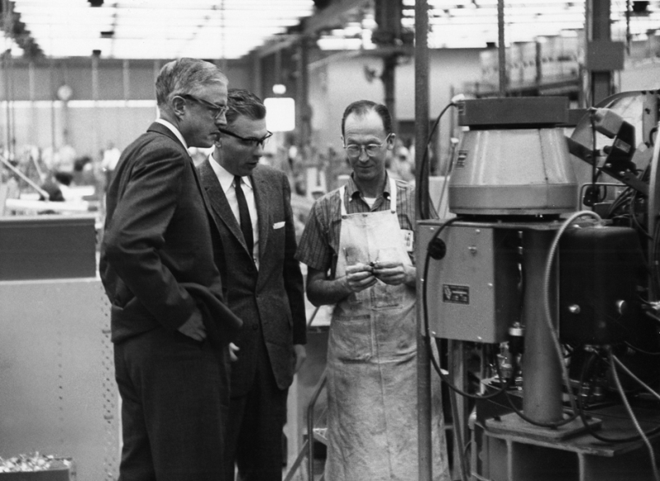
The Organization and the Organization Man
As 1950’s moved forward there were more White Collar jobs available
We saw a major increase in service industry and advertising jobs

Slide 3
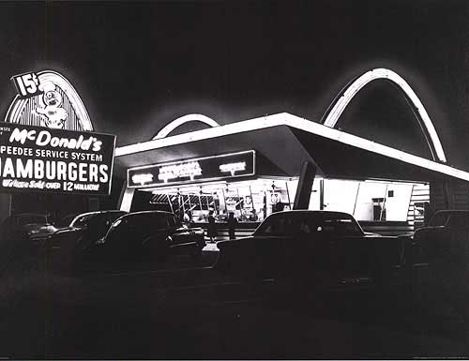
The Organization and the Organization Man
Conglomerates-
Major company that owns smaller ones in unrelated fields
It was a way to help when your company had hard times
Franchising-
They focused on providing similar products in different locations
Franchising is where they would sell “Franchise Rights” to an individual looking to open their own location
Ray Kroc:
McDonalds: He bought it from the brothers for $2.7 million
Added the mythic “Golden Arches”

Slide 4
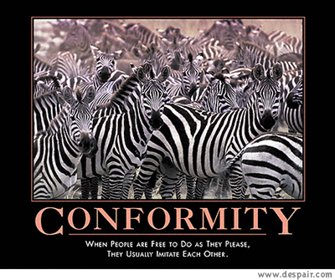
The Organization and the Organization Man
Social Conformity-
Standardized what people ate and the way they worked
Loss of individuality
“The Organization Man”: William H. Whyte
Company People: fitting in to corp. culture
Rewards for teamwork, cooperation, loyalty

Slide 5
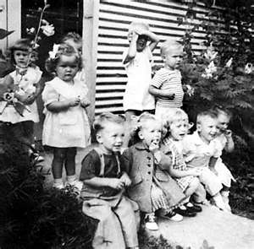
The Suburban Lifestyle
1950-Job security may have cost workers their individuality but provided “good things”
Highways and cars led to Suburbs
Baby Boom:
In 1957, an average of one infant born every seven seconds
This created the largest generation in U.S. history partially due to better medicine and childcare
Past reasons for a lower birth rate-The Great Depression and WWII

Slide 6
The Suburban Lifestyle
Advances in medicine help pioneer new drugs designed to help kids
Dr. Jonas Salk creates a vaccine that cured Polio
Dr. Benjamin Spock writes several books on childcare
He felt that the federal government should pay moms to staying home and raise their children
Effects of Baby Boomers-
Toy Sales boomed!
New schools had to be built

Slide 7
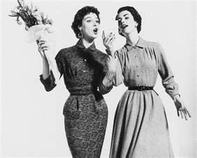
The Suburban Lifestyle
Women’s Roles-
Glorified women’s place in home
TV, magazines, everything said, women should be at home
Some women started to speak out and say it was isolating them
Betty Friedan wrote an the influential book titled The Feminine Mystique.
As we neared the 1960’s women were taking jobs outside of home, but sometimes stereotypical
Women earned less
Often limited to teaching, nursing, and office jobs
Were not pushed to go to college

Slide 8
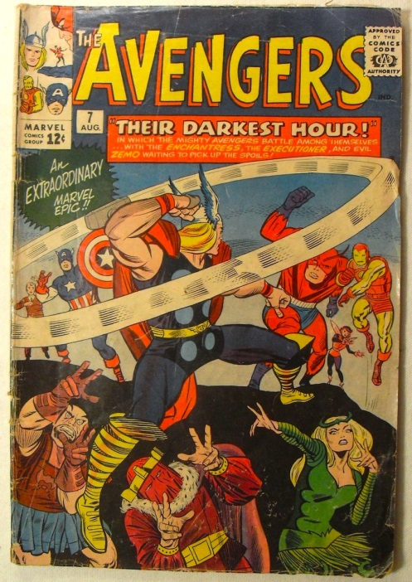
The Suburban Lifestyle
Attritional time for leisure in the 1950’s-
Americans enjoyed more time then ever before
There were more labor saving devices then before
They were able to spend time playing/enjoying sports and games
Many of the books American’s were reading were Do it yourself, comic books and mysteries

Slide 9
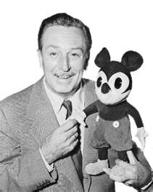
The Automobile Culture
Automania-
After the war the car defined America
Suburbs made car and highways necessary
Interstate Highway Act 1956
Helped some towns, killed others
New vacation ideas popped up due to car
In 1955, Disneyland opens in California
It had negative effect too
Environment, traffic, noise, flight from cities
Created a gap between rich and poor
Increased advertising generates increased revinue

Slide 10
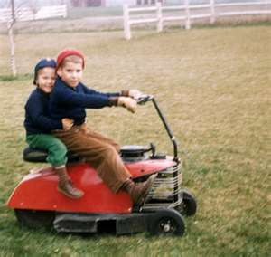
Consumerism Unbound
Consumerism-
In the 1950’s a person’s was measured by how much stuff they had
Hundreds of new products became available for purchase:
TV’s, tape recorders, HIFI record players
People bought clothes and accessories for the fun of it over the function
The backyard became a place where families would spend their nights and weekends
This increased the desire for gas powered lawn mowers, BBQ and creative lawn decorations!

Slide 11
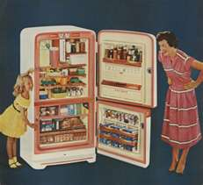
Consumerism Unbound
Planned Obsolescence-A policy where manufactures purposely produced products that easily wore out becoming quickly outdated and obsolete.
People were buying new models of their favorite products every few months
This was the start of us becoming a throwaway Society

Slide 12
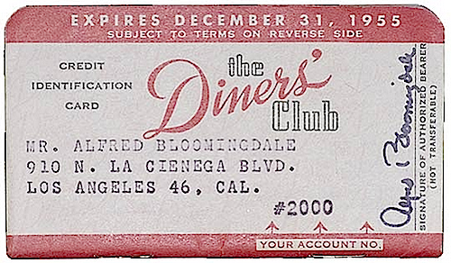
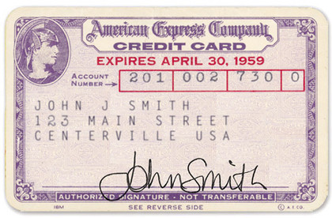
Consumerism Unbound
Credit-Our shift to planned obsolescence also led to an increased need for credit
Very first Credit Card the Diners Club Card was issued in 1950
The first American Express card was issued in 1958
American’s began to buy expensive items on installment plans
This also led to an increase in home mortgages
By the end of the 1950’s the private debt of American citizens grew from $73 billion to $179 billion

Slide 13
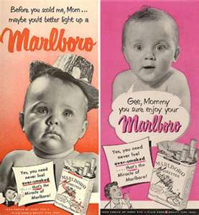
Consumerism Unbound
Advertising Age-
Encouraged more spending
Billions of dollars a year on advertising
In 1950 cooperation's were spending nearly six billion dollars a year on advertising
By 1955 the number had reached nearly nine billion
Companies' used psychology to convince you what you desperately needed these item
TV commercials became main way to convince you that you needed a product

