Slide 1
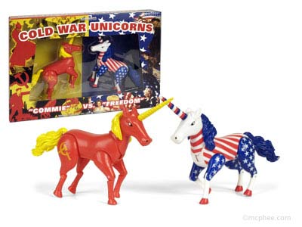
Chapter 18-Section 1-Origins of the Cold War

Slide 2
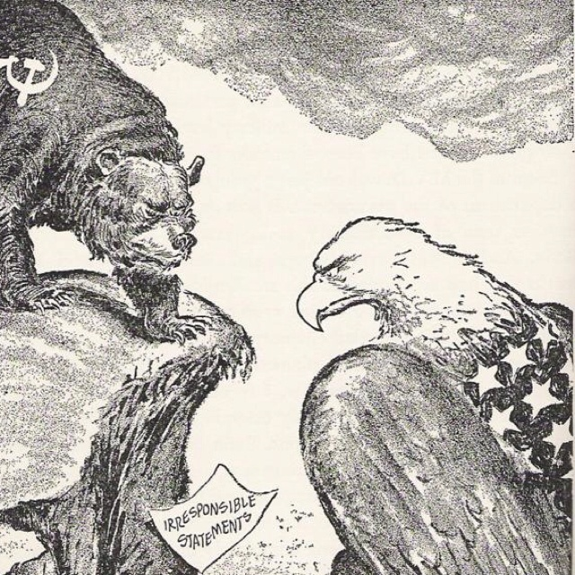
Former Allies Clash
The U.S. and U.S.S.R. have different plans for their vision of Europe
Russia-
Believed in communism where the government had total control over property and economy
No political parties, no real voting rights
America-
Believed in capitalism. A system where private citizens controlled the economy, property and held free voting rights

Slide 3
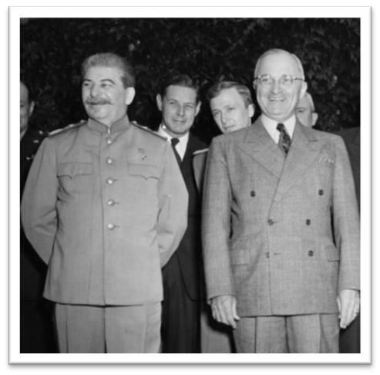
Former Allies Clash
The events of the war made both the United States and Russia suspicious one another
Harry S. Truman succeeds FDR as President
As vice-president, Truman was not included in policy decisions and was not even aware the atomic bomb existed until he became President
Joseph Stalin continued to lead Russia
However, he resented that U.S. delayed attacking Germany and hid atom bomb from him

Slide 4
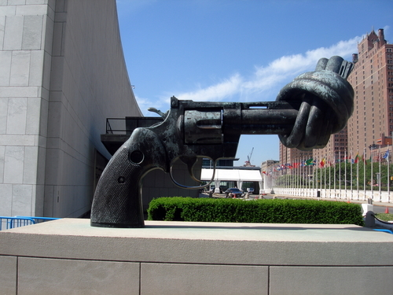
The United Nations
The United Nations-
In June of 1945 fifty nations came together to establish the United Nations established as new peacekeeping body
UN becomes the arena where U.S. and U.S.S.R. would attempt to spread their influence
Many hoped a lasting peace could be achieved

Slide 5
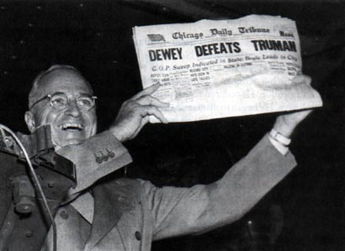
Truman Becomes President (Again)
Truman’s Role:
Had been kept out of main decisions during war
Forced to jump in without background knowledge

Slide 6
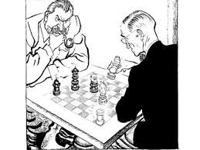
The Potsdam Conference
The Potsdam Conference-
In July 1945 a conference led by Harry Truman of the U.S., Clement Atlee of Great Britain and Joseph Stalin of the Soviet Union met to lay the foundations for a post war world
Stalin had gone back on promises for free elections
Democracy wasn’t allowed in the Soviet controlled territories
The U.S. wanted this to help open trade doors fearing that the more communist countries that existed the stronger the Soviet economy would become

Slide 7
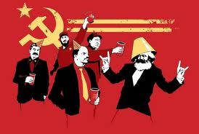
The Potsdam Conference
Bargaining at Potsdam-
Truman becomes convinced that U.S., Soviet aims deeply at odds
Soviets want reparations from Germany due to the fact that they lost over twenty million men
Truman objects to this request
The U.S.S.R agrees to take reparations mainly from own occupation zones known as satellite nations
U.S. emerges from war as great economic power and wants Eastern European raw materials, markets

Slide 8
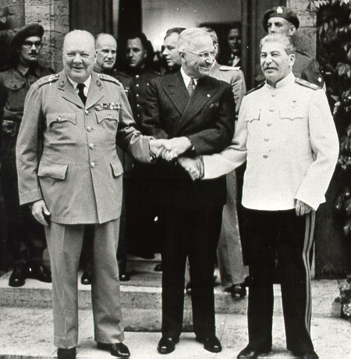
The Potsdam Conference
As a response the U.S. established the policy of containment which aimed to prevent the spread of communism
Europe Became Divided-
The eastern block of Europe was Communist controlled while the west became a non-communist area
Churchill described the division by saying that “an Iron Curtain had fallen across Europe”

Slide 9
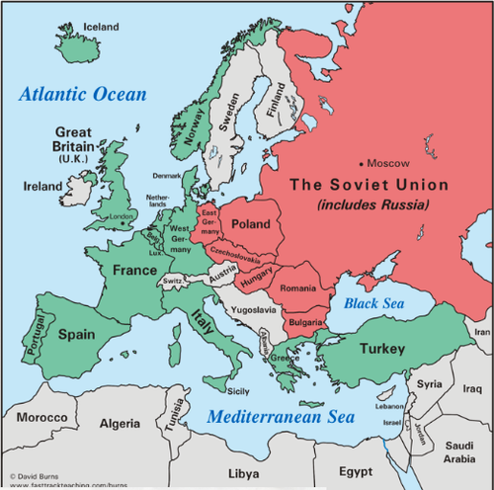

Slide 10
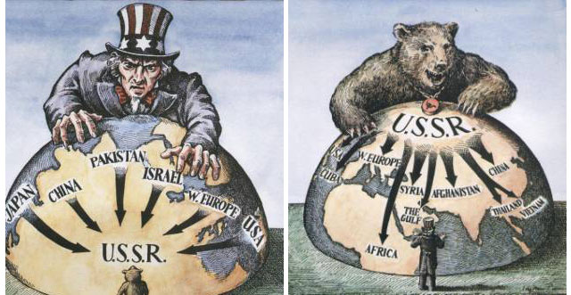
The Cold War in Europe
The Cold War was a state of geopolitical tension after World War II that lasted from 1945 until the collapse of communism in 1991.
This ideological conflict was mainly between powers in the Russian controlled Eastern Bloc and powers in the U.S. influenced Western Bloc.

Slide 11
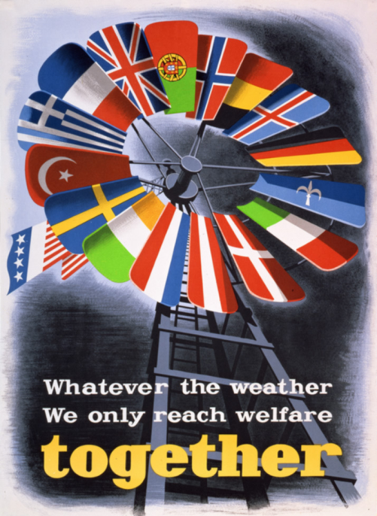
The Cold War in Europe
Truman Doctrine-
Believed in containment by giving money to countries in jeopardy of being taken over by Communism
U.S. replaces British aid to Greece and Turkey in order to reduce communist threat
The Marshall Plan-
In 1947, Secretary of State George Marshall proposes giving aid to any nation in need who is fighting off the advance of communism
Under this plan sixteen nations receive over thirteen billion dollars in aid

Slide 12
Dealing with Germany
Following the Potsdam Conference Germany is divided into four zones
A British, French, Russian and United States led zone
However, Great Britain and France were still recovering from war so control ultimately fell to the U.S. and Russia
Later it was split into an eastern and western block
Berlin was shared but technically in Soviet territory. So it was divided and the Soviets agreed to keep road open
They did not

Slide 13
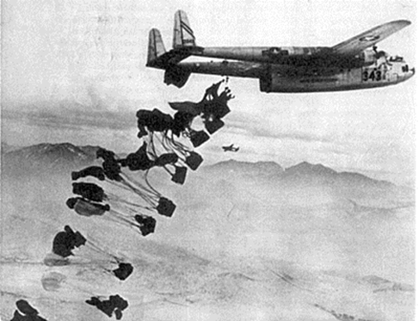
Dealing with Germany
Berlin Airlift-
The United States and Great Britain conducted 227,000 flights over a period of 327 Days
During the Berlin Airlift nearly 2.3 million tons of supplies were dropped into the city of Berlin

Slide 14
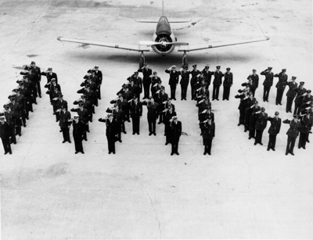
North Atlantic Treaty Organization
After seeing what happened in Germany people got nervous
So twelve countries (Belgium, the Netherlands, Luxembourg, France, and the United Kingdom, United States, Canada, Portugal, Italy, Norway, Denmark and Iceland) came together to form NATO for protection
NATO has its own military

