Slide 1
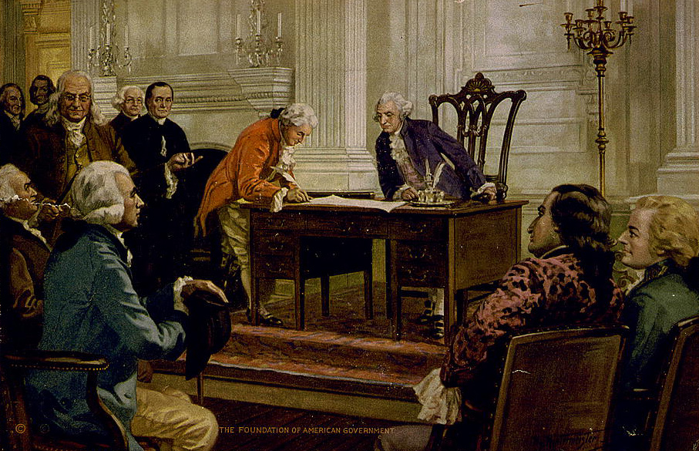
Chapter 1-Section 1-Basic Principles
The Constitution is “the supreme law of the land” – the highest form of law in the United States. It lays out the basic framework and procedures of our government.

Slide 2
An Outline of the Constitution
The Constitution is separated into:
I. “Preamble”: A short introduction.
II. “Articles”: Seven numbered sections that outline the American government.
III. “Amendments”: A total of twenty-seven additions to the document.

Slide 3
The Seven Articles of the Constitution
Article I- Created the Legislative Branch
Article II- Created the Executive Branch
Article III- Created the Judicial Branch
Article IV- Addressed relationships between the states
Article V- Covers the process of amending the Constitution
Article VI- Addressed several issues that included the national debt, supremacy of national laws and oaths of office
Article VII- Explains the process of ratifying the Constitution

Slide 4
The Six Basic Principles of the Constitution
I. Popular Sovereignty
II. Limited Government
III. Separation of Powers
IV. Checks and Balances
V. Judicial Review
VI. Federalism

Slide 5
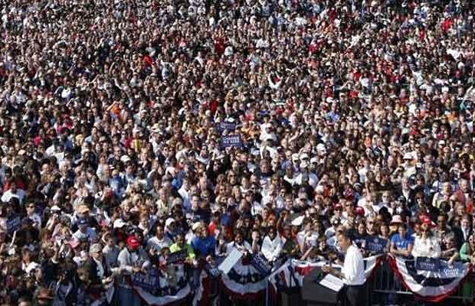
I. Popular Sovereignty:
All political power resides in the hands of the people-
Government can only govern with the consent of the governed.
*All forms of government national, state, and local operate according to this principle.

Slide 6
II. Limited Government:
Government is not all-powerful
It may only do those things that the people have given it the power to do.
*Government must obey the law–it must follow the principle of “constitutionalism”: government must be conducted according to constitutional principles.
* “Rule of law”: government and its officers are always subject to–never above–the law.

Slide 7
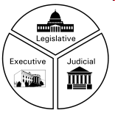
III. Separation of Powers:
The basic powers of government are separated among three independent branches in our presidential system.
*This separation of powers created the legislative, judicial and executive branches

Slide 8
III. Separation of Powers:
Article I: The legislative branch makes the laws (Congress).
Article II: The executive branch executes/administers laws (The President).
Article III: The judicial branch interprets/applies the laws (Supreme Court).
*This separation is intended to create a strong, yet limited, government.

Slide 9
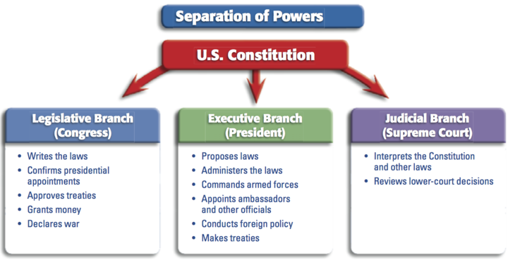
III. Separation of Powers:

Slide 10
IV. Checks and Balances:
Each branch of government is subject to a number of constitutional checks (restraints) by the other branches.
*The three branches are not entirely separated or completely independent of one another.

Slide 11
Examples of Checks and Balances:
1. Congress (legislative branch) has the power to make laws, but the President (executive branch) has the power to “veto” any act of Congress.
2. Congress can refuse to provide funds that are requested by the President.
*This system makes compromise necessary so there are very rarely are there open clashes between the branches.

Slide 12
V. Judicial Review:
The power of courts to determine whether “what government does is in accord with what the Constitution provides”.
This power is held by all federal courts and by most state courts.
*Judicial review is the power to declare something “unconstitutional”:
To declare illegal/null and void, a governmental action that violates some aspect of the Constitution.

Slide 13
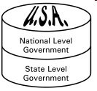
VI. Federalism:
The division of power among a central government and several regional governments-the powers held by government are distributed on a territorial basis.
*This is a compromise between an all-powerful federal government and totally independent states.

