Slide 1
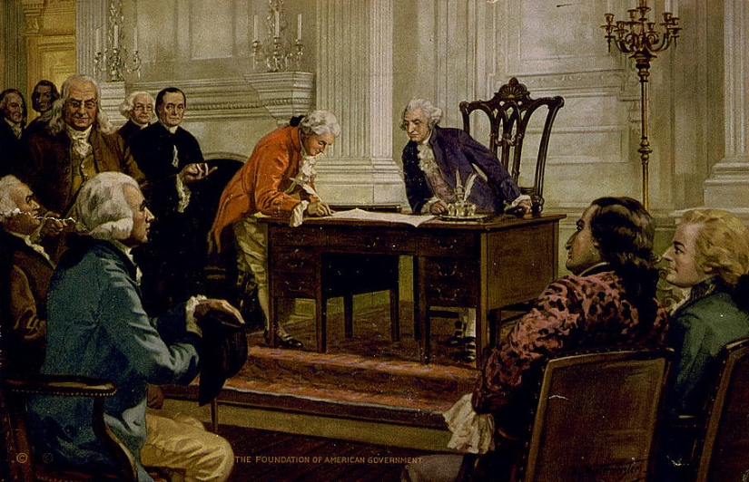
CHAPTER 2-ORIGINS OF AMERICAN GOVERNMENT

Slide 2
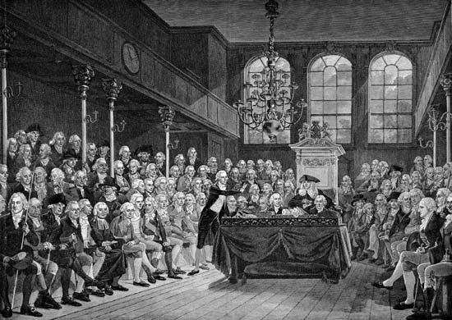
Chapter 2-Section 1-Our Political Beginnings
Pg.30-35

Slide 3
BASIC CONCEPTS OF GOVERNMENT
Earliest settlers had knowledge of political systems
Political system was based on practices in England
ORDERED GOVERNMENT
  Orderly regulation of relationships with one another
  Many offices created then are available today: sheriff, coroner, assessor, grand jury

Slide 4
BASIC CONCEPTS OF GOVERNMENT
LIMITED GOVERNMENT
  Government is not all powerful
  Government has restrictions
  Citizens have certain rights that governments cannot take away
REPRESENTATIVE GOVERNMENT
  People’s interests are represented in the government
  People should have a voice in deciding what government should and should not do

Slide 5
LANDMARK ENGLISH DOCUMENTS
THE MAGNA CARTA (1215)
  Aka the Great Charter
Barons forced King John to sign because of military campaigns and heavy taxes
Fundamental rights:
  Trial by jury and due process of law
  Protection against arbitrary taking of life, liberty, or property
  These protections originally were for the privileged classes but they spread to everyone
    Magna Carta established the principle that the power of the monarchy was not absolute.

Slide 6
LANDMARK ENGLISH DOCUMENTS
THE PETITION OF RIGHT
1621-King Charles I asked Parliament for more tax money
Parliament refused until he signed Petition
The Petition of Right limited King’s power:
  Could not imprison or otherwise punish any person but by lawful judgment of their peers
  Could not impose martial law in time of peace
  Could not require homeowners to shelter troops without consent
  Could not require tax without consent of Parliament

Slide 7
LANDMARK ENGLISH DOCUMENTS
THE BILL OF RIGHTS (ENGLAND)
  1688-Crown offered to William and Mary of Orange
  1689-List of provisions Kings had to agree to were:
    Prohibited standing army in peace time
    Required all parliamentary elections be free
    King could not suspend laws without consent of Parliament
    King could not tax citizens for the Crown’s use without Parliament’s consent
The Bill of Rights also included guarantees as the right to a fair trial, and freedom from excessive bail and from cruel and unusual punishment
  Our nation is built on ideals brought to North America but English settlers.

Slide 8
An English Political Heritage
Magna Carta 1215 | Government is not all-powerful Provided for the basis of limited government Protection against unjust punishment, loss of life, liberty, and property Certain taxes could not be levied with out popular consent
Petition of Rights 1628 | Severely limited the king’s power Could not collect tax without Parliament’s consent Could not imprison people without just cause No quartering of troops without permission of the homeowner Cannot declare marital law unless the country was at war
English Bill of Rights 1689 | Set clear limits on what a leader could or could not do Stated Monarchs do not have absolute authority; rule with consent of the people Must have consent from Parliament to suspend laws, levy taxes., maintain army; right to fair and speedy trial People protected against cruel and unusual punishment

Slide 9
FOUNDATIONS OF AMERICAN RIGHTS
The rights established in these landmark documents were revolutionary in their day and influenced government in many countries.
 | 1215 Magna Carta | 1689 English Bill of Rights | 1776 Virginia Bill of Rights | 1791 Bill of Rights
Trial by jury | √ | √ | √ | √
Due Process | √ | √ |  | √
Private Property | √ |  | √ | √
No Cruel punishment |  | √ | √ | √
No excessive bail or fines |  | √ | √ | √
Right to bear arms |  | √ | √ | √
Right to petition |  | √ |  | √
No unreasonable search or seizures |  |  | √ | √
Freedom of speech |  |  | √ | √
Freedom of press |  |  | √ | √
Freedom of religion |  |  | √ | √

Slide 10
THE ENGLISH COLONIES
English colonies described as “Thirteen schools of government”
Thirteen colonies were created separately, over 125 years
  Beginning with Jamestown, VA in 1607 up to Savannah, GA in 1733
Each colony was borne out of a particular set of circumstances
  Each colony was established on the basis of a CHARTER (written grant of authority from the king)

Slide 11
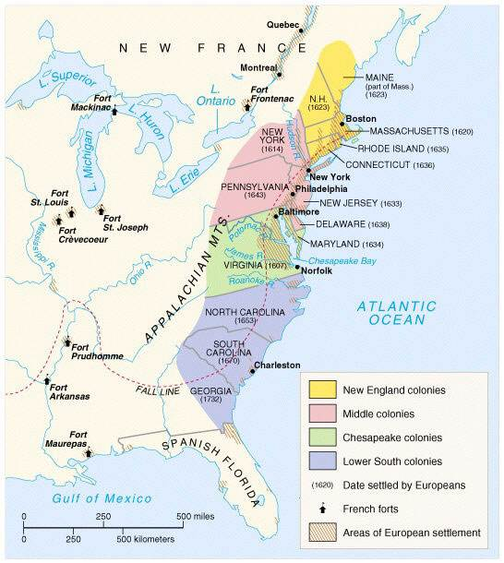

Slide 12
THE ENGLISH COLONIES
ROYAL COLONIES:
  Subject to the direct control of the Crown
  1775—NH, MA, NY, NJ, VA, NC, SC, GA
    King named a governor as chief executive
    King also named an advisory council
      This council also served as the highest court
  The advisory council became the upper house of a BICAMERAL legislature
    The lower house was chosen by property owners qualified to vote
Laws passed by the legislature had to be approved by the governor and the Crown

Slide 13
THE ENGLISH COLONIES
THE PROPRIETARY COLONIES:
  1775-Maryland, Pennsylvania, Delaware
  Organized by a PROPRIETOR (a person to which the King made a grant of land)
This land could be settled and governed as the proprietor saw fit
  Government was similar to royal colonies but appointed by the proprietor
Pennsylvania had a UNICAMERAL legislature

Slide 14
THE ENGLISH COLONIES
THE CHARTER COLONIES:
  Connecticut and Rhode Island
  These colonies were largely self-governing
  Governors were elected by white, male property owners
Laws made by the bicameral legislature were not subject to governor or King approval
  Charters were so liberal that they were left untouched and made into state constitutions until 1818 (Connecticut) and 1843 (Rhode Island)

Slide 15
Guided Questions:
1.) Explain the difference between a bicameral and a unicameral legislative body.
2.) In what ways were the 13 colonies similar to one another? How did they differ?

Slide 16
Guided Notes:
1.)Explain the concepts of ordered government, limited government, and representative government.
2.) What were some of the fundamental rights and principles established in the Magna Carta, the Petition of Right, and the English Bill of Rights?
3.) Identify and describe the three types of government in the English colonies.
4.) Explain the difference between a bicameral and a unicameral legislative body.
5.) In what ways were the 13 colonies similar to one another? How did they differ?

Slide 17
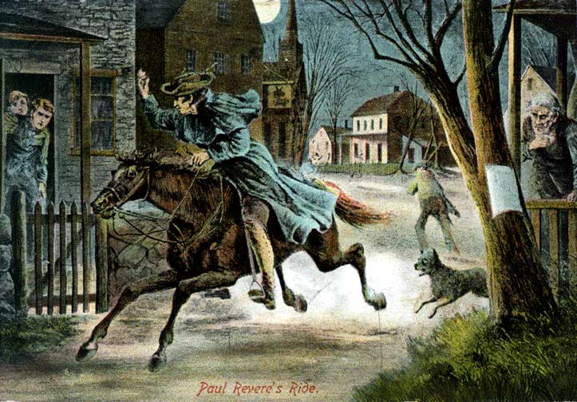
Chapter 2-Section 2-The Coming of Independence
Pg.36-42

Slide 18
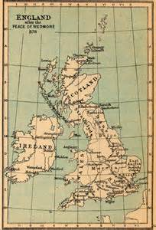
The Coming of Independence
In the beginning, colonists were given a decent amount of freedom and self-government.
  Over time, England especially under the rule of King George III began to restrict the freedoms of the colonists.
    Another problem was that the colonists had no representatives in English Parliament, which they greatly resented.

Slide 19
The Coming of Independence
Great Britain under the colonial system was responsible for:
  Defending the colonies
  Representing them in foreign affairs
  Maintaining a uniform monetary system
  Fostering a market for colonial trade
For a long time there were very little taxes were taken from the colonies
Colonist became use to self-government
  Great Britain was 3,000 miles away; and it took two months to sail to receive correspondence so they were able to act independently of the English crown
When England began passing restrictive laws, the colonists began to consider revolution

Slide 20
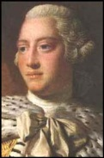
Britain's Colonial Policies
King George III-
  When he came to the throne in 1760 he started to deal with the colonists more “firmly”
  He restricted trade with nations other than England and enforced taxes to support British troops in North America

Slide 21

The Stamp Act Congress
Stamp Act-
  Required the use of tax stamps on all legal documents, certain business agreements, and on newspapers
    The Act was denounced by the colonies because they thought the taxes were too high and that they were without representation in Parliament
  This tax brought the colonies together; they formed the Stamp Act Congress
    Nine of the thirteen colonies sent delegates
  Sent a letter to the King called the Declarations of Rights and Grievances
    Parliament repealed the Stamp Act; frictions still mounted
Britain’s harsh tax and trade policies brought resentment to the colonies.

Slide 22
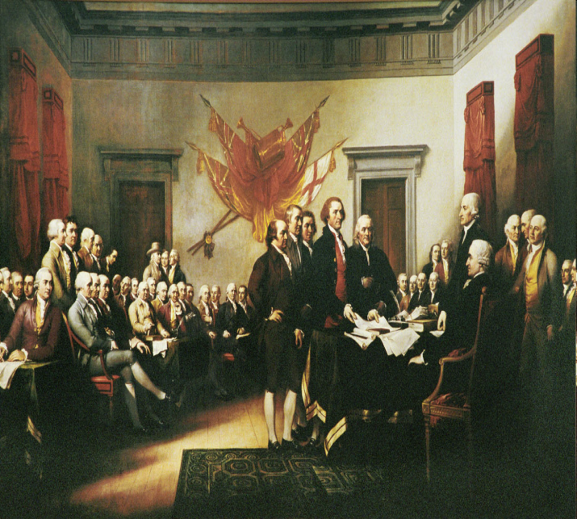
First Continental Congress
Intolerable Acts
  Britain passed new laws to punish the colonists over the troubles in Boston
    Ex. Boston Massacre and the Tea Party
  The colonists wrote the Declaration of Rights
    They urged other colonist to boycott (refusal to buy) all trade with England

Slide 23
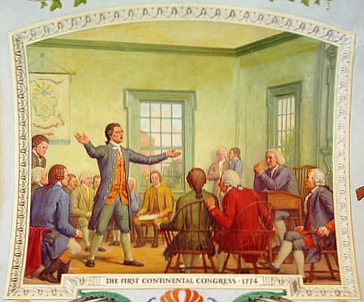
First Continental Congress
Delegates from twelve colonies (Georgia failed to send a delegate) met in Philadelphia on Sept 5th, 1774
For two months the delegates of the First Continental Congress met to discuss the crumbling relations with England.
  Delegates deliberated potential plans of action until the meeting adjourned on October 26th

Slide 24
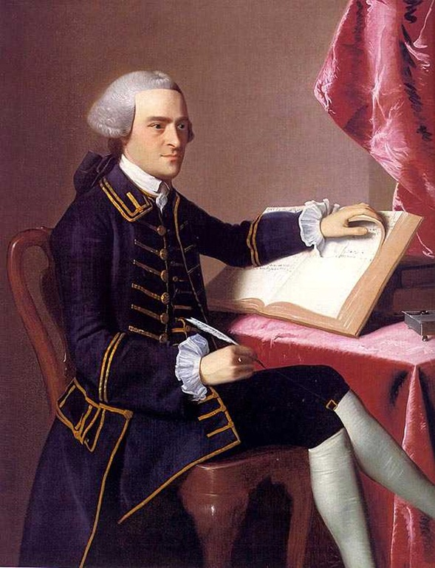
Second Continental Congress
The Second Continental Congress was a convention of delegates from the Thirteen Colonies that began meeting in the spring of 1775 in Philadelphia, Pennsylvania.
    The reason for these meetings was the British government continued to refuse reversal of their policies following the adjournment of the First Congenital Congress and declared these gatherings an act of treason

Slide 25
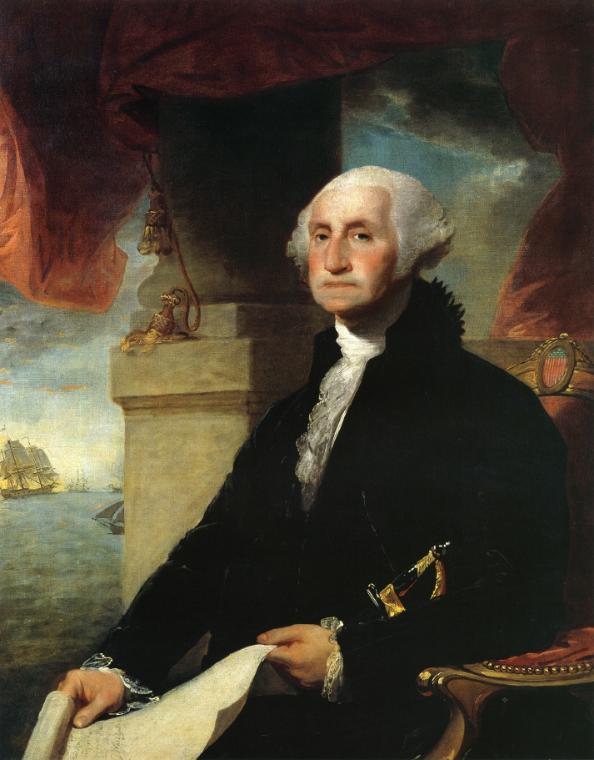
Second Continental Congress
The Second Congress managed the Colonial war effort and moved incrementally towards independence, adopting the United States Declaration of Independence on July 4, 1776.
  The Congress acted as the de facto national government of what became the United States by raising armies, directing strategy, appointing diplomats.
  John Hancock was elected President of the Congress and George Washington became the commander in chief

Slide 26
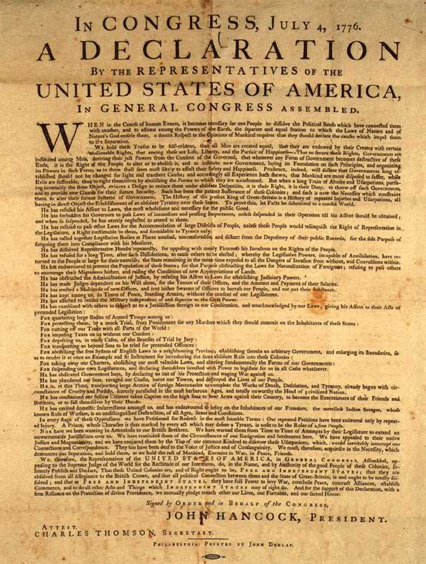
The Declaration of Independence
Ratified on July, 4th 1776
  Largely the work of Thomas Jefferson this document boldly announced the United States independence in the first paragraph
Two-thirds of the document spoke of repeated injuries the British put on the colonists which led to revolt
  Upon it’s ratification the thirteen colonies become fa collection of free and independent states

Slide 27
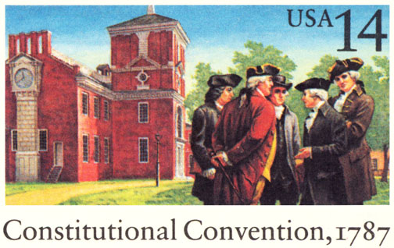
Chapter 2-Section 3
The Critical Period
Pg. 49-51

Slide 28
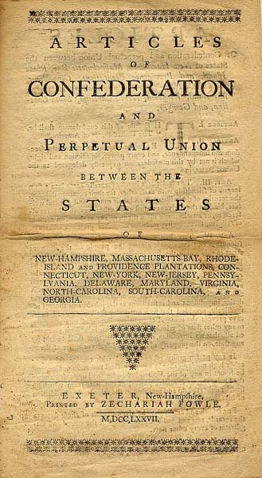
The Critical Period
The Articles of Confederation was the foundation document of the United States.
It established a “firm league of friendship” between the 13 states and was “ratified”: Formally approved in 1781.

Slide 29
Government Structure Under the Articles of Confederation
Congress: Was unicameral – its powers were very limited and each state had one vote (regardless of its population).
The States: Agreed to follow the acts of Congress, provide funds and troops requested by Congress, treat citizens of other state fairly and equally, and allow open travel and trade between states (among other things).

Slide 30
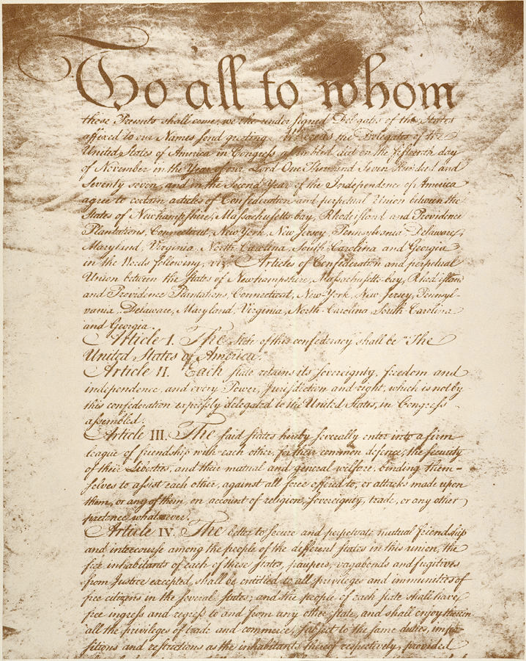
Weaknesses of the Articles of Confederation
Its Weaknesses: The powers of government were incredibly limited:
  The central government could not directly tax the population they could only borrow or request money from the states
  They could not regulate trade between the states
  They also could not make states obey the Articles of Confederation or the laws contained within it
  Congress could only assert their power with the consent of 9 out of thirteen states approving
  To amend the articles there had to be unanimous approval
    So all thirteen states had to agree

Slide 31
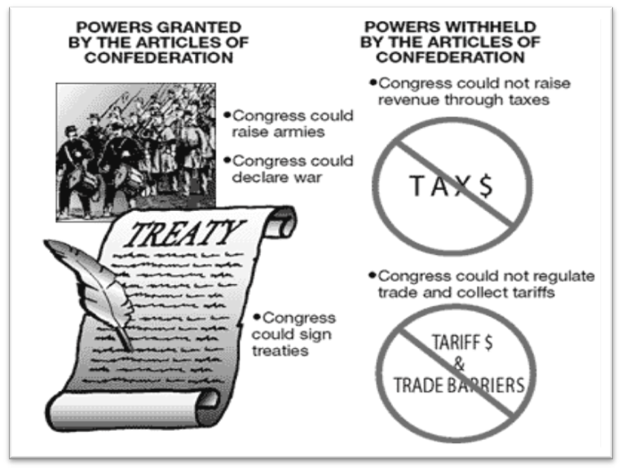

Slide 32
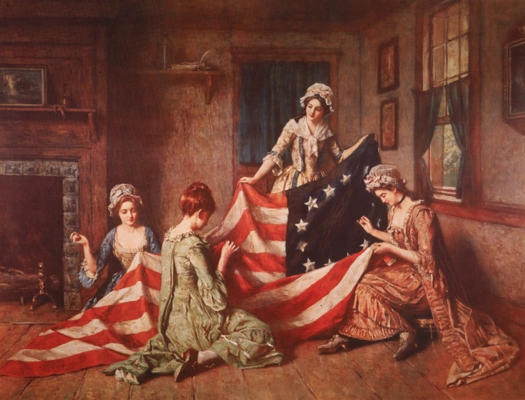
The Need for a Stronger Government
States instantly became jealous and suspicious of one another (Congress couldn’t act). States refused to follow Congressional decisions, taxed each other’s goods, banned trade, and organized their own militaries and currencies. Violence and economic chaos broke out.
Very quickly, leaders realized that a new foundation of government was needed. In 1787, state delegates met in Philadelphia in order to construct this new foundation. This meeting became known as the Constitutional Convention.

Slide 33
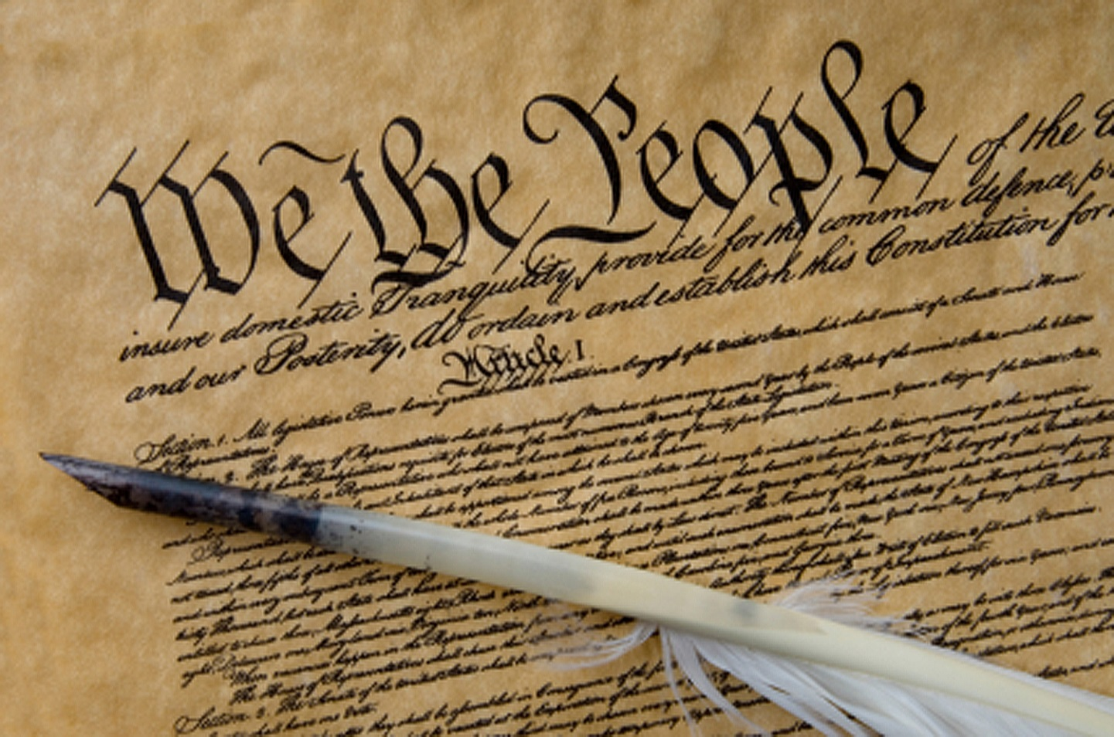
Chapter 2-Section 4-Creating the Constitution
Pg. 52 to 58

Slide 34
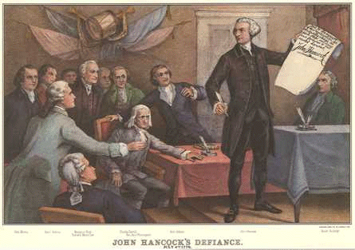
The Framers
Twelve of the Thirteen states (everyone except Rhode Island) sent a total of 55 delegates to Philadelphia in order to draft a new constitution.
These men became known as the “framers” of the constitution and included some of the most famous thinkers in American history.
  Washington, Madison, Hamilton, Franklin
Each state had one vote in each matter – sometimes disagreements occurred.
  They came up with two major plans the Virginia Plan and the New Jersey Plan

Slide 35
VIRGINIA PLAN
Drafted by James Madison
The Virginia Plan was intended to have a strong central government with three powerful branches
  Legislative Branch (Congress) designed to make the laws
  Executive Branch (President) designed to carry out the laws
  Judicial Branch (Supreme Court) designed to interpret the laws
It would also contain a Bicameral Legislature (Two Houses)
  The House of Representatives was elected by the people and the Senate was elected by the state legislatures. Both were represented proportionally.
Other Powers-The legislature could regulate interstate trade, strike down laws deemed unconstitutional and use armed forces to enforce laws.

Slide 36

THE NEW JERSEY PLAN
Like the Virginia Plan the New Jersey Plan would contain the same three legislative branches
It would contain a Unicameral Legislature (One House) where each state was represented equally in the house
  Other Powers-The national government could levy taxes and import duties, regulate trade, and state laws would be subordinate to laws passed by the national legislature

Slide 37

CONNECTICUT PLAN
The Great Compromise also known as the Connecticut Plan found the middle ground between the two plans.
  It succeeded b/c it satisfied the larger states
  It adopted the idea of a bicameral legislature
Upper House’s (Senate) number of delegates would be based on equal representation
Lower House’s (House of Representatives) number of delegates based on proportional representation

Slide 38
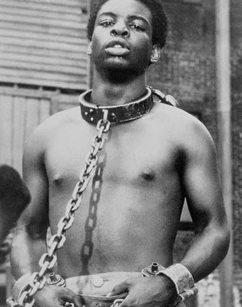
Three-Fifths Compromise
Under the Three-Fifths Compromise the number of representatives in the House would be based on population
  So it was determined that all “free persons” would be fully counted for tax purposes and representation but slaves would be counted as “three-fifths a free person”

Slide 39
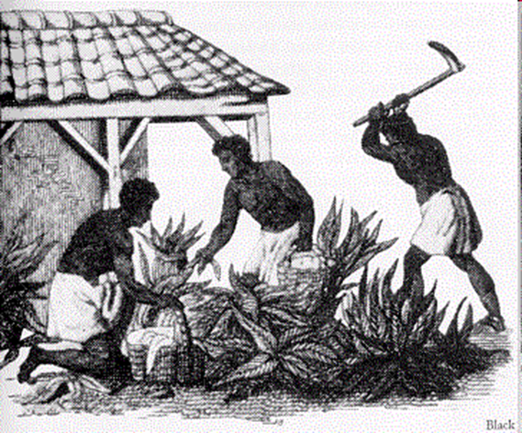
A Bundle of Compromises:
The U.S. Constitution became known as a “bundle of compromises”.
  While details were often argued, the major principles were unanimous–limited government and popular sovereignty.

Slide 40
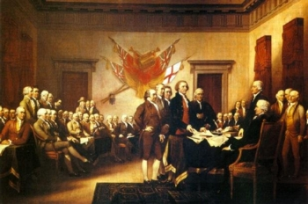
Chapter 2-Section 5
Ratifying the Constitution
Pg. 59 to 62

Slide 41
The Fight for Ratification
Many people opposed the new constitution there were two opposing sides quickly emerged:
“Federalists”: Favored a new constitution they believed the Articles of Confederation were too weak and that a new government was necessary.
“Anti-Federalists”: Opposed the new constitution believed the new government had too much power and that there should be a bill of rights that guaranteed individual freedoms.

Slide 42
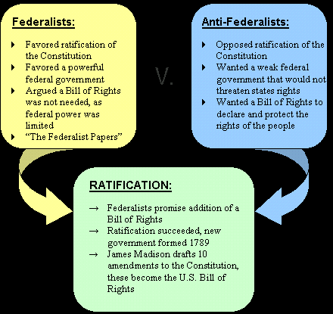

Slide 43
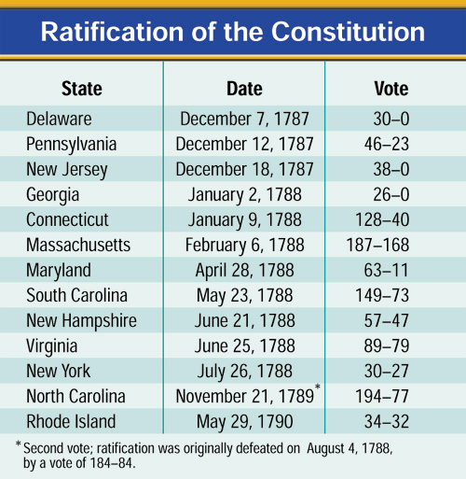
The Constitution is Ratified
Nine States ratified the Constitution by June 21, 1788, but the new government needed the ratification of the large States of New York and Virginia.
  Without these two states, the biggest of the 13, government had no hope to succeed and needed their support
Great debates were held in both States, with Virginia ratifying the Constitution June 25, 1788.
New York’s ratification was hard fought. Supporters of the Constitution published a series of essays known as The Federalist Papers.
New York was chosen as the nation’s temporary capital and George Washington was elected president by unanimous vote.

