Slide 1
Chapter 16-World War Looms
Test Materials

Slide 2
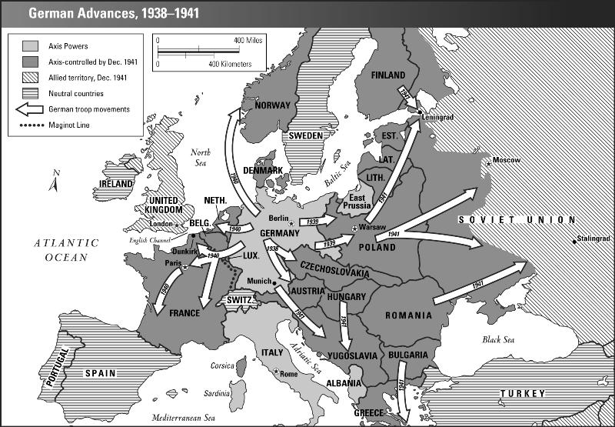
Learning Target #3

Slide 3
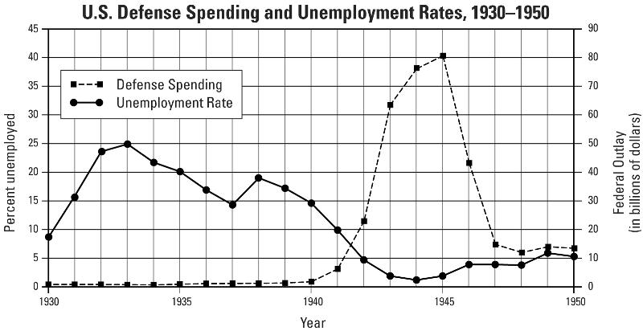
Learning Target #3

Slide 4
Learning Target #4

Slide 5
Learning Target #4

