Slide 1
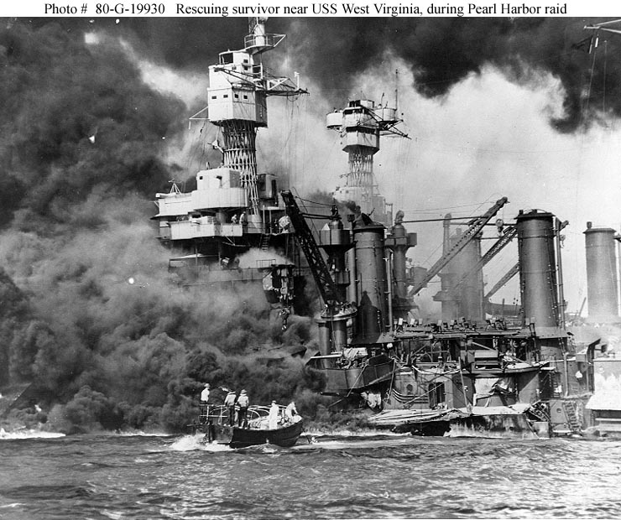
Section 4-America Moves
Towards War

Slide 2
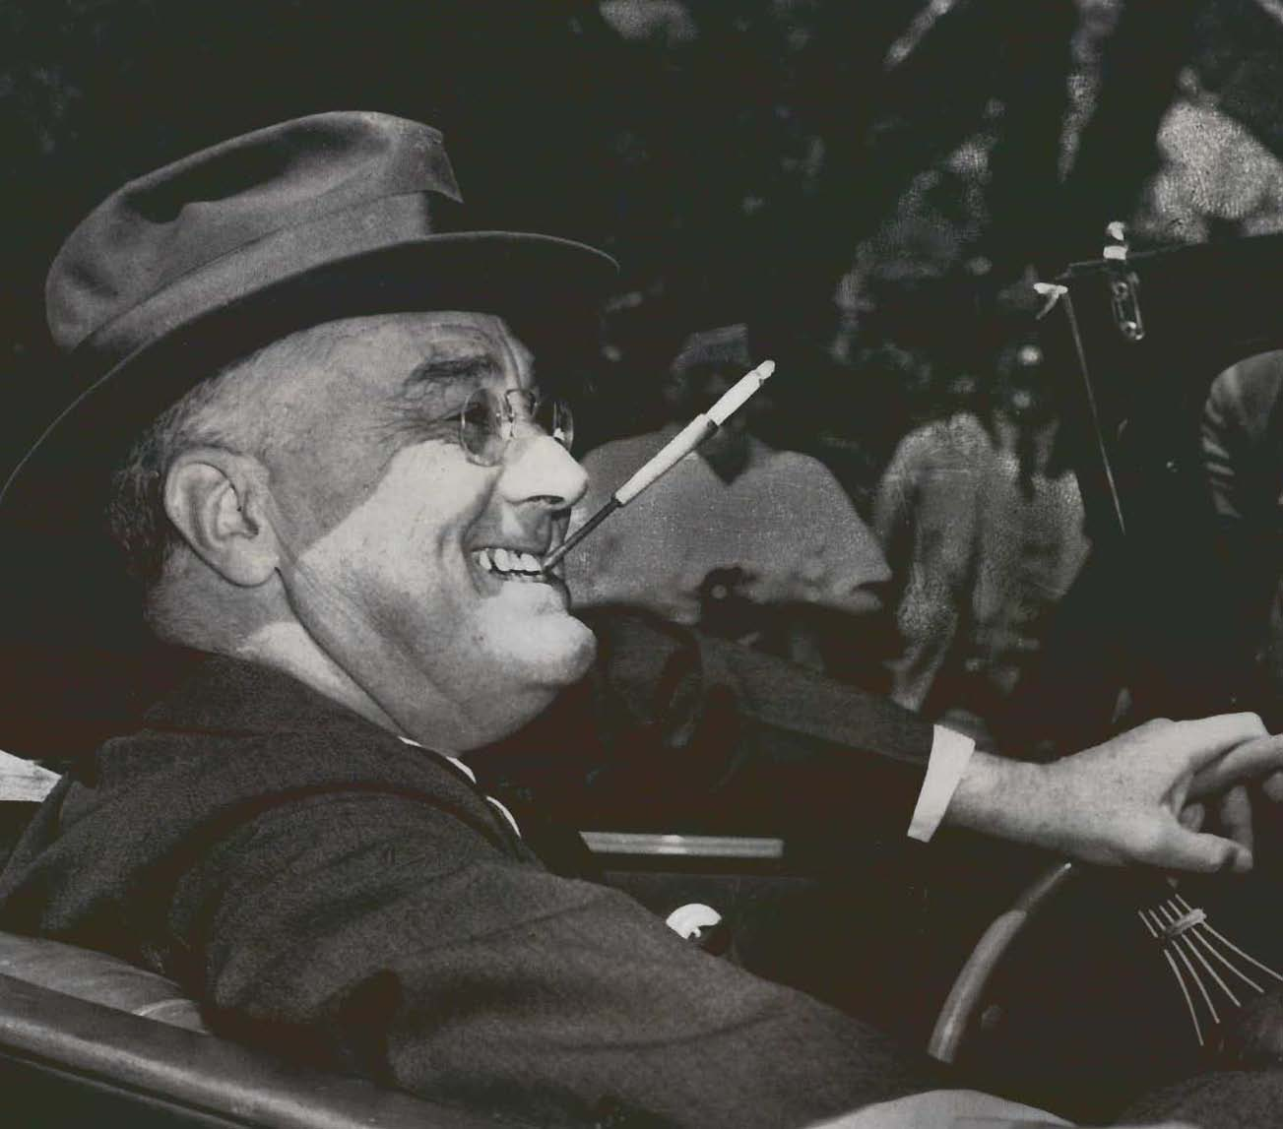
The United States Musters Its Forces
President Roosevelt thought that the United States would eventually be involved in World War II, and so he took measures to prepare the United States
His decisions were controversial, but they did prepare the U.S. for what was to come

Slide 3
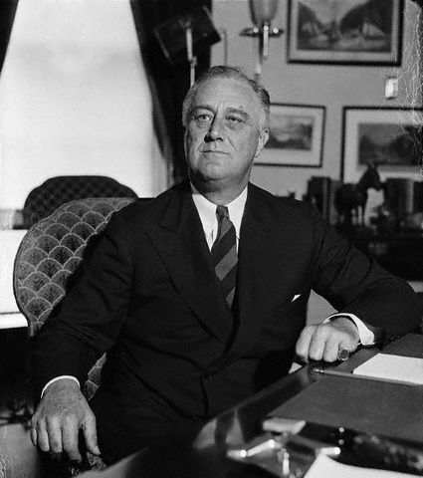
Early Steps
Cash-and-Carry-The U.S. would sell weapons to England and France, as long as they paid for them up front and transported them in their own ships
Peacetime Draft-Draft was used to enlarge the army, but these men could only serve in the western hemisphere
Third Term-Roosevelt was elected President for a third straight term in 1940
  The idea was to keep the same President through the crisis to stay consistent

Slide 4
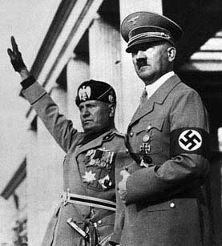
The Axis Powers
Hitler, Mussolini, and Hideki Tojo formed a defensive alliance with each other
This alliance would be known as the Axis Powers
This alliance was formed to discourage the United States from entering the war; if U.S. attacked any of them, the rest would come to help

Slide 5
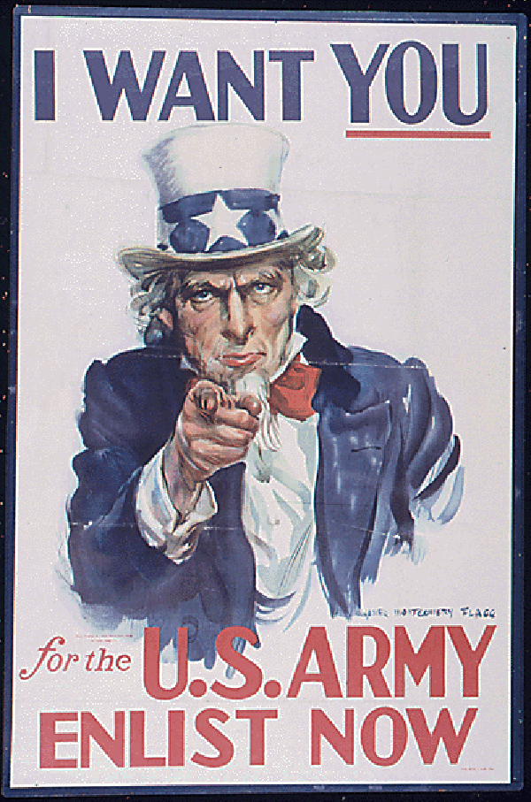
Building U.S. Defenses
1940-Congress passes first peacetime military draft
Selective Training and Service Act-
  Sixteen million U.S. men registered for the draft
  Over one million Americans were drafted within the first year

Slide 6
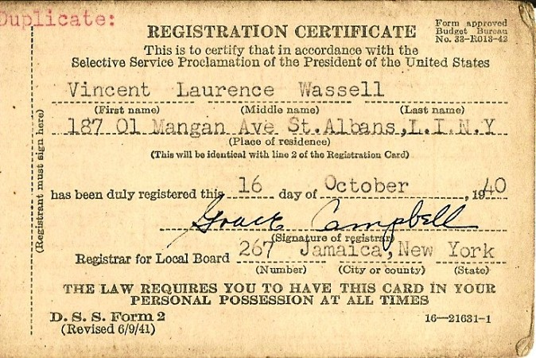

Slide 7
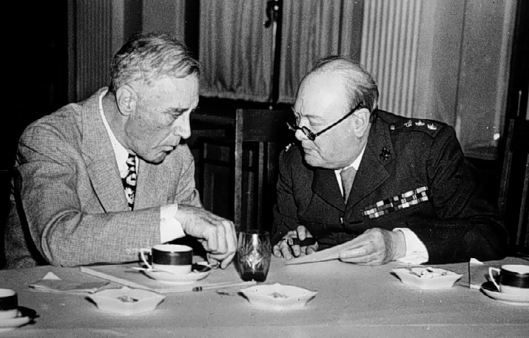
The Great Arsenal of Democracy
President Roosevelt thought that if the Great Britain fell to the Axis, the United States would not be safe
Decided to help Britain by becoming the “Great arsenal of democracy”
By 1940 Great Britain had ran out of cash so in March of 1941, Congress passed the Lend-Lease Act
Lend-lease Agreement-The U.S. would lend war materiel to any country whose defense was important to protecting the U.S., Great Britain, Soviet Union and eventually China

Slide 8
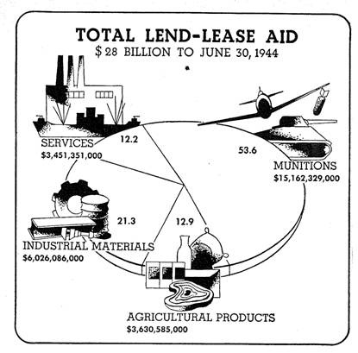

Slide 9
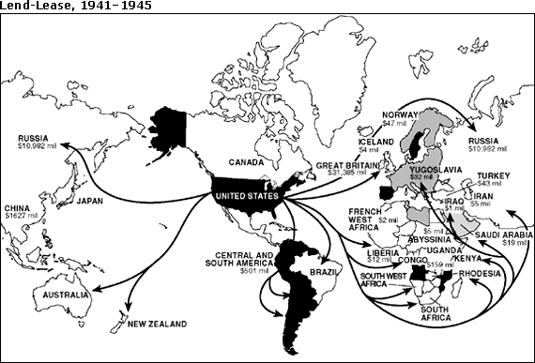

Slide 10
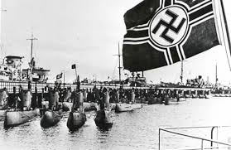
German Wolf Packs
Similar to WWI, Hitler uses German U-boats to attack cargo ships
U-boats sank up to 350,000 tons of shipments a month
September 1941, Roosevelt orders all U.S. ships to attack U-boats, only in self-defense

Slide 11
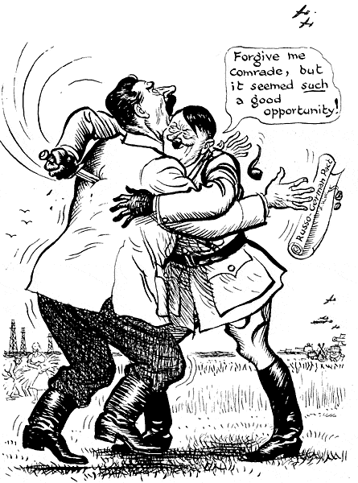
Supporting Stalin
June 1941-Hitler breaks his Non-Aggression Pact with Soviet Union and invades Poland
The Allied Powers were comprised of the United States, Great Britain and the Soviet Union
  Even though we had philosophical differences with the U.S.S.R our mutual hatred for Germany supported the notion of “The enemy of my enemy is my friend”
  After this the U.S. begins to lend/lease weapons to Soviet Union

Slide 12
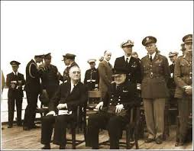
The Atlantic Charter
Roosevelt (U.S.) and Churchill (Britain) meet secretly for a joint declaration of war aims, known as Atlantic Charter
Both countries pledged; collective security, disarmament, self-determination, economic cooperation and freedom of the seas
Roosevelt tells Churchill that he cannot declare war on Germany (Congress wouldn’t approve) but he would “wage war” and do “everything to force and incident”

Slide 13
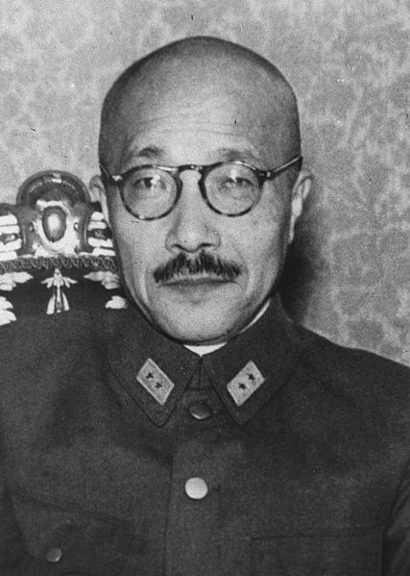
Japanese Ambitions in the Pacific Ocean
Japanese started by invading China (Manchuria) and then started going after European colonies in Asia
  Europeans were busy fighting Hitler
Only United States lay in the way of Japan’s ambitions
The U.S. protested Japanese invasions
  The U.S. cut off trade with Japan, including oil
If Japan couldn’t re-establish the flow of oil to its country, then they would lose the war without ever being defeated in battle

Slide 14
Japan Attacks the United States
Hideki Tojo promised the Japanese emperor that Japan would avoid war with United States if possible
However, on November 5, 1941 Tojo orders Japanese navy to prepare for an attack on the United States
The U.S. broke Japanese codes and began reading their messages
On December 6, 1941 the U.S. intercepts a message that reads Japanese peace envoy to reject all American peace proposals
  FDR comments that “This means war.”

Slide 15
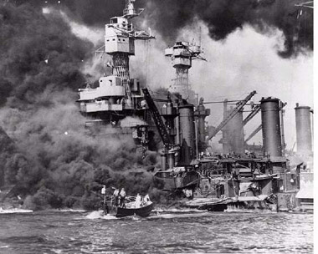
Japanese Attack Pearl Harbor
Pearl Harbor was the largest U.S. naval base in the Pacific Ocean
Early on December 7th, 1941, over 180 Japanese planes attacked Pearl Harbor
Pearl Harbor caught completely by surprise; not ready for the attack

Slide 16
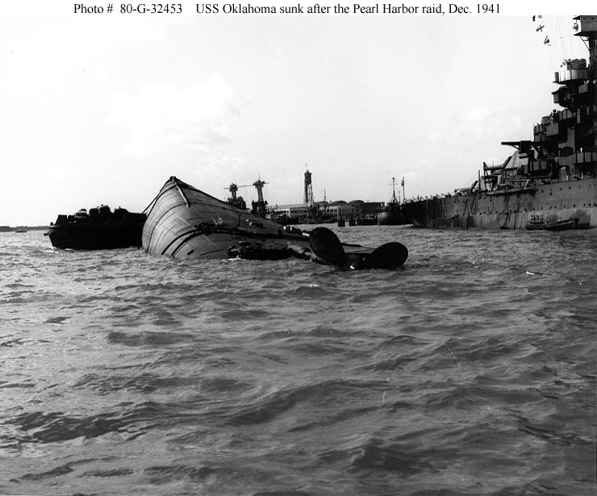
The Damage at Pearl Harbor
In less than two hours Japanese Kamikaze Pilots had killed 2,403 Americans and wounded 1,178 more
21 ships had been sunk or damaged including 8 battleships
  These were considered the most important ships in the fleet
300 aircraft severely damaged or destroyed
Luckily, at the time of the attack, three aircraft carriers were not in Pearl Harbor; these would be important as the war with the Japanese went on

Slide 18
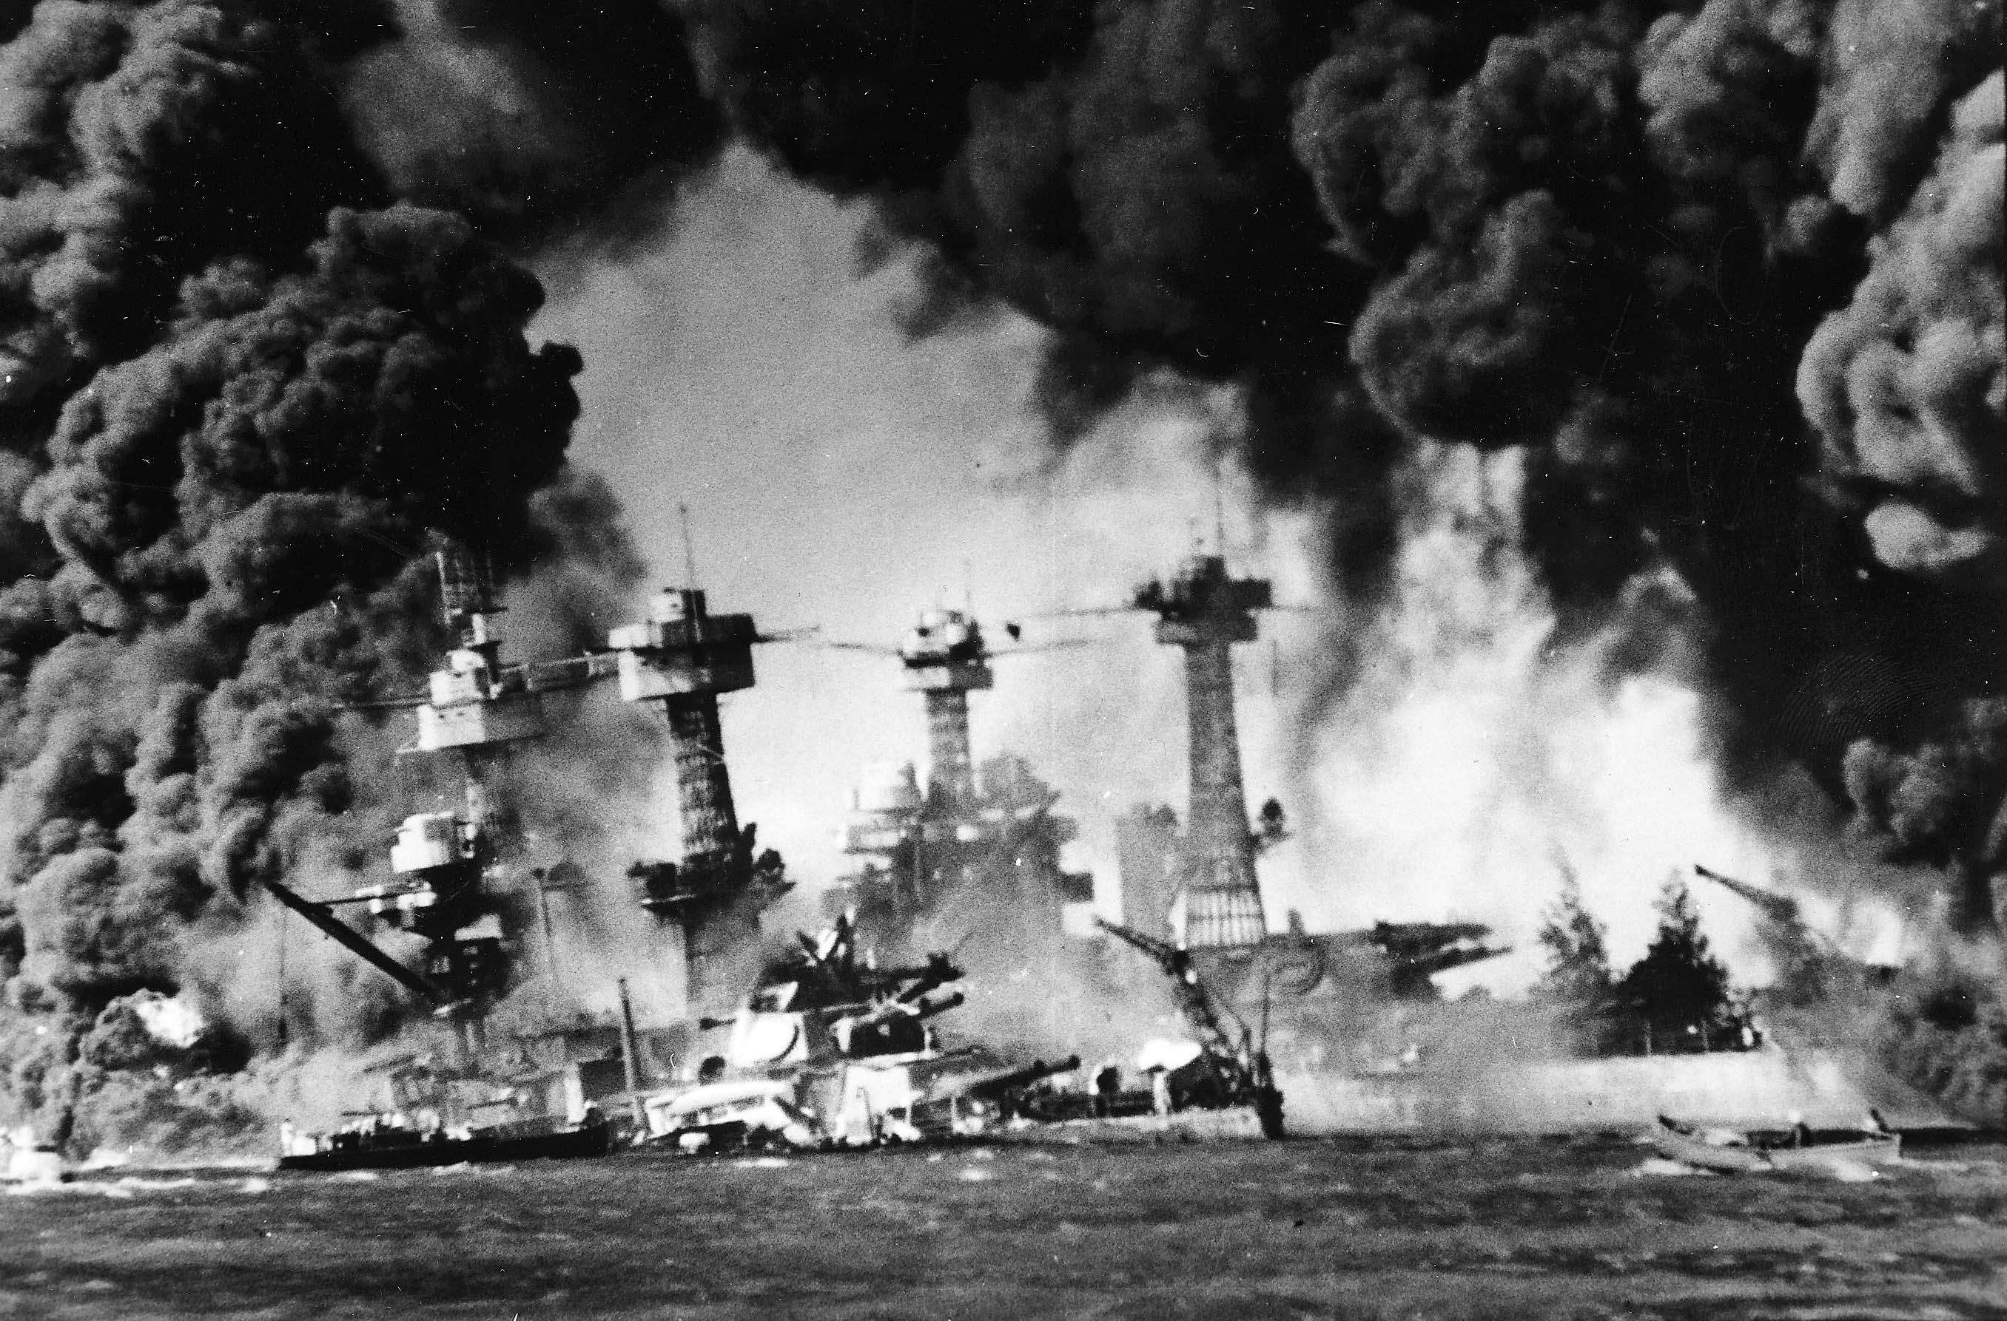

Slide 19
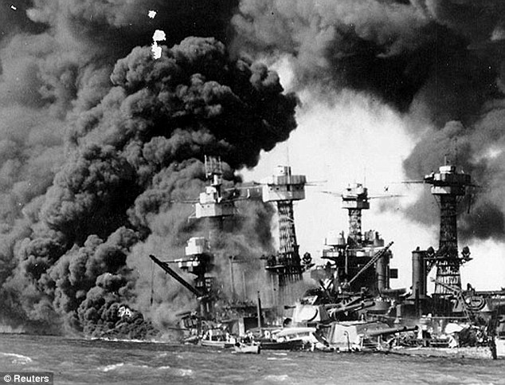

Slide 20
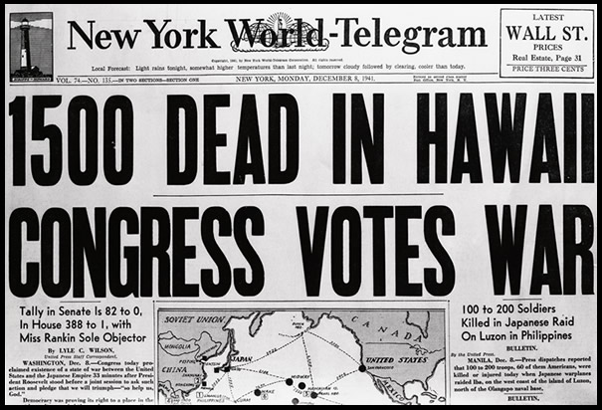

Slide 21
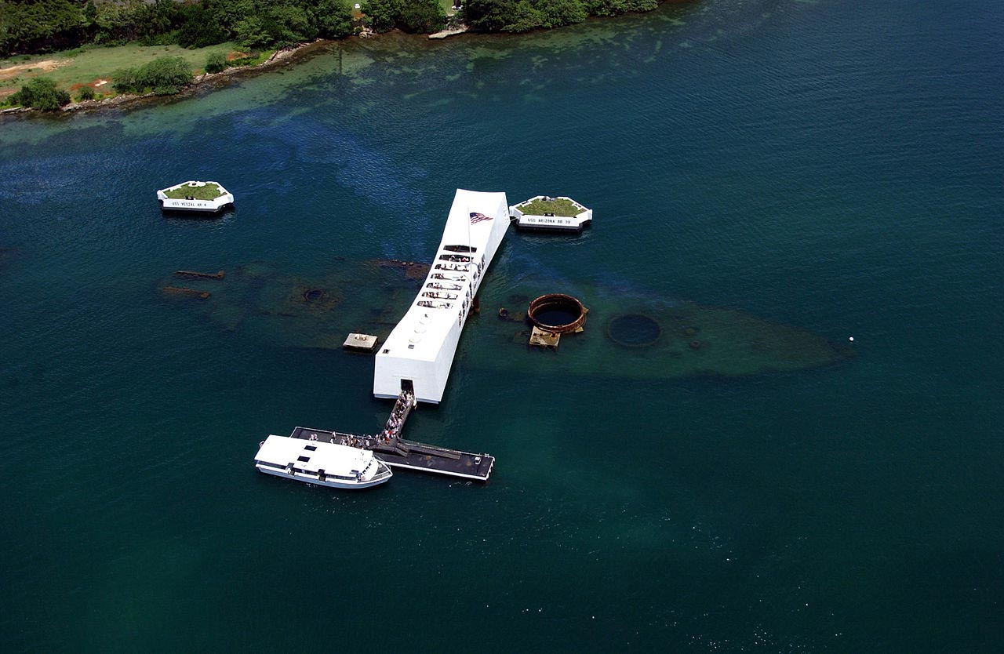

Slide 22
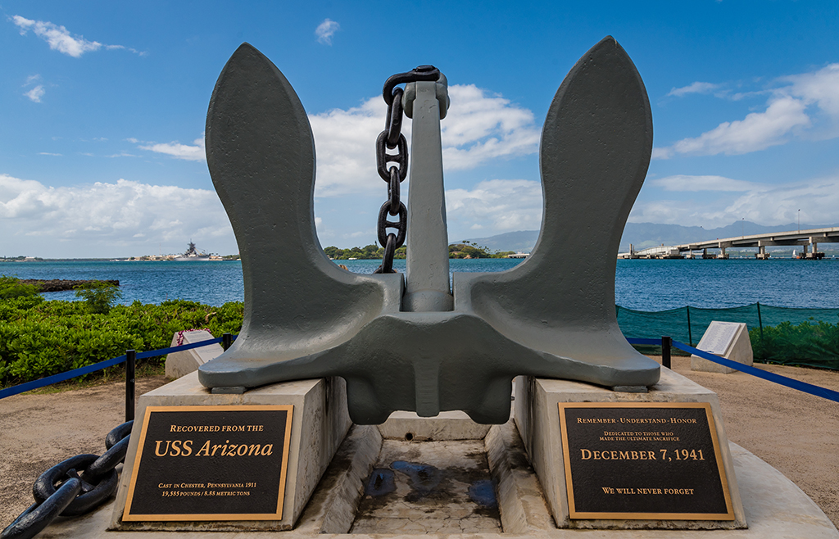

Slide 23
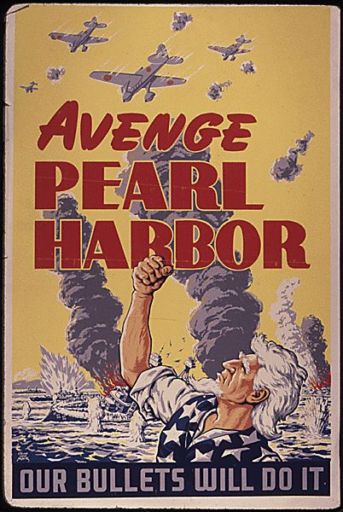
Reaction to Pearl Harbor
President Roosevelt wanted to avoid fighting this war on two fronts he saw Germany as the greater threat, but they had to shift their immediate attention to Japan following the attacks on Pearl Harbor
Roosevelt, in his speech to Congress, asked them to grant a Declaration of War against Japan
  Congress quickly did so
Three days later, Germany and Italy declared war against the United States
Very few people now saw isolationism as the answer; felt that the United States needed to go all-out to defeat the Japanese

