Slide 1
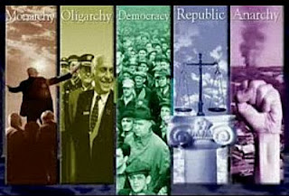
Section 2-Forms Government

Slide 2
Forms of Government
Governments can be classified by three different standards:
Who can participate in the governing process.
The geographic distribution of the governmental power within the state.
The relationship between the legislative (lawmaking) and the executive (law-executing) branches of government.

Slide 3
Forms of Government
Democracy
In a democracy, supreme political authority rests with the people.
A direct democracy exists where the will of the people is translated into law directly by the people themselves.
In an indirect democracy, a small group of persons, chosen by the people to act as their representatives, expresses the popular will.
Dictatorship
A dictatorship exists where those who rule cannot be held responsible to the will of the people.
An autocracy is a government in which a single person holds unlimited political power.
An oligarchy is a government in which the power to rule is held by a small, usually self-appointed elite.

Slide 4
Forms of Government
Unitary Government
A unitary government has all powers held by a single, central agency.
Confederate Government
A confederation is an alliance of independent states.
Federal Government
A federal government is one in which the powers of government are divided between a central government and several local governments.
An authority superior to both the central and local governments makes this division of power on a geographic basis.

Slide 5
Forms of Government
Presidential Government- Features an elected president who serves as the head of state (the ceremonial “face” a state presents to the world )as well as its Chief Executive (head of the executive branch of government), with a separate and co-equal elected legislature (which actually makes the laws).
In Parliamentary Government, the head of state is a king or queen, or someone called a president (but nothing like our kind). They are ceremonial or “figurehead” leaders.
The head of government is the prime minister (sometimes called a premier).
The prime minister and his/her cabinet is the executive branch, and these executives also serve as members of parliament, which is the legislative branch.

Slide 6
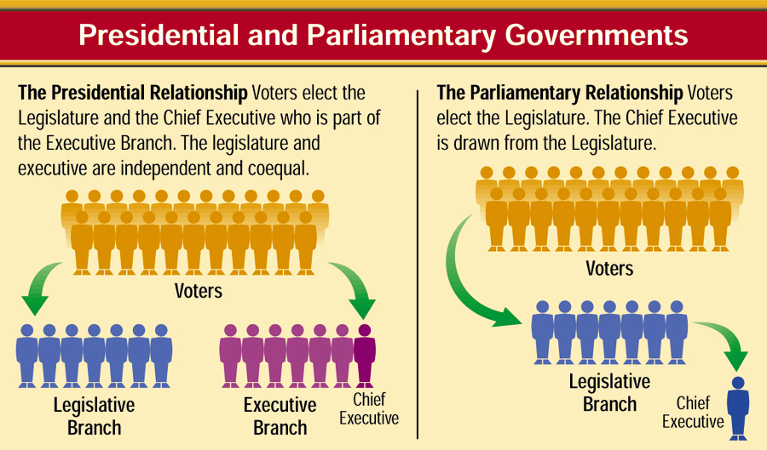
Classification by the RELATIONSHIP BETWEEN THE LEGISLATIVE AND EXECUTIVE BRANCHES

Slide 7
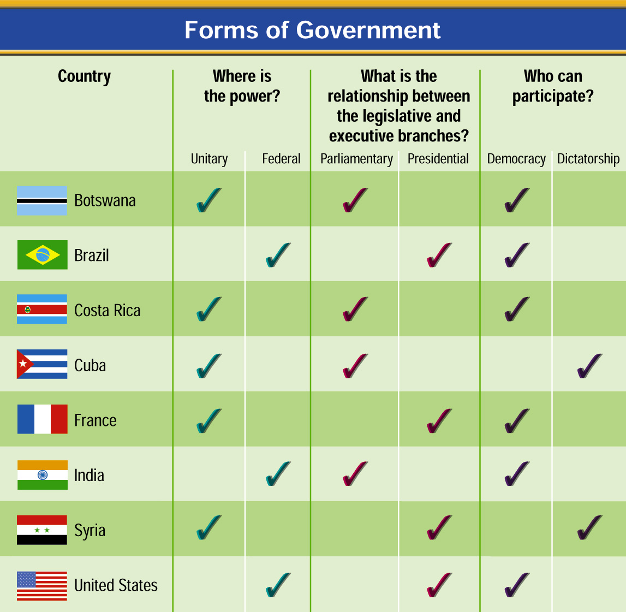
Forms of Government

