Slide 1
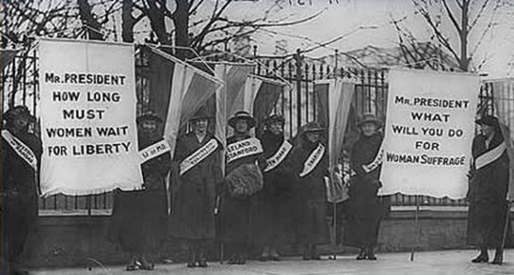
Chapter 9: The Progressive Era

Slide 2
Section 1: The Origins of Progressivism

Slide 3
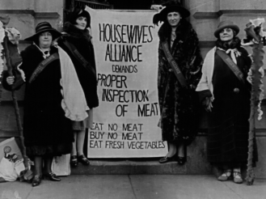
The Progressive Movement
In the late 1800’s many Americans began calling for sweeping changes across the nation
This voice mainly came from the rapidly growing middle class
Shared a belief that industrialization and urbanization had created troubling social and political problems
Wanted to bring about reforms that would correct these problems and injustices through logic and reason
Chapter 9 Section 1

Slide 4
Progressives Target a Variety of Other Problems
Political Reform-
The vote was the primary goal of many woman
Honest Government-
Targeted political officials who build corrupt organizations, called political machines
Wretched living conditions caused by inadequate services
Big Business-
Wanted greater economic opportunities for smaller businesses
Class System-
Wanted to reduce growing gap between rich and poor
Attacked harsh working and living conditions
Wanted social welfare laws for children
Wanted government regulations to aid workers and consumers

Slide 5
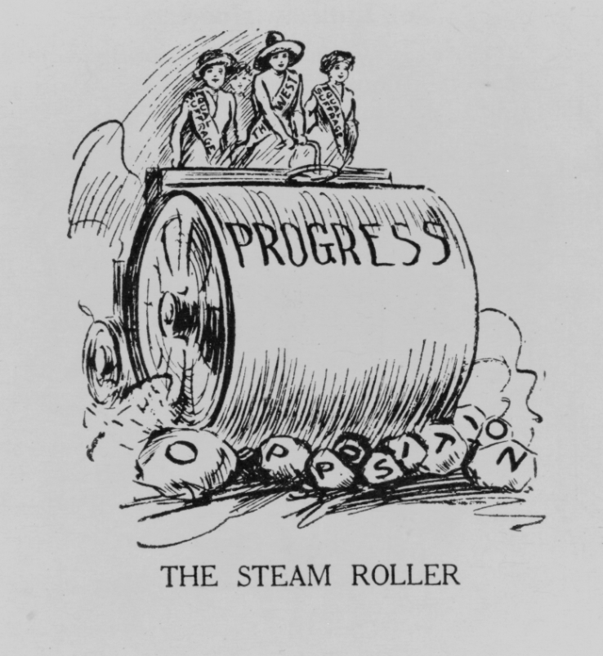
The Progressive Movement
The Progressive Movement-A movement to restore economic opportunities and correct injustices in American life
The Progressive Movement had four main goals:
Protecting Social Welfare
Promoting Moral Improvement
Creating Economic Reform
Fostering Efficiency

Slide 6
The Four Goals of the Progressive Movement
Four Goals:
Protecting Social Welfare-Help and services for poor. YMCA activities, education, community centers, social services.
Promoting Moral Improvement-Improvement in personal behavior and morals.
Prohibition (ban of alcohol) and the Woman’s Christian Temperance Union (WCTU).
Sponsor schools, visit inmates, work for suffrage.
Creating Economic Reform- Muckrakers expose corruption in business and public life
Fostering Efficiency-Performing in the best possible manner with the least waste of time and effort.
Shorter work hours, higher pay, assembly lines.

Slide 7
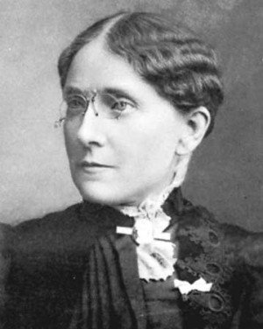
Protecting Social Welfare
During the late 1800’s social welfare reformers worked to soften the harsh conditions resulting from rapid industrialization
Social Gospel and settlement house movements worked with community centers and local churches to help the poor through social service programs
The Young Men’s Christian Association (YMCA) opened libraries, sponsored classes, built along with organizing activities like handball and building swimming pools
Florence Kelly was influential in helping pass the Illinois Factory Act of 1893.
This act prohibited child labor and limited the hours a woman would be forced to work

Slide 8
Promoting Moral Improvement
While protecting social welfare was important many felt that the key to reform was an improved sense of morality.
These reformers wanted immigrants and poor city dwellers to help themselves by improving their personal behavior
One solution was adopting prohibition
Prohibition-The movement to ban alcoholic beverages for the preservation of American morals and values

Slide 9
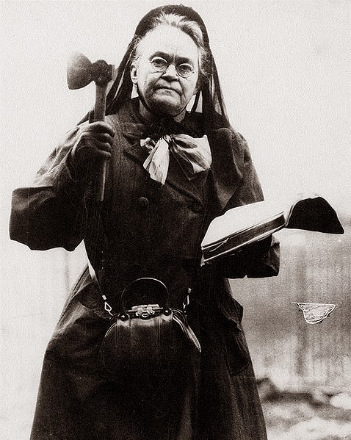
Promoting Moral Improvement
Crusade against alcohol led by Women’s Christian Temperance Union (WCTU) and the Anti- Saloon League
Supported prohibition
Laws that would ban making or selling of alcohol
Opposed alcohol for moral and social reasons
18th Amendment: The Prohibition Law: Ratified in 1919

