Slide 1
Chapter 9-Test Materials
The Progressive Era

Slide 2
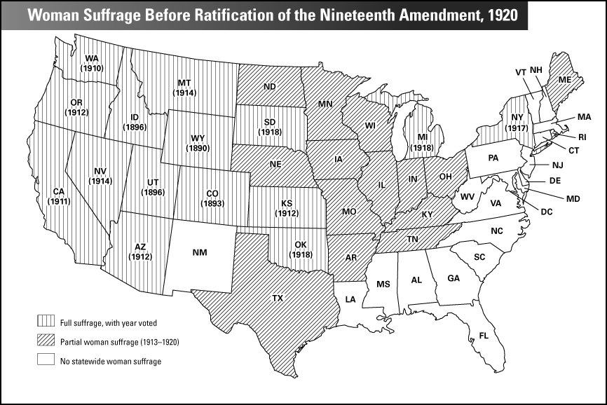
Women Suffrage Before Ratification of the 19th Amendment

Slide 3
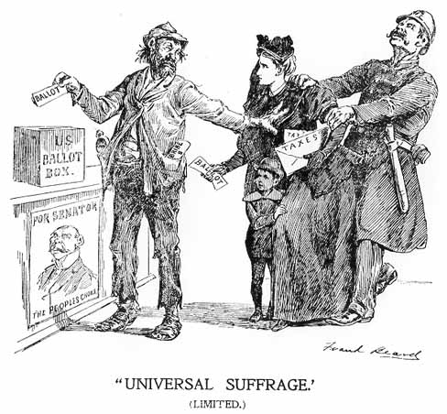
Universal Suffrage-Political Cartoon

Slide 4
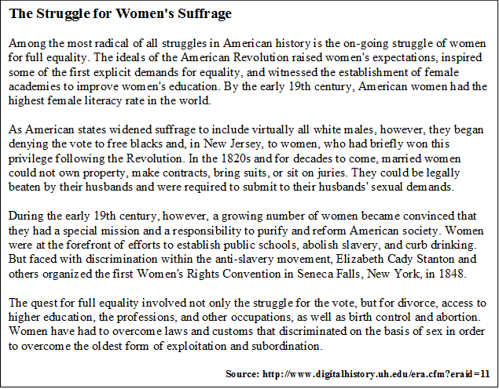
The Struggles for Women’s Suffrage

