Slide 1
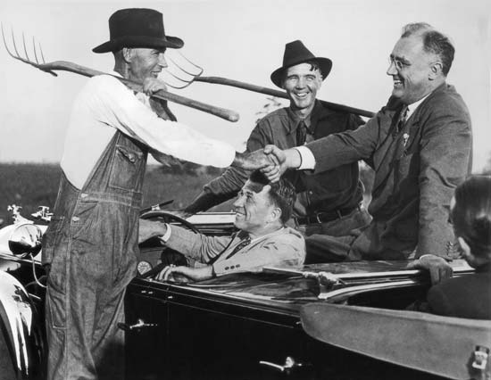
Chapter 15- The New Deal

Slide 2
A New Deal Fights the Depression
Chapter 15-Section 1

Slide 3
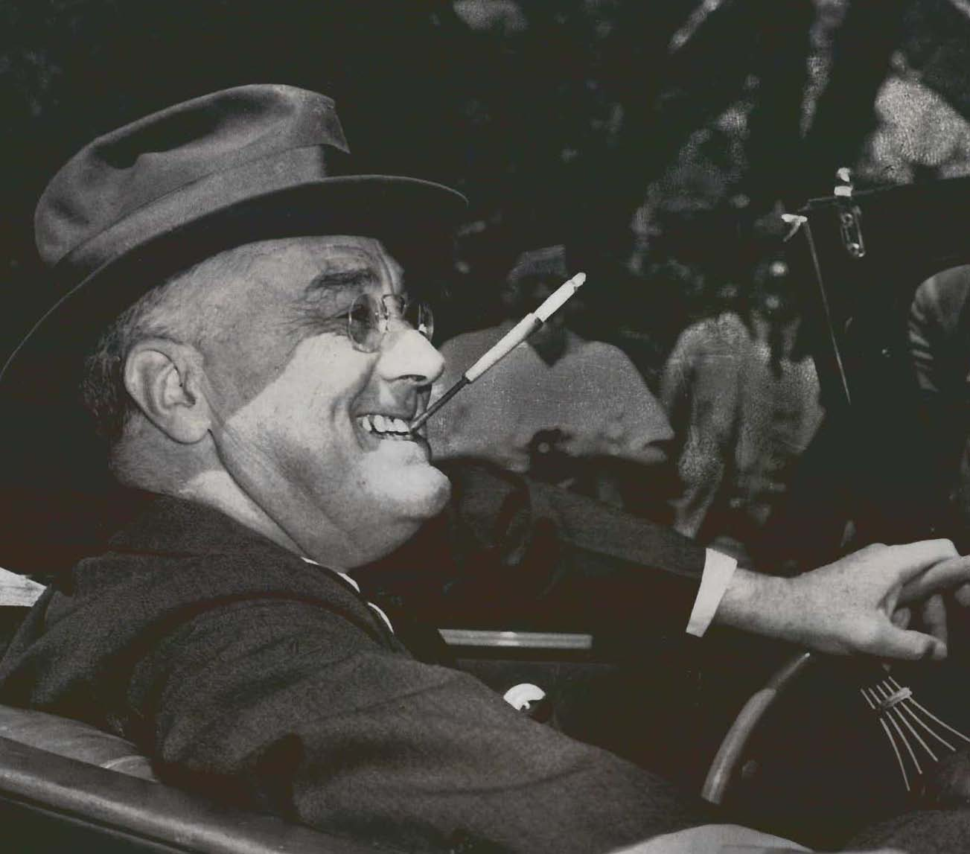
Franklin Delano Roosevelt (1882-1945)
Elected president in 1932
  32nd President of the United States
Served longest term of all the presidents (12 years)
5th Cousin of Teddy Roosevelt

Slide 4
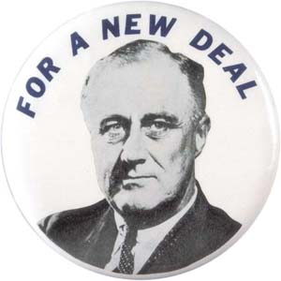
Roosevelt’s New Deal
New Deal policies focused on three general goals:
  Relief (for the needy)-The immediate effort to help the one-third of the population that was hardest hit by the depression
  Economic Recovery-The effort in numerous programs to restore the economy to normal health
  Financial Reform-Government intervention to stabilize the economy, and to balance the interests of farmers, business and labor

Slide 5
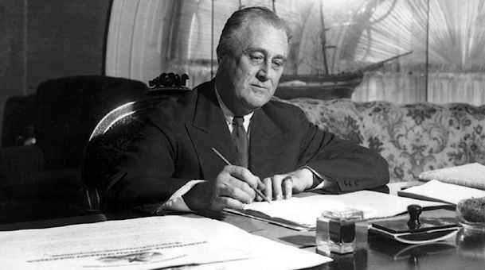
The First 100 Days
March 4th–June 16th
Roosevelt and Congress passed more than 15 major pieces of New Deal legislation

Slide 6
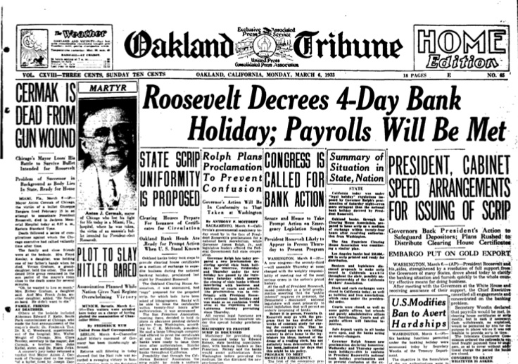
The “Bank Holiday”
Roosevelt closed all the banks on March 5th, 1933
Passed the Emergency Banking Act
  Banks could only be re-opened under the Treasury Departments supervision
  Federal loans were handed out as needed
Helped restore the publics confidence in the nation’s banking system

Slide 7

Regulating Banking and Finance
Glass-Steagall Act (1933)
  Established the Federal Deposit Insurance Corporation (FDIC)
  Provided federal insurance on each bank account
  Restored confidence to the customers with the banks

Slide 8
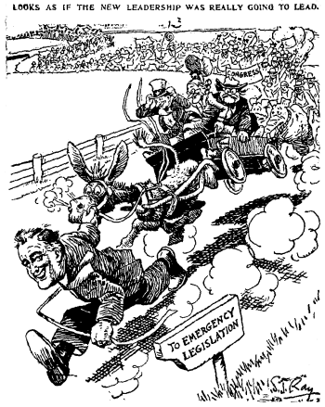
Federal Securities Act (1933)
Required corporations to provide complete information on all stock offerings
Created the Securities and Exchange Commission to regulate stock market

Slide 9
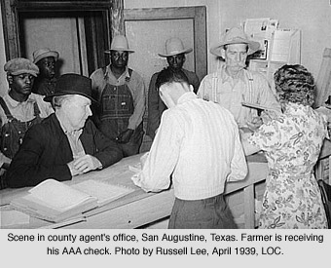
Help for the Farmers
Agricultural Adjustment Act (AAA)
  Sought to raise crop prices by lowering production
  The government paid farmers to leave some of their land fallow (unseeded)
  This lowered production which in turn raised crop prices

Slide 10
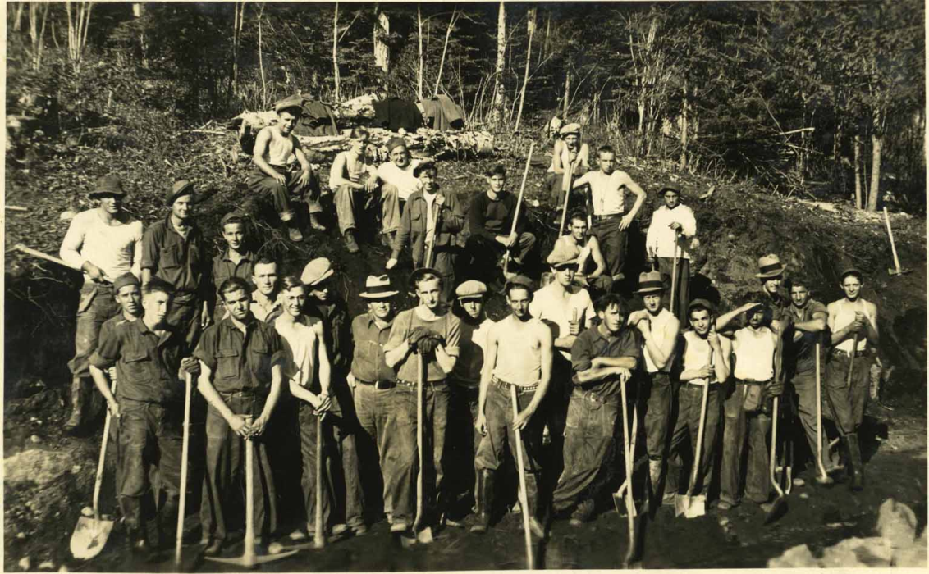
New Deal Projects
Civilian Conservation Corps (CCC)
  Put young unemployed men to work building roads, developing parks, planting trees, and helping in soil-erosion and flood-control projects

Slide 11
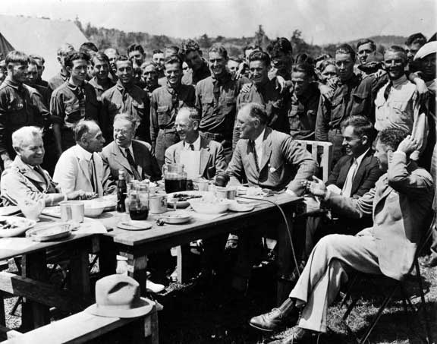
National Industrial Recovery Act (NIRA)
Established codes of fair practice for Industries and to promote industrial growth
Example:
  Public Works Administration (PWA) - Provided money to states to create jobs chiefly in the construction of schools and other community buildings

Slide 12
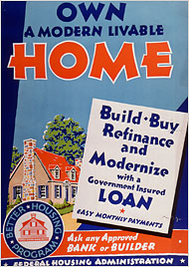
Food Clothing and Shelter
Home Owners Loan Corporation (HOLC)
  Provided government loans to homeowners who faced foreclosures
Federal Housing Administration (FHA)
  Furnishes loans for home mortgages and repairs
Federal Emergency Relief Administration (FERA)
  Provided direct relief for the needy

Slide 13
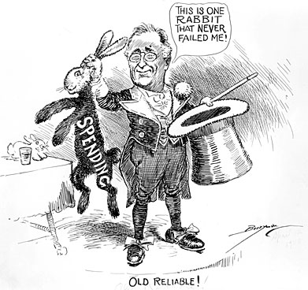
Deficit Spending
Spending more money than the government receives in revenue
FDR regarded deficit spending as a “necessary evil” to bring the United States out of the depression

Slide 14
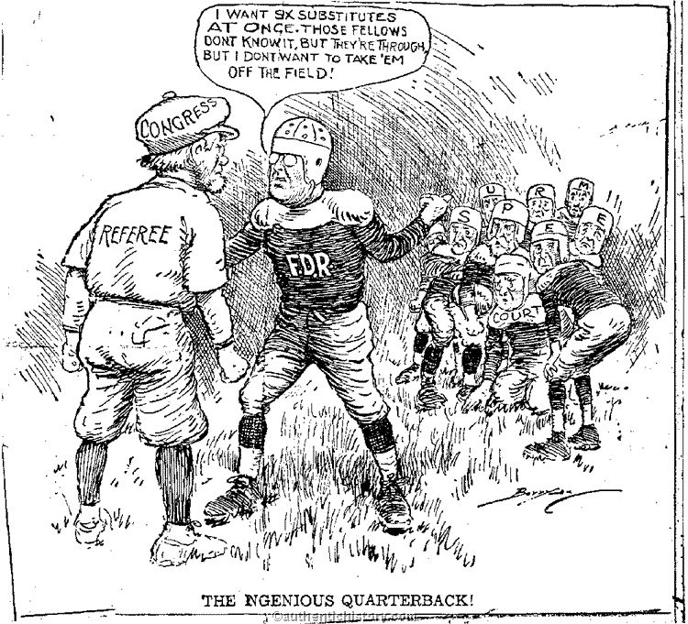
FDR vs. Supreme Court
Supreme Court in the early 1930’s was more conservative (did not favor New Deal) & declared many programs unconstitutional
  1935 found the NIRA to be unconstitutional
  1936 found the AAA to be unconstitutional and struck it down
In 1937 FDR proposed a Congressional bill to reorganize the Supreme Court calling for six new justices (And by law, he gets to appoint those justices!!!)
Congress and press were outraged at his “Court-Packing” Bill
Eventually he gets his way as several justices over the next four years retire

Slide 15
The Second New Deal Takes Hold
Chapter 15-Section 2

Slide 16
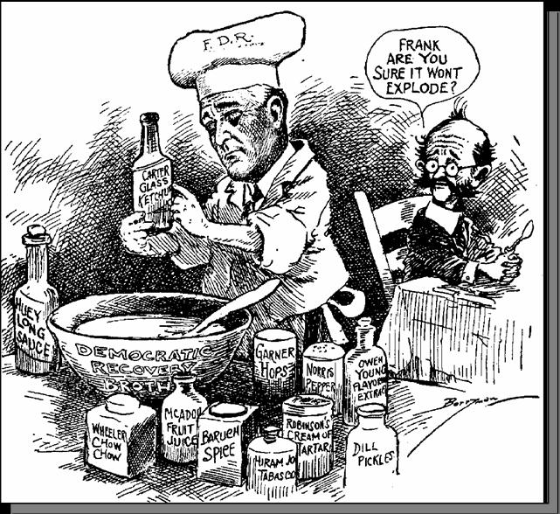
The Second Hundred Days
Economy had improved during FDR’s first two years as president
He still wanted more improvement
  Unemployment rates remained high
  Production still lagged behind 1920’s levels
Roosevelt decided to launch a Second New Deal-Another burst of activity aimed at providing more help for farmers and workers

Slide 17
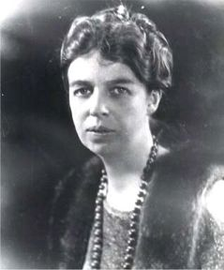
Eleanor Roosevelt
The First Lady (FDR’s wife)
Helped her husband out every chance she got
  Her contributions in the areas of civil rights, the welfare of young Americans and her political presence was a very important part of the second new deal

Slide 18
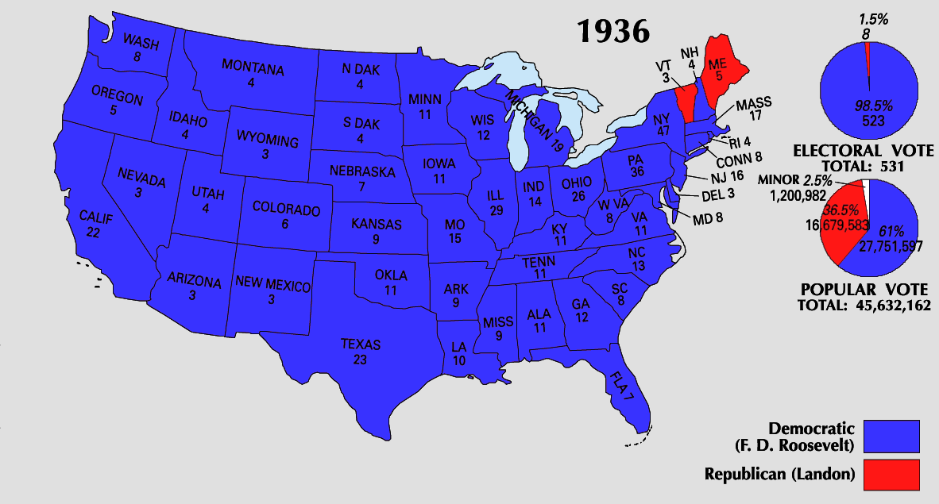
Re-electing FDR
1936 presidential election
  FDR (democrat) vs. Alfred Landon (republican)
Overwhelming victory by FDR
  FDR won 523 out of 531 Electoral College votes
  Landon only won 8

Slide 19
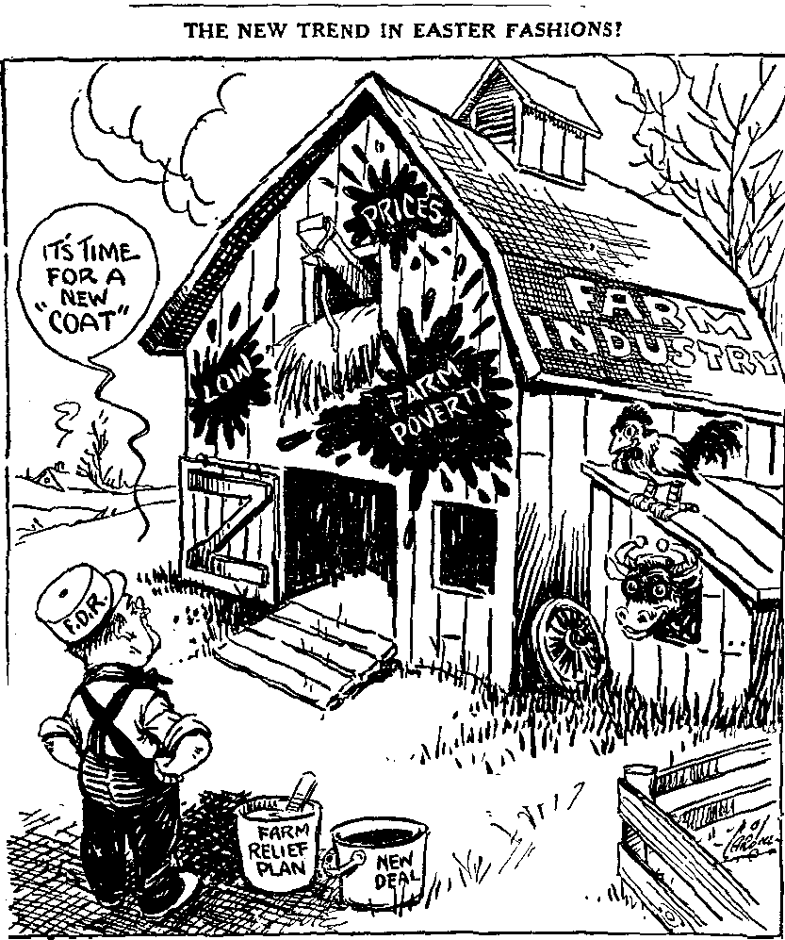
Helping Farmers
Soil Conservation and Domestic Allotment Act
  Paid farmers for cutting production
1938-Second Agricultural Adjustment Act
  Did not include a previous processing tax to pay for farm subsidies

Slide 20
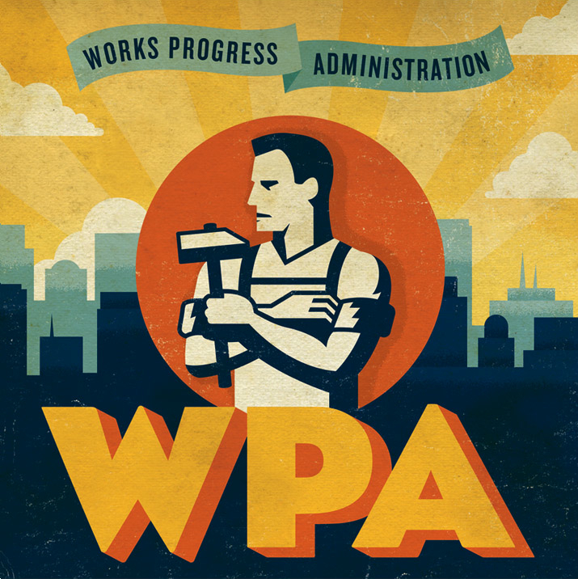
Works Progress Administration (WPA)
Designed to help the nation’s youth, professionals, and other workers
  Headed by Harry Hopkins
Provided the unemployed with jobs in construction, garment making, teaching, arts, and other fields

Slide 21
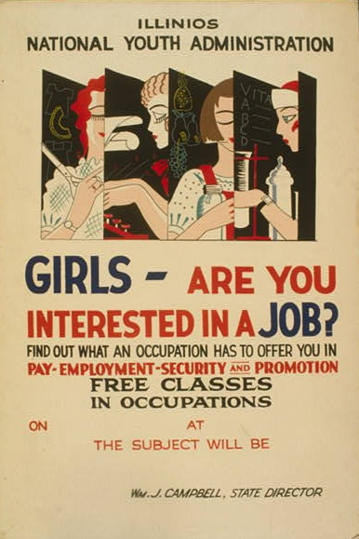
National Youth Administration (NYA)
Created to provide education, jobs, counseling, and recreation for young people
  Eleonore Roosevelt was a major supporter of this program
Also provided financial aid for high school, college, and graduate school

Slide 22
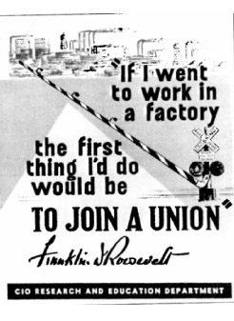
Wagner Act
Re-established the NIRA provision of collective bargaining
Protected the rights of workers
Allowed them to join unions without pressure from management

Slide 23
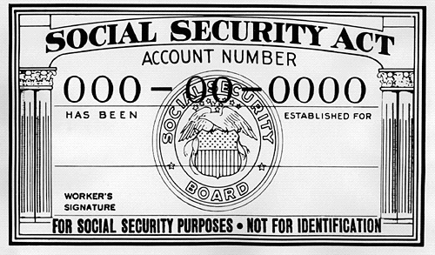
Social Security Act
Passed in 1935 it contained three major provisions:
  Old-age insurance for retirees 65 or older and their spouses
  Unemployment compensation system
  Aid to families with dependent children and the disabled

Slide 24
The New Deal Affects Many Groups
Chapter 15-Section 3

Slide 25
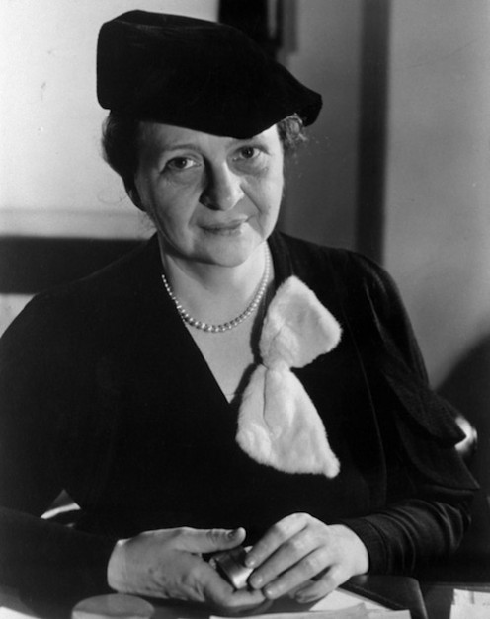
New Opportunities
Several Women appointed to government positions
Frances Perkins first female Cabinet Member (Secretary of Labor)

Slide 26
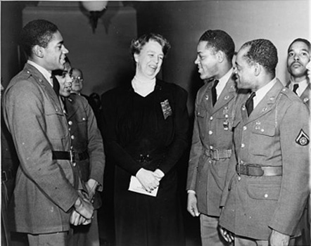
African-American Activism
1930’s saw growth of activism for African Americans
Laid groundwork for Civil Rights Movement (1950’s-60’s)
“Black Cabinet”–Group of influential African Americans to advise Roosevelt on racial issues.

Slide 27
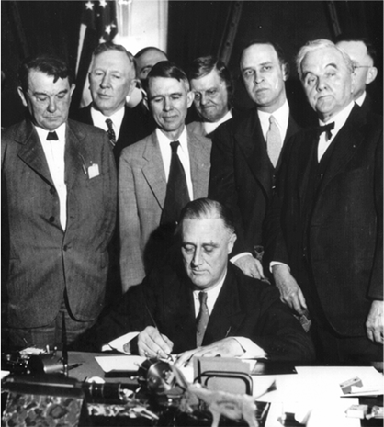
President Fails to Support Civil Rights
Roosevelt never committed to full civil rights for African Americans
Did not want to upset Southern voters
NRA, CCC and TVA discriminated against African Americans
  Lower Wages
  Few Jobs

Slide 28
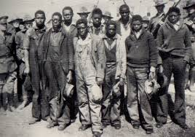
Powell v. Alabama
Powell v. Alabama was a Supreme Court Case in 1932
Nine African American men were put on trial for raping two white women
  Eight of the Nine men were found guilty and sentenced to death in short 1 day trials
The men didn’t have adequate legal counsel (a lawyer)
Alabama ruled cases were legal
Supreme Court disagreed, said that states must provide lawyers in capitol cases (death penalty)

Slide 29
Culture in the 1930’s
Chapter 15 Section 4

Slide 30
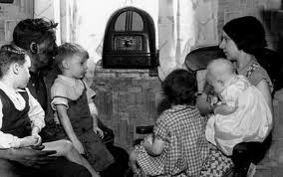
Motion Pictures and Radio
Very profitable during the 1930’s
By 1940 65% of Americans were attending the movies at least once a week
90% of American households owned a radio

Slide 31
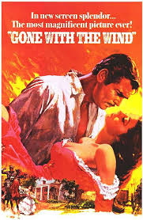
“Gone With The Wind”
Made in 1939
One of the most popular films of all time
Dealt with the life of plantation owners in the south
Acted as a “get-a-way” from the everyday hardships of the Great Depression

Slide 32
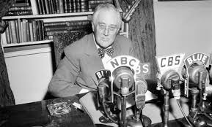
Fireside Chats
Families usually spent several hours a day together listening to the radio
Allowed FDR to speak directly to the people.
Spoke to them as if he were a friend, not the President.
  These messages comforted the common man

Slide 33
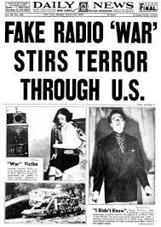
Orson Welles
Actor, director, producer, and writer
Created “War of the Worlds” (1938)
  Many people actually believed it was a real news report

Slide 34
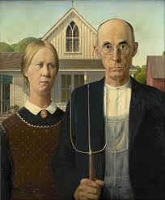
Grant Wood
American painter
Painted “American Gothic” – 1930
FDR appointed writers and artists to paint murals to cheer up Americans

Slide 35
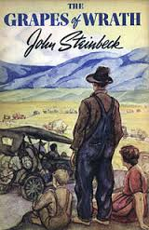
The Grapes of Wrath
Written by John Steinbeck in 1939
  Also received assistance from the Federal Writer’s Project
About the lives of a group of people from Oklahoma and their hardships during the Dust Bowl

Slide 36
The Impact of the New Deal
Chapter 15 Section 5

Slide 37
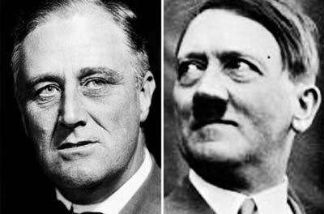
New Deal Reforms
During 2nd Term in office FDR sought to create a Third New Deal
  FDR did not favor deficit spending
Economy had slightly recovered, and Congress pressured FDR to scale back the New Deal
  Caused more unemployment
By 1939, FDR more concerned with Europe (Hitler’s Rise in Germany)

Slide 38
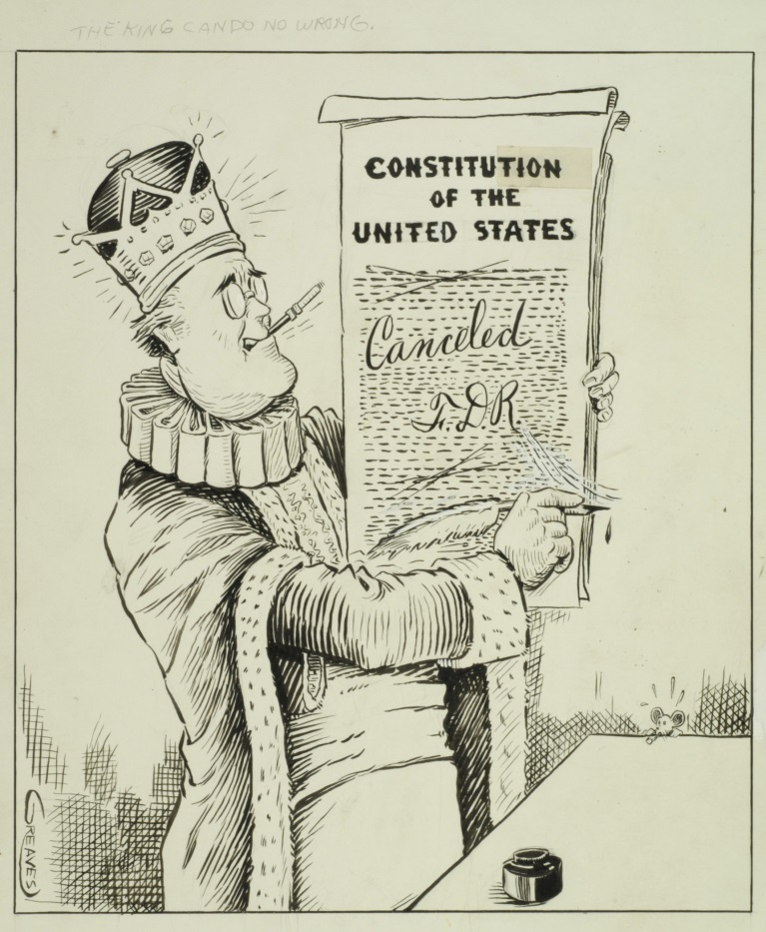
Critics of New Deal
Critics–Typically Conservatives
  New Deal Made Federal Government too large
  Government stifled free enterprise and individual initiative
  Liberal Critics claimed that Roosevelt did not go far enough

Slide 39
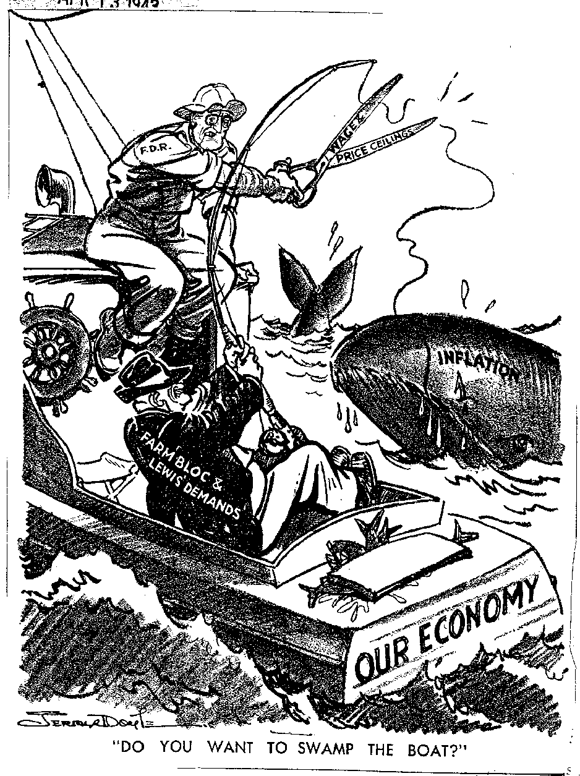
Supporters of the New Deal
Supporters–Typically Liberals
  FDR Struck a reasonable balance between two extremes (unregulated capitalism and overregulated socialism)
  Helped Country recover from economic difficulties

Slide 40
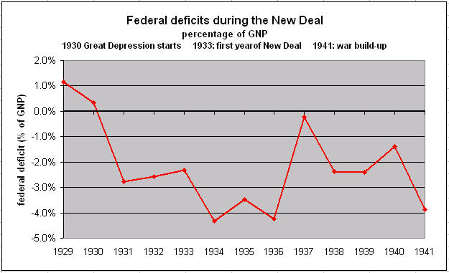
Deep Debt
Federal Government had to go deeply into debt to provide jobs and help Americans
Federal Deficit
  1934- $2.9 Billion
  1937-38 - $100 Million
  1939 - $2.9 Billion

Slide 41
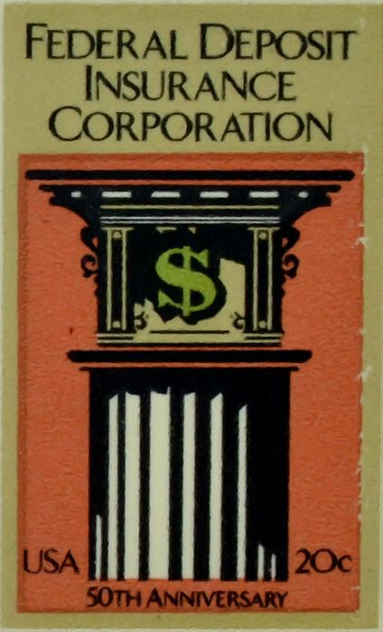
Lasting Effects
Workers Rights
  National Labor Relations Board
    Acts as a mediator in labor disputes between Unions and Workers
    Still Around today
Banks and Finance
  FDIC–Banking regulations and protection
  SEC–Monitors stock market

Slide 42
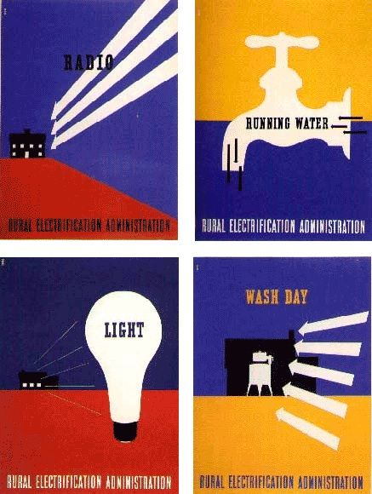
Lasting Effects
Social Security
  One of the most important legacies of New Deal
  Old Age insurance and unemployment continues to help families.
  Impacted millions of Americans since 1935
Rural Scene
  AAA– Helped farmers keep farms.
  Rural Electrification Administration (REA)– Provided electricity to people in rural areas.

Slide 43

Lasting Effects
Environment
  Tennessee Valley Authority (TVA)– Provided jobs to thousands of workers in the region
  Prevented floods in the Tennessee Valley
  Provided cheap electricity to the region

Slide 44
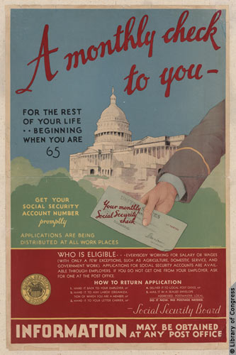
New Deal Legacy
Brought hope and gratitude to some people for the benefits and protections
Also brought criticism from those who believed it took too much of their money in taxes.
United States does not fully recover until after World War II

