Slide 1
The New Deal
Chapter 15-Test Materials

Slide 2
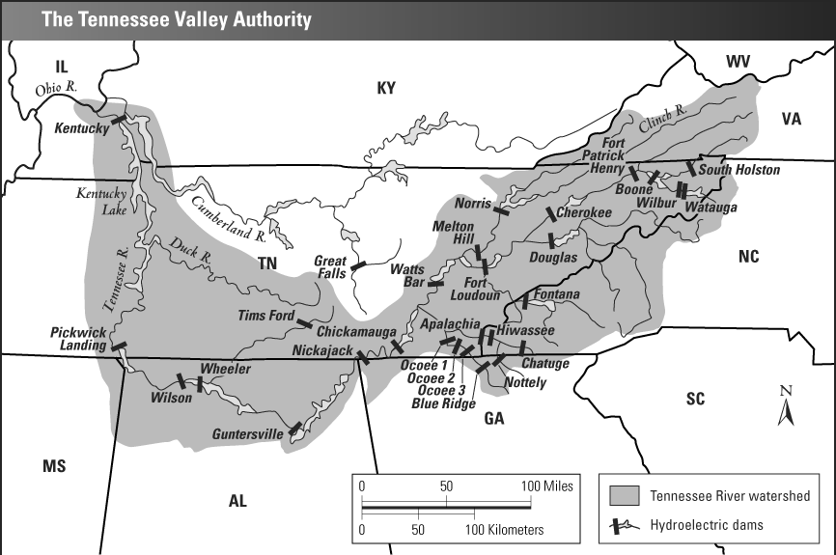

Slide 3
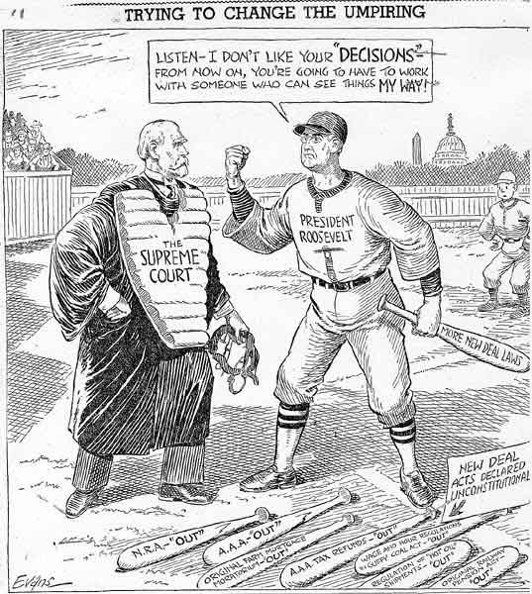

Slide 4
Primary Source-
Brother, Can You Spare a Dime?
They used to tell me I was building a dream
And so I followed the mob.
When there was earth to plow or guns to bear,
I was always there, right on the job.
They used to tell me I was building a dream
With peace and glory ahead —
Why should I be standing in line, just waiting for bread?
Once I built a railroad, I made it run,
Made it race against time.
Once I built a railroad, now it’s done —
Brother, can you spare a dime? . . .
Once in khaki suits, gee, we looked swell
Full of that Yankee Doodle-de-dum.
Half a million boots went slogging through hell,
And I was the kid with the drum. . . .
By E. Y. Harburg and J. Gorney, 1932

