Slide 1
Presidential Nominations
Chapter 13 Section 4

Slide 2
Does the nominating system allow Americans to choose the best candidates for president?

Slide 3
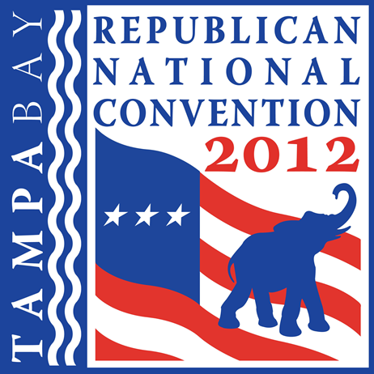
National Conventions
Both the Republicans and Democrats use National Conventions as their parties nominating device
  Both parties picked the time and the place to hold their convention
    2012 Presidential Election
      Republic National Convention–Tampa, Florida
    Republican National Convention
      Democrat National Convention–Charlotte, North Carolina Democratic National Convention
  Each state is given a certain number of delegates to represent the state.

Slide 4
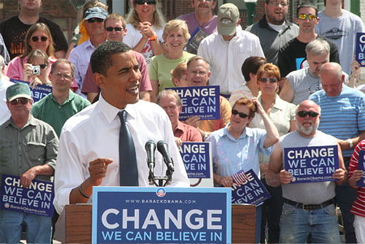
Presidential Primaries
Presidential Primary
  An election in which a party’s voters
    Choose some or all of the State party organization’s delegates to their party’s national convention
    Express a preference among various contenders for their party’s presidential nomination

Slide 5
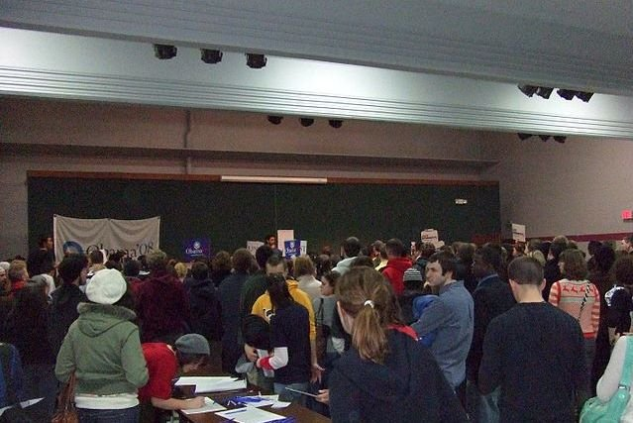
Caucuses
A closed meeting of members of a political party who gather to select delegates to the national convention.
The Iowa caucuses generally get the most attention, largely because they are now the first delegate-selection event held in every presidential election season.
Iowa Caucus, 2008

Slide 6
Securing the Nomination
The National Conventions Have Three Major Goals:
  Naming the party’s presidential and vice-presidential candidates
  Bringing the various factions and the leading personalities in the party together in one place for a common purpose
  Adopting the party’s platform – it formal statement of basic principles, stands on major policy matters, and objectives for the campaign and beyond.

Slide 7
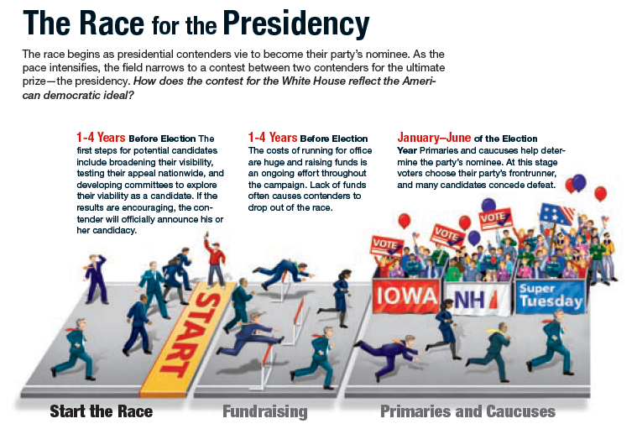

Slide 8
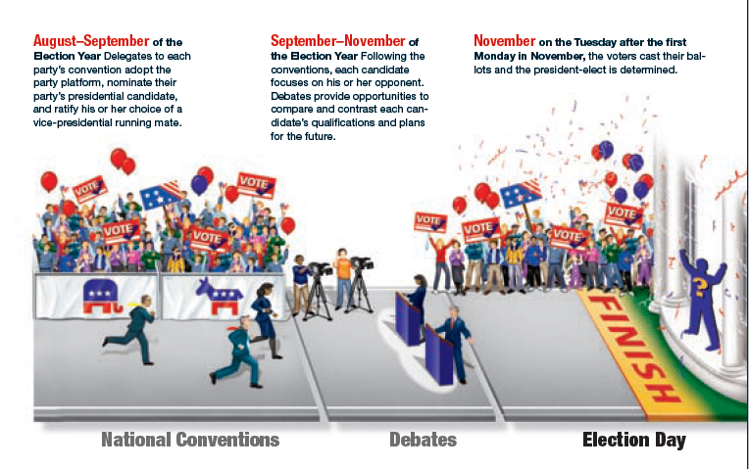

Slide 9
The Presidential election
Chapter 13 Section 5

Slide 10
Does the election process serve the goals of American democracy today?

Slide 11
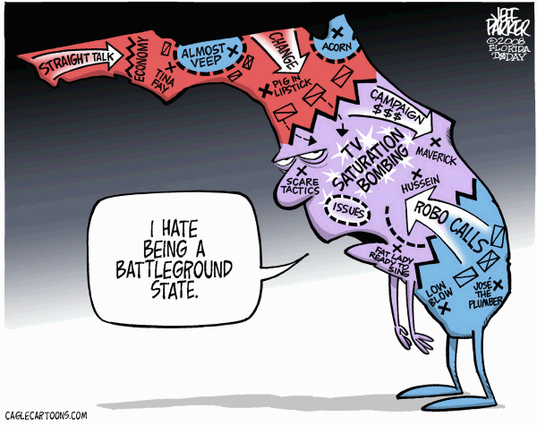
The Presidential Campaign
The campaign itself it organized chaos
  Candidates work to show their “best side” and take negative jabs to their opponents.
    Television Campaign Ads
  Both campaigns focus much of their efforts on swing voters – people who have not made up their mind on who to vote for.
  Would-be-presidents also target the battleground states – those states in which the outcome is “too close to call” and either candidate can win.

Slide 12
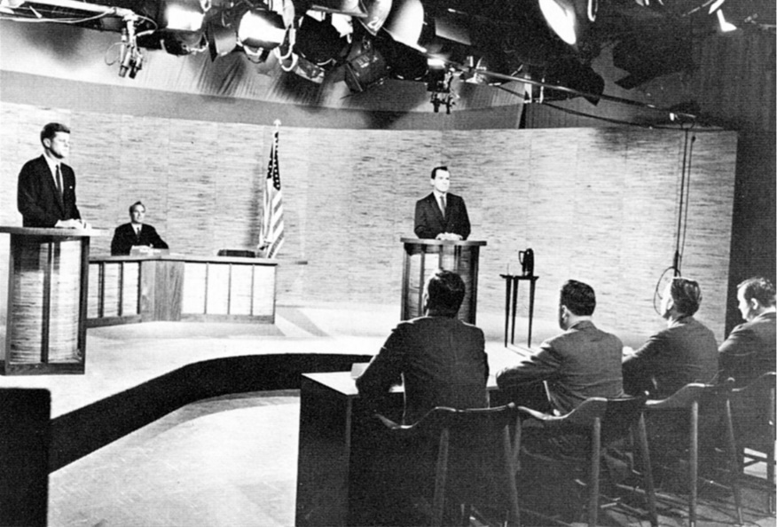
The Presidential campaign-Debates
The candidates agree to hold debates
  Both sides will present and argue over issues that are crucial to the United States.
Obama v. McCain debate
Kennedy v. Nixon Debate
1st televised Presidential debate

Slide 13
The Election
When people vote in the presidential election, they do not cast a vote directly for one of the candidates, instead, they vote for presidential electors.
The electoral college elects the President of the United States
The electors are chosen by popular vote in every State on the same day everywhere
  The Tuesday after the first Monday in November every fourth year.
  2012 presidential election is set for November 6, 2012
  2016 presidential election is set for November 15, 2016
  2020 presidential election is set for November 3, 2020

Slide 14
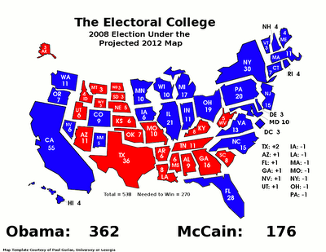
Counting the Electoral Votes
270 Electoral Votes to Win
The electors meet in their respective State capitals on the Monday after the second Wednesday in December.
Electors, then, cast their votes, sign their ballots and are sent to the President of the Senate.
Who wins the majority of the electoral votes becomes president.

Slide 15
What happens if no candidate wins the majority of electoral votes?
Candidates need 270 out of the 538 electoral votes to win
  If this does not happen:
    The House of Representatives chooses the president among the top three candidates voted on by the electoral college
    The Senate will choose the vice-presidential candidate among the top two candidates

Slide 16
PRESIDENTIAL INNAUGURATION
After all of the votes have been counted, the President of the United States is sworn into office on January 20th on the steps of the Capitol.
  Prior to the 20th Amendment, the President was sworn in on March 4th
  The President of the United States is sworn in by the Chief Justice of the Supreme Court (Oath of Office).
    “I (name of president) do solemnly swear that I will faithfully execute the office of President of the United States, and will to the best of my ability, preserve, protect, and defend the Constitution of the United States.
      Usually it is followed by “so help me god” and the playing of “Hail to the Chief”

Slide 17
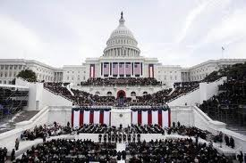
PRESIDENTIAL INNAUGURATION
After the President is sworn into office, it is usually followed by a speech, a parade, and many celebrations throughout the day.

Slide 18
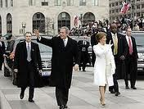
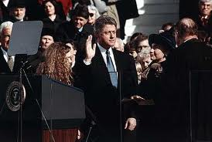
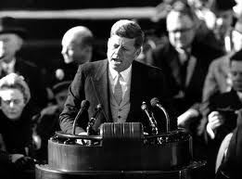
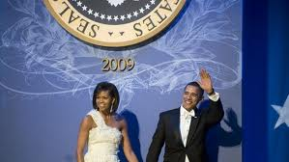
PRESIDENTIAL INNAUGURATION

Slide 19
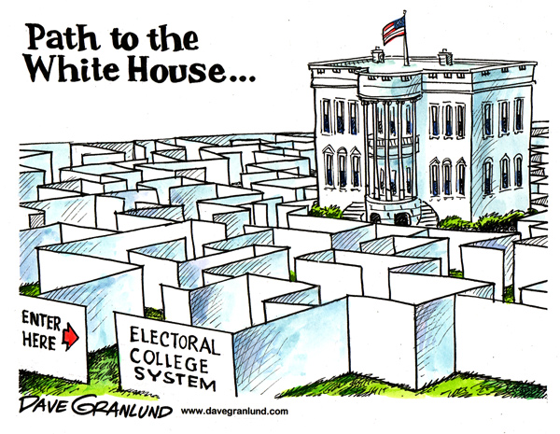
Flaws in the Electoral College
The winner of the popular vote is not guaranteed the presidency
Electors are not required to vote in accord with the popular vote
Any election might have to be decided by the House of Representatives

Slide 20
Proposed Reforms
District and Proportional Plans
  Under the district plan, each state would choose its electors similar to how the choose members of Congress
    Would be required to vote with the popular vote of the state.
  Under the proportional plan each candidate would receive a share of each State’s electoral vote
    For example, a candidate that won 62% of the vote cast in a State with 20 electors would receive 12.4 of that State’s electoral votes.

Slide 21
Proposed Reforms
Direct Popular Election
The National Popular Vote Plan
Abolishes the Electoral College
The people would elect the President and Vice-President
The candidate would be elected with the majority of votes
Same as direct popular election; however, no changes would be made to the Constitution.
All States would give their electoral votes to the winner of the national popular vote.

Slide 22
Defending the Electoral College
Supporters of the Electoral College argue:
  It is a known process
  The present system identifies the President-to-be quickly and certainly
  Helps promote the nation’s two-party system

