Slide 1
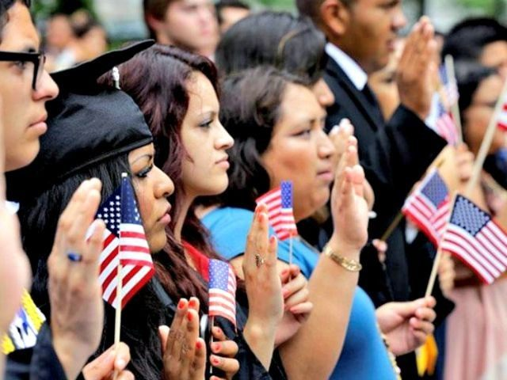
American Citizenship
Chapter 21-Section 4
Supplemental Power Point

Slide 2
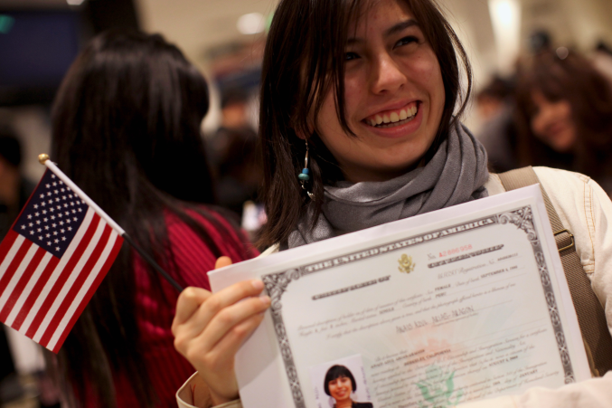
Rights and Responsibilities of Citizenship
American citizenship involves great privileges and serious responsibilities:
Citizenship in the United States is determined in several ways.
Citizens are expected to fulfill a number of important duties.
Active citizen involvement in government and the community is encouraged.

Slide 3
Becoming an American Citizen
The 14th Amendment to the Constitution defines two means of obtaining citizenship:
Through being a natural born citizen
Anyone born in the United States or U.S. territory is a citizen, as is anyone whose parent is a citizen.
Through the process of naturalization
Foreign-born people whose parents are not citizens can become naturalized citizens.
Requirements for becoming a naturalized citizen:
Be over eighteen years old and be able to support themselves financially or have someone assume financial responsibility for them.
Be law-abiding resident in good legal standing who supports the U.S. Constitution.
Demonstrate both orally and in written English a basic understanding of American history, principles and values.
Go before a naturalization court and take an oath of allegiance to the United States.

Slide 4
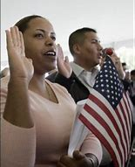
The Naturalization Process
Aliens, or noncitizens, must go through a specific process for Naturalization:
First they must file a Declaration of Intent with the INS (Immigration and Naturalization Service).
They must have lived in the U.S for at least five years.
They must take citizenship classes.
The need to interview with an INS official.
They need to take and pass the U.S. citizenship test.
Finally they will pledge an oath of allegiance to the United States

Slide 5
Naturalization Oath of Allegiance to the United States of America
The principles embodied in the Oath are codified in Section 337(a) in the Immigration and Nationality Act (INA), which provides that all applicants shall take an oath that incorporates the substance of the following:
Support the Constitution
Renounce and abjure absolutely and entirely all allegiance and fidelity to any foreign prince, potentate, state, or sovereignty of whom or which the applicant was before a subject or citizen
Support and defend the Constitution and laws of the United States against all enemies, foreign and domestic
Bear true faith and allegiance to the same
A. Bear arms on behalf of the United States when required by the law; or B. Perform noncombatant service in the Armed Forces of the United States when required by the law; or C. Perform work of national importance under civilian direction when required by the law.

Slide 6
Naturalization Oath of Allegiance to the United States of America
"I hereby declare, on oath, that I absolutely and entirely renounce and abjure all allegiance and fidelity to any foreign prince, potentate, state, or sovereignty, of whom or which I have heretofore been a subject or citizen; that I will support and defend the Constitution and laws of the United States of America against all enemies, foreign and domestic; that I will bear true faith and allegiance to the same; that I will bear arms on behalf of the United States when required by the law; that I will perform noncombatant service in the Armed Forces of the United States when required by the law; that I will perform work of national importance under civilian direction when required by the law; and that I take this obligation freely, without any mental reservation or purpose of evasion; so help me God."

Slide 7
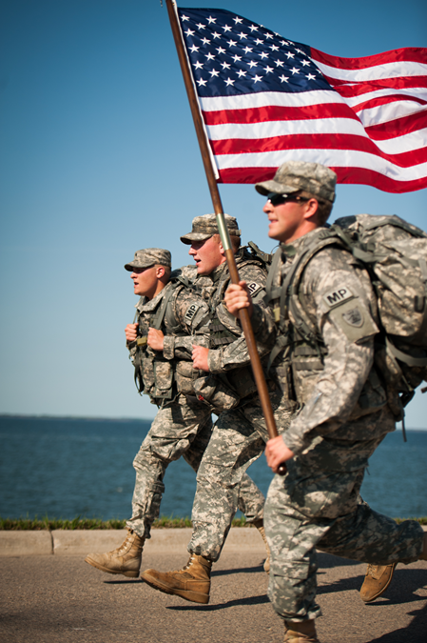
Civic Duties
For a representative democracy to truly work each and every American need to fulfill their civic duties.
A civic duty is a course of action required by law.
Duties include Participating in elections
Obeying laws
Paying taxes
Defending the nation
Men over 18 may be required to serve in the military in the event of a draft.
Serving on juries
Failure to perform these civic duties results in legal consequences such as fines or jail time

Slide 8
Civic Responsibilities
A civic responsibility is an action of choice, done voluntarily.
Taking part in the elections process by voting may be a citizen’s most vital duty.
Citizens should be informed about issues and candidates before voting.
Americans may choose to campaign for candidates or issues through the following measures:
Many people help campaigns by giving money to political action committees (PACs) (good way to help influence things even if you cannot vote!).
Others work with interest groups, groups of people who share a common interest that motivates them to take political action.
Some write letters to government leaders or attend city council meetings.
Some citizens exercise their civic responsibilities by volunteering for community service groups like:
Neighborhood watch groups that can help the police.
American Red Cross helping people in times of natural disasters and other emergencies.
Joining the Girl and Boy Scouts of America can help preserve the environment and their serve their communities.

Slide 9
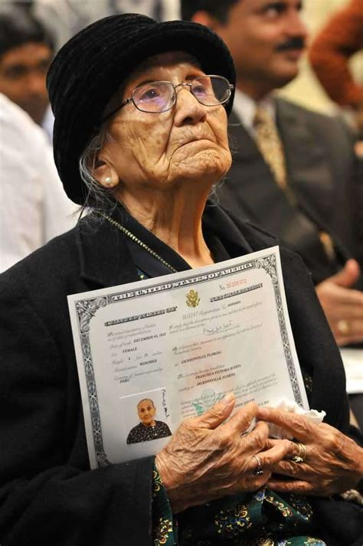
Civil Rights
Civic rights are established and protected by the Constitution of the United States
The First Amendment guarantees certain freedoms by due process and equal protection of the laws.
Freedom of religion
Freedom of speech
Freedom of the press
Freedom of assembly
Freedom to petition

