Slide 1
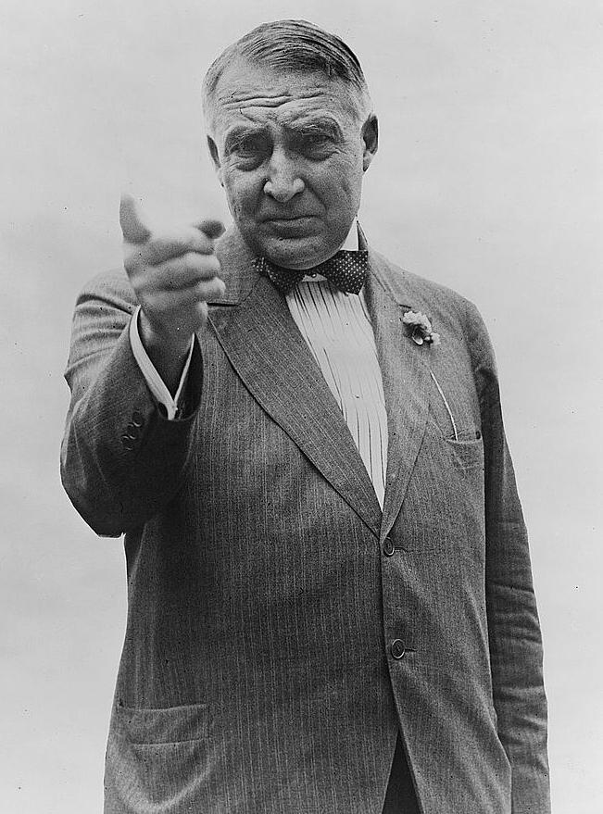
Chapter 12-Section 2- The Harding Presidency

Slide 2
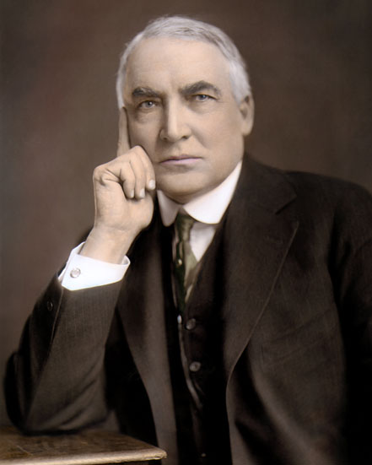
The Harding Presidency
Warren G. Harding
Served as the 29th U.S. president of the United States (1921 to 1923)
He was elected president on his birthday and inaugurated in 1921.
Born on November 2, 1865, in Corsica (now Blooming Grove), Ohio.
Harding's campaign for the Presidency promised a "return to normalcy."
Something many American’s wanted after the war
After serving as president for less than three years Harding died unexpectedly of a heart attack while traveling in California, on August 2, 1923.

Slide 3
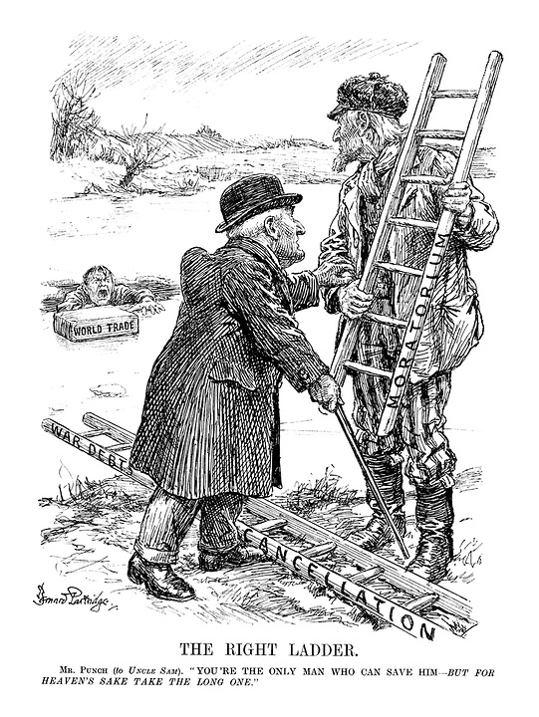
Struggles for Peace
Harding Struggles for Peace
-After World War I many problems faced the U.S.
Arms control
War debts
Reconstruction of war torn countries

Slide 4
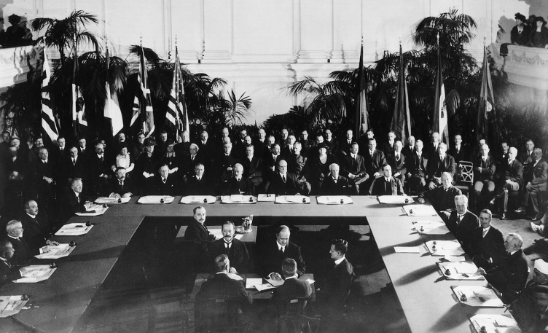
Struggles for Peace
To Solve these problems President Harding hosted a conference called the Washington Naval Conference
Secretary of State suggested no more warships be built for ten years and should scrap current ships
This would make them one of the first nations in history to voluntarily disarm themselves

Slide 5
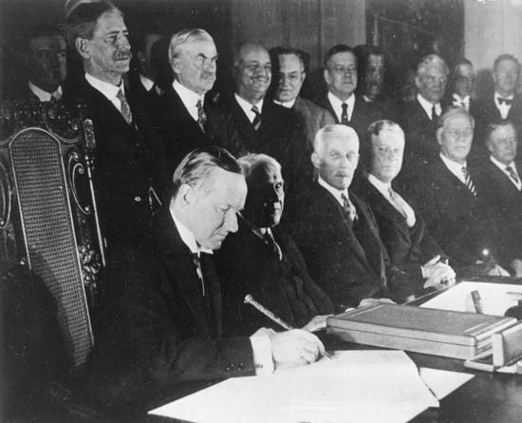
Struggles for Peace
Later in 1928 The Kellogg Briand Pact was signed:
It was a policy designed to solve disputes between countries without using war, but no way for the nations of the world to enforce it
It was an attempt at peace but ultimately was unrealistic

Slide 6
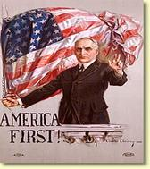
Tariffs and Reparations
Tariffs and Reparations: The road back to War
France and Britain owed us a large amount of money
In order to collect this we pushed them to either sell goods or collect reparations for nations indebted to them
Unfortunately, the U.S. made it impossible to for them to sell goods a large amount of goods due to high tariffs

Slide 7
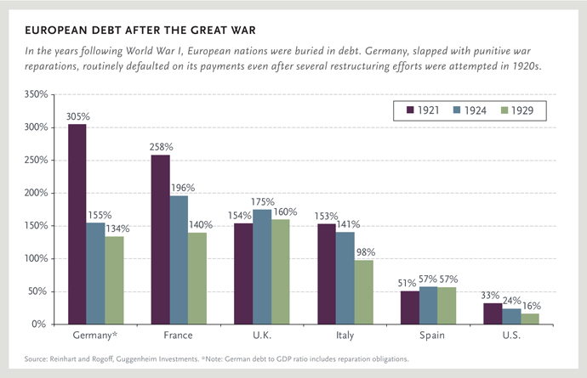

Slide 8
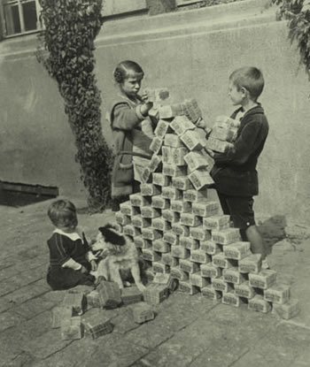
Tariffs and Reparations
Fordney-McCumber Tariff:
Raised taxes to 60% which made European goods difficult to sell
Reparations- The War Guilt Clause forced Germany to repay $33 billion dollars after the war
The German economy collapsed and they could not afford their payment
As a result France marched in to Germany
No one wants war
The Dawes Plan was set up where American banks lent Germany $2.5 billion so they could make their payments to France and Britain
European nations were mad because they felt we were not doing enough to help

Slide 9
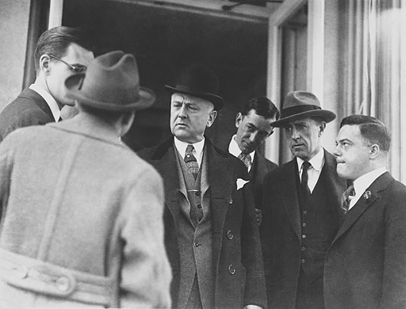
Scandal
Warren G. Harding’s biggest downfall as President was that he made some poor choices in selecting his cabinet members.
The Bad Ones- The Ohio Gang was the friends and poker playing buddies of Harding who too advantage of their position for their own personal gain
This included the head of the Veterans Bureau Charles R. Forbes.
It was discovered that he entered into corrupt arrangements with a number of contractors, particularly with those involved in the operation of hospitals, and sold government property at a fraction of its value.
However there were a few good ones:
Herbert Hoover: Secretary of Commerce
Charles Evan Hughes: Secretary of State
Andrew Mellon: Secretary of the Treasury

Slide 10
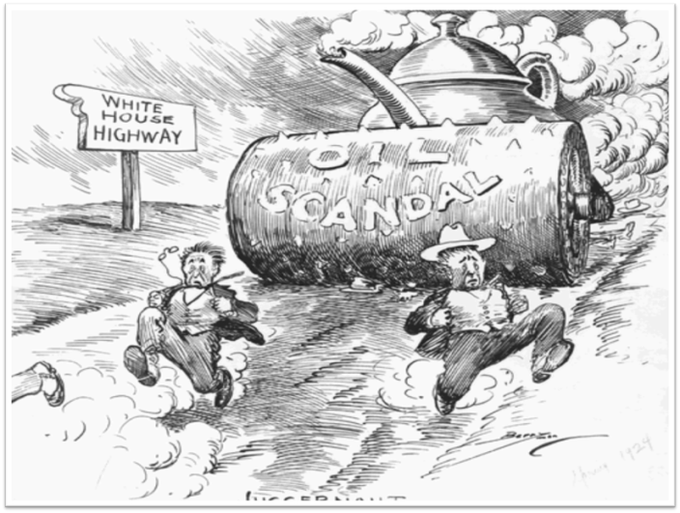
Teapot Scandal
Teapot Dome Scandal:
The U.S. government had set aside oil rich public land at Teapot Dome, Wyoming and in Elks Hill California for use by the Navy
Secretary of the Interior Albert B. Fall got control of land and transferred control of the oil to his friends in the oil industry
Claimed it was in the governments best interests but received $400,000 in “loans, bribes and cash”
He was convicted and became the first person convicted of a felony while holding a cabinet post

