Slide 1
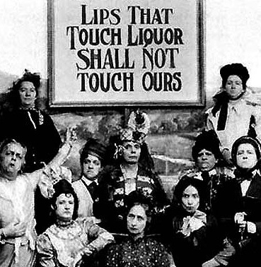
Chapter 12-Section 1-Americans Struggles with Post War Issues

Slide 2
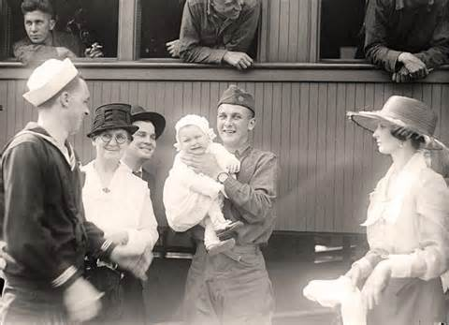
Post War Trends
America is tired after WWI
Lots of adjustment had to take place:
Soldiers are trying to adjust to life without war why the economy tried to adjust to European countries not needing our stuff

Slide 3
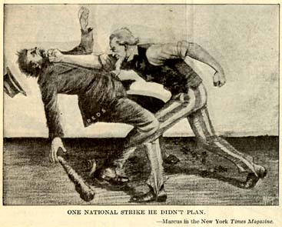
Post War Trends
Nativism-A prejudice against foreign-born people
Isolationism-The policy of pulling away from involvement in world affairs

Slide 4
Communism
Communism-An economic and political system where everything is controlled by the government and there is no private property or private ownership of business
Government would control things like factories, railroads, large scale farms and businesses
Red Scare-Many Americans were afraid Communism would take over the country following the overthrow of the Russian czar in 1919.
Soon after a Communist party in America formed with roughly 70,000 members
They mailed bombs Attorney General Palmer starts to combat the “Red Scare” by using extremely harsh tactics

Slide 5
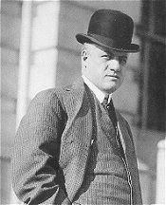
The Palmer Raids
The Palmer Raids-
In August of 1919, A. Mitchell Palmer and Herbert Hoover begin to hunt down suspected Communists, socialists and anarchists in the United States.
The fear of outsiders and communists got so bad that people who were different were singled out
Mitchell and Hoover trampled over peoples civil rights by searching their homes, mail, tapping their phones and even deporting people.
After all their searching they never really found evidence of a revolutionary conspiracy

Slide 6
Sacco and Vanzetti
Nicola Sacco and Bartolomeo Vanzetti were two immigrant anarchists who were accused of murder without much proof in 1920
After a weak trial they were both sentenced to death by electric chair
People all around the world protested especially since they may have been innocent

Slide 7
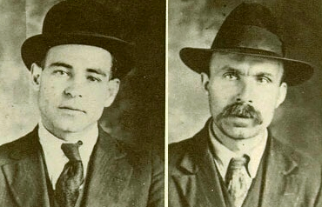

Slide 8
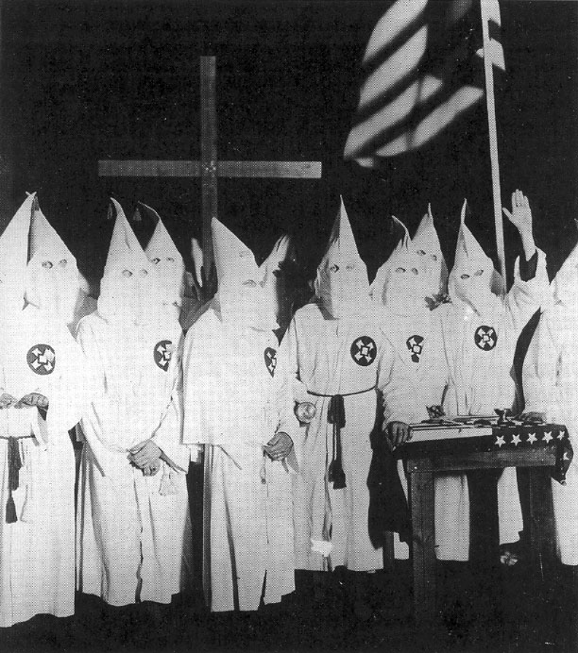
Limiting of Immigration
Many people wanted to Keep America for Americans
New Anti-immigrant groups popped up because they thought immigrants were stealing jobs
The Ku Klux Klan resurfaces-
1920’s saw rise of KKK which began to diversify their hatred eventually reaching nearly 4.5 million followers in 1924

Slide 9
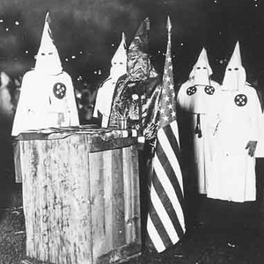

Slide 10
Legal Measures to Limit Immigration
The Quota System-From 1919 to 1921 the number of immigrants entering had grown by 600 percent from 141,000 to 805,000
Emergency Quota Act 1921:
It set a maximum number of people from each foreign country
Quota Act of 1924:
Limited immigration even more especially those from southern European countries to 2% of the nationals living in the U.S.
Quota Act of 1927:
Limited even more and included Japanese to only 150,000 a year

Slide 11
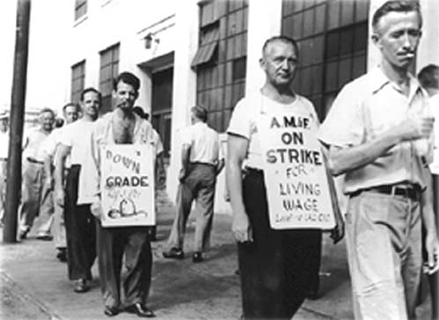
Labor Unrest
Labor Unrest-
Another problem facing the early 1920’s
After war strikes were rampant
Owners said strikers were communist
This was an attempt to try and scare people from joining unions

Slide 12
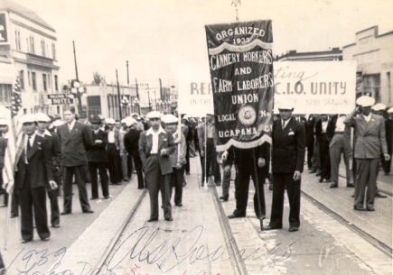

Slide 13
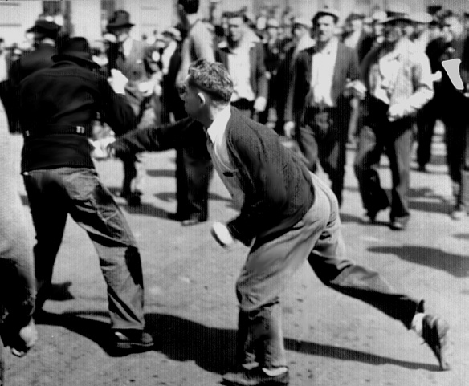

Slide 14
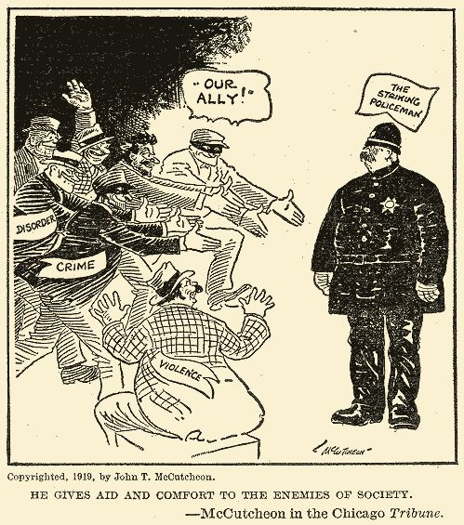
Labor Unrest
Boston Police Strike:
Boston police had not received a raise since before WWI and were not allowed to for a union so in 1919 they went and strike
Massachusetts Governor Calvin Coolidge fired the police and called out the national guard to remove them
The strike ended but new officers were hired instead of calling the old ones back
This proved that the government had power over labor

Slide 15
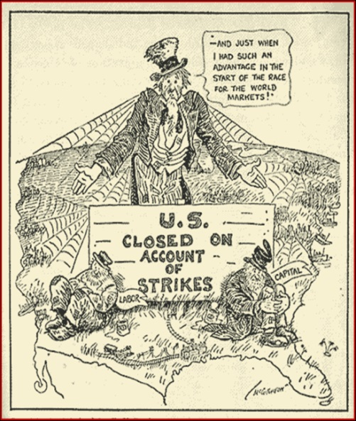
Labor Unrest
Steel Mill Strike-
Steel workers wanted lower hours and a living wage
In September 1919, over 300,000 workers at U.S. Steel Corporation went on strike
Strikers were beaten by police, federal troops and state militias.
The workers labeled as communist
The strike finally ended in 1920 and although the workers won an eight hour day they still could not unionize

Slide 16
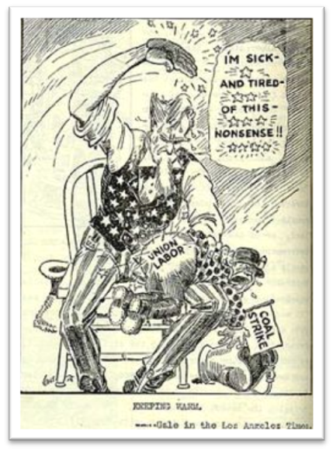
Labor Unrest
Coal Miners Strike-
Unions had some success in coal mines
John L. Lewis a labor leader led the strike of the United Mine Workers of America
He told the owners it was over, but kept it going
President Wilson brought end to it by bringing in an arbitrator.
Coal workers received a 27% raise, but still could not unionize

Slide 17
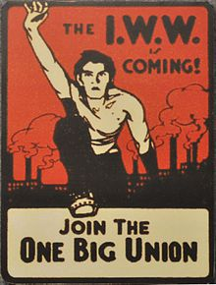
Labor Loses Appeal
Labor movements begin to lose support during 1920’s
Union membership dropped from 5 million members to around 3.5 million
There were too many immigrants who were eager to work
The fact that immigrants spoke different languages made it hard to organize unions
Farmers who had moved to the cities were not used to working together
Most unions excluded African Americans

