Slide 1
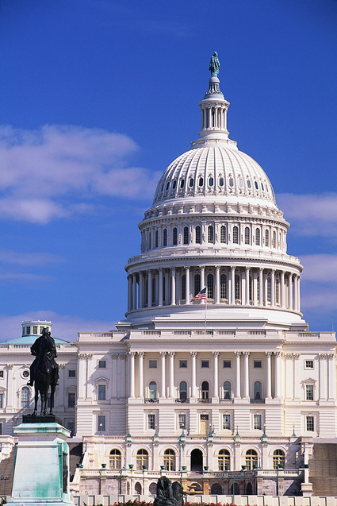
The Purpose of Government
Chapter 1-Section 1 (pg. 9-11)

Slide 2
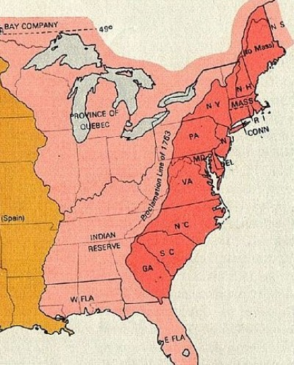
1. Form A More Perfect Union
Following the failure of the Articles of Confederation (1781) which created a weak central government our current Constitution was created (1787) in order to link the states together under the idea that “unity is our greatest strength”

Slide 3
Thoughtful Response #1
What were some of the powers that the Articles of Confederation lacked and how were those weaknesses addressed in the “new” Constitution of the United States (1787)?

Slide 4
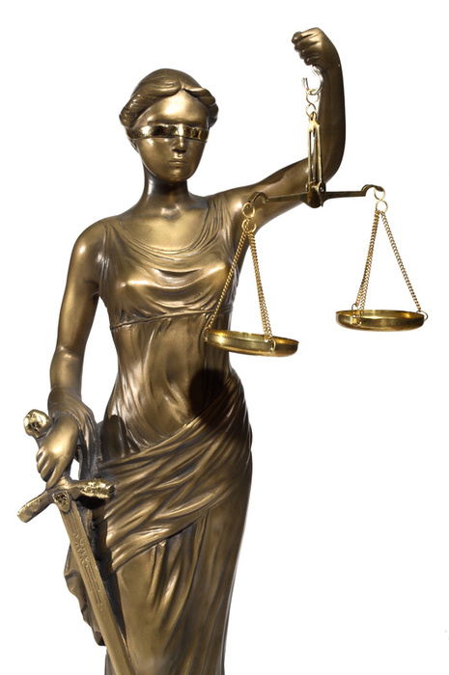
2. Establish Justice
Thomas Jefferson felt that providing justice is “the most sacred of the duties of government”
What does that mean:
The law in both it’s administration and content must be reasonable, fair and impartial”

Slide 5
Thoughtful Response # 2
Using a historical example why is it so important that the administration and content of justice must be reasonable, fair and impartial?

Slide 6
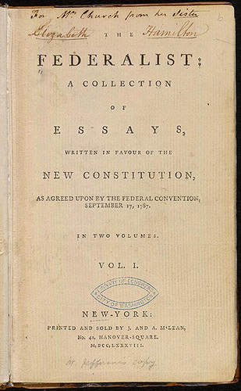
3. Insure Domestic Tranquility
The key to maintaining peace within our nation is establishing order. This is the prime function of government.
James Madison said in The Federalist Papers No. 51 that “If men were angels, no government would be necessary”

Slide 7
Thoughtful Response # 3
1. In your own words please explain why you think James Madison wrote “If men were angels, no government would be necessary”?
2. As a society can we ever expect to live in a world where this scenario could be achieved?
Explain and support your answer with a complete coherent thought

Slide 8
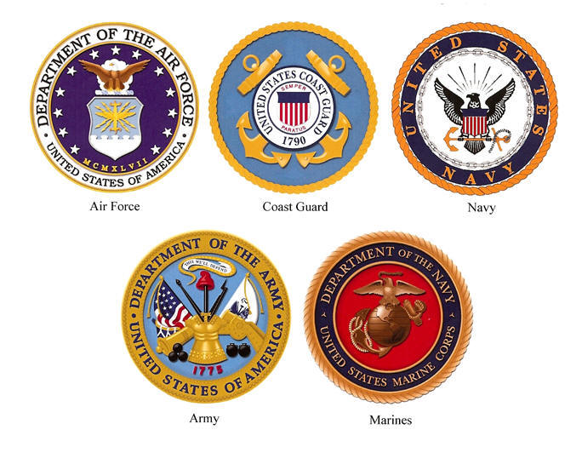
4. Provide for the Common Defense
Defending our nation from attacks both foreign and domestic has always been one of our government's chief responsibilities.
In order to maintain our safety our nation maintains an army, navy, air force and coast guard. While the department of Homeland Security keeps watch for threats entering our country.

Slide 9
Thoughtful Response # 4
If you were placed in charge of appropriating one billion dollars in funds between the army who works to maintain global security and the Office of Homeland Security who defends our national security at home how would you divide up the funds?
Please explain why you chose to divide up the funds the way you did

Slide 10
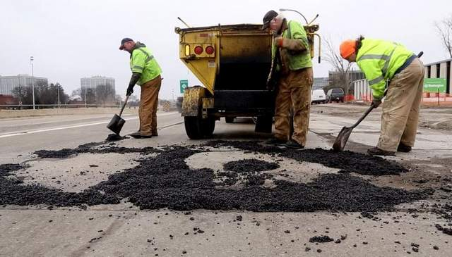
5. Promote the General Welfare
The services our government provides are designed to benefit all or most of our citizens.
Some examples are:
Improving education
Improving Roads
Lowering Taxes
Welfare
Disability
Social Security

Slide 11
Thoughtful Response # 5
After examining the list of government services we just discussed please create a top five list by ranking them in order from most important to least important.
Please explain in one to two sentences why you decided to rank your top choice as number one and why you decided to leave the sixth service off your top five list.

Slide 12
6. Secure the Blessing of Liberty
Although a high priority for our government is the ideas of freedom and liberty they are not considered absolute but relative.
People can not be free to do whatever they want because that would infringe on the freedom of others.
Both Federal and State Constitutions define the rights and liberties of for those living in our country.

Slide 13
Thoughtful Response # 6
In certain examples there are laws at the state level that conflict with Federal laws and statues.
Please list one example currently in the news that fits the statement above. Do you believe that there a law can be enforceable at the state level if they contradict existing laws on the Federal Level?

