Slide 1
The Progressive Era

Slide 2
The Progressive Movement
Essential Question
How did the Progressives fight corruption in business and government?

Slide 3
Fighting Corruption
Many Americans called for reform in the late 1800s
The reformers, called Progressives had many different goals
Urban problems
Government
Business – claimed big businesses were taking advantage of the American people

Slide 4
Fighting the Political Machine
Political Machine: Powerful organizations linked to political parties
Each district had a machine representative known as a “boss”
Controlled local government
Controlled jobs and services
Many were corrupt and dishonest
Accepted bribes
Took campaign contributions from people wanting to do business in the city
Took kickbacks or illegal payments

Slide 5
William M. Tweed – “Boss Tweed”
New York City’s corrupt political machine boss
Led the Tweed Ring
Network of city officials
Controlled city police, courts and many newspapers
Controlled millions of dollars in illegal payments
Exposed by political cartoonist Thomas Nast

Slide 6
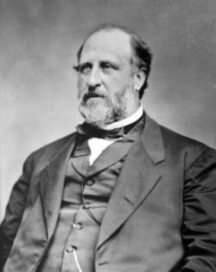
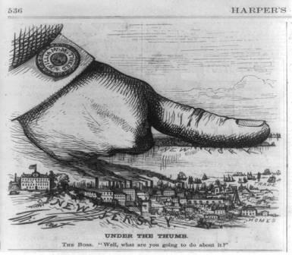
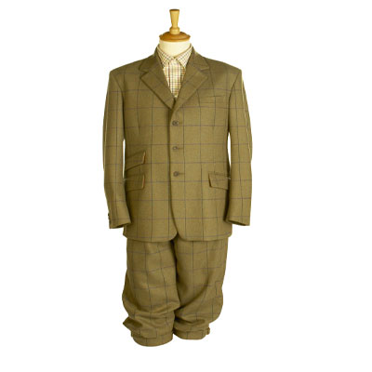
Boss Tweed

Slide 7
Fighting the Spoils System
Political supporters were rewarded with jobs and favors
Can be found at all levels of government
Many people who received jobs were not qualified or were dishonest

Slide 8
Controlling Business
Many Americans believed that trusts and monopolies had too much control over the government and economy
1890 – Sherman Anti Trust Act
Prohibits monopolies and trusts
Rarely enforced

Slide 9
Reining in the Railroads
Railroads formed an oligopoly
A few large companies controlled prices for the entire industry
Reformers called for government regulation of prices
1887 – Interstate Commerce Commission (ICC)
Regulates rates and prices

Slide 10
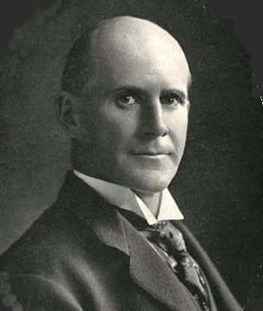
The New Reformers
Socialists
Founded by Eugene V. Debs
Believed government should own and operate resources and major industries in the interest of all the people
Progressives
Believed government should regulate industry rather than own it
Wanted government to be less influenced by big business
Believed society had a duty to protect and help all its members

Slide 11
The Seventeenth Amendment
Direct election of senators
Eliminated party bosses and business interests
Gave the people a direct voice in choosing their representatives

Slide 12
Answer the Essential Question
How did the Progressives fight corruption in business and government?

Slide 13
Muckrakers Expose Problems
Who were Muckrakers and what impact did they have on the Progressive Movement?
They helped bring reform issues to the attention of the public. They were journalists and writers who investigated corruption and injustice through magazines
Yellow Journalism –
Sensational style of reporting used by newspapers at the turn of the century

Slide 14
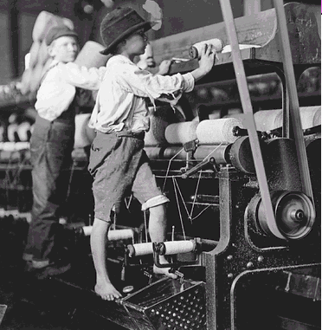
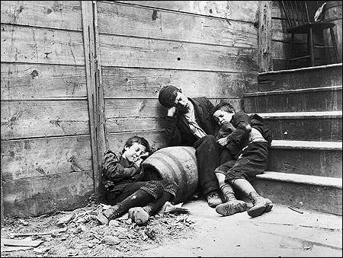
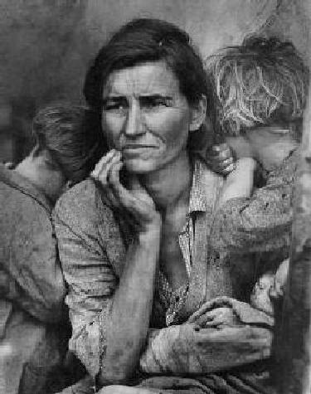
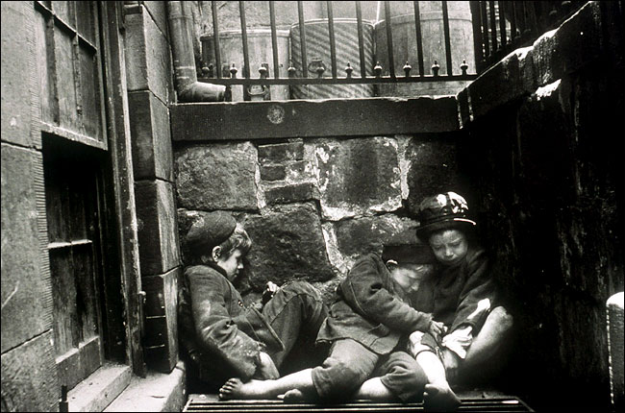

Slide 15
Major Legislation
Pure Food and Drug Act – All food was to be inspected by the FDA before sale (Consumer Protection)
Meat Inspection Act – Inspected all meat products before sale (Consumer Protection)

Slide 16
These major pieces of legislation that were passed by the Federal Government came about because of a major book that was written by Upton Sinclair. That book is known as The Jungle.
What was the significance of the book? Exposed the unsanitary working conditions of the meat packing industry at the turn of the century.

Slide 17
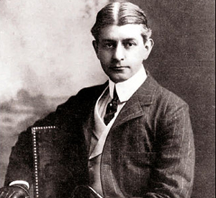
Muckrakers Expose Problems
Muckraker
Frank Norris
Book/Article
The Octopus (1900)
Subject Exposed
Monopolistic railroad practices in California

Slide 18
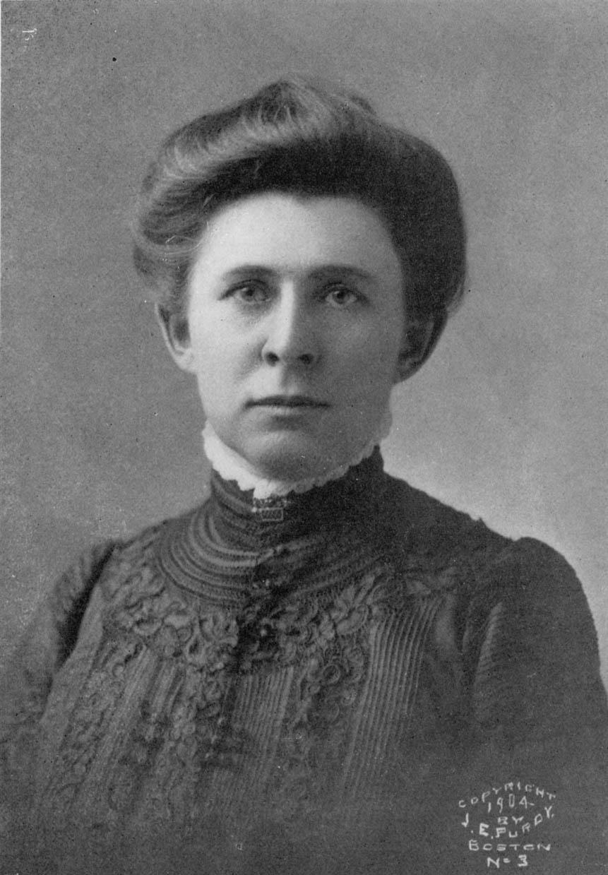
Muckrakers Expose Problems
Muckraker
Ida Tarbell
Book/Article
History of Standard Oil (1904)
Subject Exposed
Ruthless practices of Standard Oil

Slide 19
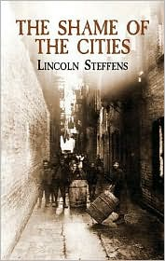
Muckrakers Expose Problems
Muckraker
Lincoln Steffens
Book/Article
The Shame of the Cities (1906)
Subject Exposed
Urban political corruption

Slide 20
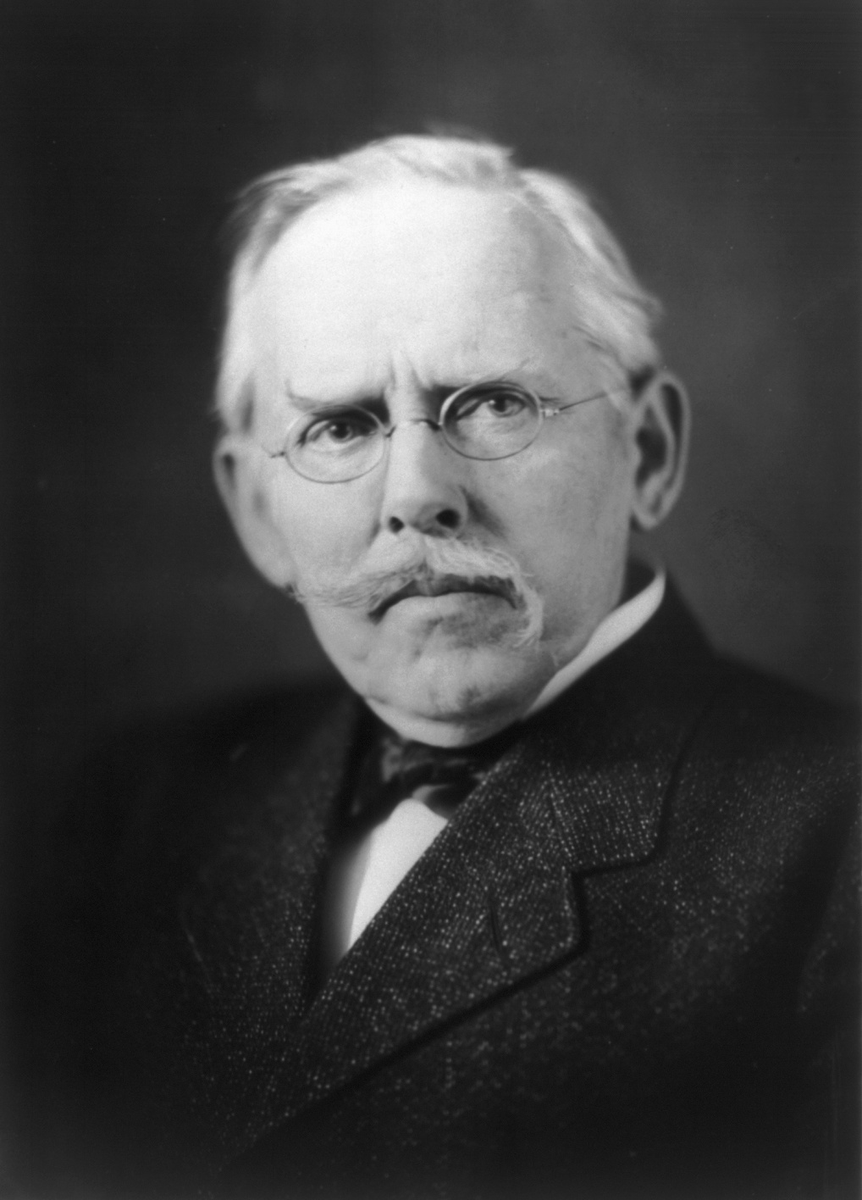
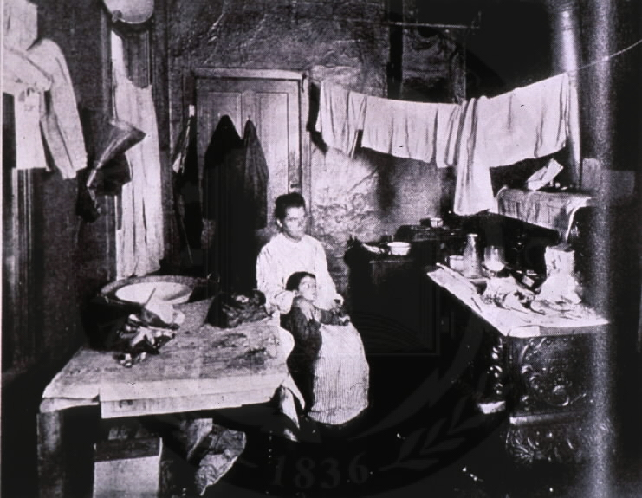
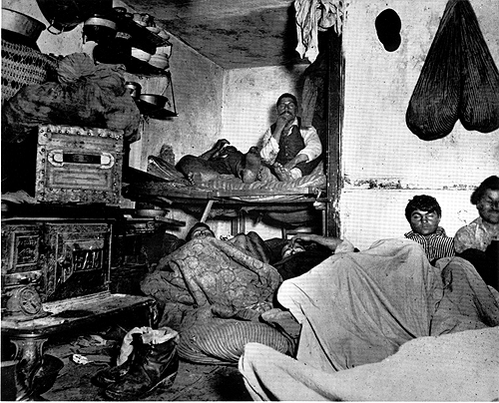
Muckrakers Expose Problems
Muckraker
Jacob Riis
Book/Article
How the Other Half Lives
Subject Exposed
Life in New York City tenement homes

Slide 21
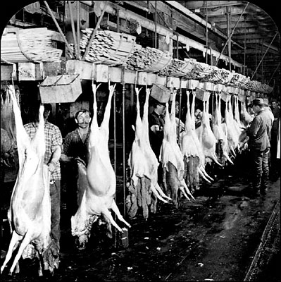
Muckrakers Expose Problems
Muckraker
Upton Sinclair
Book/Article
The Jungle (1906)
Subject Exposed
Dangerous conditions in the meat packing industry

Slide 22
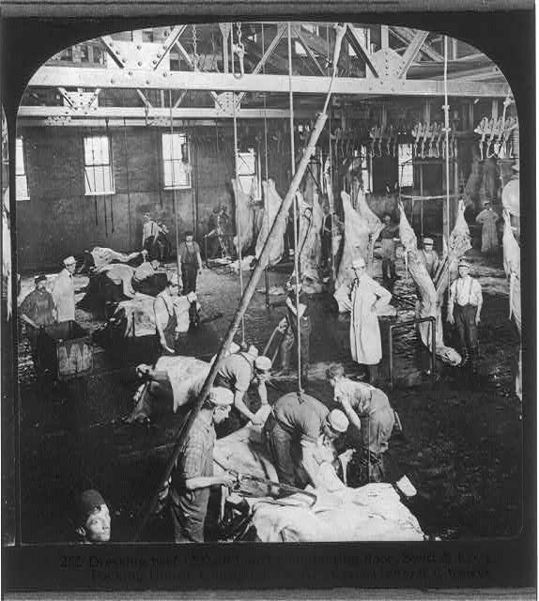

Slide 23
Muckrakers Expose Problems
What are some current examples of investigative media using television and other new media forms?
What is the difference between investigative reporting and sensationalism in the media?
Do you think that many of the stories that we see on the television and in the news today are sensationalized to sell newspapers or do you think many of the stories are legitimate?

Slide 24
Making Connections
Identify some ways in which political machine were corrupt in the late 1800s.
How did muckrakers bring about reform?
Answer the Essential Question: How did the Progressives fight corruption in business and government?
Eliminated the spoils system
Exposed corruption in business and government (muckraking)
17th amendment gives control to the people

Slide 25
Women and Progressives
Essential Question:
How did reforms affect the lives of women and other groups in the late 1800s?

Slide 26
Women’s Roles Change
Middle Class women’s lives became less centered around maintaining a home
Migration to cities = fewer children needed to help families survive
More children in school
Men working away from the home
More free time due to advances in technology
More time to pursue higher education

Slide 27
The “New Woman”
Popular way to refer to educated, modern women who pursued interests outside of the home
Jane Addams – Hull House – Chicago, 1889
Writers, public speakers, fund raisers, social and political reformers
Often formed clubs to focus their talents and energy

Slide 28
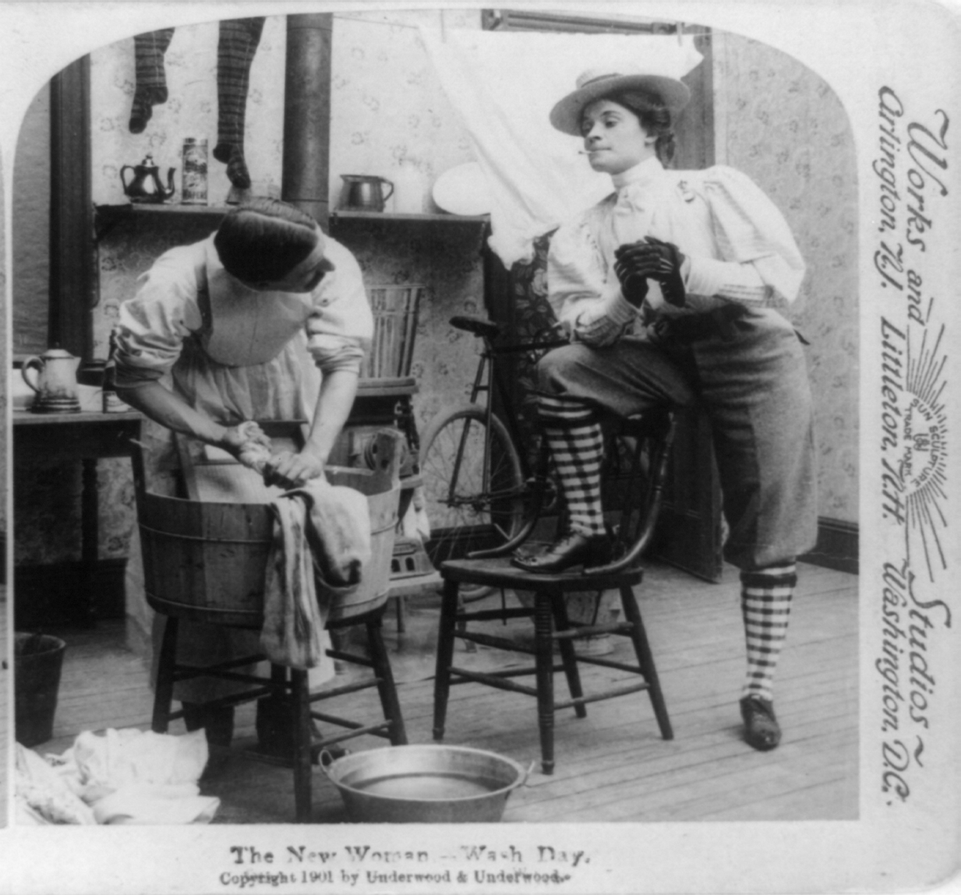
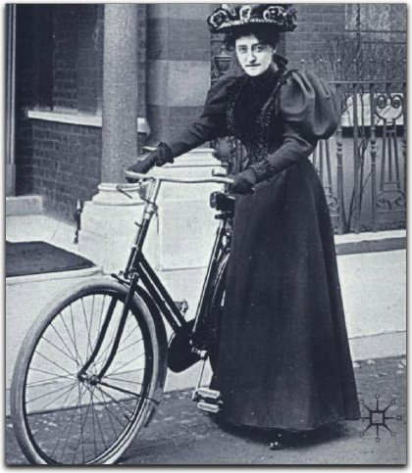

Slide 29
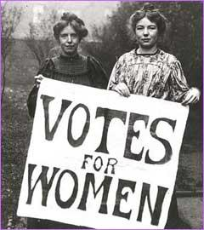
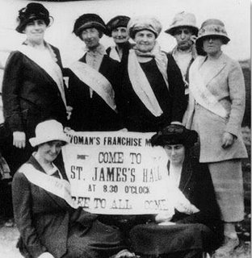
The Fight for Suffrage
Suffragists
Men and women who fought for women’s right to vote
Formed organizations to help their cause
Carrie Chapman Catt – National American Women’s Suffrage Association (NAWSA)

Slide 30
Opposition to Women’s Suffrage
Some men and women claimed that women’s suffrage would upset societies “natural” balance
Suffrage movement gains a lot of momentum
Wanted to vote for labor laws that would protect women and children
Respected people spoke out for the vote (Jane Addams)
Lobbied lawmakers
Organized marches
Delivered speeches on street corners

Slide 31
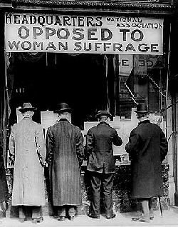

Slide 32
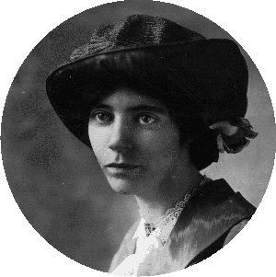
Continuing the Fight
Alice Paul
Quaker, social worker
Founded the National Women’s Party (NWP)
Sought greater economic and legal equality and suffrage
1917 – Paul and fellow suffragists arrested for protesting in front of White House
Hunger Strike

Slide 33
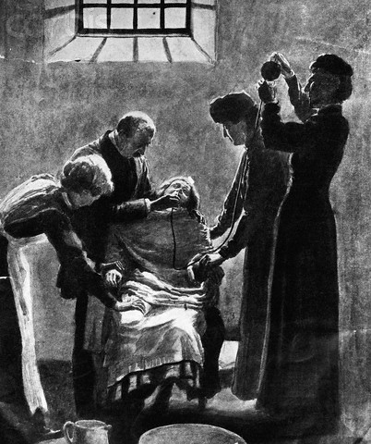

Slide 34
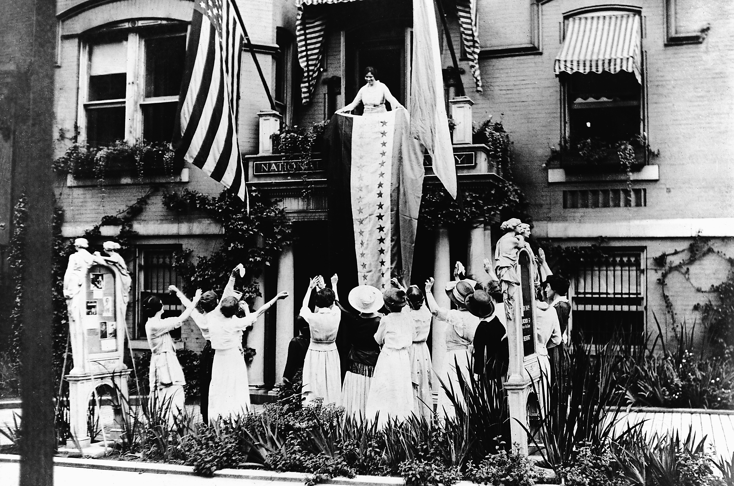
Women Vote Nationally
Gradually, more and more states allowed women to vote
1920 – Nineteenth Amendment goes into effect

Slide 35
Women and Social Reform
Women were active in many social reform efforts to improve the lives of others
Working class people and immigrants
Staffed libraries, schools and settlement houses
Sought to regulate the labor of both women and children
Sought regular inspections of the work place

Slide 36
The Work Place
Long Hours, Low Pay
No safety equipment or regulations for machines
Limited Breaks
Limited or no government regulation of cleanliness or safety

Slide 37
The Temperance Crusade
Crusade against alcohol led by Women’s Christian Temperance Union (WCTU) and the Anti- Saloon League
Supported prohibition
Laws that would ban making or selling of alcohol
Opposed alcohol for moral and social reasons
18th Amendment: The Prohibition Law: Ratified in 1919

Slide 38
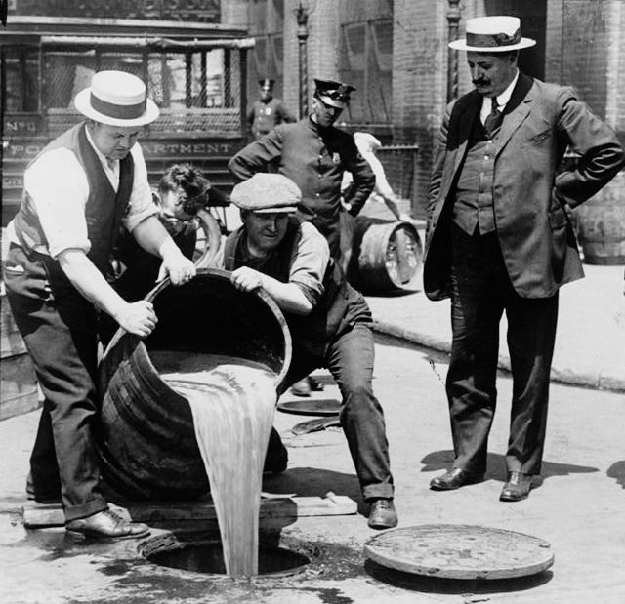
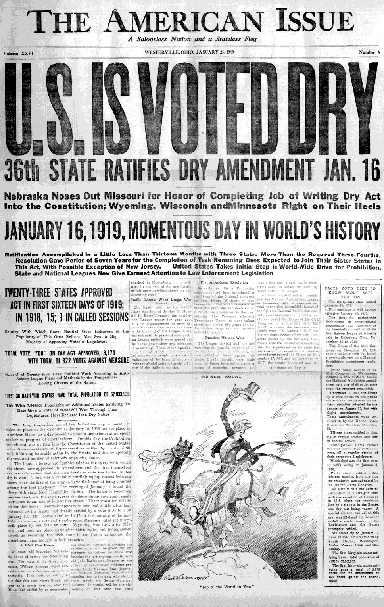

Slide 39
Making Connections
In what ways did middle class women’s roles change near the end of the 1800s?
In what ways did reformers try to improve the lives of workers?
Why was gaining the right to vote important to women?
Answer the Essential Question: How did reforms affect the lives of women and other groups in the late 1800s?

Slide 40
Progressive Presidents
Essential Question:
Why were Theodore Roosevelt and William Howard Taft known as Progressive presidents?

Slide 41
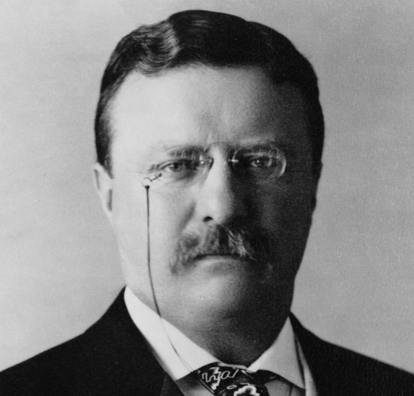
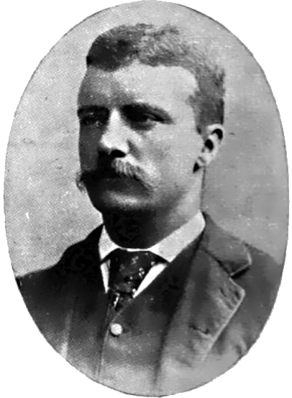
Theodore Roosevelt
Becomes president with the assassination of William McKinley in 1901
Brought Progressive ideas with him to the White House
Believed business must be regulated

Slide 42
The “Trustbuster”
Enforced the Sherman Anti-trust Act
Obtained legal charges against the beef, oil, railroad and tobacco industries
Did not want to destroy all trusts but thought they should be regulated
Used government power to force company owners to negotiate with strikers

Slide 43
Square Deal
Election of 1904 – Roosevelt wins easily by promising people a “square deal”
Fair and equal treatment for all
Called for government regulation of business (no more laissez-faire)
Meat Inspection Act and Pure Food and Drug Act
Ensure consumer safety
Gave the Food and Drug Administration the power to inspect products sold by a company

Slide 44
Conserving the Wilderness
Roosevelt had a life-long enthusiasm for the outdoors and the wilderness
Believed in the need for conservation
Protection and preservation of a country’s natural resources
Created the National Conservation Commission
Made conservation an important public issue

Slide 45
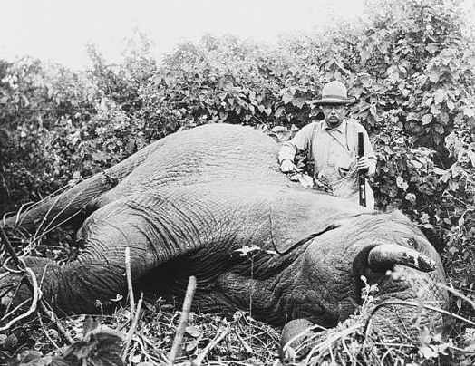
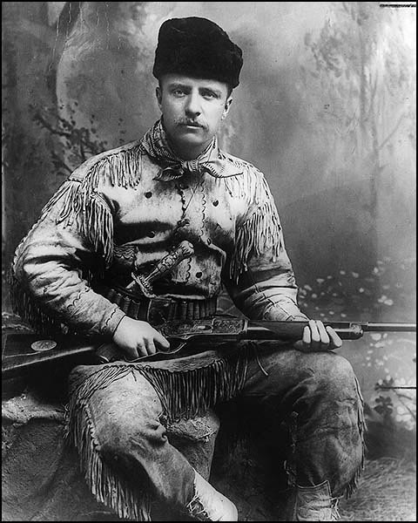
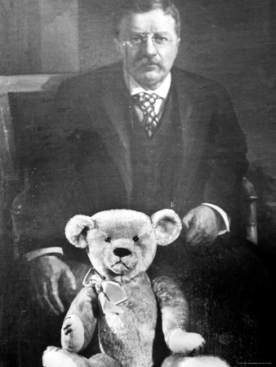

Slide 46
William Howard Taft
Election of 1908 – Roosevelt chose Taft to run as Republic President
The Taft Administration
Won may anti-trust cases
Favored safety standards in mines and railroads
Supported the Sixteenth Amendment: Graduated Income Tax
By 1912 however, Roosevelt withdrew his support for Taft due to lack of attention to conservation and lowering tariffs

Slide 47
Roosevelt Challenges Taft
Election of 1912 – Roosevelt challenges Taft for the Republican presidential nomination
Roosevelt won every primary but Taft won the nomination due to support from some businesses and party leaders
Roosevelt and his followers broke away from the Republican Party and formed the Progressive Party
Progressive Party nominated Roosevelt for president

Slide 48
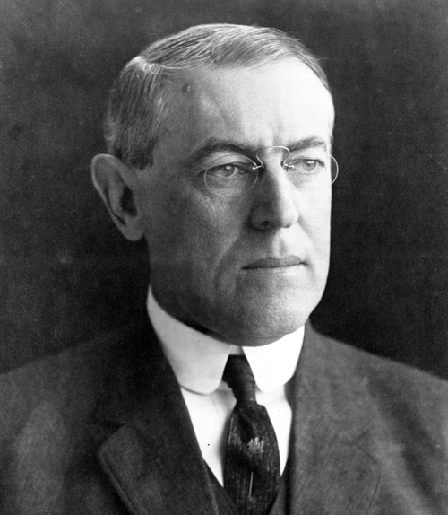
The Election of 1912
The split in the Republican Party hurt both Roosevelt and Taft in the election
Democrat and progressive reformer Woodrow Wilson was elected president due to the split in votes of the Republican and Progressive Parties

Slide 49
Wilson in the White House
1913 – Congress passed the Federal Reserve Act
Created 12 regional banks supervised by the government
Regulates banking
1914 – Federal Trade Commission (FTC)
Investigated corporations for unfair trade practices
Clayton Anti-trust Act
Replaced Sherman Anti-trust Act as government weapon against trusts
Tried to regulate child labor

Slide 50
Making Connections
How do you think Roosevelt might have felt about President Wilson’s policies?
Using the diagram below, identify legislation supported by President Roosevelt.
Answer the Essential Question: Why were Theodore Roosevelt and William Howard Taft known as Progressive presidents?

Slide 51
Excluded From Reform
Essential Question:
How did minority group react to discrimination?

Slide 52
Prejudice and Discrimination
Many members of ethnic and religious minority groups in the United States faced discrimination and even violence
The received unequal treatment because of their
Race
Religion
Ethnic background
Place of birth
Catholics, Jews, Asians and Mexicans faced much discrimination during this time

Slide 53
Discrimination Against African Americans
Faced prejudice in the North and South
Most worked as rural sharecroppers or as low paid workers in the cities
Separated from white society
Neighborhoods, schools, parks, restaurants, theaters, cemeteries
Plessy vs. Ferguson – “Separate but equal”
Resurgence of the Ku Klux Klan in 1915 calling for “100 percent Americanism”

Slide 54
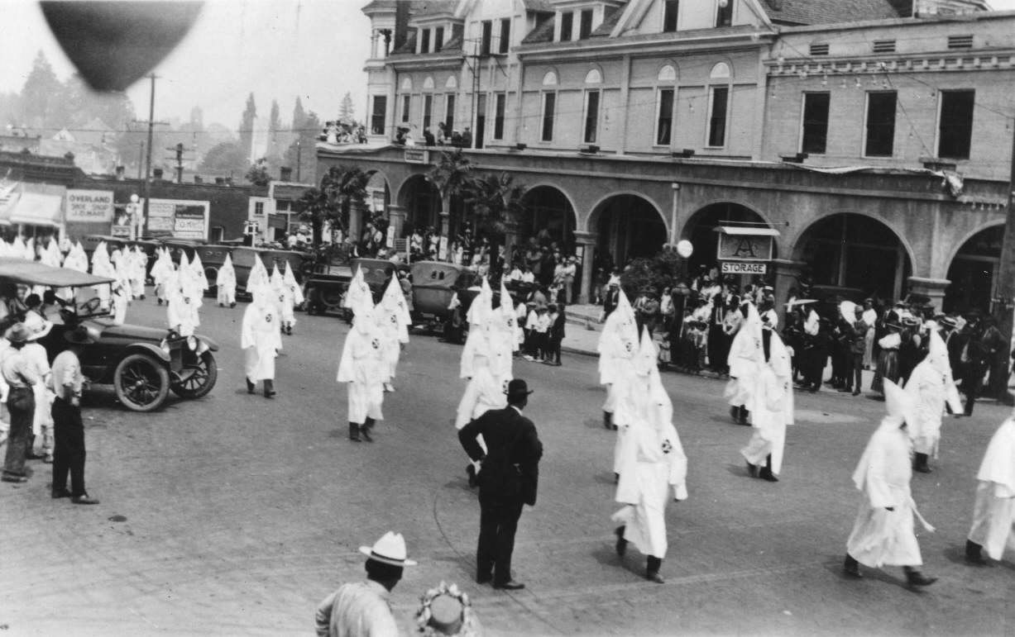
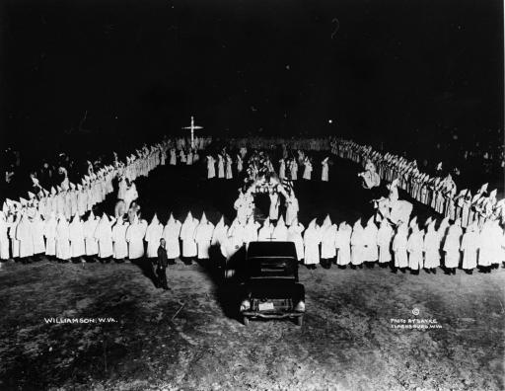
KKK Membership
KKK Membership
1915-----5,000
1920-----100,000
1924-----4,000,000
1930-----30,000

Slide 55
Struggle for Equal Opportunities
Minorities often banned from joining progressive organizations due to prejudice
Many minorities took steps to form organizations that would improve their lives
Major figures who fought for the rights of African Americans were
Booker T. Washington: Vocational Training (Skill/Trade)
W.E.B. DuBois: Educational Training (Career/Activism)
Marcus Garvey: Created UNIA (African American nationalism, Separatism, “Back to Africa” movement
Ida B. Wells: Anti-lynching crusade, founder of the NAACP

Slide 56
Making Connections
Why did many Americans and recent immigrants face discrimination in the Progressive Era?
Answer the Essential Question: How did minority groups react to discrimination?

