Slide 1
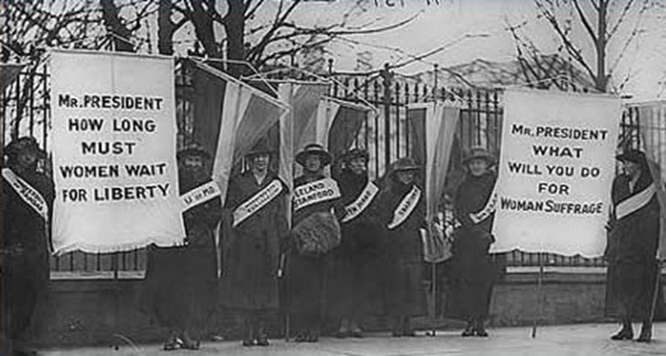
Chapter 9: The Progressive Era

Slide 2
Section 1: The Origins of Progressivism

Slide 3
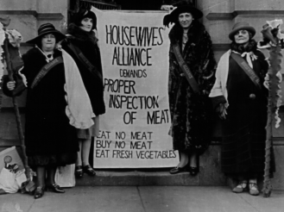
The Progressive Movement
In the late 1800’s many Americans began calling for sweeping changes across the nation
This voice mainly came from the rapidly growing middle class
Shared a belief that industrialization and urbanization had created troubling social and political problems
Wanted to bring about reforms that would correct these problems and injustices through logic and reason
Chapter 9 Section 1

Slide 4
Progressives Target a Variety of Other Problems
Political Reform-
The vote was the primary goal of many woman
Honest Government-
Targeted political officials who build corrupt organizations, called political machines
Wretched living conditions caused by inadequate services
Big Business-
Wanted greater economic opportunities for smaller businesses
Class System-
Wanted to reduce growing gap between rich and poor
Attacked harsh working and living conditions
Wanted social welfare laws for children
Wanted government regulations to aid workers and consumers

Slide 5
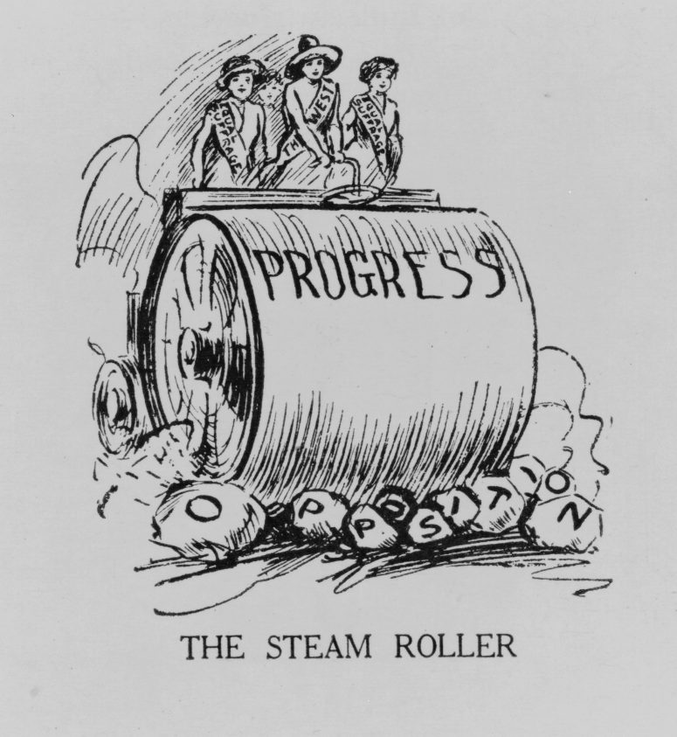
The Progressive Movement
The Progressive Movement-A movement to restore economic opportunities and correct injustices in American life
The Progressive Movement had four main goals:
Protecting Social Welfare
Promoting Moral Improvement
Creating Economic Reform
Fostering Efficiency

Slide 6
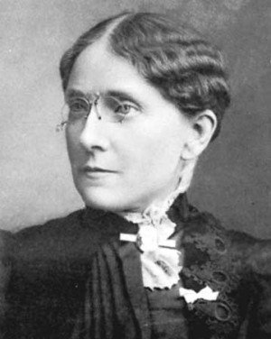
Protecting Social Welfare
During the late 1800’s social welfare reformers worked to soften the harsh conditions resulting from rapid industrialization
Social Gospel and settlement house movements worked with community centers and local churches to help the poor through social service programs
The Young Men’s Christian Association (YMCA) opened libraries, sponsored classes, built along with organizing activities like handball and building swimming pools
Florence Kelly was influential in helping pass the Illinois Factory Act of 1893.
This act prohibited child labor and limited the hours a woman would be forced to work

Slide 7
Promoting Moral Improvement
While protecting social welfare was important many felt that the key to reform was an improved sense of morality.
These reformers wanted immigrants and poor city dwellers to help themselves by improving their personal behavior
One solution was adopting prohibition
Prohibition-The movement to ban alcoholic beverages for the preservation of American morals and values

Slide 8
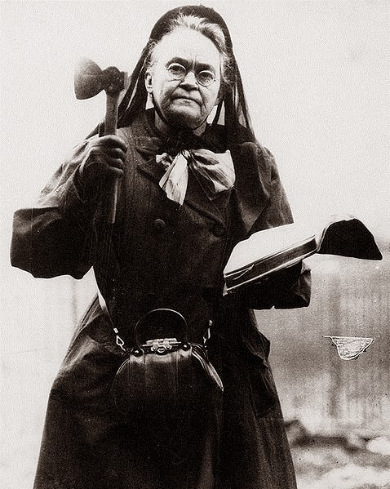
Promoting Moral Improvement
Crusade against alcohol led by Women’s Christian Temperance Union (WCTU) and the Anti- Saloon League
Supported prohibition
Laws that would ban making or selling of alcohol
Opposed alcohol for moral and social reasons
18th Amendment: The Prohibition Law: Ratified in 1919

Slide 9
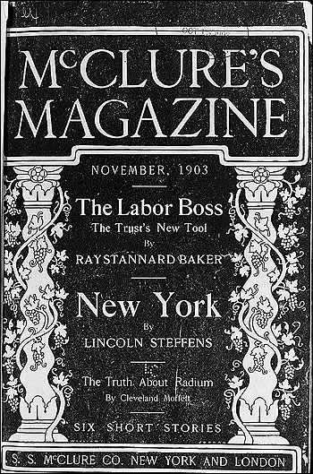
Muckrakers
Socially conscious journalists/writers who uncovered a wide range of ills afflicting America in the early 1900s
Name coined by Theodore Roosevelt, who thought they were too focused on the ugly side of things
Muckrake is a tool used to clean manure and hay out of animals’ stables
Articles appeared in newspapers and magazines which were widely read by American families, many of whom were horrified by what they read

Slide 10
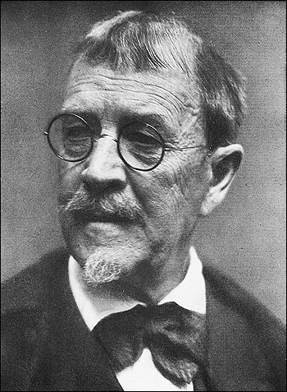
The Shame of Cities
Lincoln Steffens
Leading Muckraker and managing editor at McClure’s, a magazine well known for uncovering social problems
Published The Shame of the Cities in 1903
Collection of articles on political corruption
Exposed corrupt politicians, especially those from Philadelphia, and revealed the effect of corruption

Slide 11
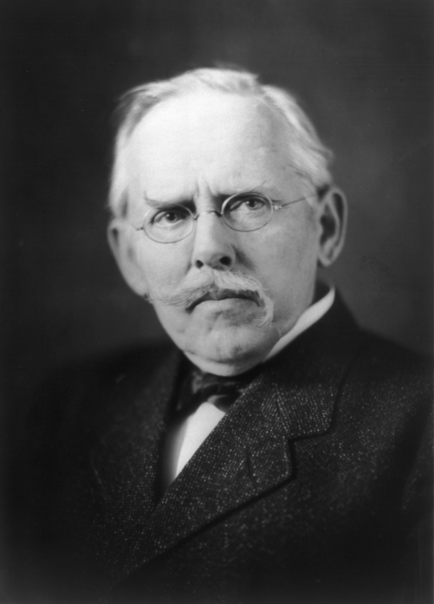
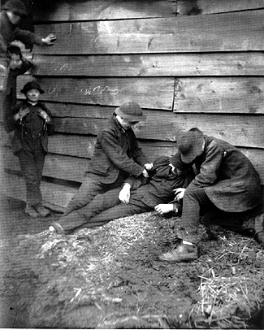
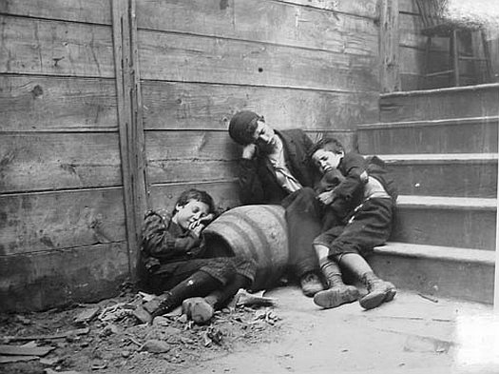
Jacob Riis
Muckraker photographer for the New York Evening Sun
Photographed crowded, unsafe, rat-infested, tenement buildings where the poor lived
Published several works, including How the Other Half Lives

Slide 12
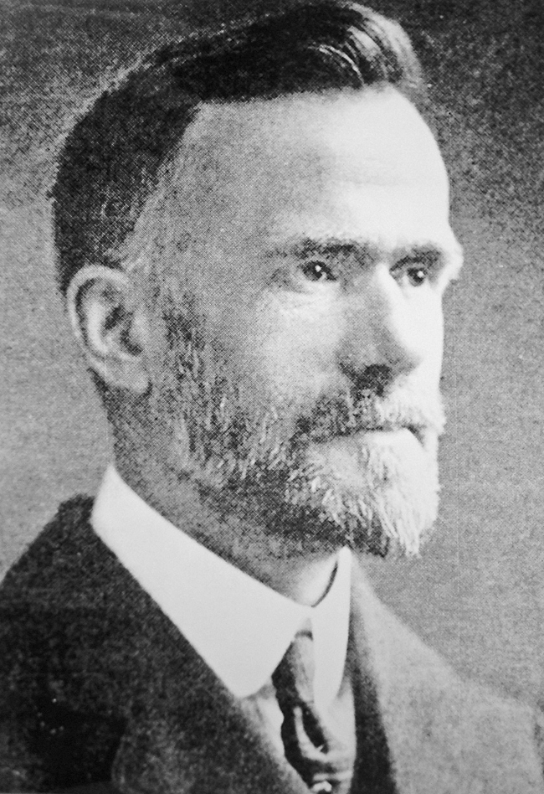
Social Gospel
Many people thought Christianity should be the basis for social reform
Walter Rauschenbusch
Baptist minister who combined German socialism and American Progressivism to form the Social Gospel
Taught that people could make society the kingdom of God
Inspired a push against child labor and for a shorter work week, as well as a push for a limitation of power for corruption and trusts

Slide 13
Settlement house
Settlement House Workers Aid the Union:
Settlement House- community center that provided social services to the urban poor
Used to improve the lives of poor people
Settlement House Workers:
Taught women childcare
English to immigrants
Ran nursery schools and kindergartens
Theatre/art/dance programs for adults

Slide 14
Jane Addams
Jane Addams- Leader in the settlement house movement
Inspired by work at “Toynbee Hall” (settlement house in London)
Opened Hull House in Chicago
“Hull House”
The number of settlement houses greatly increased over the years
Success inspired college-educated, middle class women to become social workers

Slide 15
Florence Kelley’s Contribution
Lawyer Florence Kelley was a leading figure
Protecting children and their education
Efforts to ban child labor in Illinois
“National Child Labor Committee”: Successfully promoted the national government to create the U.S. Children’s Bureau
Protected the health and welfare of children

Slide 16
Triangle Shirtwaist Factory
(1911) Triangle Shirtwaist Factory Fire:
Caused large-scale casualties
Fire that rose awareness to protect the workers
Progressives called for reform to protect factory workers
New York passed laws to protect workers and other states followed the suit
Other states passed compensation laws
Prevented the previous dangers of factory workers (long hours/poor ventilation/hazardous fumes/dangerous machinery etc.)
Funded workers who were hurt on the job

Slide 17
Section 2: Women in Public Life

Slide 18
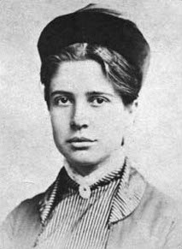
Florence Kelley
Women advocator that believed that women were hurt by the unfair prices of goods they had to buy to run their homes
1899 helped founded National Consumers League
Labeled goods as fairly priced and urged women to buy labeled goods
Helped form Women’s Trade Union League (WTUL) – tried to improve female working conditions, pushed for minimum wage, and 8-hour work day

Slide 19
NCL – National Consumer’s League
Group organized in 1899 to investigate conditions under which goods were made and sold and to promote safe working conditions and a minimum wage
Special labels to “goods produced under fair, safe, and healthy working conditions”
Pushed for reforms – government inspect meatpacking plants, make workplaces safer, give unemployed payments

Slide 20
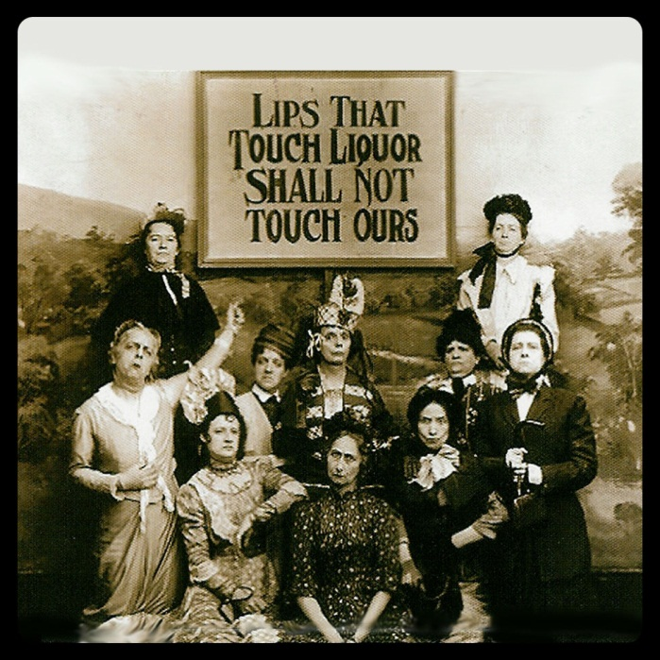
Temperance Movement
Led by Women’s Christian Temperance Union (WCTU)
Promoted temperance – “practice of never drinking alcohol” or moderate use
Believed alcohol use led men to neglect their families, abuse their wives, and spend majority of money on liquor
Led to passage of 18th Amendment – outlawed production and sale of alcohol

Slide 21
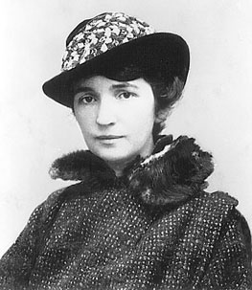
Margaret Sanger
Nurse who thought that family life and women’s health would improve if women had fewer children
One of 11 children
1916 opened first birth-control clinic
Jailed several times as a “public nuisance”
1921 – founded American Birth Control League to make this information available to more women
Federal courts said doctors could give out this information about “family planning”

Slide 22
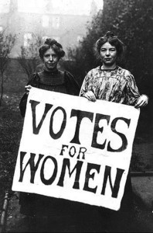
Suffrage
Right to vote
Goal of Progressive women
Only way to make sure government would protect children, foster education, and support family life
Women need to vote because political issues reached inside people’s homes – Jane Addams
Reformers – Susan B. Anthony and Elizabeth Cady Stanton succeeded at state level in Wyoming and Colorado by end of 1890s

Slide 23
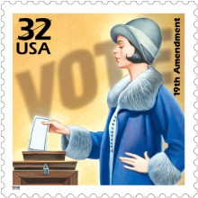
Nineteenth Amendment
Constitutional amendment that gave women the right to vote
Vote “shall not be denied on account of sex”
Tennessee State House of Representatives passed the amendment by one vote – became official

Slide 24
Progressive women reformers

Slide 25
How did Progressive women reformers propose to solve societal problems?
Alice Paul – formed National Women’s Party
Public protest marches
Focused on right to vote
Carrie Chapman Catt – speaker, urged people to join National American Woman Suffrage Association
President of association
Ida B. Wells – black teacher, helped form National Association of Colored Women
Raised money to educate black children while parents went to work
Florence Kelly
Margaret Sanger

Slide 26
Section 3: The Struggle Against Discrimination

Slide 27
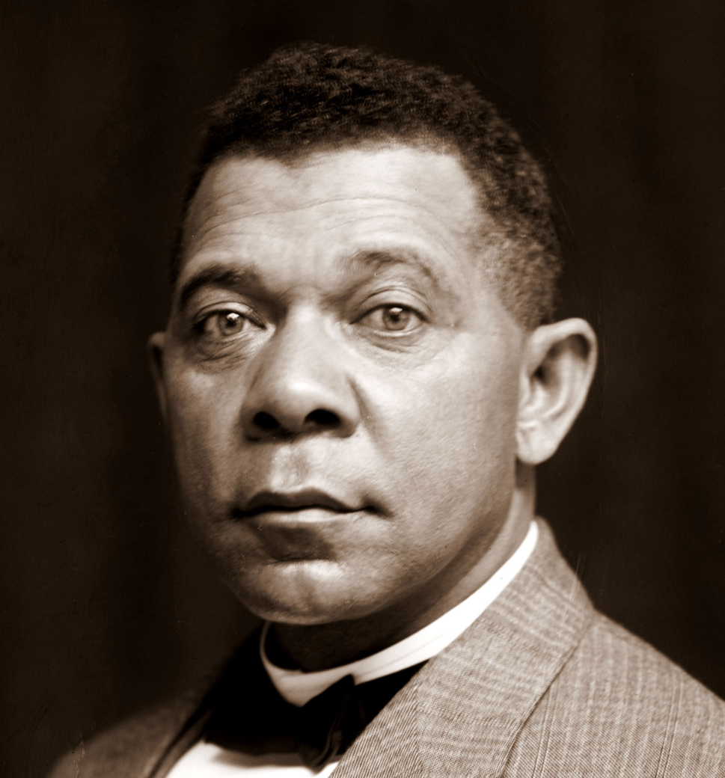
Booker T. Washington
(1856-1915)
Believed that African Americans had to achieve economic independence before civil rights
Black people must tolerate discrimination while they proved them selves equal to white people
By working hard and waiting patiently he believed African Americans would gradually win white American’s respect
Notes:
“[The Negro must] live peaceably with his white neighbors… the Negro [must] deport himself modestly… depending upon the slow but sure influences that proceed from the possessions of property, intelligence, and high character for the full recognition of is political rights

Slide 28
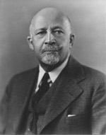
W.E.B. Du Bois
(1868-1963)
Believed that African Americans had to demand their social and civil rights
If they didn’t they would become permanent victims of racism
They must fight every day for the rights given to them in the constitution.
Both he and William Monroe Trotter urged African Americans to demand for their rights
Notes:
“We claim for ourselves every single right that belongs to a freeborn American, political, civil and social; and until we get these rights we will never cease to protest… How shall we get them? By voting where we may vote, by persistent, unceasing agitation, by hammering at the truth, by sacrificing and work.”

Slide 29
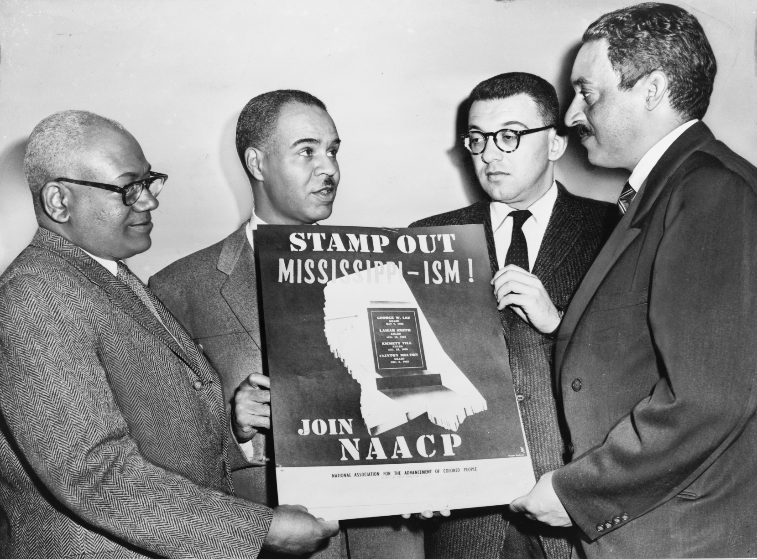
National Association for the Advancement of Colored People NAACP

Slide 30
National Association for the Advancement of Colored People NAACP
Their goal was for African Americans to be “Physically free from peonage [forced, low-paid labor], mentally free from ignorance, politically free from disfranchisement, and socially free from insult”
Leaders included white and black Progressives.
They focused on the battle for equal access to decent housing professional careers like teaching
Focused on middle class
Famous leaders: Jane Addams, Ray Stannard Bakers, Florence Kelley
Ida B. Wells used her newspaper to make clear the horror of lynching

Slide 31
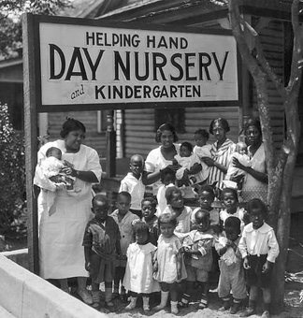
Urban League
Local black clubs and churches set up employment agencies and relief efforts to help African Americans get settled and find work
Focused on poorer workers
Helped families buy clothes, books, and send children to school
Helped factory workers and maids find jobs
Notes:
Both NAACP and Urban League still aid African Americans today

Slide 32
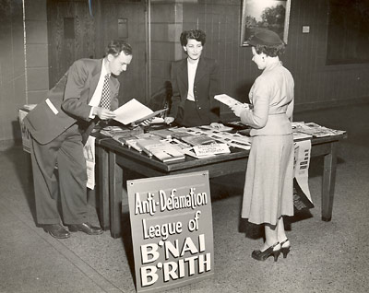
Anti-Defamation League
Goal: to defend Jews and others against physical and verbal attacks, false statements, and “to secure justice and fair treatment to all citizens alike”

Slide 33
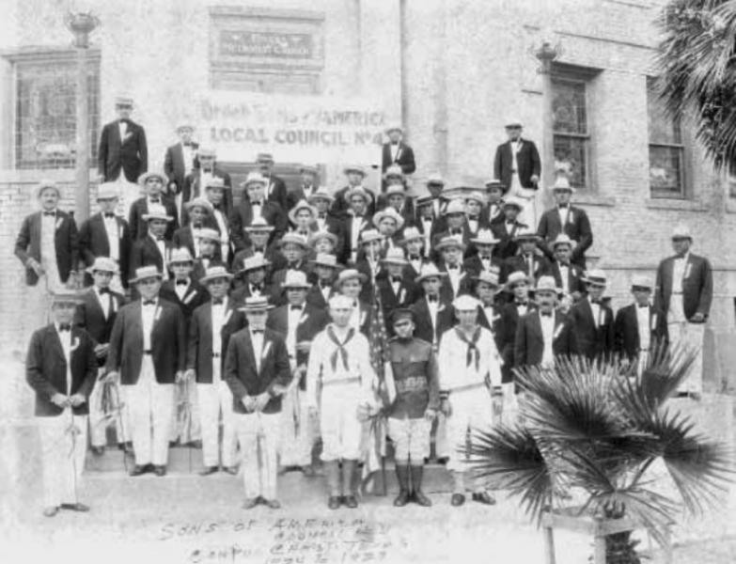
Mutualistas
Organized by Mexican Americans
Groups that made loans and provided legal assistance
Had insurance programs to help members if they were too sick to work

Slide 34
Works Cited PPT-Based on the work of : Lauren Davis, Mary Kate DeLuca, Gabby Hummel, Jordan Veneri
"90 Years Hence: Honoring the Women's Suffrage Movement." Politic365. N.p., n.d. Web. 07 Apr. 2014.
"Barnhardt." Barnhardt. N.p., n.d. Web. 07 Apr. 2014.
"Blanche Armwood - Tampa Native." Blanche Armwood - Tampa Native. Tampix, n.d. Web. 07 Apr. 2014.
"Blanche Armwood - Tampa Native." Blanche Armwood - Tampa Native. Tampix, n.d. Web. 07 Apr. 2014.
"Booker T. Washington on Black Victimhood." The American Vision. N.p., n.d. Web. 07 Apr. 2014.
"Florence Kelley." About.com Women's History. N.p., n.d. Web. 07 Apr. 2014.
"Florence Kelley." Wikipedia. Wikimedia Foundation, 04 June 2014. Web. 07 Apr. 2014.
"History of the University of Illinois at Chicago." History of the University of Illinois at Chicago. N.p., n.d. Web. 07 Apr. 2014.
"Jewish Museum Milwaukee." Community Organizations » Archives & Collections » Historical Records ». N.p., n.d. Web. 07 Apr. 2014.
"Mutual Aid Societies | Open Websites." Mutual Aid Societies | Open Websites. N.p., n.d. Web. 07 Apr. 2014.
"NAACP History: W.E.B. Dubois." NAACP. NAACP, n.d. Web. 06 Apr. 2014.
"National Association for the Advancement of Colored People." Wikipedia. Wikimedia Foundation, 04 Apr. 2014. Web. 06 Apr. 2014.
"National Women's History Museum." Education & Resources. N.p., n.d. Web. 05 Apr. 2014.
"Progressive Era." Mrspencerinfo. N.p., n.d. Web. 08 Apr. 2014.
"Settlement Houses: Lillian Wald / Women 's Leadership in America History." Settlement Houses: Lillian Wald / Women 's Leadership in America History. N.p., n.d. Web. 07 Apr. 2014.

Slide 35
Works Cited Cont’d
"Tenon Tours: It's a Big World. Travel It." Tenon Tours. N.p., n.d. Web. 07 Apr. 2014.
"The Triangle Shirtwaist Factory Fire." EVE Equal Visibility Everywhere RSS. N.p., n.d. Web. 06 Apr. 2014.
"USPS Stamp of Approval." USPS Stamp of Approval. N.p., n.d. Web. 07 Apr. 2014.
"VII. Pietro and the Jew. Riis, Jacob A. 1902. The Battle with the Slum." VII. Pietro and the Jew. Riis, Jacob A. 1902. The Battle with the Slum. N.p., n.d. Web. 07 Apr. 2014.
AP US History. N.d. Library of Congress, Washington, DC. Progressive Era. Web. 08 Apr. 2014.
Children "Helped" Their Parents to Make Meager Family Wages Prior to the Federal Law, in The Long Road: Fortieth Anniversary Report of the NCLC, National Child Labor Committee, [1944], Harry Elkins Widener Memorial Library, Harvard College Library.
How Was the Photograph Taken? 1936. Library of Congress, Washington, DC. How Was the Photograph Taken? By Jacob Riis. Web. 08 Apr. 2014.
Lapsansky-Werner, Emma J. "Chapter 17: The Progressive Era." United States History. Upper Saddle River, NJ: Pearson, 2013. 546-68. Print.
MassCommSHEVEN. Digital image. : Muckraking: The Birth of Investigative Journalism. N.p., n.d. Web. 08 Apr. 2014.
McDurmon, Joel. "Booker T. Washington on Black Victimhood." The American Vision. A Biblical Worldview Ministry, n.d. Web. 07 Apr. 2014.
Members of the National Woman's Party Picket the White House. N.d. Library of Congress, Washington, DC. Women in the Progressive Era. By NWHM. Web. 06 Apr. 2014.
Spartacus Educational. 1890. Library of Congress, Washington, DC. Spartacus Educational. By Jacob Riis. Web. 08 Apr. 2014.
The Selvedge Yard. 1880-1890. New York Tenement Museum, New York, New York. The Selvedge Yard. By Jacob Riis. Web. 08 Apr. 2014.
United States Library of Congress Prints and Photographs Division. Jacob Riis in 1906. Digital image. Wikipedia. N.p., 2006. Web. 2014.
Walter Rauschenbusch. 1923. Georgetown University, Washington, DC. Wikipedia. Web. 08 Apr. 2014.

Slide 36
Section 3
Teddy Roosevelt’s square deal

Slide 37
A rough riding president
Roosevelt was initially placed as Vice President with McKinley by the big business leaders so as to not have any power.
This worked until McKinley was assassinated 6 months into his 2nd term making teddy Roosevelt president.
Roosevelt was very ambitious and achieved many things. He was an avid horse back rider and marksman. While in school at Harvard he wrestled and boxed
He was an aspiring new York politician he was on city council, became police commissioner, and also assistant secretary of the U.S. Navy
He led a group known as “the roughriders” into battle against Spain down in Cuba at the battle of san Juan hill.
After this he became a national hero and was elected as governor of new York

Slide 38
A rough riding president
Roosevelt became (and still is) the youngest president ever at the age of 42
While he was in office he loved to box and ride horseback
He was very bold in his decisions and actions and made the presidency what it is today with his actions and policies
He saw the presidency as a “bully pulpit” to get things done.
He put into place the square deal which helped people if the big businesses did them wrong

Slide 39
Using federal power
Roosevelt felt America needed a strong federal government as the country grew
Trusts were a big issue in America in this time period
Trusts were legal bodies created to hold stock in many companies therefore they controlled many companies in a market
Trusts controlled 4/5 of the market he filed 44 antitrust law suits under the Sherman antitrust law winning several of them and successfully breaking up several trusts

Slide 40
1902 coal strike
In 1902 140,000 coal miners went on strike demanding a 20% pay raise, 9 hour work days, and the right to organize a union
After5 months of the strike Roosevelt called both sides to the white house and worked out a deal to end the strike
This set a precedent moving forward that if strikes were to occur the federal government would intervene and help resolve it.

Slide 41
Railroad regulation
Roosevelt had congress pass the elkins act of 1903 which made it illegal to use rebates for rail road shippers or receivers based on what rail road company they used
This also said they could not change their rates without notifying the public first
Hepburn act of 1906 prohibited the use of free rail road passes
It also gave the icc the ability to set a maximum rate for the rail roads.

Slide 42
Health and the environment
After reading Upton Sinclair’s book “the jungle” he pushed for regulations for food especially meats
1906 he passed the meat inspection act which insured meat was clean and not spoiled before being allowed to be sold or used in public. These policies were used until the 1990’s until more up to date procedures were implemented
1906 he passed the pure food and drug act which made sure all foods were clean and not contaminated and it also made sure that all labels on foods were accurate

Slide 43
Conservation and natural resources
Roosevelt made it a priority to conserve some of Americas natural land
America was destroying al of their natural resources rapidly and Roosevelt set out to stop this from happening
1905 he named Gifford Pinchot head of the u.s. forest service. He encouraged Roosevelt to set aside large tracts of land for national conservation and made it illegal to sell it or mess it up in any way.
He also created large scale conservation acts that created waterways, dams and protected the natural lands of America

Slide 44
Roosevelt and civil rights
Roosevelt did not pay much attention to civil rights and it was not a major issue of his presidency
Roosevelt respected and dealt with booker t. Washington who a lot of other blacks opposed due to his position that blacks were the cause of their own poverty and they should accept segregation until they can work to improve their own situation.
W.e.b. dubois was particularly against washingtons views
1909 a group of them formed the naacp (national associati0on for the advancement of colored people)

