Slide 1
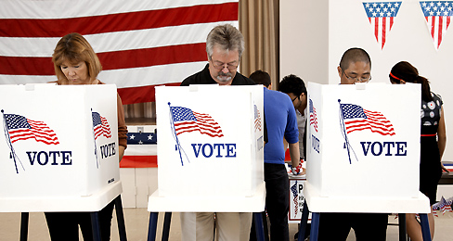
Chapter 6: Voters and Voter Behavior

Slide 2
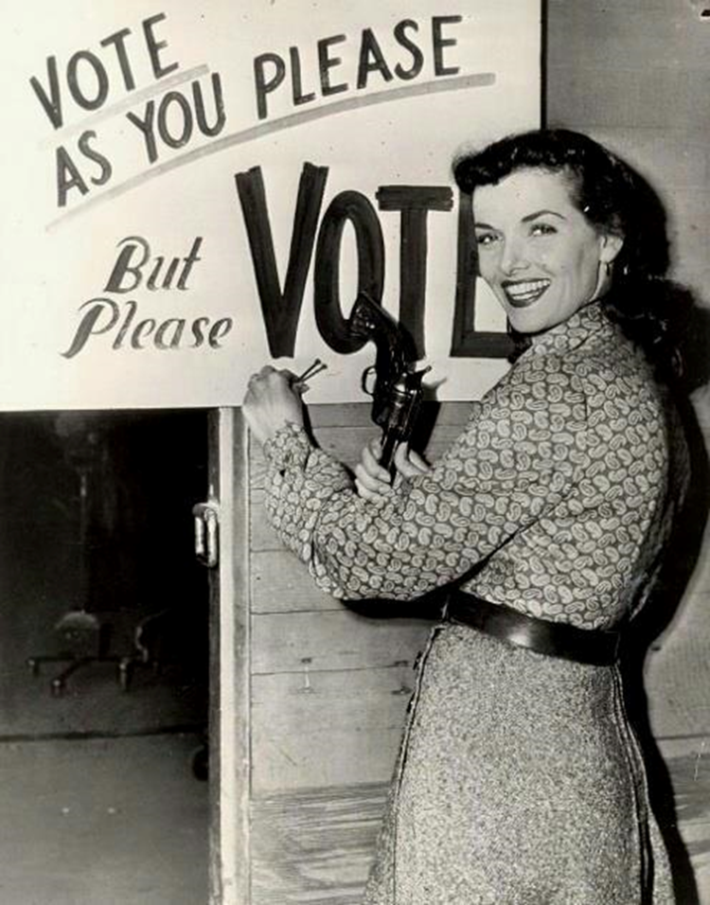
Section One: The Right to Vote (pg. 152-155)

Slide 3
History of Voting Rights
How have voting rights changed over the course of American history?
Over time, voting rights have been extended to more Americans
Previous voting qualifications based on property ownership, religion, race, sex have all been eliminated through federal laws and constitutional amendments
Age requirement for voting has been reduced

Slide 4
The Electorate
The Constitution originally gave the power to decide voter qualifications to the States
White male property owners
Since 1789, many restrictions to voting rights have been eliminated
Power to decide who has the right to vote has been shifting from the States to the federal government
This trend can be examined in five stages

Slide 5
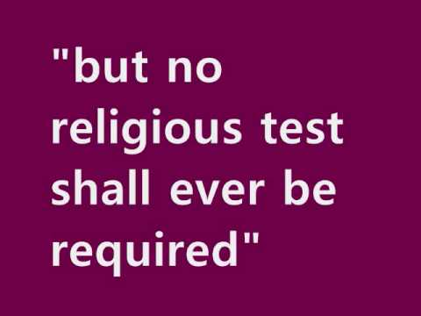
Stage One
Religious, property, and tax qualifications begin to disappear in every State
Religious qualifications eliminated by 1810
In early 1800s, gradual elimination of property ownership and tax payment qualifications
By 1860, almost all white males could vote in every State

Slide 6
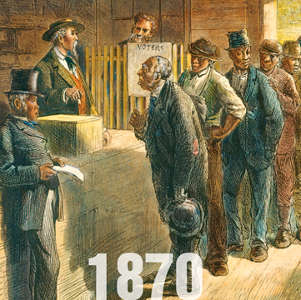
Stage Two
After the Civil War, the 15th Amendment made it illegal to deny any citizen the right to vote based on their color or race
African Americans given right to vote?

Slide 7
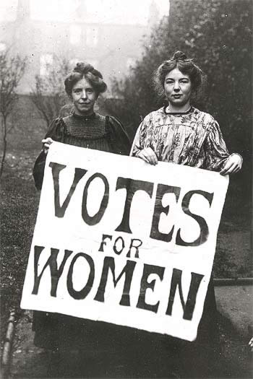
Stage Three
In 1920, the ratification of the 19th Amendment gave women the right to vote
By 1920, more than half the States had already followed the example set by Wyoming in 1869

Slide 8
Women’s Suffrage in 1919

Slide 9
Stage Four & Five
During the 1960s, the civil rights movement led to new protections for African American voting rights.
The Voting Rights Act of 1965 defended racial equality in voting.
The 24th Amendment eliminated the poll tax in federal elections.
In 1971 the 26th Amendment gave those 18 and older the right to vote.

Slide 10
Voting Qualifications
The Constitution sets five restrictions on the ability of the States to set voter qualifications.
Anyone allowed to vote for members of their State legislature must be allowed to vote for members of Congress.
The 15th Amendment bans the States from depriving any person of the right to vote on account of their race, color, or having once been enslaved.

Slide 11
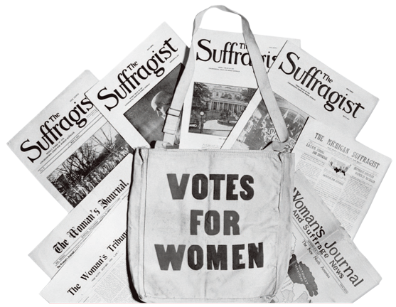
Voting Qualifications
Under the 19th Amendment, no State can deprive any person of the right to vote based on their sex.
No State can levy a tax on the right to vote for President, Vice President, or members of Congress.

Slide 12
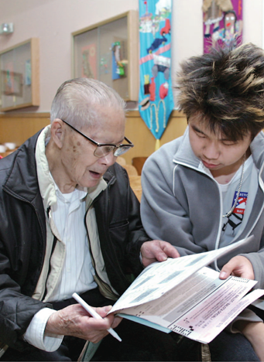
Voting Qualifications
Under the 26th Amendment, no State can deprive any person who is at least 18 years of age of the right to vote because of their age.

Slide 13
Chapter 6: Section 2
Voter
and
Voter Behavior

Slide 14
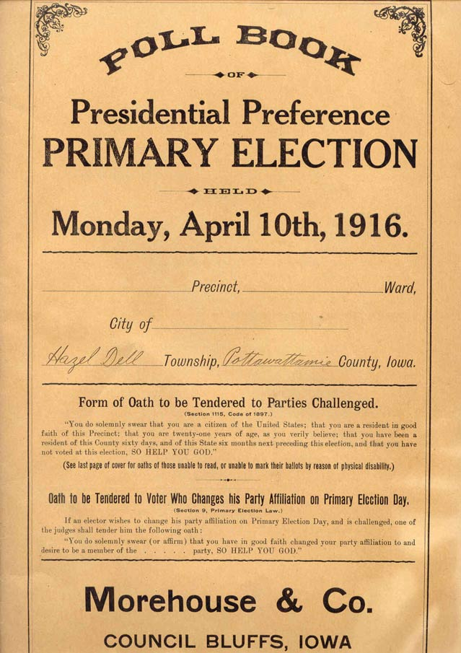
Vocab
Alien
Transients
Registration
Purging
Poll Books

Slide 15
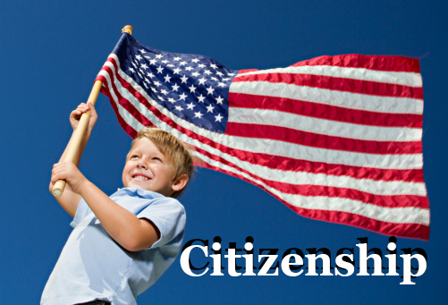
Universal Requirements
1. Citizenship
2. Residence
3. Age

Slide 16
Citizenship
In most States, foreign-born residents who are not citizens cannot vote
Citizenship is determined by each State
States can also distinguish between native born and naturalized citizens, requiring that voters become citizens of that State for a minimum period of time before being allowed to vote
Ex: Pennsylvania

Slide 17
Residency
A person must be a legal resident of the State in which he or she votes
In the past, this meant a person had to be a State resident for at least a year to vote in that State
Dunn v. Blumstein (1972)
Transients cannot vote in the State where they are living temporarily
Why do you think that is?
Voters living outside their State, such as soldiers, can cast absentee ballots

Slide 18
Soldiers & Absentee Ballots

Slide 19
Age
Under the 26th Amendment, the minimum voting age cannot be older than 18
Before the passage of this amendment, the minimum age had been 21 in most States
Some States allow 17 year olds to vote in primary elections
Illinois
Historically, young voters have been less likely to vote than other age groups

Slide 20
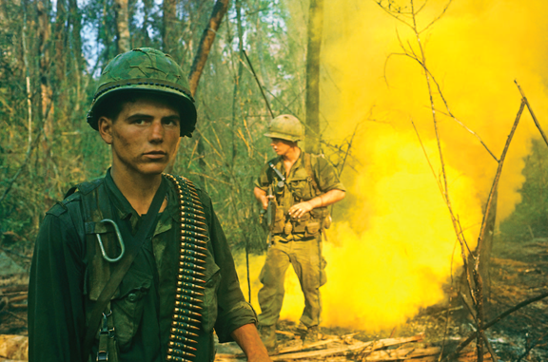
Age
What event was significant to lowering the voting age?

Slide 21
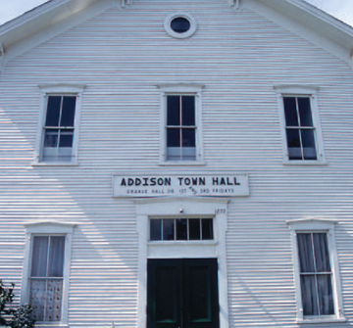
Voter Registration
In almost all States, one must be registered in order to vote
Usually this involves providing age, name, place of birth, address, length of residence
Registrar or county clerk typically keeps record of all eligible voters

Slide 22
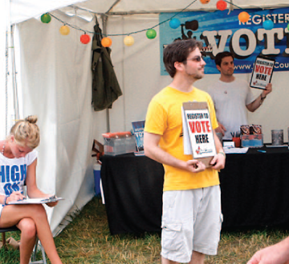
Voter Registration
Can take place at rallies, fairs, school campuses, and other public places
In other democracies, voters must be registered by law, in the United States it is voluntary
Opinions?

Slide 23
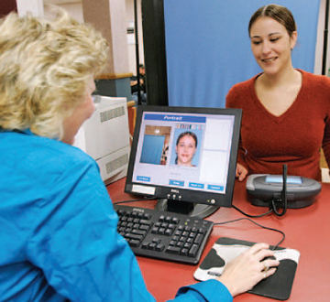
Voter Registration
The Motor Voter Act requires all States to:
Let eligible citizens register when they apply for or renew a driver’s license
Provide voter registration by mail
Make registration forms available at State offices

Slide 24
ID to Vote?
In 2005, Indiana passed a law requiring voters to present photo ID to vote
In 2008, the Supreme Court ruled that the law was constitutional and did not create a barrier to voting
Why do you think that voter ID laws are controversial?
Does it create an impediment to voting?
Is it necessary?

Slide 25
Tests and Taxes
Literacy tests for voting were once common, but are no longer used
These were often aimed at denying African Americans the ability to vote
Grandfather clauses
Some States, particularly in the South, also charged a poll tax to vote
24th Amendment

Slide 26
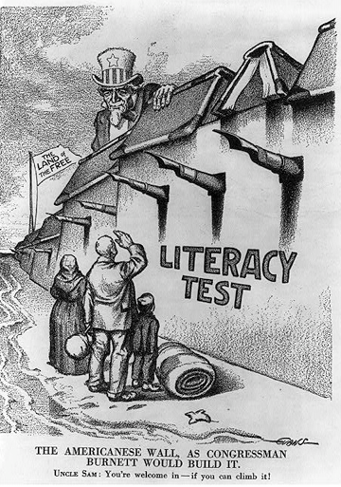

Slide 27
Persons Denied the Vote
Every State denies the vote to some people
Few States allow people found mentally incompetent to vote
Most States disqualify people convicted of serious crimes from voting (felons)
However, in many of these states, it is possible for felons to regain their voting rights
Can you name the two states were there are no restrictions on convicted felons?
Some States also ban those dishonorably discharged from the armed forces from voting

Slide 28
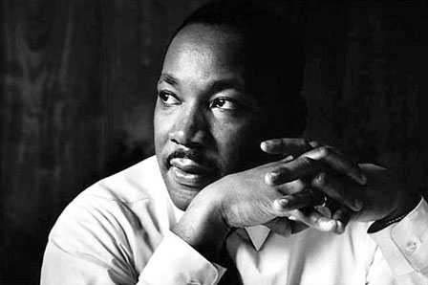
Section 3-Suffrage and Civil Rights

Slide 29
Gerrymandering
Gerrymandering-The process of drawing electoral district lines in order to limit the voting strength of a particular group or party.
It’s a method that helps political parties gain seats in the House of Reps
There are two main styles of gerrymandering:
Packing: Putting as many members of one party into one district to limit the amount of seats they win
Cracking: Splitting voters of the opposing party into two different districts

Slide 30
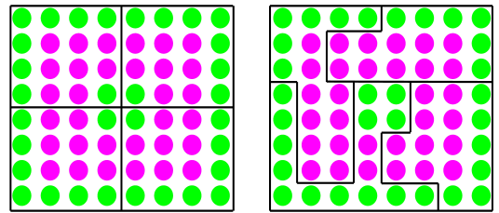
Gerrymandering Example Diagram
Left: Four districts of even “Red” and “Green” party voters, 8 from each party.
Right: Redrawing the balanced electoral districts in this example creates only one packed district of 14 green voters.
The remaining 18 green voters are cracked across the 3 other districts. The result is a 3-to-1 advantage for the “Red” party.

Slide 31
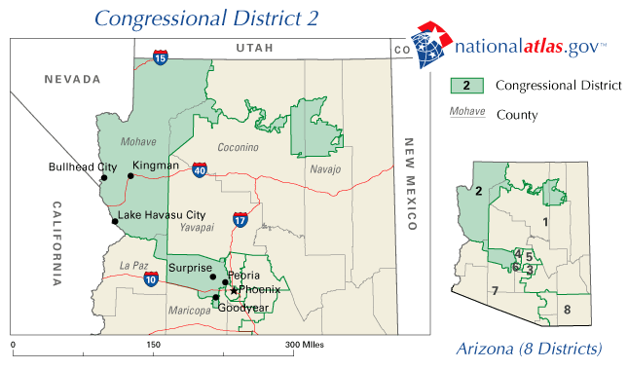
Gerrymandering Example: Arizona's 2nd Congressional district
The unusual division was not drawn to favor politicians, but to separate the Hopi and the Navajo tribes, due to historic tensions.
Since the Hopi reservation is completely surrounded by the Navajo reservation, and in order to comply with current Arizona redistricting laws, some means of connection was required that avoided including large portions of Navajo land, hence the narrow Colorado River connection.

Slide 32
White Primaries
White Primaries-White primaries were primary elections held in the Southern states in which only white voters were permitted to participate.
White primaries were established by the state Democratic Party units or by state legislatures in many Southern states after 1890.
The Supreme Court outlawed white primaries through the case of Smith v. Allwright (1944)
They ruled that political nominations are an integral part of election process which makes it beholden to the 15th Amendment

Slide 33
Fifteenth Amendment
How did the U.S. fulfill the promise of the 15th Amendment?
After many years, Congress passed a series of federal civil rights and voting acts, most of them adopted in the 1960s.
These laws outlawed practices such as:
Blocking African American voter registration
Levying poll taxes
Requiring voter examinations.

Slide 34
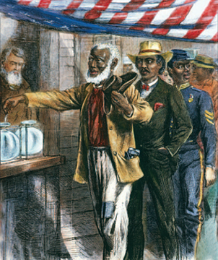
15th Amendment
In 1870, the ratification of the 15th Amendment gave African Americans, mostly former slaves living in the South, the right to vote.
However, this principle had no effect if Congress failed to enforce it.
This is why literacy tests and poll taxes existed

Slide 35
Civil Rights Acts
Pressure from the civil rights movement led Congress to act.
The Civil Rights Act of 1957 created the U.S. Commission on Civil Rights, which investigated voter discrimination.
The Civil Rights Act of 1960 allowed federal voting referees to help qualified people register and vote in federal elections wherever federal courts found voter discrimination.

Slide 36
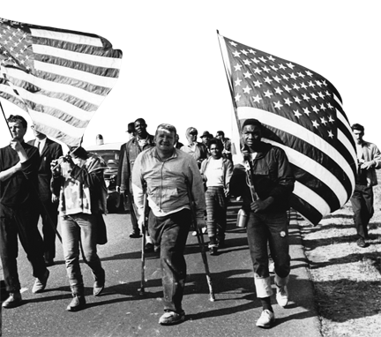
Civil Rights Acts
The Civil Rights Act of 1964 outlawed racial discrimination in job related-matters and banned unfair voter registration practices and literacy requirements.
Federal court orders were used to enforce these provisions

Slide 37
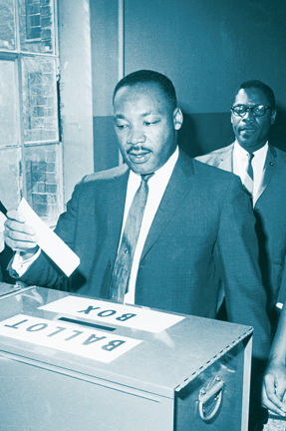
Civil Rights Act
In 1965, Dr. Martin Luther King, Jr. led a voter registration drive in Selma, Alabama.
National television showed peaceful civil rights marchers being attacked by State police, shocking the country.

Slide 38
Voting Rights Act of 1965
The Voting Rights Act of 1965 protects African Americans against various tactics intended to prevent them from voting.
It led to State poll taxes being overturned in the federal courts.
This Act applies to all elections: federal, State, and local.

Slide 39
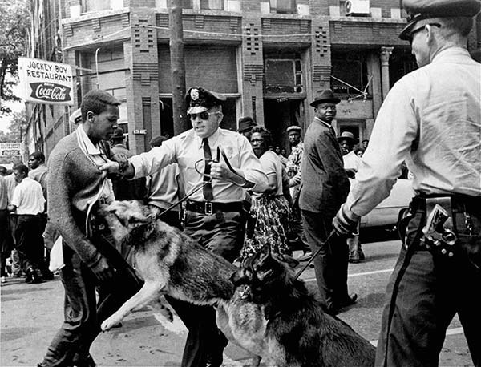

Slide 40
Checkpoint: Voting Rights Act
What provision about literacy tests was in the Voting Rights Act of 1965?
The Act ended the use of literacy tests in places where less than half the eligible electorate had registered or voted in 1964.
It also allowed federal voting examiners to oversee elections and register voters in these areas.

Slide 41
Preclearance
No new or changed election laws can take effect in a state where less than half the eligible electorate had registered or voted in 1964, unless first approved by the Department of Justice.
Preclearance has led to many court cases.
Often involve changes to the location of polling places, the boundaries of election districts, election deadlines, qualifications of candidates, or shifts from district elections to at-large elections.

Slide 42
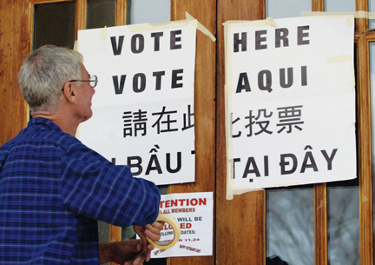
Amendments to the Act
The voter-examiner and preclearance provisions now apply to every community with a minority language population of 10,000 or more.
In these areas, ballots and other official election materials must be printed in English and the languages of the minorities involved.

Slide 43
Amendments to the Act
The ban on literacy tests now applies to all elections.
Some States and counties have been removed from the law’s coverage through the bail-out process.
To be removed, a State or county must show that it has not applied any voting procedures in a discriminatory way for at least 10 years.
Today the law still applies to everywhere in eight States, as well as parts of eight others.

Slide 44
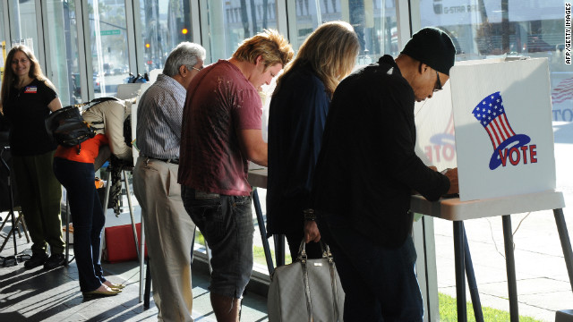
Chapter 6-Section 4

Slide 45
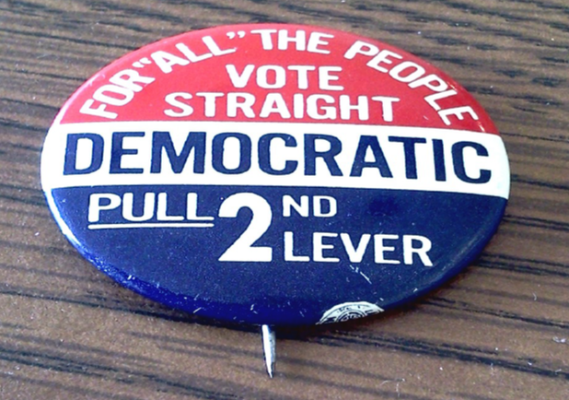
Key Terms
Off-year election
Ballot Fatigue
Political Efficacy
Political Socialization
Gender Gap
Party Identification
Straight-Ticket Voting
Split-Ticket Voting
Independent

Slide 46
Introduction
What factors influence voter behavior?
Voters are influenced by sociological factors such as income, occupation, education, gender, age, religion, ethnic background, geography, and family.
Voters are also influenced by psychological factors such as political party identification, specific candidates, and key issues.

Slide 47
Nonvoting
Millions of Americans do not vote.
Many people who do vote do not cast votes for every candidate on the ballot.
These people are called “nonvoting voters.”
Statewide offices and the presidency receive the most votes.
Voter turnout is highest in presidential election years.
More people vote in general state elections than in primaries or special elections.

Slide 48
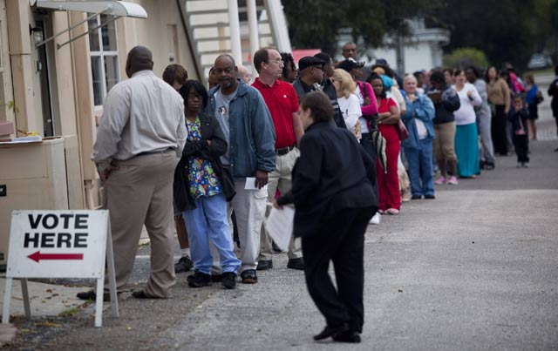
Voter Turnout
Voter turnout varies from election to election, but presidential elections always draw more voters than off-year elections

Slide 49
People Who Cannot Vote
Many people cannot legally vote.
This includes resident aliens, people with disabling mental conditions, and adults in prison.
Many others simply cannot vote.
Some 5-6 million people are too ill or disabled to vote.
Other people do not vote due to their religious beliefs or because they are traveling.
Discrimination effects?

Slide 50
Checkpoint
Why do people choose not to vote?
They may feel that their votes will not influence local or national government or they may not trust political institutions.
They may believe that conditions will remain fine even if they do not vote.
Western voters in presidential elections may feel that the election has been decided by eastern and central states before they can vote.

Slide 51
Voters vs. Nonvoters
Who are the people who are most likely to vote? (characteristics)
Have higher levels of income
Higher levels of education
Higher status
Older
Married
Long-time residents with strong party affiliation

Slide 52
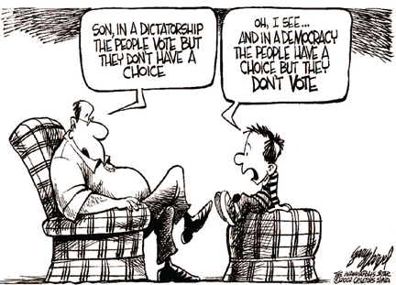

Slide 53
Studying Voter Behavior
Three sources that are used to gather voter behavior:
The results of specific elections
Scientific polls and surveys of public opinion
Studies of political socialization—how people gain political attitudes and opinions

Slide 54
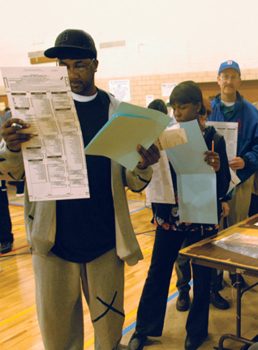
Studying Voter Behavior
Voters influenced by a combination of sociological and psychological factors
Sociology includes a voter’s personal qualities and their group affiliations.
Psychology includes how a voter sees politics.

Slide 55
Sociological Influences
Every voter has several qualities that combine to influence their votes.
A majority of the following groups tend to vote Republican:
Voters with higher incomes (such as professional and business people)
Voters with higher levels of education
Older voters (though this has varied in the past 30 years)
Protestants

Slide 56
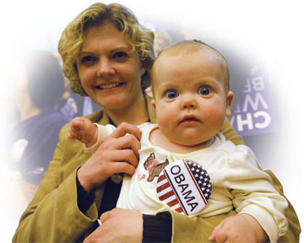
Sociological Influences
A majority of the following groups tend to vote for Democrats.
Women (by a 5-10 percent margin)
African Americans (by large margins since the 1930s)
Latinos (this varies among Latino groups)
Catholics

Slide 57
Sociological Influences
Geography affects voting:
Southerners once voted heavily Democratic, but now Republicans win many southern elections.
A majority of voters in big cities tend to vote for Democrats.
A majority of voters in the suburbs, small cities, and rural areas tend to vote Republican.
In general, family members tend to vote in similar ways.

Slide 58
Party Affiliation
Party identification is the strongest predictor of how a person will vote.
Party loyalists are likely to vote for all of their party’s candidates in any election.
This tendency has decreased recently as more people identify themselves as independents with no party affiliation.
More people are also willing to vote for some candidates from the opposing party, “splitting” their ticket.

Slide 59
Independents
It is estimated that from one fourth to one third of all voters today are independents.
Independent voters once tended to be less concerned, less informed, and less active in politics than Democrats or Republicans.
In recent years, a rising number of independents are young people with above average levels of education, income, and job status.

Slide 60
Candidates and Issues
Short-term factors such as particular candidates or key issues can swing voters in any specific election.
The image projected by a candidate—personality, style, character, appearance, and ability—influences voters.
Emotional, publicized issues such as civil rights, war, scandals, or the economy can also sway voters.

