Slide 1

The New Frontier and the Great Society
Chapter 20

Slide 2
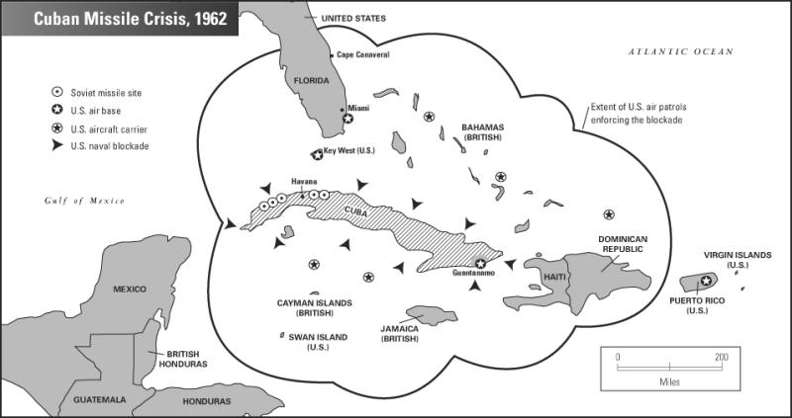

Slide 3
