Slide 1
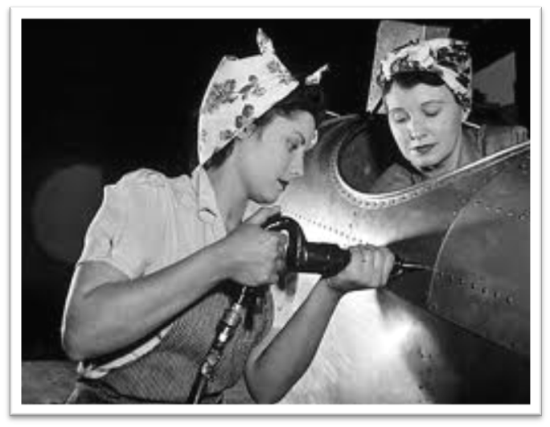
Chapter 17-The United States in WWII Test Materials

Slide 2
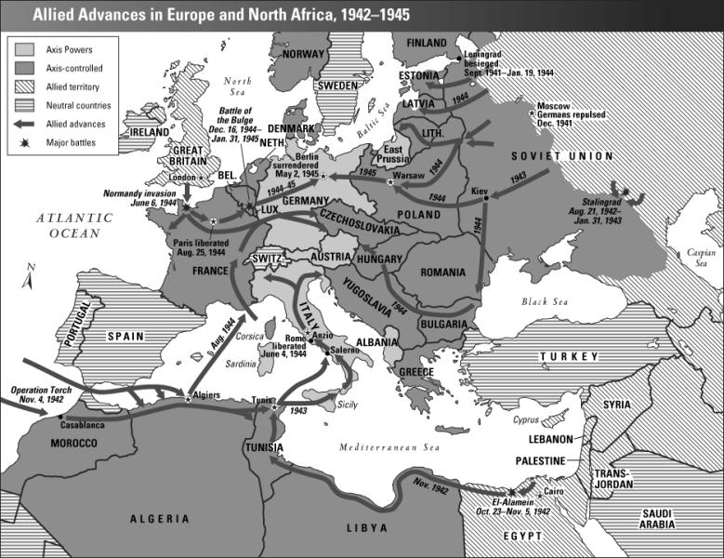

Slide 3
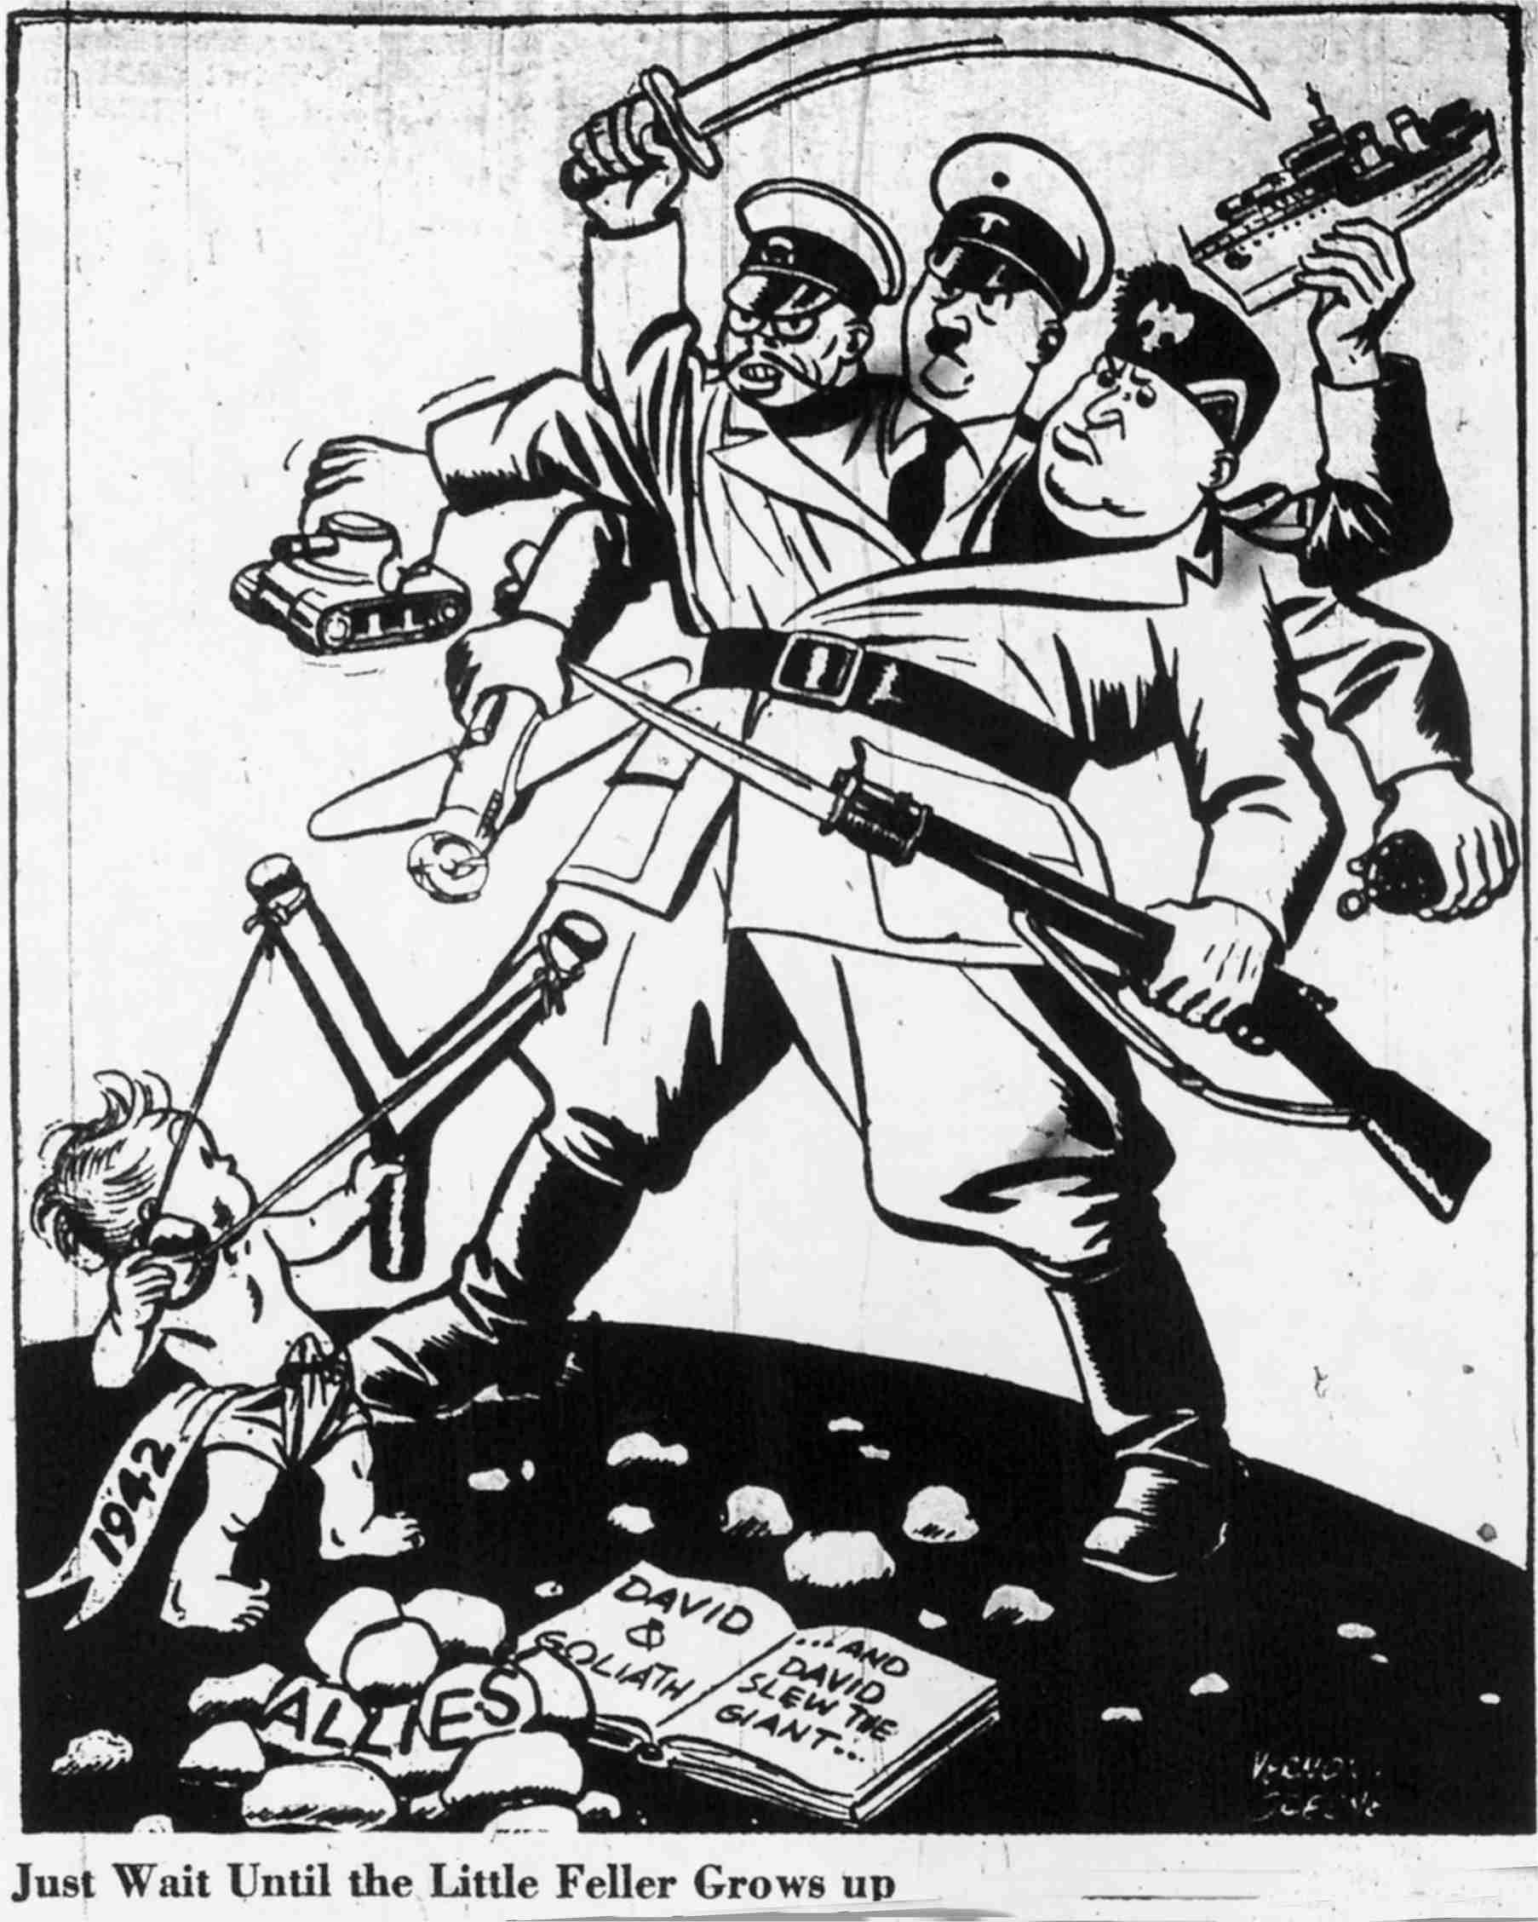
Political Cartoon #1

Slide 4
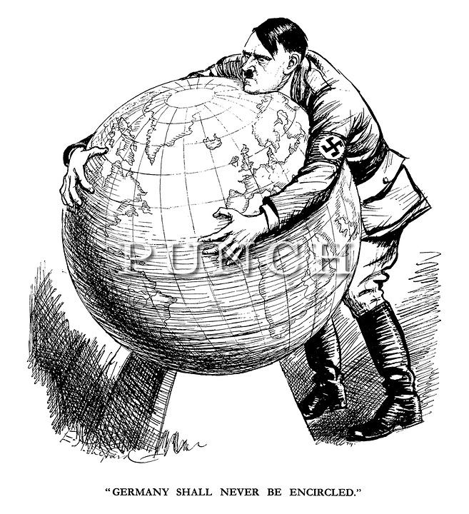
Political Cartoon #2

Slide 5
