Slide 1
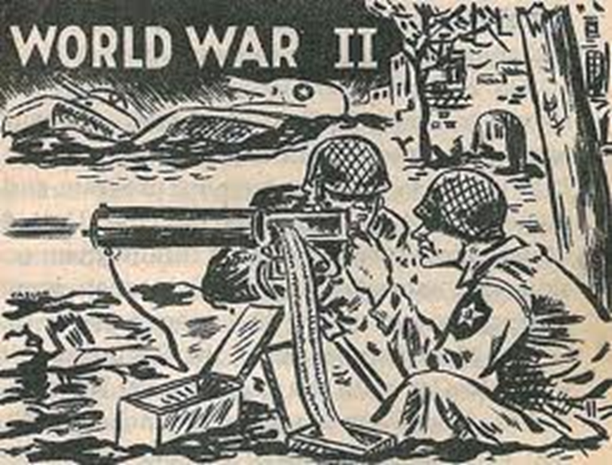
World War Looms
Chapter 16

Slide 2
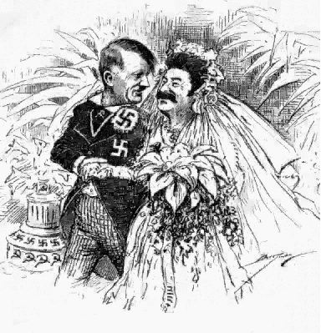
Section 1-Dictators Threaten World Peace

Slide 3
What was WWII?
Largest war in human history
Involved countries, colonies, and territories around the entire world
Over 70 million died
WWII-1939 to 1945

Slide 4
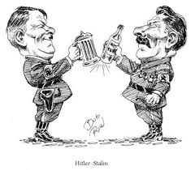
Nationalism Grips Europe
People angry after WWI
Peace had not brought stability, but revolution
Dictators rose up to deal with hard times
Nationalism-Pride in one’s country, loyalty, dreams of expansion

Slide 5
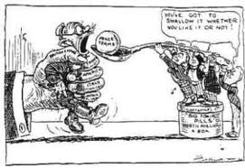
Failures of WWI Peace
Treaty of Versailles did not bring peace, but resentment
Germans feel picked on
Germany in depression, could not pull itself out due to the massive amount of reparations they had to pay
Young democracies in Europe were quickly overthrown

Slide 6
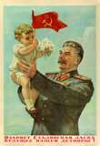
Joseph Stalin and Soviet Union
1917-Communist state set up
1924-Lenin dies and Stalin takes charge
Government controlled all aspects of the economy, no private ownership
Became an industrial giant off the backs of its workers

Slide 7
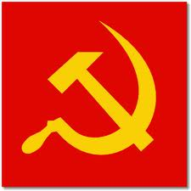
Joseph Stalin and Soviet Union
Instituted five year plans
Became 2nd largest industrial country in world
Purge-Stalin killed 8-13 million people who got in his way or possibly could
Established a totalitarian government: Individuals have no rights, gov. supreme power

Slide 8
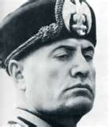
Rise of Fascism in Italy
Mussolini establishes himself in Italy
Nationalist ideals
Fascism-A political party that stressed nationalism and placed the interests of the states above those of the individual
Had to be one leader to have power

Slide 9
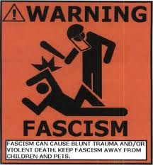
Rise of Fascism in Italy
1922 marched on Rome
Took power
Il Duce- “The Leader”
Totalitarian Government- In this political state individuals have no rights and the government stresses all opposition

Slide 10
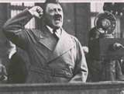
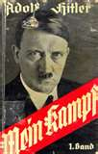
Nazis in Germany
Nazi Party-
Three Goals:
1.) Racial Purification
2.) Unite all German people
3.) Expansion of Germany
Adolf Hitler
Rose to power through the party
Plan was in Mein Kampf:

Slide 11
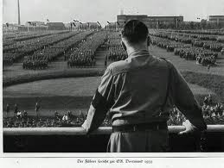
Nazis in Germany
Depression allowed Nazis to come to power
Storm Troopers- Hitler’s private army
1933- Hitler named chancellor
Third Reich-Third German Empire

Slide 12
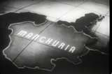
Militarists Gain Control in Japan
Need to expand
Japan-Small island
Attacked China
Japan gained control of Manchuria in 1931
League of Nations was powerless to stop it

Slide 13
Totalitarianism
USSR:
Communist
Dictatorship
Germany & Italy:
Fascist
Dictatorship
Japan:
Military
Dictatorship

Slide 14
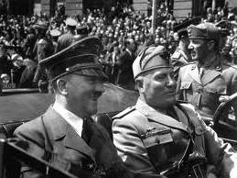
Aggression in Europe and Africa
Dictators realized League had no power
Germany pulls out of League in 1935
Violated the Treaty of Versailles
Hitler-
Sent troops into Rhineland, not stopped
Mussolini-
Attacks Ethiopia

Slide 15
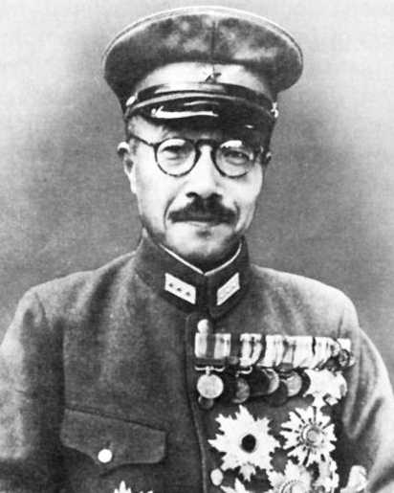
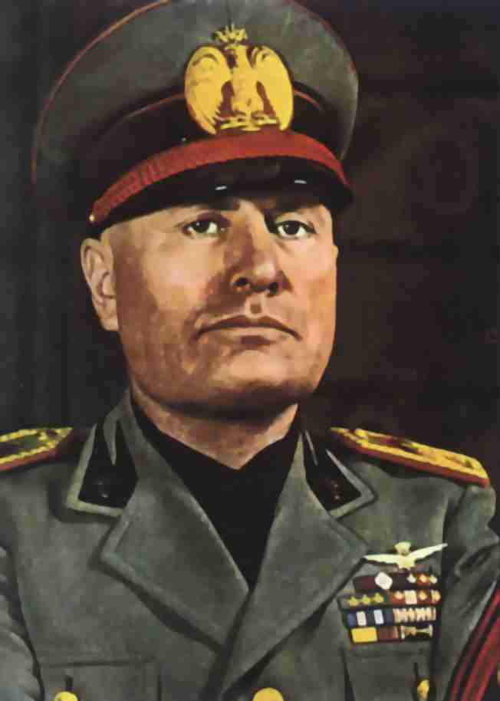
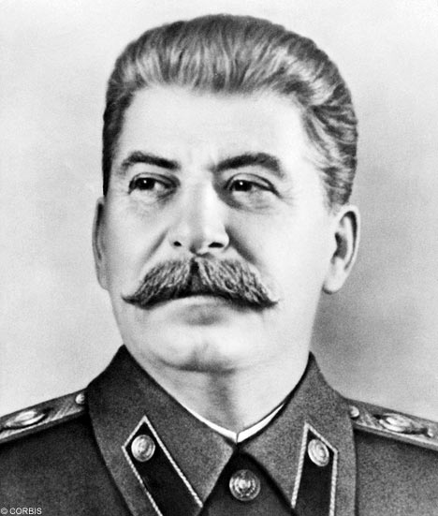
Adolf Hitler-Germany
Hideki Tojo -
Japan
Benito Mussolini-Italy
Joseph Stalin-USSR

Slide 16
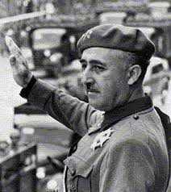
Civil War Breaks out in Spain
1936-Franco Francisco and his army revolts against Spain
Whole world interested in it
USSR sent weapons
Italy and Germany sent troops
U.S. did nothing
1939- Franco becomes Spain’s fascist dictator

Slide 17
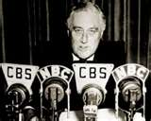
America’s Cautious Response
U.S. was alarmed, but still clings to Isolationism
Nye Commission said U.S. was dragged into WWI and could not do that again
Neutrality Acts-
1st and 2nd-Banned the sale of weapons to nations at war
3rd-Expanded this to countries in civil war

Slide 18
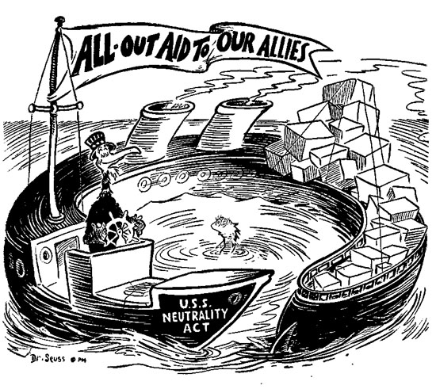

Slide 19
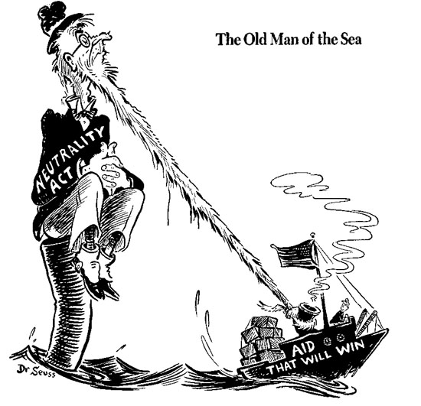

Slide 20
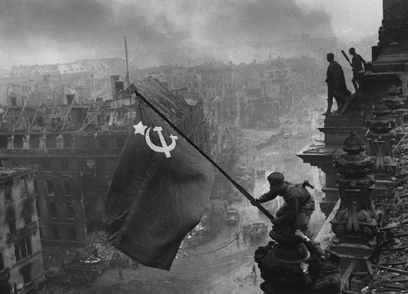
Section 2-War in Europe

Slide 21
Austria and Czechoslovakia Fall
1937 Hitler decides to absorb Czech. and Austria
Austria created after WWI
Most were Germans who favored reunification
1938-Hitler marched in, unopposed
Anschluss: Union w/ Austria

Slide 22
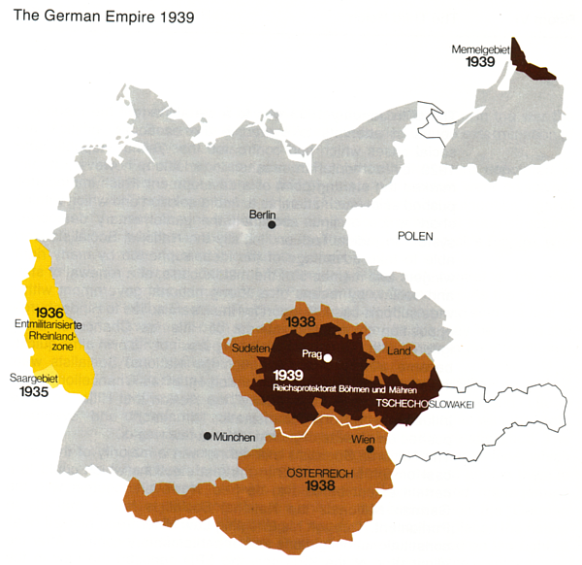
How did WWII start?
Germany invaded Poland to get lebensraum

Slide 23
Bargaining for the Sudetenland
Sudetenland: Czech. Border of Germ.
Most spoke and were German
Lebensraum: Elbow (Living) Room
Hitler said Czechs. were mistreating Germans in Sudetenland

Slide 24
Bargaining for the Sudetenland
France and England promised to protect the Czechs
Daladier: France, Chamberlain: England meet with Hitler in Munich
1938 Munich Agreement-
Appeasement- Give Hitler what he wants and he’ll stop

Slide 25
German Offensive
1939- Hitler sets his sights on Poland
Attacking Poland = War with Russia
The two front war killed Germany in WWI, so Hitler would not make the same mistake
Stalin signs Non-aggression Pact in 1939
Now no fear from USSR, Poland is target

Slide 26
German Offensive
September 1st, 1939
Germany invades Poland
Hitler uses Blitzkrieg: Lightening war
Sept. 3, 1939- Brit. and France declare war on Germany
Poland split between Russia and Germany
WWII had begun

Slide 27
Hitler Attacks
April 9th, 1940- Hitler attacks Norway and Denmark, Netherlands, Belgium and moves into France
France and Britain fight on
Frances defenses fell quickly
Hitler takes France

Slide 29
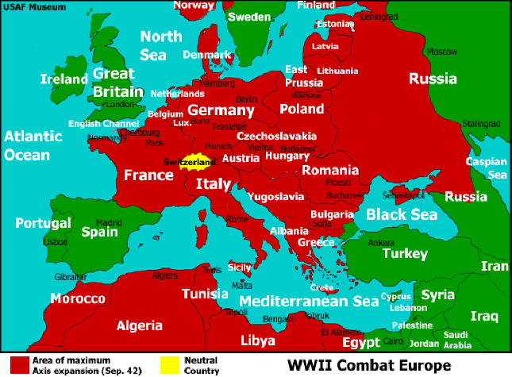

Slide 30
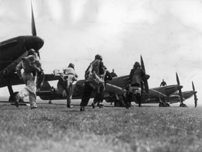
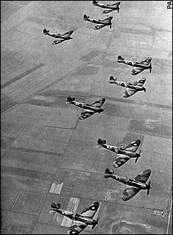
The Battle of Britain
A series of air battles
Daily battles that lasted the summer of 1940
German bombers escorted by fighter planes
Royal Air Force out-shot Luftwaffe
England able to replace losses
England out-produced Germany fighter planes (avg. 563/month)
England had Radar
RAF would not be caught on ground

Slide 31
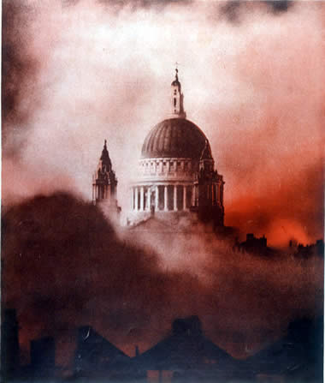
The Blitz
September 1940
Luftwaffe changed targets from RAF to cities, especially London
Most terrifying phase of battle occurred mostly at night
Sept 1940 to June 1941
‘The Blitz’ – British cities bombed day and night
Battle of Britain effectively over once Hitler moved from trying to destroy the RAF, ‘Operation Sealion’ was put on shelf
St Paul’s Cathedral, 29 Dec 1940

Slide 32
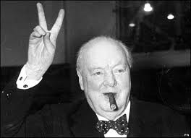
The Battle of Britain
Winston Churchill
“Never in the field of human conflict, was so much owed, by so many, to so few.”
Winston Churchill, Aug 19th,1940

Slide 33
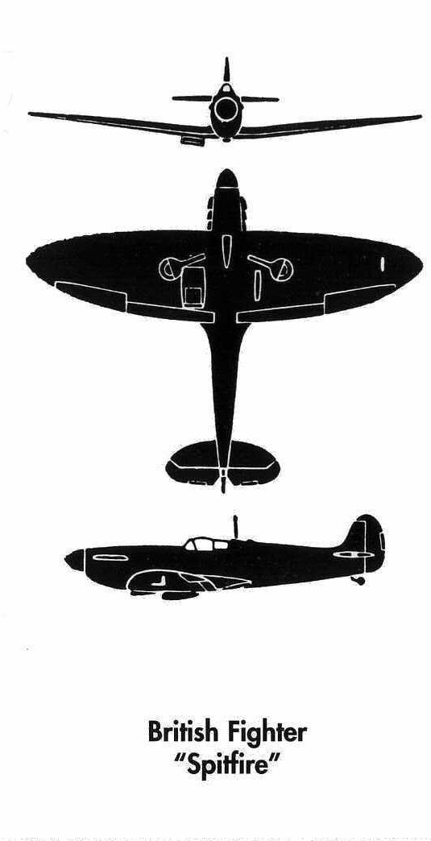
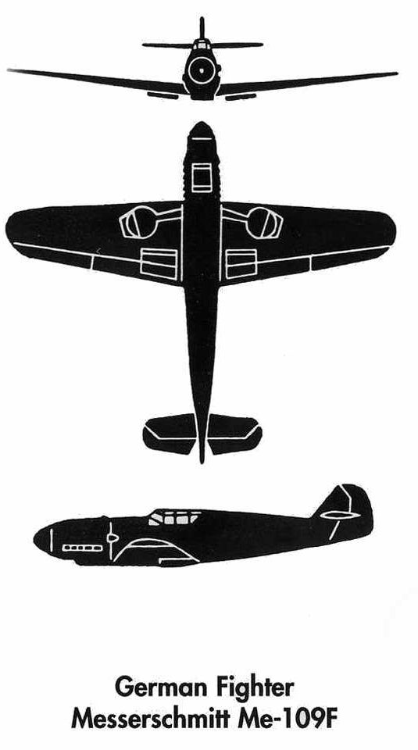
British & German aircraft destroyed July 1^{st-}October 31st, 1940
 | British | German
1 – 15 July | 51 | 108
16 – 31 July | 69 | 117
1 – 15 Aug | 156 | 259
16 – 31 Aug | 249 | 332
1 – 15 Sept | 268 | 323
16 – 30 Sept | 133 | 213
1 – 15 Oct | 100 | 147
16 – 31 Oct | 90 | 161
Totals | 1,116 | 1,660

Slide 34
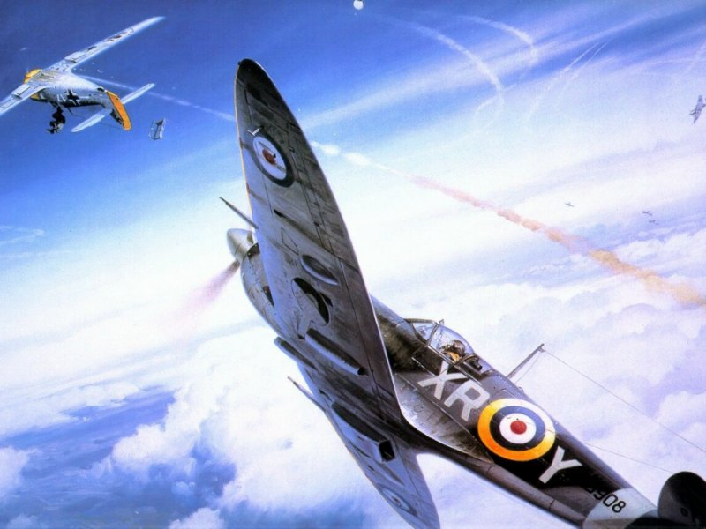

Slide 35
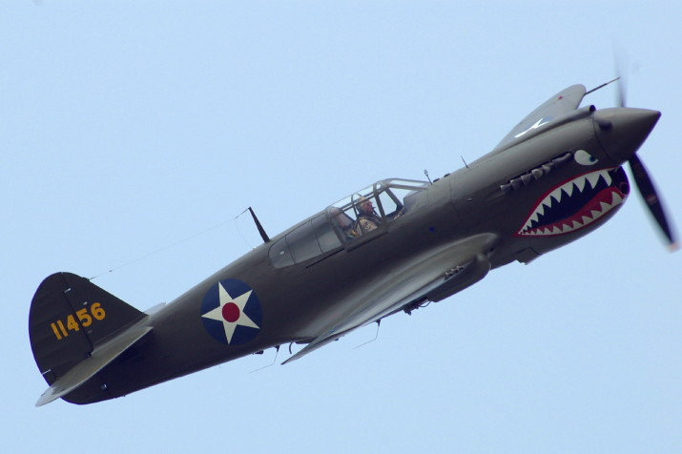

Slide 36
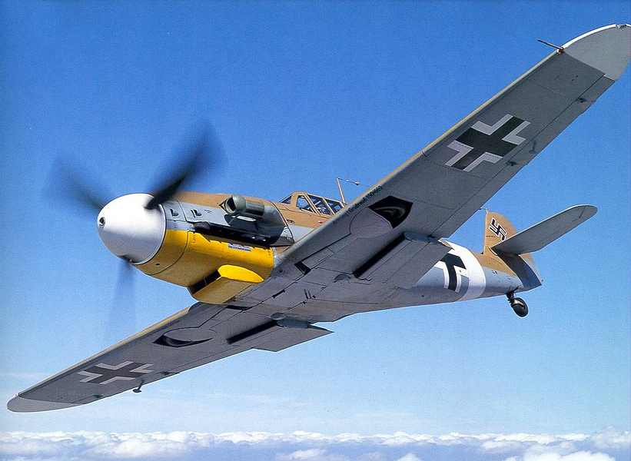

Slide 37
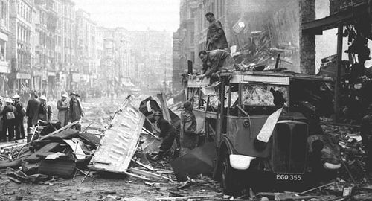

Slide 38
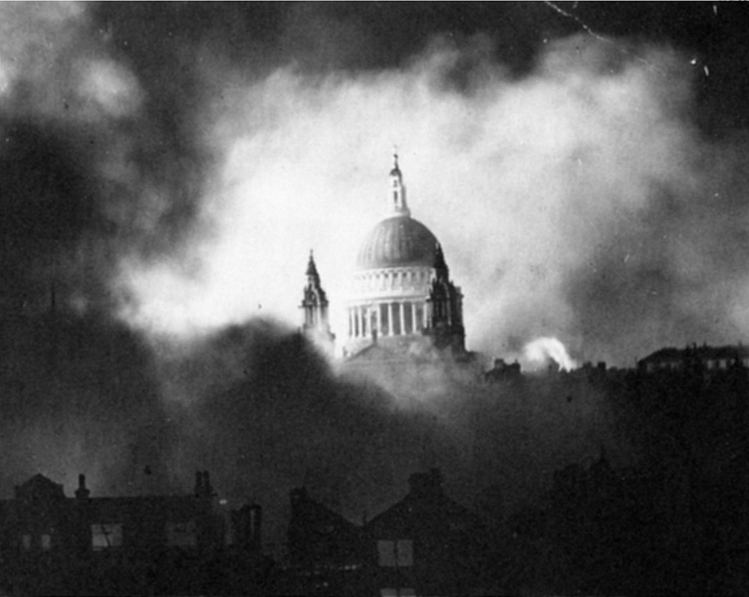

Slide 39
