Slide 1
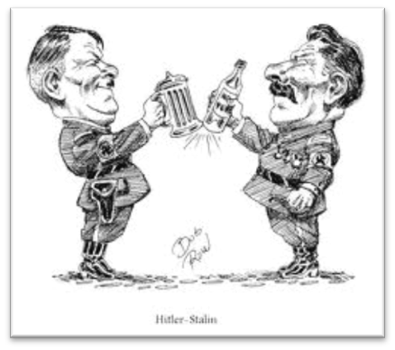
Chapter 16-Test Materials
World War Looms

Slide 2
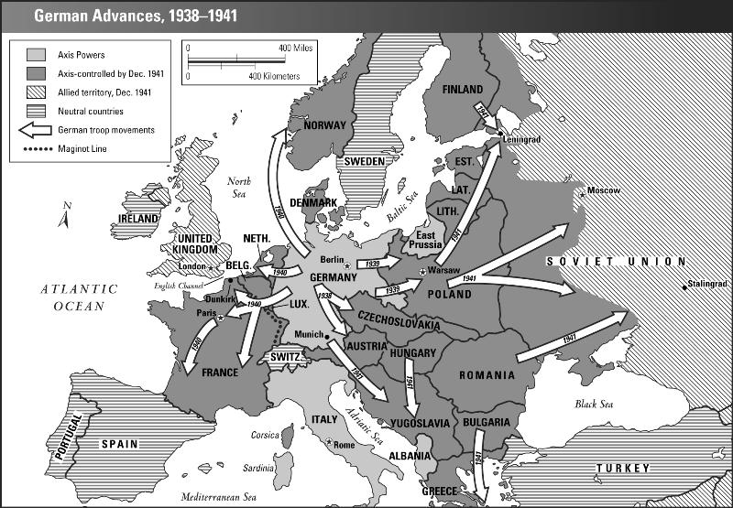

Slide 3
