Slide 1
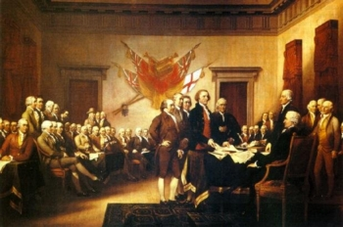
Test Materials
Chapter 1–Principles of Government and Chapter 2-Origins of American Government

Slide 2
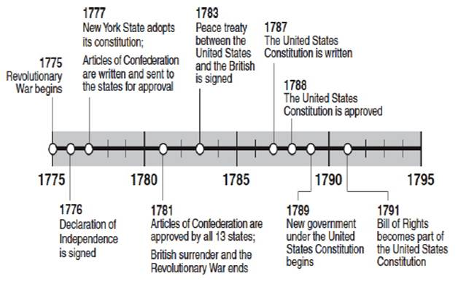

Slide 3
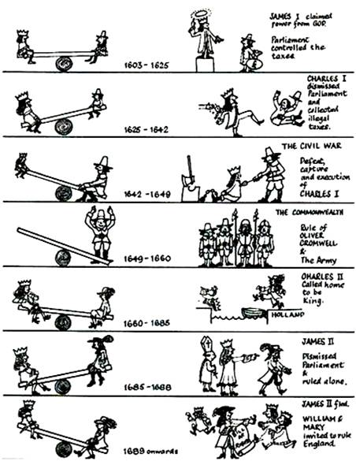

Slide 4
