Slide 1
Chapter 14-The Great Depression Begins
Test Graphics

Slide 2
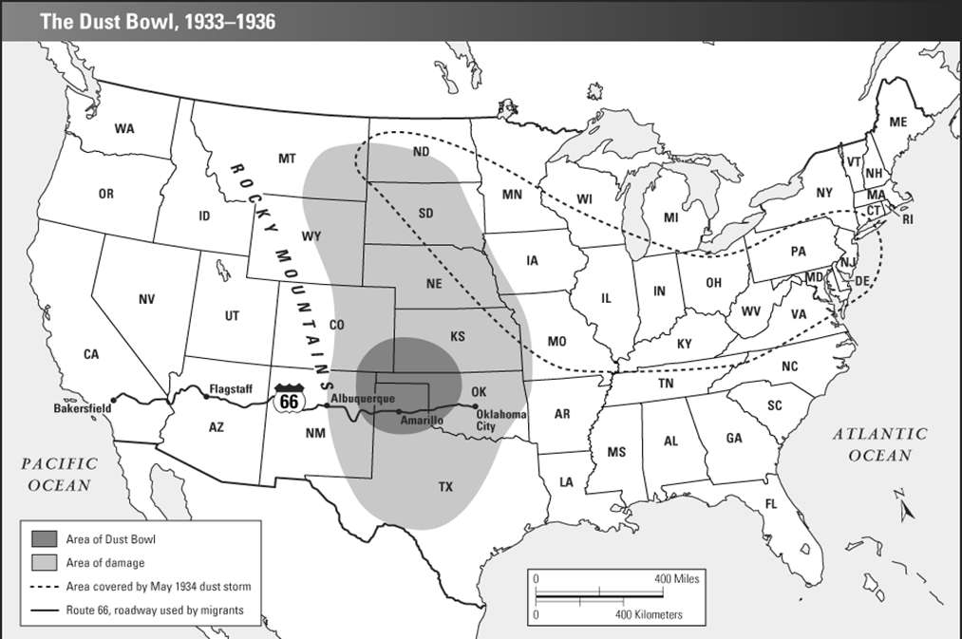

Slide 3
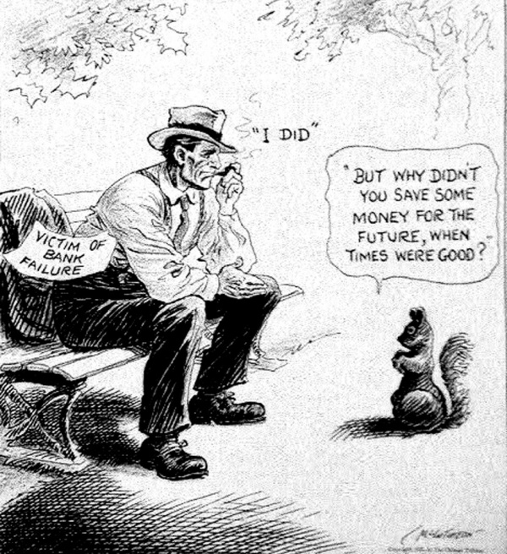

Slide 4
