Slide 1
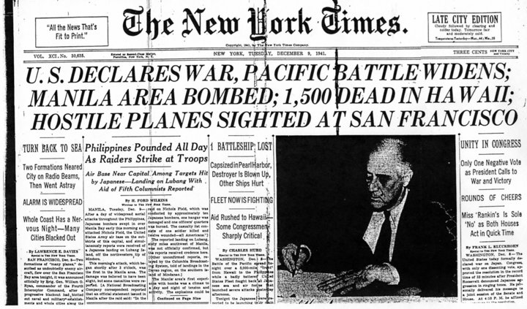
The Other Expressed Powers
Chapter 11-Section 2

Slide 2
Foreign Relations
Foreign Relations Powers
Congress has the power to deal with foreign states and shares these powers with the President.
The Constitution gives the President primary responsibility over the conduct of America foreign policy
Congress has two sources of authority when it comes to foreign affairs
1.) From expressed powers they have spending power and the power to regulate foreign commerce in addition to war powers
2.) Sovereignty powers b/c the U.S. is a sovereign state with in the world community

Slide 3
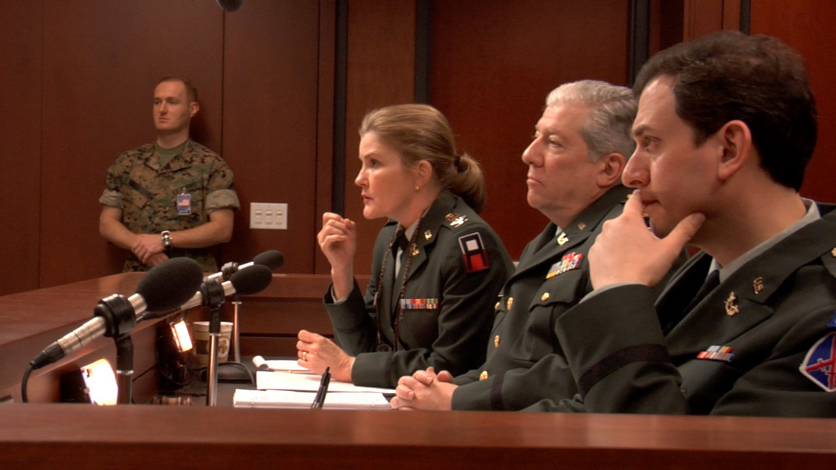
War Powers
War Powers
6 of 27 expressed powers deal with war which allows Congress to:
President is commander in chief, but congress declares war, regulates the militia and armed services, creates military laws, military tribunals… etc.

Slide 4
Domestic Powers-Copyright
Copyrights
A copyright is the exclusive right of an author to reproduce, publish, and sell his or her creative work
Copyrights must be registered in the Copyright Office of the Library of Congress
They are good for 70 years beyond the life of the author

Slide 5
Domestic Powers-Patents
Patents
A patent grants an inventor the sole right to manufacture, use, or sell any new and useful art, machine, manufacture, or composition of matter, or any new and useful improvement on previous inventions
They’re good for 20 years unless extended by Congress
The Patent and Trademark Office of the Department of Commerce administers or transfers patent
Private individuals, not the government, must enforce their rights

Slide 6
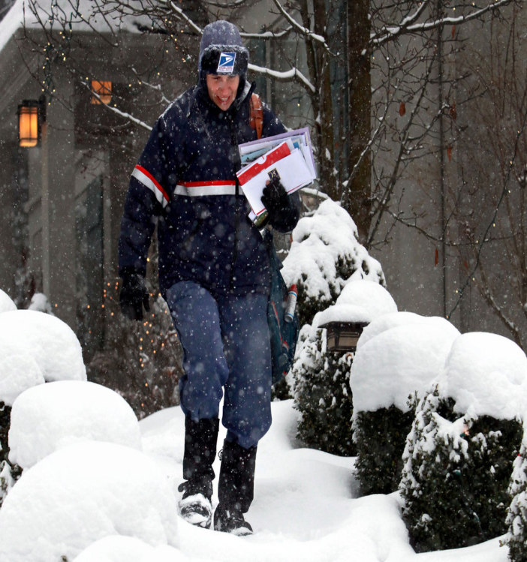
Domestic Powers-The Postal Powers
Postal Powers
Established in Article I, Section 8, Clause 7 Congress has the power to establish post offices and post roads.
Postal roads include rail lines, roads, airways and water routes

Slide 7
Domestic Powers-Territorial Powers
Territorial Powers
Congress has the power to acquire, manage, and dispose of land
The government may acquire property through purchase, donation, or eminent domain
Generally federal laws, rather than state laws, are enforced on federal properties, even if those properties lie within the boundaries of states

Slide 8
Domestic Powers-Weights and Measures
Weights and Measures
Congress guarantees uniform, accurate gauges of time, distance, area, weight, volume, etc.
In 1838 Congress legalized the English system of pound, mile, etc.
In 1866 Congress legalized the metric system of gram, meter, etc.
Congress created the National Bureau of Standards in the Commerce Department, now known as the National Institute of Standards and Technology, in 1901

Slide 9
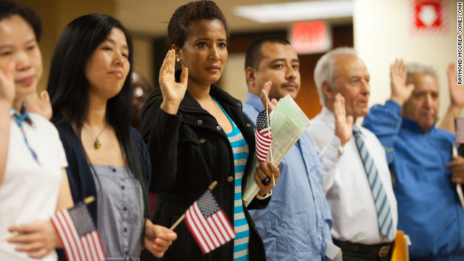
Domestic Powers-Naturalization
Naturalization
Naturalization is the legal process by which citizens of one country become citizens of another
Article I, Section 8, Clause 4 makes this an exclusive power of the national government

Slide 10
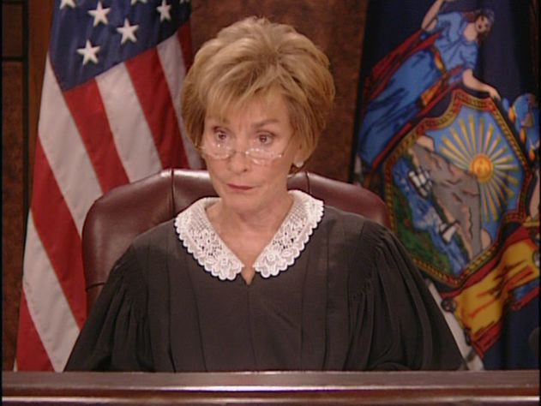
Domestic Powers-Judicial Powers
Judicial Powers
Congress has the power to create inferior courts beneath the Supreme Court and structure the federal judiciary
This included establishing the number of Supreme Court justices who will serve

Slide 11
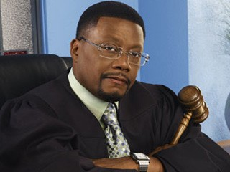
Domestic Powers-Judicial Powers
Judicial Powers (Continued)
Congress has the power to define federal crimes and set punishments for those crimes
The Constitution mentions four federal crimes
Counterfeiting, Crimes committed on the high seas (international waters), Offenses against international law or Treason
Congress has created more than 100 federal crimes (bank robbing, kidnapping, etc.)

