Slide 1
The Electoral Process
Chapter 7

Slide 2
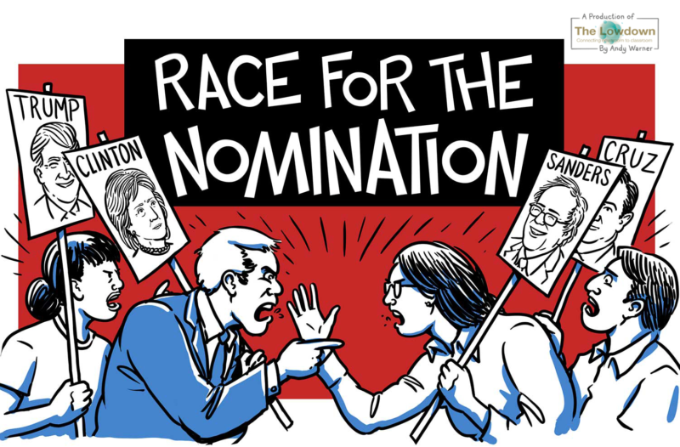
The Nominating Process
Section 1

Slide 3
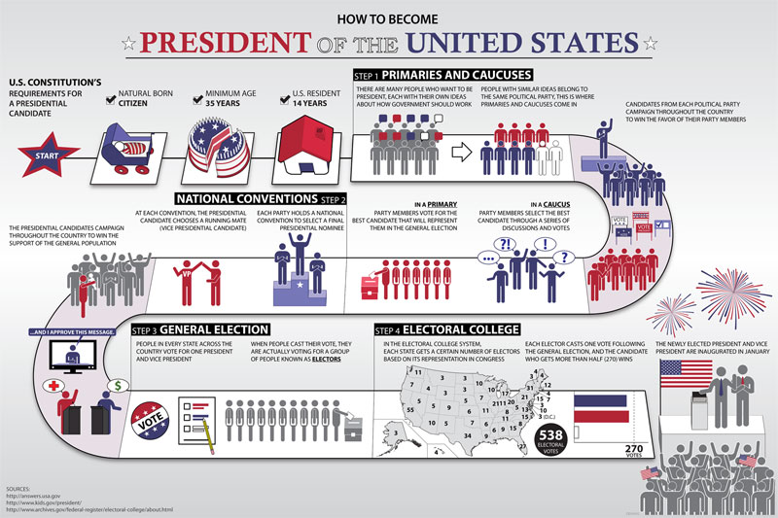

Slide 4
The Nominating Process
The nominating process is the process of selecting a candidate for political office
The Two Steps of the Election Process-
  Nomination–The naming of those seeking office
  General Election–regularly scheduled election where voters make the final choice of officeholder

Slide 5
Five Ways to Nominate
Self-Announcement–person who wants to run for office announces their candidacy
  - Mainly used early in early years of our nation and for write in candidates
Caucus–A meeting between a group of like minded people who elect the candidates they will support in an upcoming election
  not widely used since the 1820’s but still used in places like New England for local nominations

Slide 6
Five Ways to Nominate
Convention–A process where party members meet to pick candidate for local offices while at the same time selecting delegates to represent them at the county conventions
  By around 1910 the direct primary system had replaced the conventions as the principal nominating process
    however, they still play a part in Connecticut, Michigan, South Dakota, Utah and Virginia
Petition–candidate gathers a required number of signatures required to qualify for the general election

Slide 7
Five Ways to Nominate
Direct Primary–An intraparty election held to choose candidate to represent the party in the general election
Closed Primary-A party’s nominating process in which only declared (or registered) Party members can vote
Open primary-a nominating process in which any qualified voters can cast a ballot

Slide 8
Closed vs Open Primary
Arguments in favor of a closed primary
  It prevents one party from “raiding” the other primary in hopes of nominating a weaker candidate
  It helps make candidates more responsive to the platform (It’s members)
  Makes voters more thoughtful b/c they have to identify with a party in order to vote
Arguments against a closed primary
  It compromises the secrecy of the ballot because voters have to identify with a particular party
  It excludes independent voters from the voting process

Slide 9
Closed vs open primary
Supporters of an open primary feel that it addresses the concerns associated with closed primaries
  They feel that it promotes individuality since a voter is not forced to publicly identify with a political party
  Independent voters are excluded from the voting process

Slide 10
Nonpartisan and Presidential primaries
Nonpartisan primary-Elections where candidates are not identified by party labels
  About half of the states in the United states use this process for electing judges
Presidential primary-One part of the process by which presidential candidates are chosen
  This is not a nominating device

Slide 11
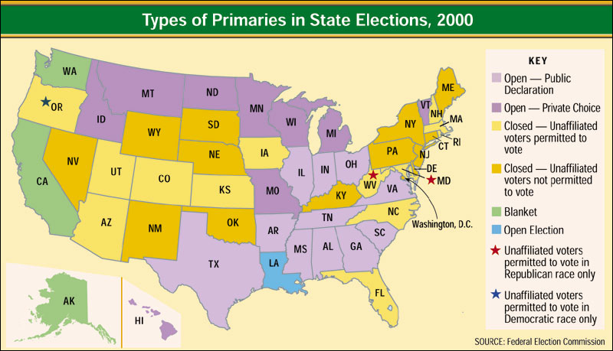

Slide 12
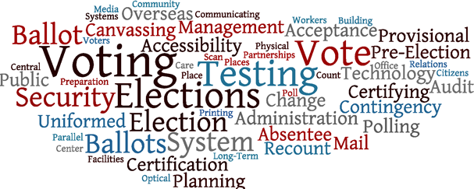
Elections
Section 2

Slide 13
Extent of Federal Control
All elections in the United States are held to select nearly 500,000 elected positions in over 89,000 units of government at the state and local levels
Most election law in U.S. are concentrated at the State Law.
Elections are held on the Tuesday after the first Monday in November of even numbered years

Slide 14
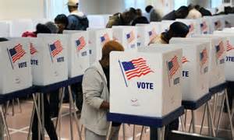
Extent of Federal Control
The constitution gives congress the ability to fix
the time, place and manner of elections
Require secret ballot
Regulates financing of campaigns for federal office

Slide 15
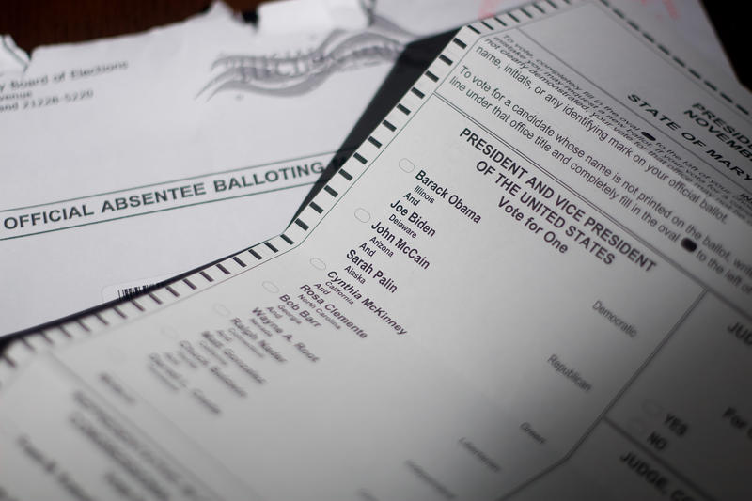
Absentee Voting
Who tends to file absentee ballots
  I. People who are ill or unable to leave their homes
  II. Those who know they will not be in their local town during the election
    Away at college, Traveling for work or leisure
  III. Those serving in the military

Slide 16
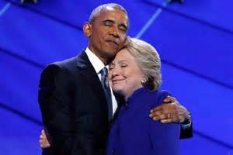
The Coattail Effect
The Coattail Effect-The phenomenon that occurs when a strong candidate running for an office at the top of the ballot helps attracts voters to other candidates on the party’s ticket

Slide 17
Precincts and Polling Places
Precinct -is a voting district
  Smallest political unit in elections
About 500 to 1,000 voters
Polling place -is where those in a precinct vote
Poll watchers -from each party help monitor fairness at polling place

Slide 18
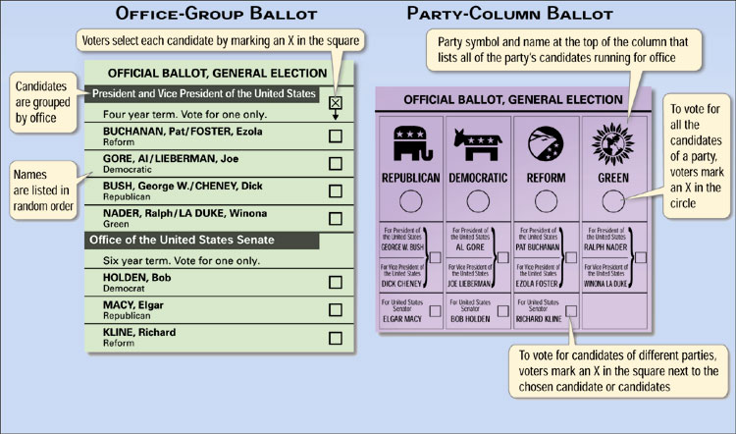
Types of Ballots

Slide 19
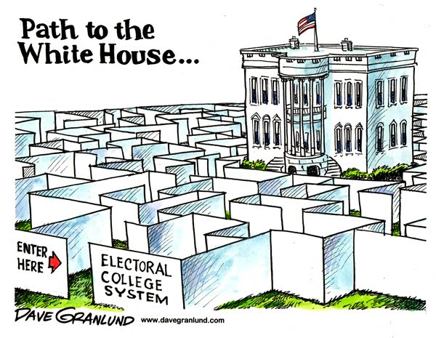
Electoral College
Just the Facts:
Good, bad, and confusing…
Directions:
Watch videos
  Take down any notes!
Read “You can get to know the electoral College”
Answer questions
Be ready to discuss!
http://www.youtube.com/watch?v=W9H3gvnN468
http://www.youtube.com/watch?v=ok_VQ8I7g6I

Slide 20
Electoral Votes
The Representatives and Senators in your state make up your Electoral Votes
Total of 538 electoral votes
  (435 Reps, 3 from DC and 100 Sen)
Based on the popular vote
  Whoever the people voted for is who the Electoral votes go to
“Winner Takes All”
  ALL electoral votes go to the candidate who won the most popularity votes in that state

Slide 21
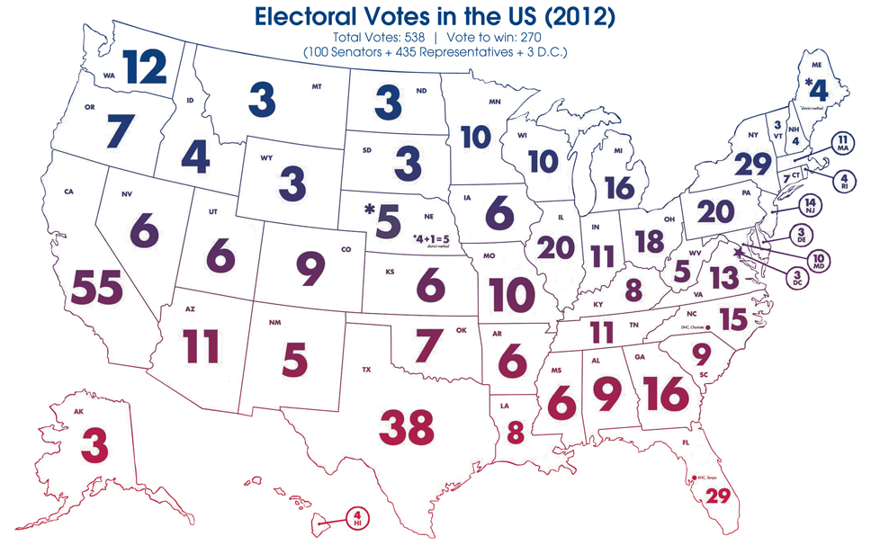
Electoral Votes 2012

Slide 22
270 Votes To Win
Candidate must win majority of electoral votes to win presidency (270)
IF THERE IS A TIE – House of Representatives votes. Each state has 1 vote
IF the candidate wins the POPULAR VOTE but not the ELECTORAL VOTE they DO NOT become President
  (could be decided by as few as 11 states up until 2010 Census)

Slide 23
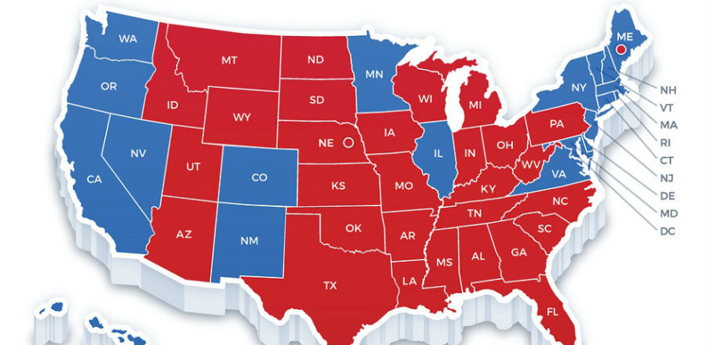
2016 Election

Slide 24
Near Failures of System?
1888- Cleveland received 48.6% of popular vote while Harrison received 47.8%
Harrison won electoral college with 233 votes to Cleveland’s 168 votes
1960 -JFK won with 303 electoral votes to Nixon’s 219
Results were much closer in popular vote with JFK receiving 49.7% to Nixon’s 49.5%
2000-Al Gore received 539,947 more popular votes than George W. Bush
- Bush won with 271 EC votes to Gore’s 266
1800- Thomas Jefferson & Aaron Burr (same party) each had 73 electoral votes
- Jefferson was chosen by House on 36th attempt
- Led to the passing of the 12th Amendment
1876 - Rutherford B. Hayes lost the popular election to Samuel Tilden (48% to 51%)
- Electoral votes disputed in 4 states
- Committee in House gave states to Hayes in exchange to end Reconstruction

Slide 25
Why the Electoral College?
Three Reasons why the framers of the Constitution wanted an electoral college:
  Equality – balanced between big states and small states (population)
  Fear – general public wasn’t educated enough to cast adequate votes
  Knowledge - No way for people to know about candidates from other places (no media!)

Slide 26
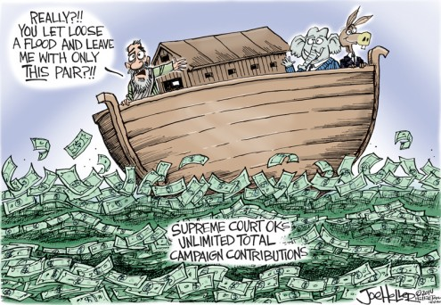
Money and Elections
Section 3

Slide 27
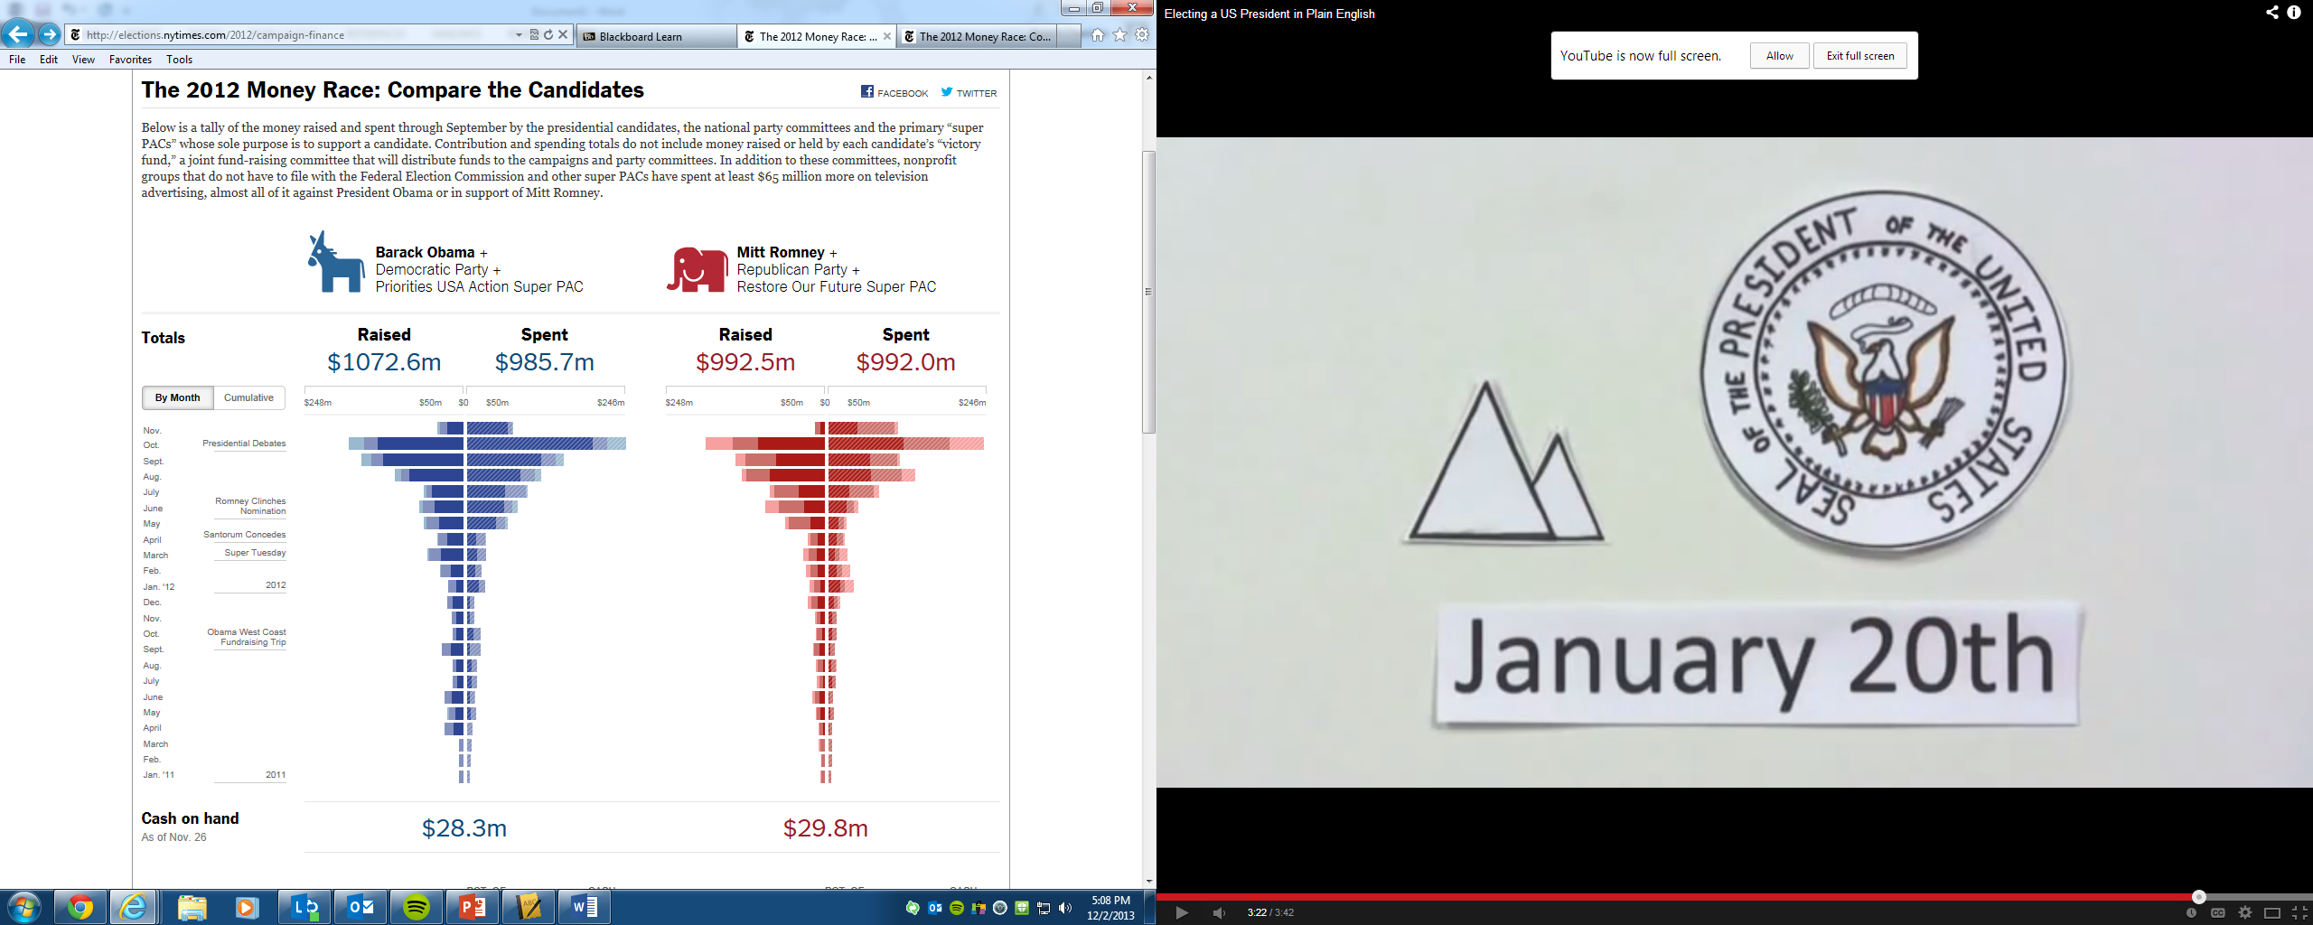
Money and Elections
Money is a necessary campaign resource
The getting and spending of $ can corrupt the political process

Slide 28
Sources of Funding
Private and Public Sources of Campaign Money
Small contributors
Nonparty groups such as PACs
(Political Action Committees)
Ex: Priorities USA or
Restore Our Future
Wealthy supporters
Temporary fund-raising organizations
(direct mail requests, telethons, Internet solicitations)
Candidates
Ross Perot - $65 Million

Slide 29
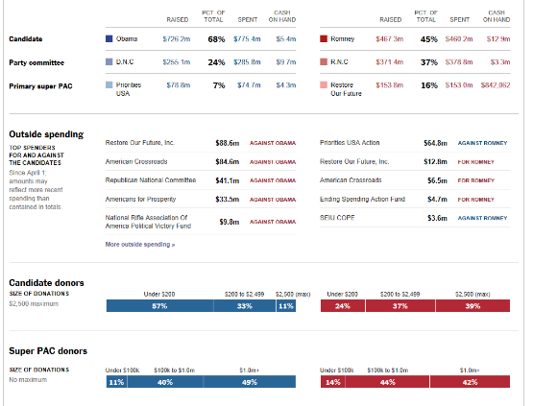

Slide 30
Why do people donate?
Political participation
Believe in party or candidate
Access to government
Want appoint to office
Social recognition
Organizations want things done

Slide 31
FEC regulates campaign finance
The Federal Election Commission (FEC) enforces:
Timely disclosure of campaign finance information
Limits on campaign contributions
Limits on campaign expenditures
Provisions for public funding of presidential campaigns

Slide 32
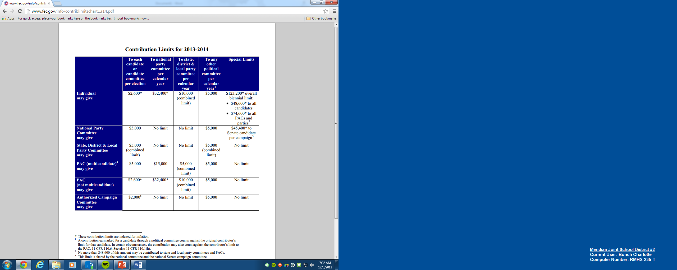

Slide 33
Loopholes in the law
“More loophole than law…” —Lyndon Johnson
Soft money—money given to State and local party organizations for “party-building activities”
  filtered to presidential or congressional campaigns.
  $500 million was given in 2000
Independent campaign spending—a person unrelated and unconnected to a candidate or party can spend as much money as they want to benefit or work against candidates.
Issue ads—take a stand on certain issues in order to criticize or support a certain candidate without actually mentioning that person’s name.

