Slide 1
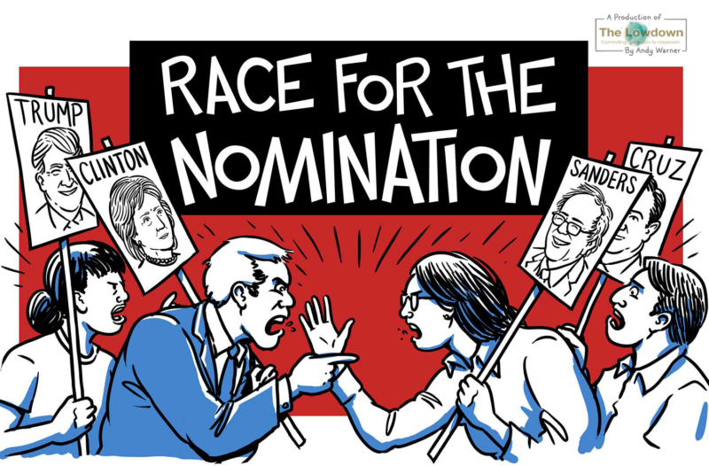
The Nominating Process
Chapter 7-Section 1

Slide 2
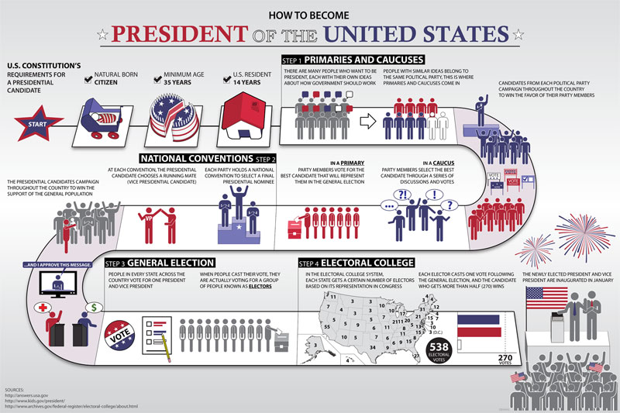

Slide 3
The Nominating Process
The nominating process is the process of selecting a candidate for political office
The Two Steps of the Election Process-
Nomination–The naming of those seeking office
General Election–regularly scheduled election where voters make the final choice of officeholder

Slide 4
Five Ways to Nominate
Self-Announcement–person who wants to run for office announces their candidacy
- Mainly used early in early years of our nation and for write in candidates
Caucus–A meeting between a group of like minded people who elect the candidates they will support in an upcoming election
not widely used since the 1820’s but still used in places like New England for local nominations

Slide 5
Five Ways to Nominate
Convention–A process where party members meet to pick candidate for local offices while at the same time selecting delegates to represent them at the county conventions
By around 1910 the direct primary system had replaced the conventions as the principal nominating process
however, they still play a part in Connecticut, Michigan, South Dakota, Utah and Virginia
Petition–candidate gathers a required number of signatures required to qualify for the general election

Slide 6
Five Ways to Nominate
Direct Primary–An intraparty election held to choose candidate to represent the party in the general election
Closed Primary-A party’s nominating process in which only declared (or registered) Party members can vote
Open primary-a nominating process in which any qualified voters can cast a ballot

Slide 7
Closed vs Open Primary
Arguments in favor of a closed primary
It prevents one party from “raiding” the other primary in hopes of nominating a weaker candidate
It helps make candidates more responsive to the platform (It’s members)
Makes voters more thoughtful b/c they have to identify with a party in order to vote
Arguments against a closed primary
It compromises the secrecy of the ballot because voters have to identify with a particular party
It excludes independent voters from the voting process

Slide 8
Closed vs open primary
Supporters of an open primary feel that it addresses the concerns associated with closed primaries
They feel that it promotes individuality since a voter is not forced to publicly identify with a political party
Independent voters are excluded from the voting process

Slide 9
Nonpartisan and Presidential primaries
Nonpartisan primary-Elections where candidates are not identified by party labels
About half of the states in the United states use this process for electing judges
Presidential primary-One part of the process by which presidential candidates are chosen
This is not a nominating device

Slide 10
