Slide 1
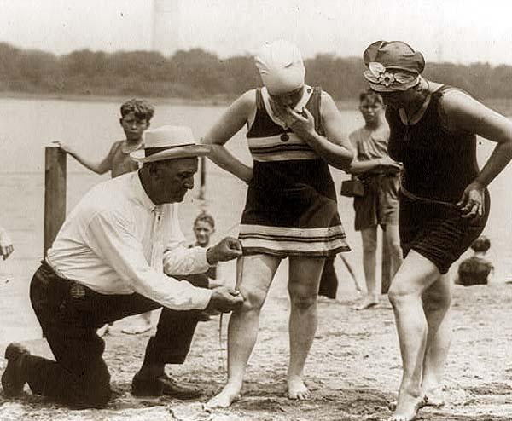
Section 2-The Twenties Woman

Slide 2
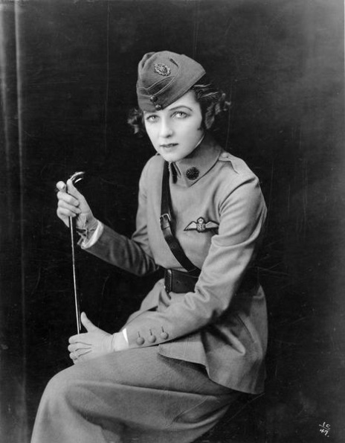
Young Women Change the Rules
Young women were ready for permanent change from traditional female roles
WWI gave them opportunities that they never had before
They held jobs, became the head of the household and made important family decisions

Slide 3
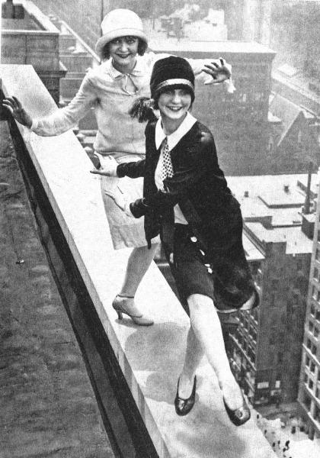
Young Women Change the Rules
Media helped popularize the image of a strong, independent woman
Flapper-An emancipated young woman who embraced the new fashions and urban attitudes of the day.
In reality, this was not widespread

Slide 4
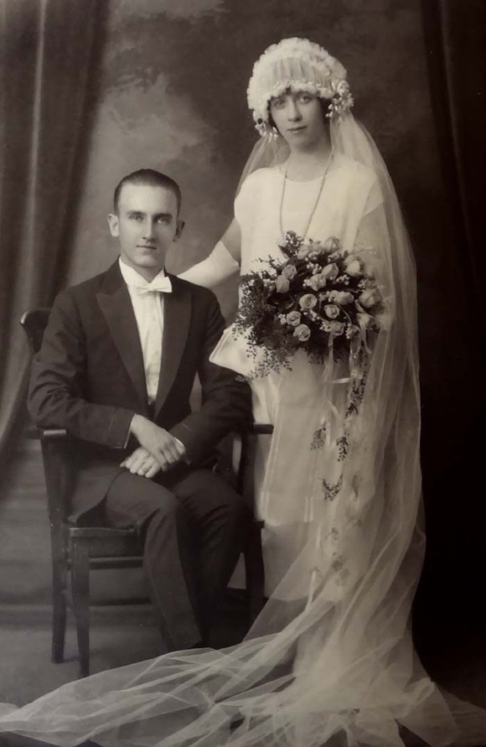
Young Women Change the Rules
Marriage began to be viewed as more of a partnership based on love, not convenience
With some exceptions
Women still responsible for most of the housework, even if they had a job outside the home
Double Standard-A set of principle granting greater sexual freedom to men than to women.
This caused women to be held to a stricter standard when it came to dating
It also pressured women to stick with one partner or risk being ridiculed by society

Slide 5
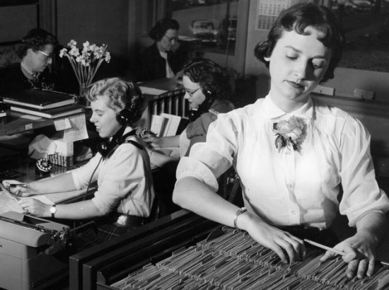
Women Shed Old Roles at Home and at Work
Women continued to seek new opportunities
Many college educated women turned to “women's professions” such as nursing, teaching and being librarians
Businesses that required extensive amounts of record keeping and correspondence hired women to work as typist, filing clerks, secretaries, stenographers and office-machine managers

Slide 6
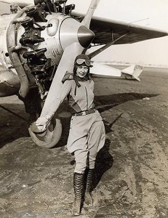
Women Shed Old Roles at Home and at Work
By 1930, 10 million women were earning wages; however, few rose to managerial jobs and almost always earned less than their male counterparts.
Although some were able to break through into traditional male professions like flying airplanes, driving taxis and drilling oil wells

Slide 7
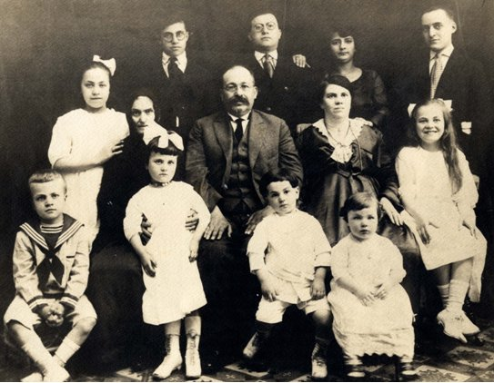
Women Shed Old Roles at Home and at Work
Family life in the 1920’s saw birthrates decline partially due to birth control becoming more available
Margaret Sanger helped women to understand their options along with the American Birth Control League in 1921
We also became more of an urban society so we didn’t require the labor of kids like they on farms

Slide 8
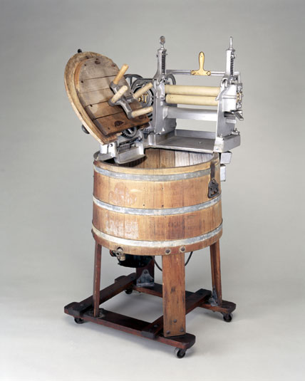
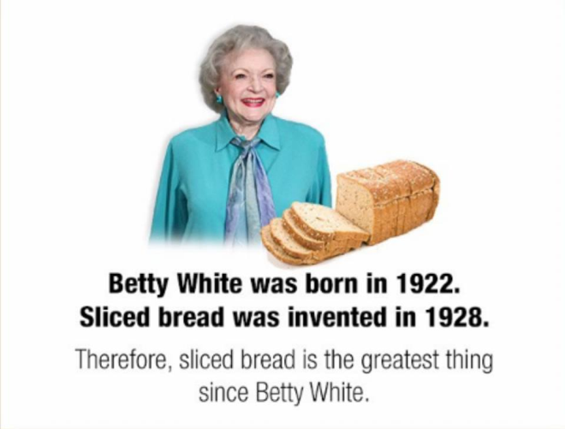
Women Shed Old Roles at Home and at Work
Social and technological advancements made housework easier
Electricity, vacuums, washing machines, etc…
Canned goods, sliced bread and ready made clothes filled the stores
With these new advancements families had more time for leisure activities or even another job

Slide 9
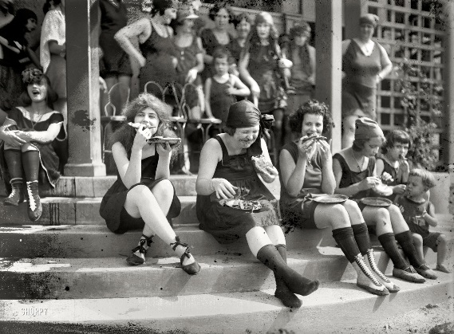
Women Shed Old Roles at Home and at Work
Children began spending more time in school and less time working
Adolescents seemed to be more rebellious than previous generations
Images from media were influential
They spent less time with their family and more time with friends

