Slide 1
Changing Ways of Life
Chapter 13-Section 1

Slide 2
Rural and Urban Differences
The 1920’s
The Shift to the City
In 1920-51% lived in small towns
From 1922-1929 migration to city increased…
WHY?
The city was new, exciting and provided opportunity

Slide 3
Rural and Urban Differences
What were the big cities?
New York, Chicago, Philadelphia
Mostly industrial centers

Slide 4
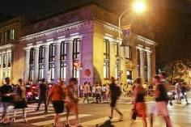
“Rural and Urban Differences
What were they like?
Ethnically mixed
Competitive: Not like farm…The individual was important, not the community
Toleration of many peoples, ideas, thoughts
Fast paced, exciting

Slide 5
“Rural and Urban Differences
But also:
Impersonal, frightening, lonely
No morals
All the technology and fast paced living led to people wanting more conservative values.
Especially alcohol reform and religion

Slide 6
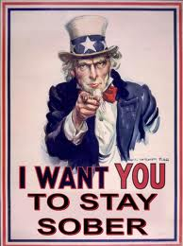
The Prohibition Experiment
Prohibition
An attempt to maintain morals, fails
1919: Volstead Act- Prohibition Bureau
1920: 18th Amendment
Forbid sale, transportation, and manufacture
Supported by south and west mostly
Immediate Success
Absenteeism down
Savings increase

Slide 7
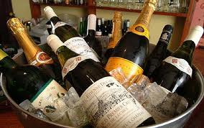
The Prohibition Experiment
Problems with Prohibition:
Used to put pressure on immigrants
Prohibition Bureau under-funded
Didn’t we just sacrifice for war? Why after it?

Slide 8
“No Booze for You”
What did Prohibition Create:
Speakeasies and Bootleggers
Mostly for middle and upper class
Increased traffic of illegal liquor
Organized crime became mainstream to handle demands
Led to violence and Al Capone
Prohibition lost support and finally ends in 1933

Slide 9
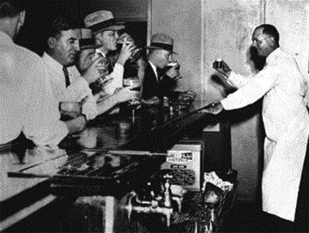

Slide 10
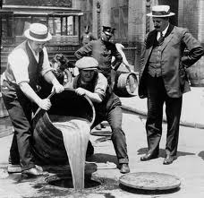

Slide 11
Organized Crime
Charles “The Bug” Workman
Jack “Legs” Diamond
Al Capone
“Scar Face”

Slide 12
“Science vs. Religion-Round 1”
Science and Religion
Old and new values clash in 1920’s as people become more modern
One is the idea of evolution and science

Slide 13
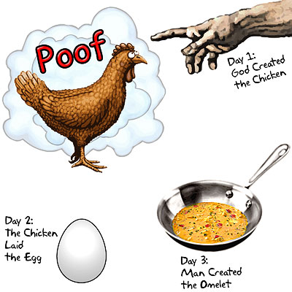

Slide 14
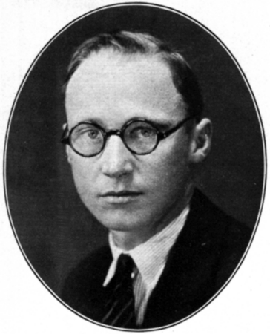
The Scopes Trial
Fundamentalists vs. Modernists
Fundamentalists: believe in strict religious teachings
Modernists support teachings of modern science
Scopes Trial: 1925
ACLU made it clear they wanted a teacher to challenge
Scopes steps up and is arrested
National Trial begins
Clarence Darrow: ACLU
William Jennings Bryan: State of Tenn.
Scopes was found guilty and had to pay a $100.00 fine

Slide 15
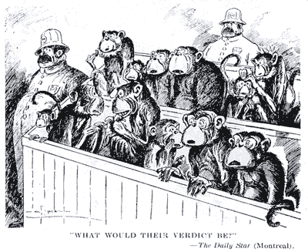
The Scopes Trial
National Sensation
Where was Science’s place? Where was Religion?

