Slide 1
Chapter 12 and 13-Test Materials

Slide 2
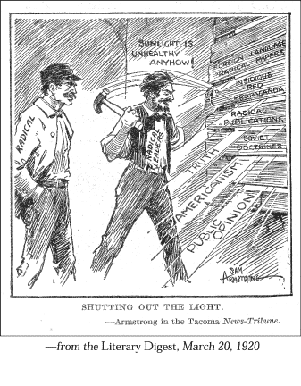
“Shutting Out the Light” Political Cartoon

Slide 3
Distribution of Personal Income Earned by All Americans in 1929 Chart/Graph

Slide 4
Primary Sources
“He smiled understandingly-much more than understandingly. It was one of those rare smiles with a quality of eternal reassurance in it, that you may come across four or five times in life. It faced–or seemed to face–the whole eternal world for an instant, and then concentrated on you with an irresistible prejudice in your favor. It understood you just as far as you wanted to be understood, believed in you as you would like to believe in yourself, and assured you that it had precisely the impression of you that, at your best, you hoped to convey.”
-F. Scott Fitzgerald, The Great Gatsby
“They were smart and sophisticated, with an air of independence about them, and so casual about their looks and clothes and manners as to be almost slapdash. I don't know if I realized as soon as I began seeing them that they represented the wave of the future, but I do know I was drawn to them. I shared their restlessness, understood their determination to free themselves of the Victorian shackles of the pre-World War I era and find out for themselves what life was all about.”
-Colleen Moore

