Slide 1
Chapter 11
The First World War

Slide 2
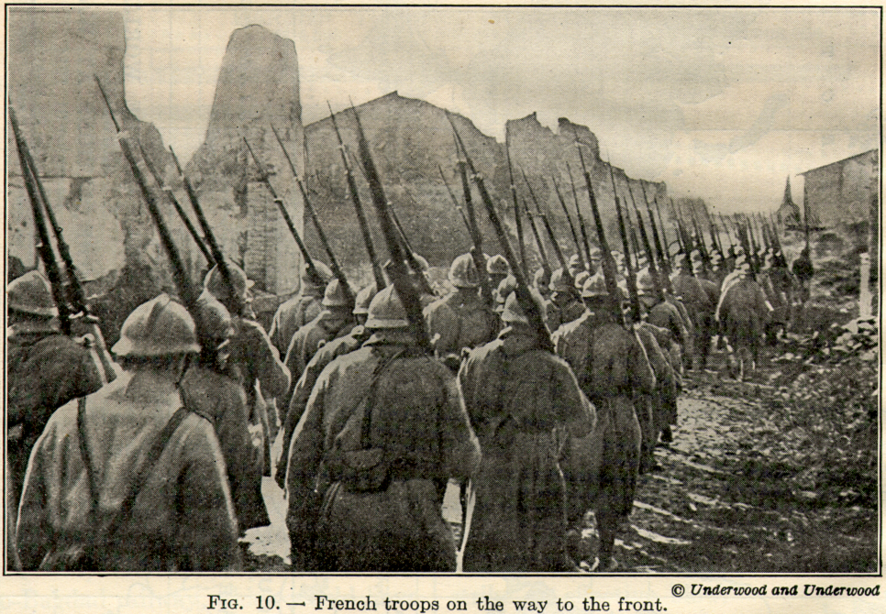
Section 1-World War I Begins

Slide 3
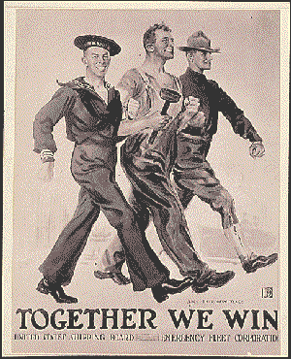
Causes of WWI
Although many Americans wanted to continue their isolationist approach and stay out of Europe's conflicts several factors including industrial interests and our position as a world power made U.S. neutrality difficult

Slide 4
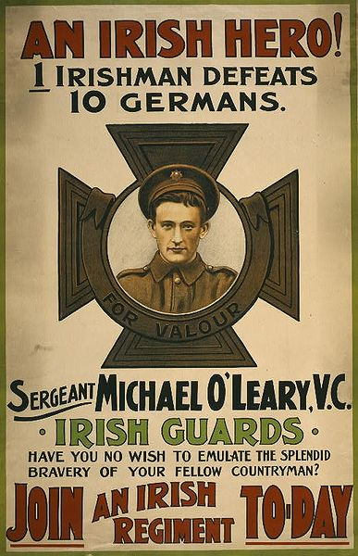
Causes of WWI
Generally historians cite four long-term causes of WWI:
  Nationalism
  Imperialism
  Militarism
  Alliance Systems

Slide 5
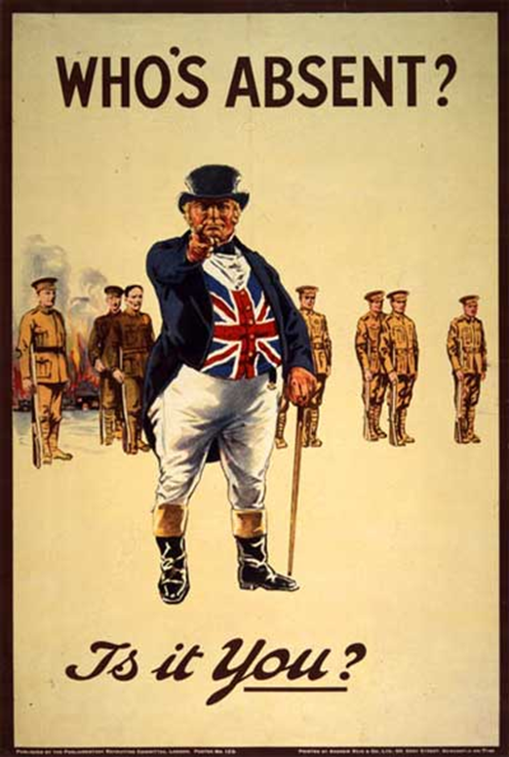
Causes of WWI
Nationalism-A deep devotion to one’s own nation
    It can serve as a unifying force or the catalyst for fierce competition among others
      Ex. By the turn of the 20th century Great Britain, Germany, Russia, Italy, France and the Austria-Hungarian empire were engaged in a fierce rivalry
Imperialism-For centuries European nations had been building empires slowly extending their economic and political control around the world

Slide 6
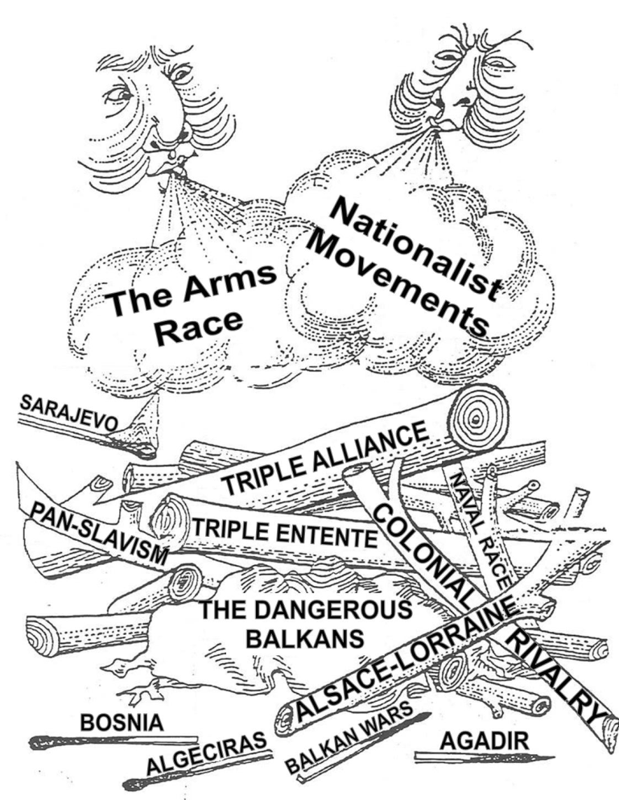
Causes of WWI
Militarism-The policy of glorifying military power and keeping an army prepared for war
Alliance System-There were two major alliance systems in Europe at the beginning of WWI
  The Triple Entente
    Later known as the Allies
  Triple Alliance
    Later known as the Central Powers

Slide 7
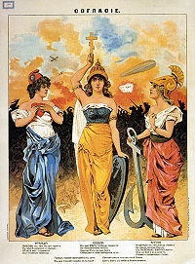
Causes of WWI
Triple Entente-Britain’s alliance with France and Russia
  Did not mean that Britain would fight with them but it did ensure they would not fight against them
By 1907 the Triple Alliance and Triple Entente were the strongest powers in Europe and would soon lead them into war

Slide 8
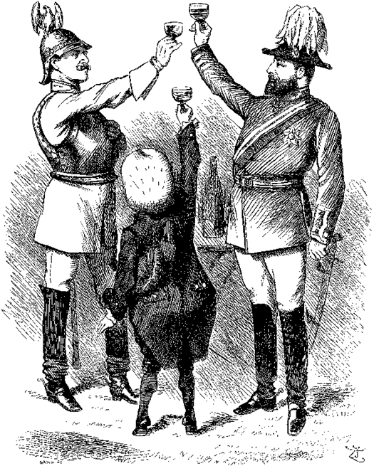
Causes of WWI
Triple Alliance-Alliance between Germany, Austria-Hungary and Italy whose goal was to isolate France
  Otto von Bismarck felt that “As long as it is without allies, France poses no danger to us (Triple Alliance)”

Slide 9
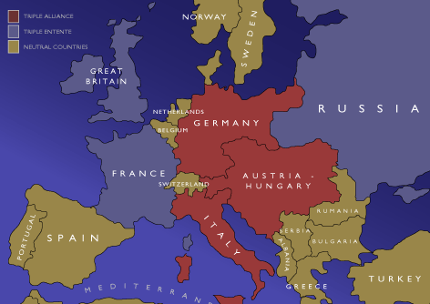

Slide 10
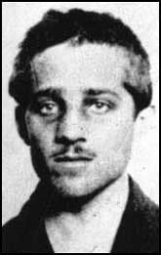
An assassination Leads to War
In 1908 Austria-Hungary annexed Bosnia and Herzegovina thus creating tension in the region
On June 28th, 1914 Gavrilo Princip assassinated the Archduke Franz Ferdinand and his wife Sophie in Sarajevo, Bosnia.
  Princip was Serbian so the Austrians declared war to punish Serbia
    Harsh demands were placed on Serbia
Russia soon sided with Serbia and soon the rest of Europe began to take sides as well

Slide 11
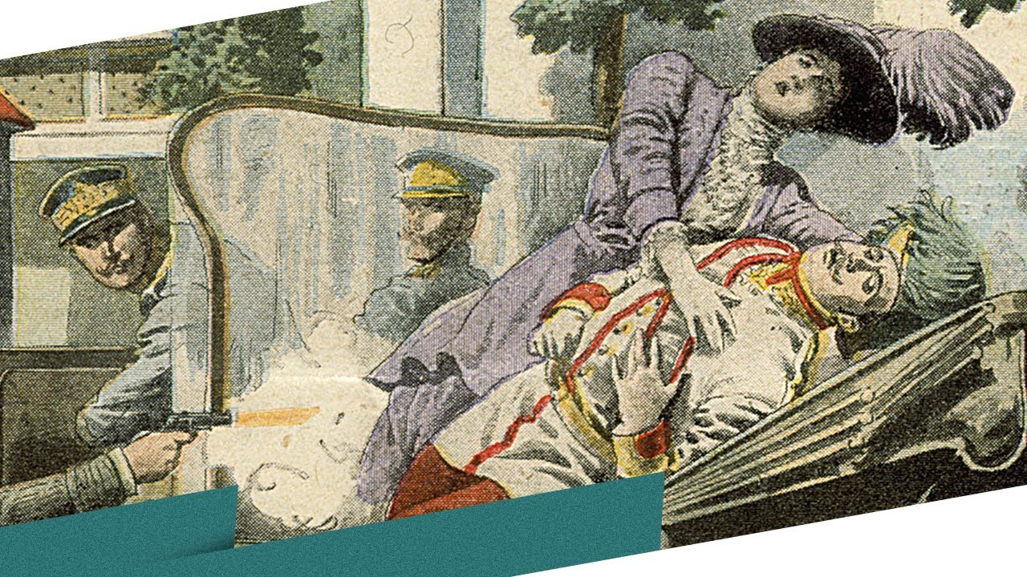

Slide 12
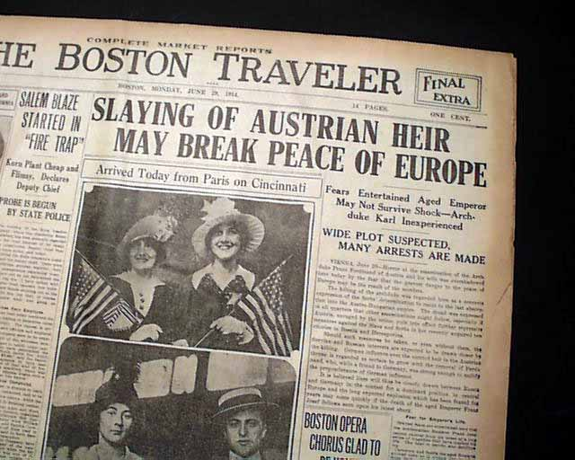

Slide 13
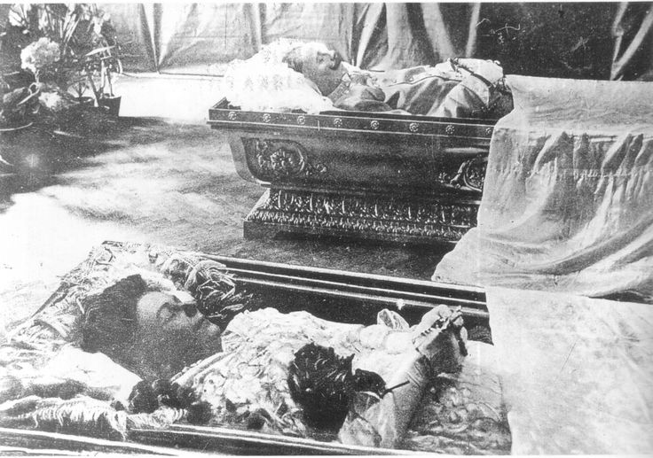

Slide 14
Source: John T. McCutcheon, cartoonist, Chicago Tribune, August 5th, 1914

Slide 15
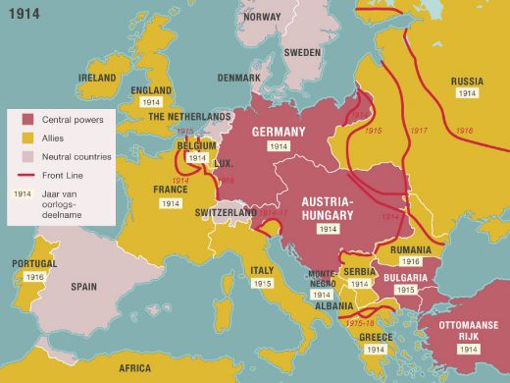

Slide 16
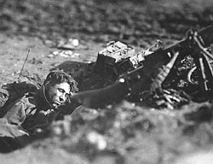
The Fighting Starts
Western Front- The deadlocked region of Northern France fought over in WWI
The Eastern Front-The battlefield along the German and Russian border
  Russians and Serbs battled Germans and Austro-Hungarians for control of the Eastern front

Slide 17
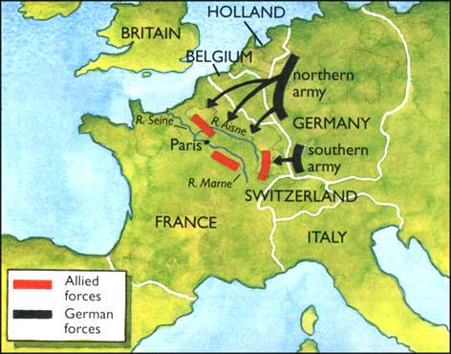
The Fighting Starts
Schlieffen Plan-The Germany plan in which they would defeat France 1st then turn east to fight Russia
  A quick defeat of France was vital to the plan

Slide 18
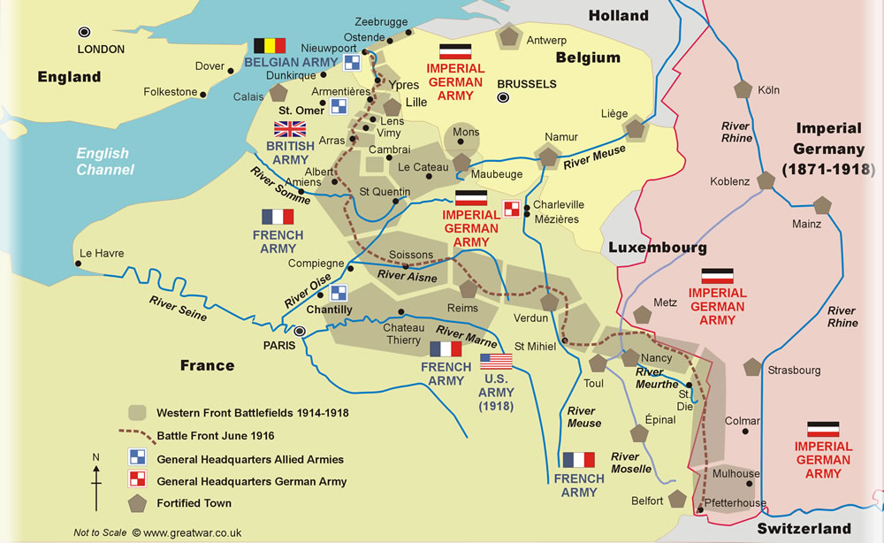

Slide 19
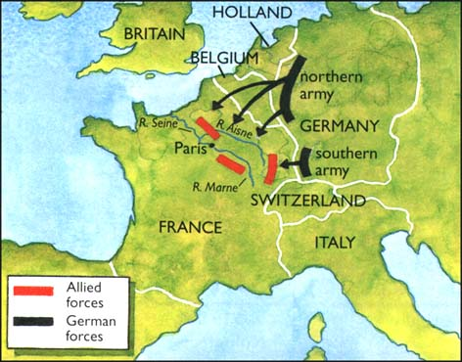
The Fighting Starts
Failures of the Schlieffen Plan-
  Sept. 5th, 1914 Allied forces attacked the Germans northeast of Paris in the valley of the Marne River
    600 taxicabs brought Allied re-enforcements to the front
  Sept.9th, the Germans retreated
  The 1st Battle of the Marne left the Schlieffen Plan in ruins b/c a quick victory no longer existed

Slide 20
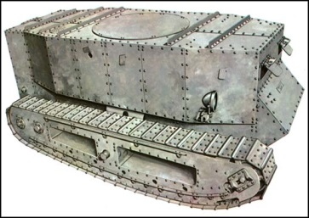
The Fighting Starts
Trench Warfare-Soldiers would fight from trenches often for pitifully small pieces of land
  The space between the trenches was called “no man’s land”
  The trenches along the Western Front reached nearly 500 miles from the North Sea to the Swiss border
New Military Technologies-
  Machine guns, poison gas, tanks, armored cars and submarines were widely used for the 1st time in war

Slide 21
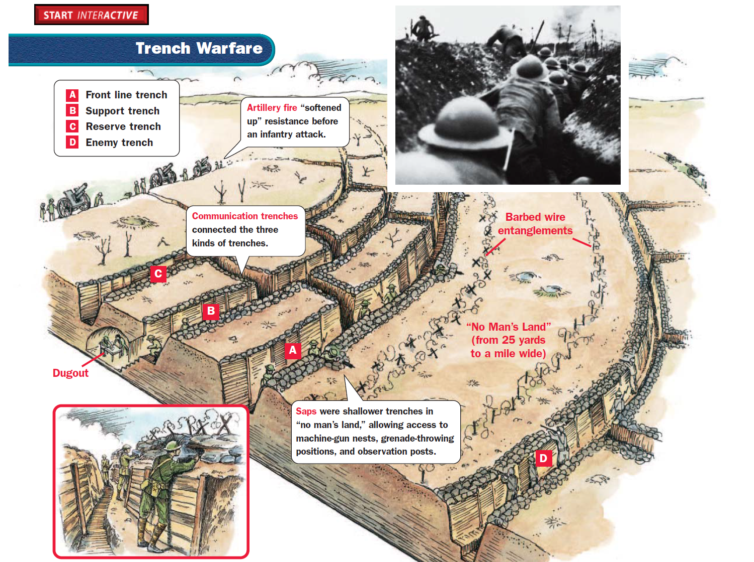

Slide 22
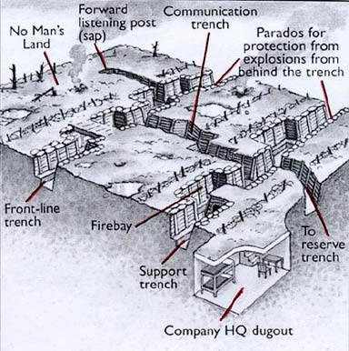

Slide 23
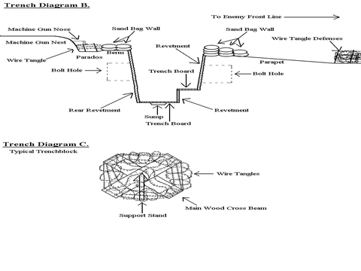

Slide 24
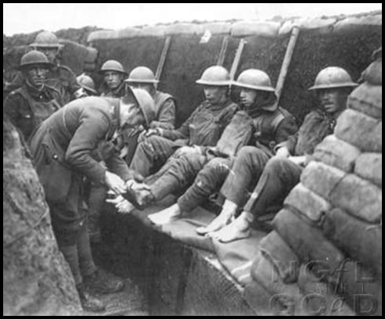
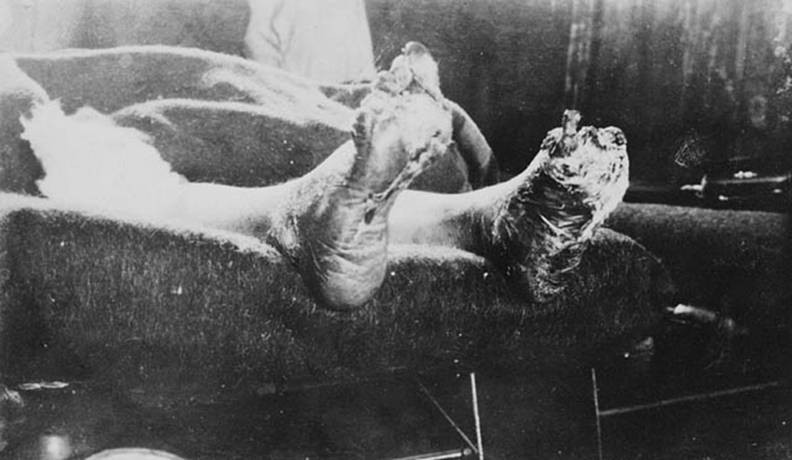
Trench Warfare

Slide 25
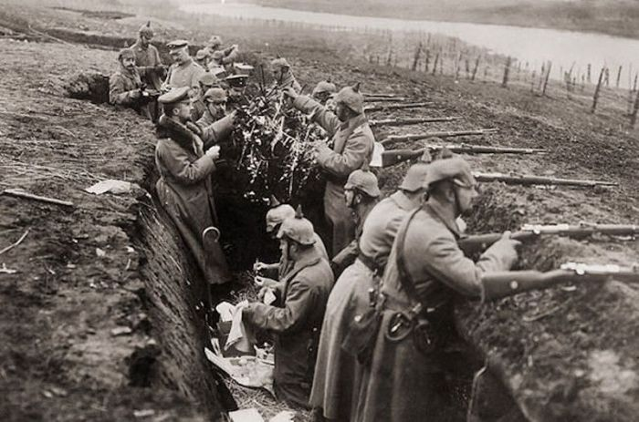

Slide 26
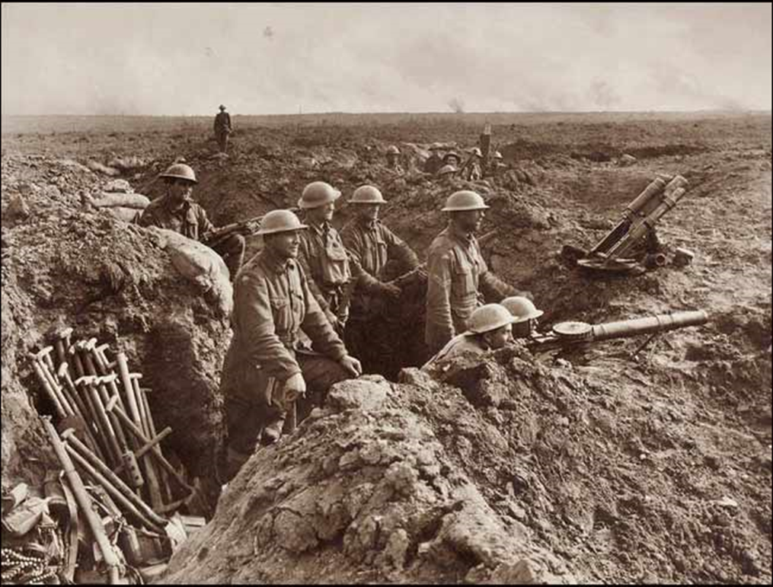

Slide 27
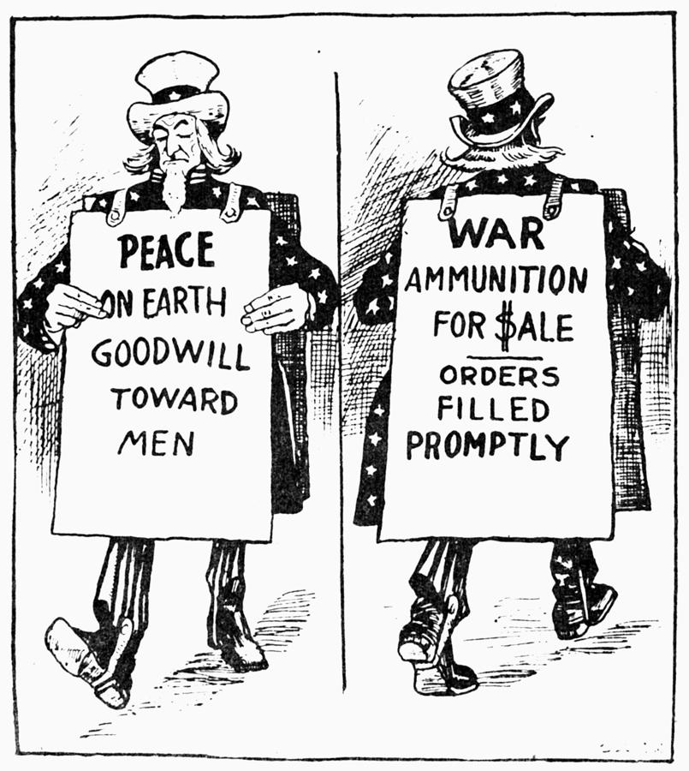
Americans Question Neutrality
In 1914 many Americans felt we had no reason to get involved in a war 3,000 miles away.
  Most preferred an isolationist approach
Another issue was that many former immigrants identified and sympathized with the nations which they came from.
  This divided Americans along ethnic and social lines
America’s economic ties also played a role in our favored position to support the Allies over the Central Powers

Slide 28
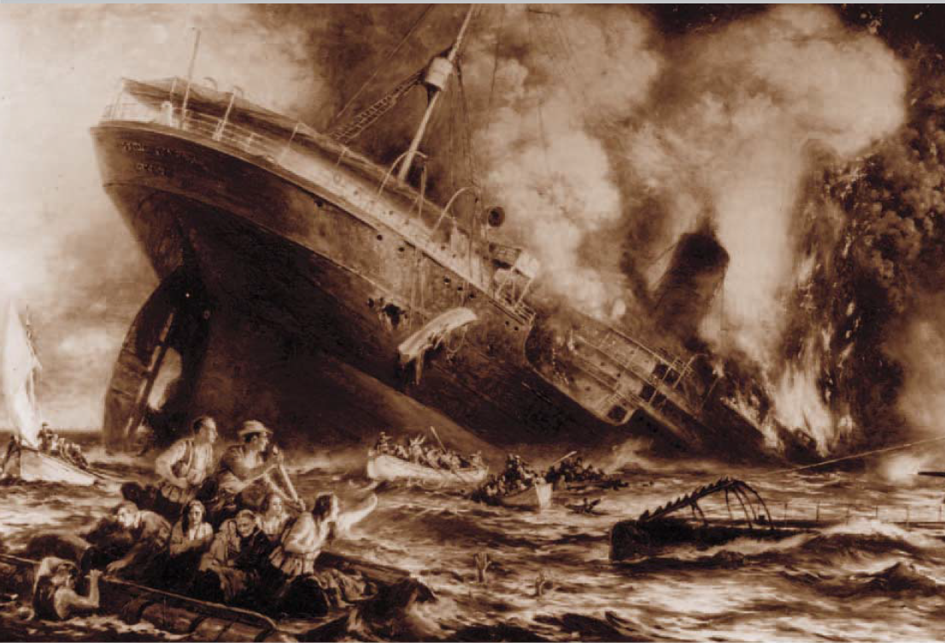
The War Hits Home
Unrestricted Submarine Warfare- Germany announced that their submarines would sink any ships in the water surrounding Britain without warning
  After the cruise ship Lusitania was sunk by a German U-boat leaving 1,198 passengers (128 of them American) dead the U.S. threatened action if the Germans continued to sink neutral ships

Slide 29
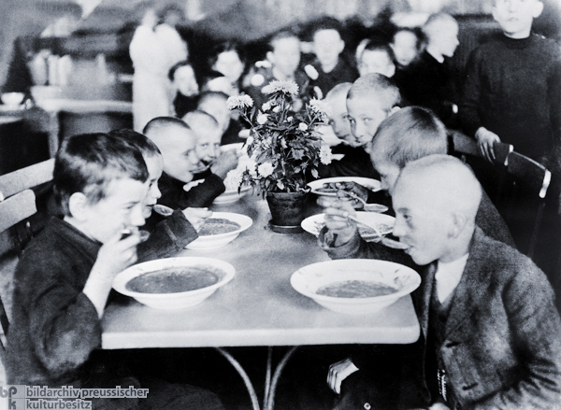
The War Hits Home
Americans Join the Fight-
  Germany returned to unrestricted submarine warfare in 1917
The British Blockade-
  As the war raged on Great Britain began blocking the German coast to prevent weapons and other military supplies from reaching the hands of the Germans
  By 1917, famine gripped Germany resulting in nearly 750,000 Germans starving to death

Slide 30
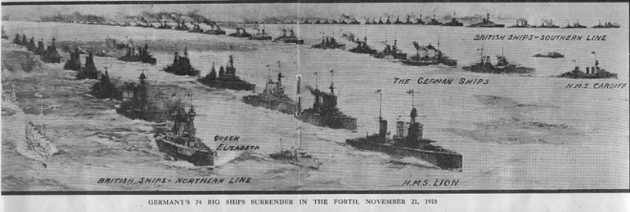
The British Blockade

Slide 31
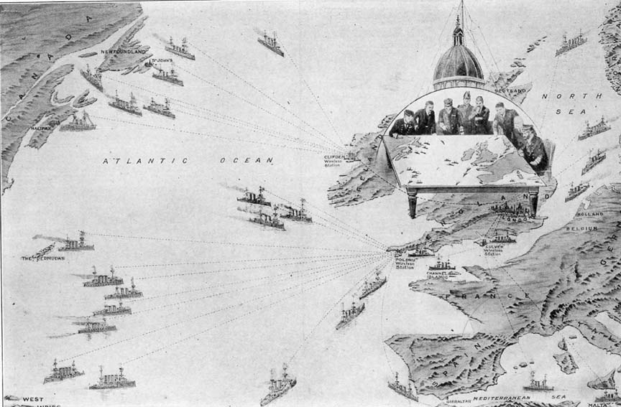

Slide 32
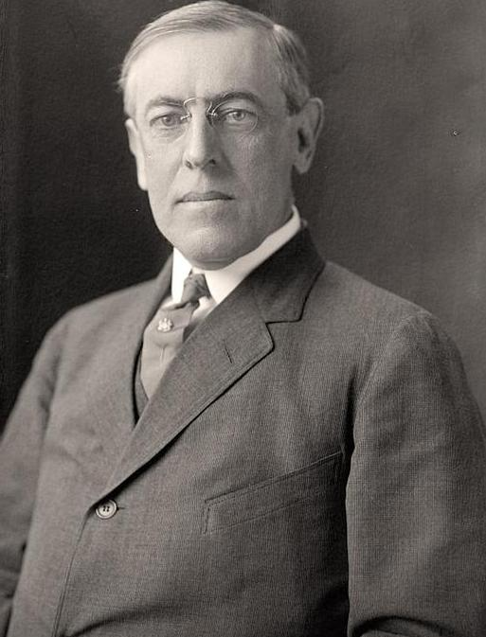
The War Hits Home
The Election of 1916-
  President Woodrow running under the slogan “He kept us out of war” wins the election against Supreme Court Justice Charles Evans Hughes

Slide 33
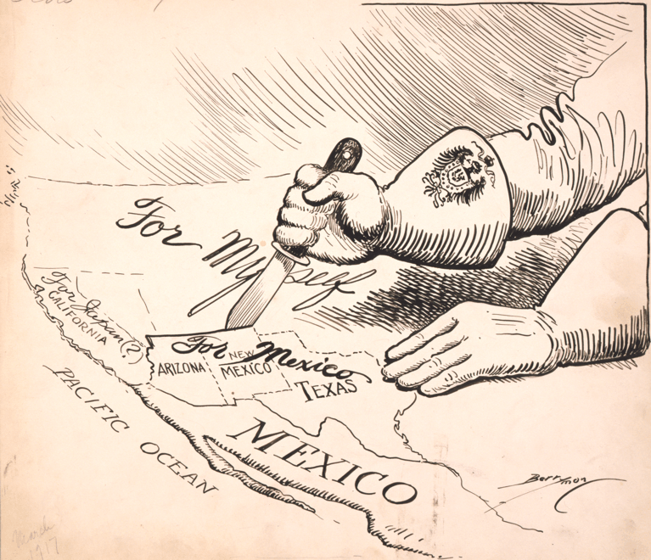
The United States Declares War
The Zimmerman Note- In February, 1917 the U.S. intercepted a German telegram headed to Mexico
    Germany wanted Mexico to join their fight and in return they would help Mexico “reconquer” the lands they lost to the U.S.
    This led President Wilson to ask for a declaration of war against Germany on April 2nd, 1917

Slide 34
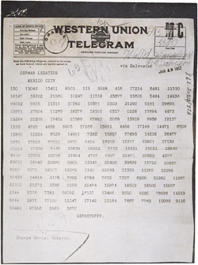
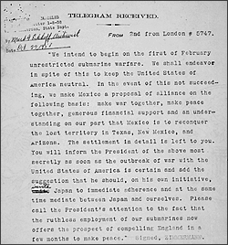
The Zimmerman Note

Slide 35
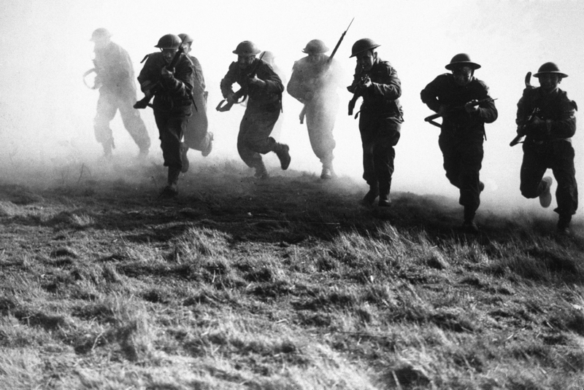
The United States Declares War
America Acts-
  On April 2nd, 1917 President Wilson delivered his war resolution in which he hoped to make the world “safe for democracy”
    Congress granted a declaration of war a few days later allowing the United States to enter the war on the side of the allies

Slide 36
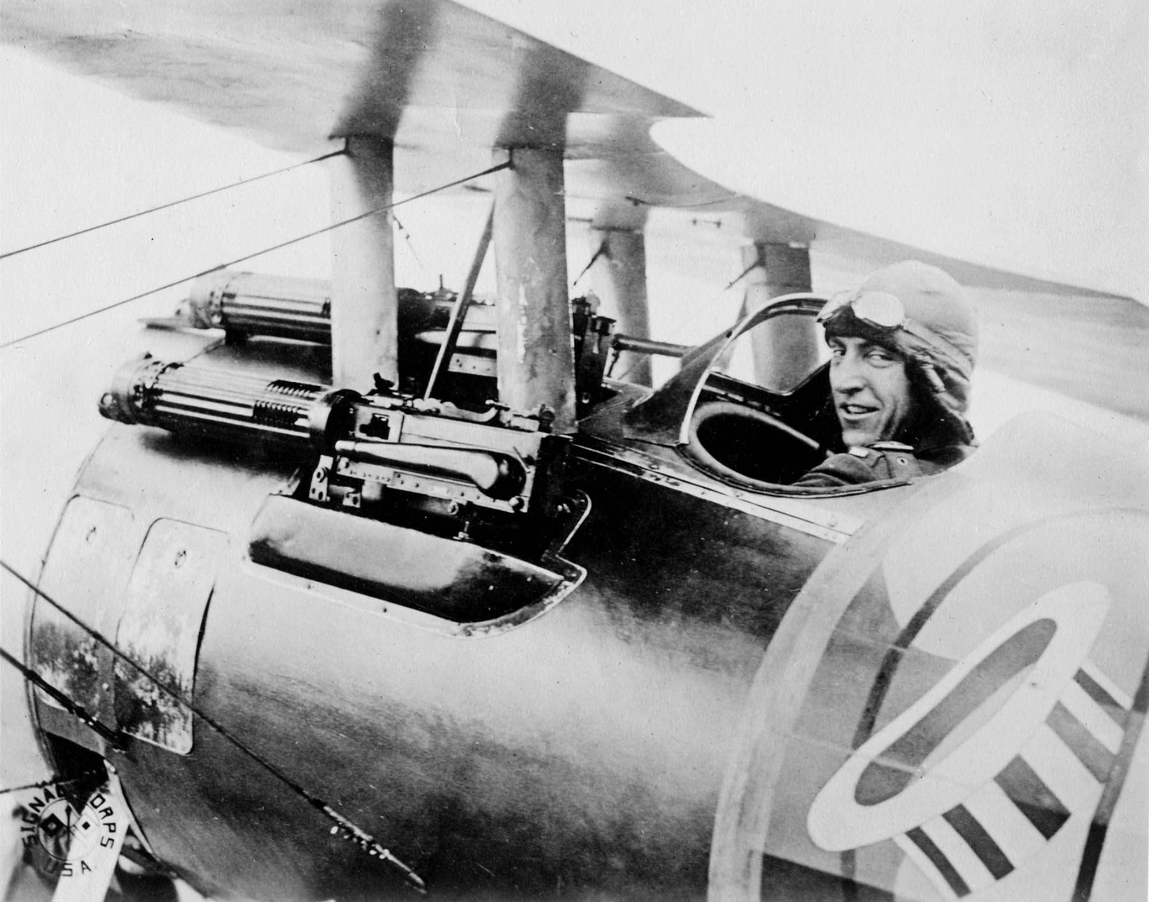
Section 2-American Power Tips the Balance

Slide 37
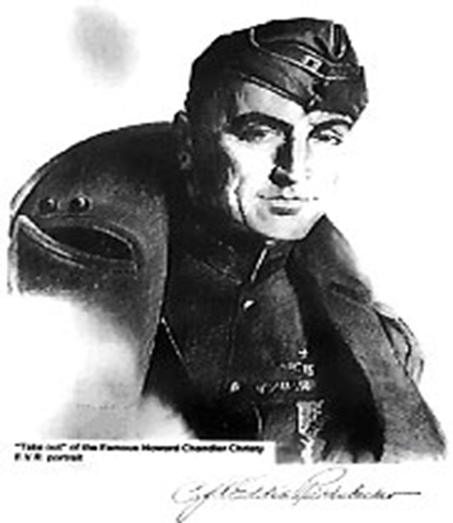
A New American HEro
Eddie Rickenbaker
  Famous WWI fighter pilot who before the war was a race car driver
Very little military training and he actually learned to fly on his own
He is best known for fighting the German “Flying Circus” led by the “Red Baron” Manfred von Richthofen
Engaged in 134 air battles and downed 26 enemy aircrafts
  He received the nickname “American Ace of Aces”

Slide 38
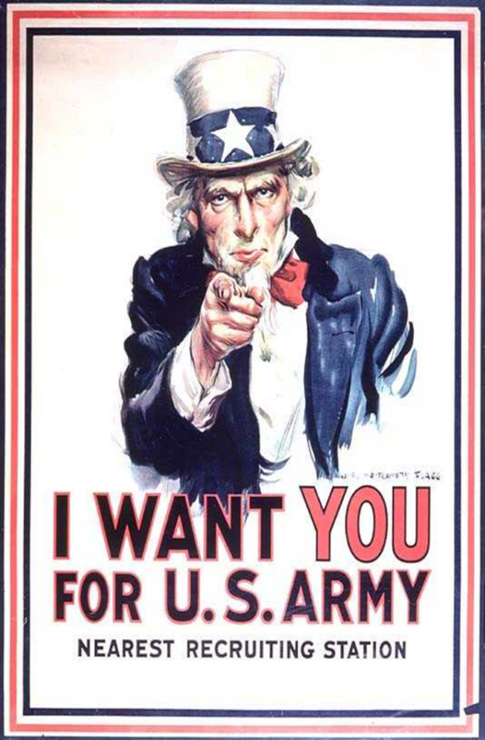
1. How did the United States raise an army?
Selective Service Act-This act forced men to register to be randomly selected for military service.
  There was only 200,000 men in service when war was declared.
  Selective Service Act required all abled bodied men 18 to 45 to register
  24 million register; 3 million are drafted; 2 million go to Europe.
  Most did not attend high school (illiteracy at 25%)
  Almost ½ million African Americans in US armed forces; over ½ served in France.
    Their units were segregated. The all-black 369th infantry saw more continuous duty on front line than any other regiment.
  Women served in the Navy & Marines (non-combat positions).

Slide 39
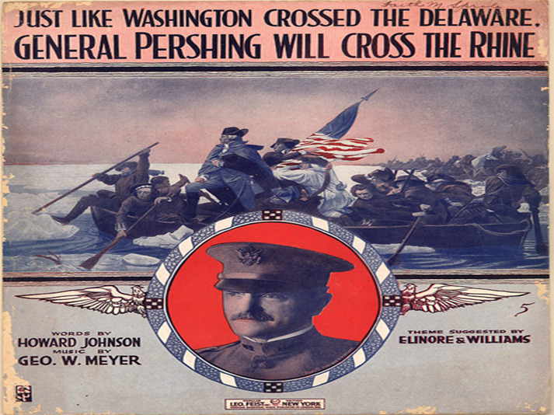
2. How did U.S. soldiers help win the war?
Gov’t. made mass production of ships a priority.
US factories (with help from the Gov’t.) mass produced ships to get men, supplies & equipment overseas);
After almost three years of fighting, Allied forces were exhausted.
American troops were fresh and enthusiastic!

Slide 40
3. How did the U.S. build its naval force?
Four crucial steps:
  Did not draft shipyard workers
  Emphasized the importance of shipyard workers
  Prefabrication using standardized parts saved valuable time
  Government took control of all ships.

Slide 41
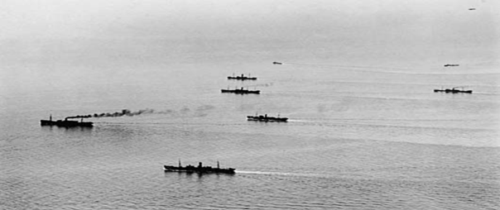
4. How did the U.S. Navy help win the war?
Convoy System-A strategy where armed destroyers escorted merchant ships across the Atlantic Ocean
Laid a 230-mile barrier of mines in the North Sea to “bottle” the German subs (U-boats) & keep them out of the Atlantic.
  This cut down the number of American lives lost at sea significantly.
On land, US troops brought freshness & enthusiasm.
  After two and a half years of fighting, Allied troops were exhausted & demoralized.

Slide 42
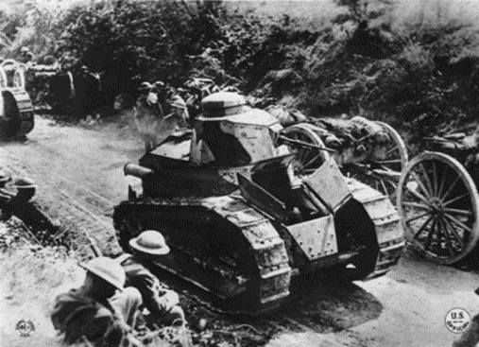
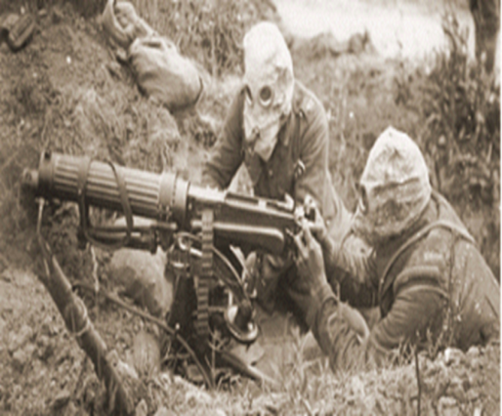
5. Why were US troops so effective in combat?
Strong Leadership-General John. J. Pershing – Commander of U.S. Army in Europe (AEF).
  He changed the style of combat from a series of DEFENSIVE (trenches) battles to one marked by strategic OFFENSIVE attacks.
DOUGH BOYS- The nickname for American infantryman.
New Weapons were introduced:
  Machine gun; Tanks; Airplanes; Antiaircraft guns
    Poison gas masks became standard issue.

Slide 43
6. American troops on the offensive…
Russia pulls out of the war in 1917 and soon the Germans are within 50 miles of Paris.
  US troops arrived in time to stop Germany from making big gains in France.
    By mid-year the tide had turned against the Central Powers.
Alvin York emerged as a U.S. war hero, despite his initial position as a conscientious objector (a person who opposes warfare on moral grounds, based on religious beliefs).
  He kills 25 Germans and with the help of six other dough boys captures another 132
Collapse of Germany–November 1918 naval mutiny quickly spreads throughout German army
  That same month Socialist leaders take control of the gov’t. and the Kaiser gives up the throne.
On November 11th, 1918 and ARMISTACE (truce/cease fire) is signed officially ending WWI.

Slide 44
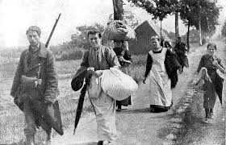
7. What did the war cost in terms of the number of…
22 million people die during WWI
  Civilian deaths accounted for nearly half of that number.
  Military deaths are estimated to between nine and eleven million
    Twenty million soldiers are wounded but survive
    Ten million refugees are forced to leave their homes
The cost of American involvement:
  52,000 died in battle
  62,000 died of disease
  200,000 wounded

Slide 45
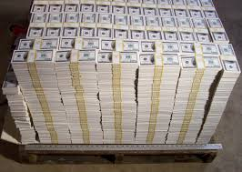
8. What were the estimated economic costs?
The war cost an estimated $338 billion dollars
  Since Germany was the last of the Central Powers to surrender the burden of this debt will rest squarely on their shoulders setting the stage for WWII

Slide 46
WWI impacts life in the U.S.
Closing Activity-Marking Predictions
Brainstorm with your small groups as to how you think being involved in a long, costly war like WWI would affect the lives of Americans on the home front during its course.
  Create a thinking map that would help list the economic, social and political changes your group thinks we might have experienced at home as a result of America entering into WWI.

Slide 47
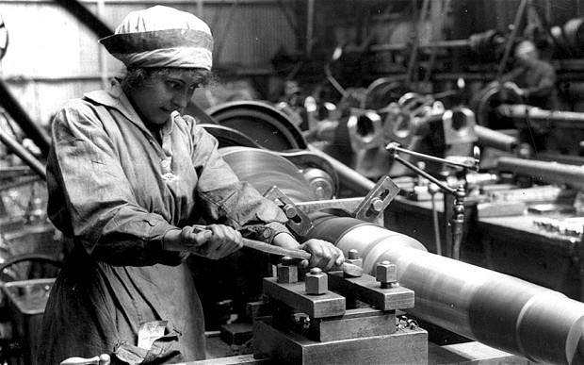
Section 3-The War at Home

Slide 48
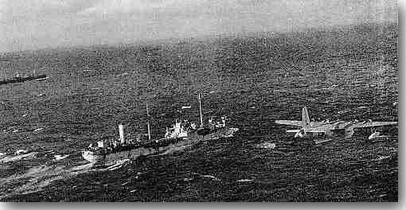
American Proprieties During WWI
The Three Priorities of Congress during WWI
  1. Supply allies with food and equipment
    Over a million women joined the work force
  2. Raise money to pay for war
    Selling war bonds
  3. Get the American public to maintain support for the war
    Use of war propaganda

Slide 49
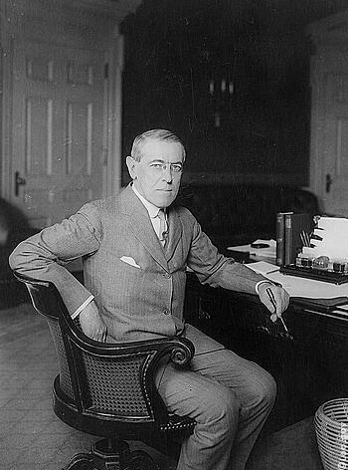
Congress Gives Power to Wilson
Due to the war being such an immense conflict private industry and the government began to work together to guide the U.S. economy from the production of consumer goods to war time materials
Congress gave Wilson direct control over the economy
  Including the power to fix prices and nationalize or regulate war-related industries

Slide 50
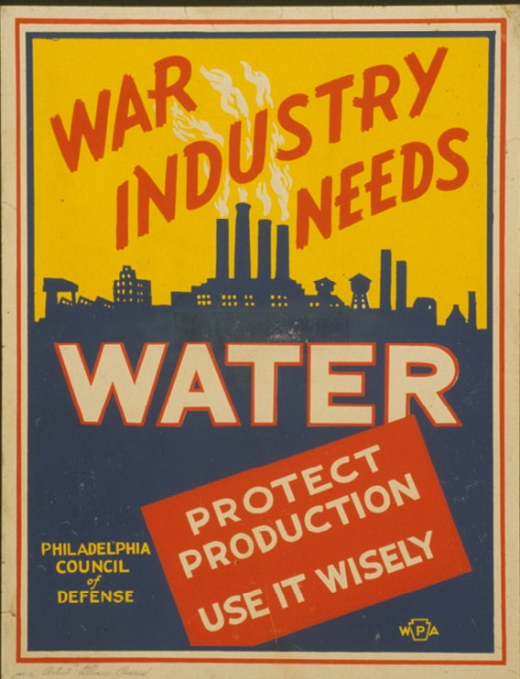
War Industries Board
War Industries Board
  Created in 1917 and headed by Bernard Baruch
Purchased items for war
  Converted factories
  Could control prices
Businesses made massive profits, but consumers lacked many of the things they needed

Slide 51
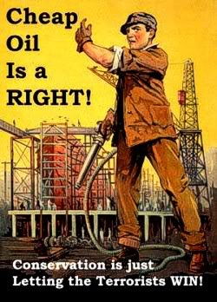
War Industries Board
The WIB (War Industries Board) along with the Fuel Administration and Railroad Administration helped regulate the economy during the war
  Regulated the railroads, boosted coal and oil production, encouraged conservation of energy
In March 1918 the Fuel Administration created Daylight Savings Time
  Originally suggested by Ben Franklin in the 1770’s

Slide 52
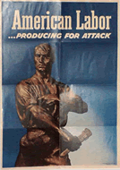
War Economy
Designed to prevent Labor disputes
Union membership doubled
  Membership climbed to nearly four million
    There were also more than 6,000 strikes that broke out
Better pay and working conditions
  Mainly those in metal trades, shipbuilding and meatpacking by roughly 20%
  However, household incomes were undercut by rising food costs

Slide 53

Food Administration
Food Administration- Created by Wilson under the Hoover administration
  Instead of rationing food Wilson encouraged people to prevent waste citing the “gospel of the clean plate”
    He declared to prevent waste Americans should have one day “meatless”, one “sweetless”, two days “wheatless” and two days “porkless”
    Restaurants removed sugar bowls from tables and only served bread after the first course

Slide 54


Slide 55

War Financing
The United States spent about $35.5 billion on the war. They raised the money through:
  1. Taxes-
    Not just income, but corporate and excise tax (gum, liquor…)
  2. Bonds-
    Sold to “War Bonds” and solicited “Victory Loans” from the public
  3. Propaganda-
    They used films, posters, public speakers and radio ads to help

Slide 56

Espionage and Sedition Act
U.S. Government was worried about spies so they passed the Espionage and Sedition Acts (1918)
  Fine and jail people who violate these laws which limited 1st Amendment
Schenck v. US-
  Socialist who wrote pamphlets that said the draft was like slavery
  During was First Amendment does not always apply
  Sentenced to Jail

Slide 57

The Great Migration
Seeking better opportunities thousands of African Americans began moving north in search of jobs
  This was called the Great Migration
    African Americans experienced less discrimination and found a better standard of living
      Although some race riots erupted

Slide 58

A Citizens Role
Regular people had part to play
  Herbert Hoover encouraged volunteerism and created the food administration
Women went to factories, proved they could do mans job and got vote
Americans created “Victory Gardens”
Americans sacrificed with things like “Wheat-less Wednesdays”
Government bought farmers goods for soldiers at great price

Slide 59


Slide 60

Anti-German Sentiment
Some Germans were picked on and many citizens did not want to be connected to anything German
  Change city names
  Change food names
  Ban German books and songs
  Some violence against recent German immigrants

Slide 61

The Flu Epidemic
In 1918 the flu hit Americans during war
  People stayed home and businesses shut down to avoid contagion
Doctors did not have answers and many soldiers affected due to close quarters
Nearly 30 million people around the world died from the flu among them roughly 500,000 Americans
The epidemic ended in 1919
  Only real answer was to clean up and quarantine

