Slide 1
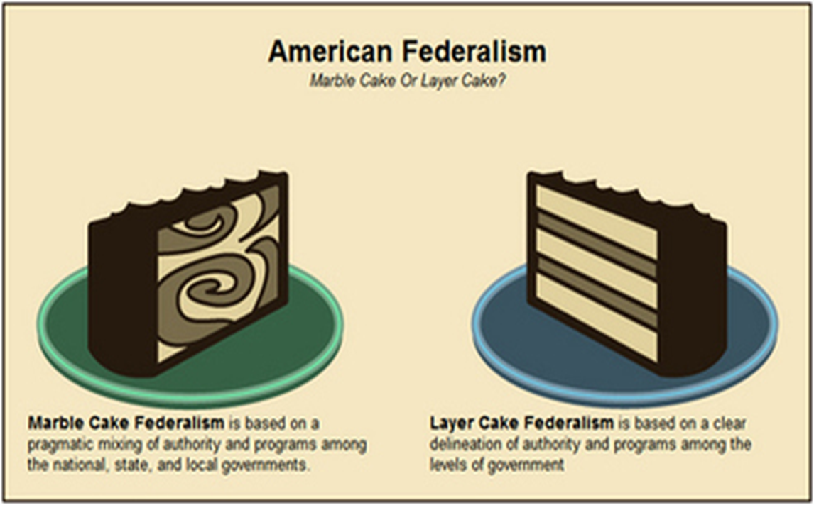
Test Materials
Chapter 3 and 4

Slide 2
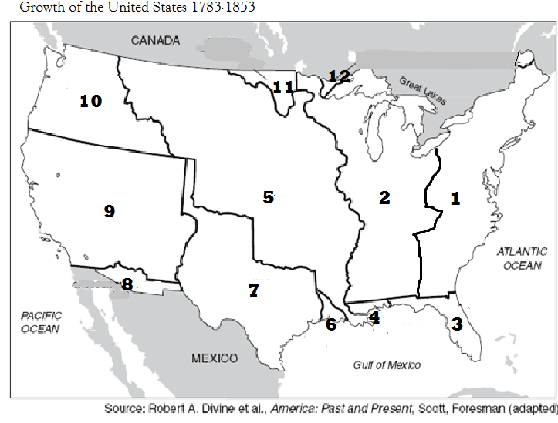

Slide 3
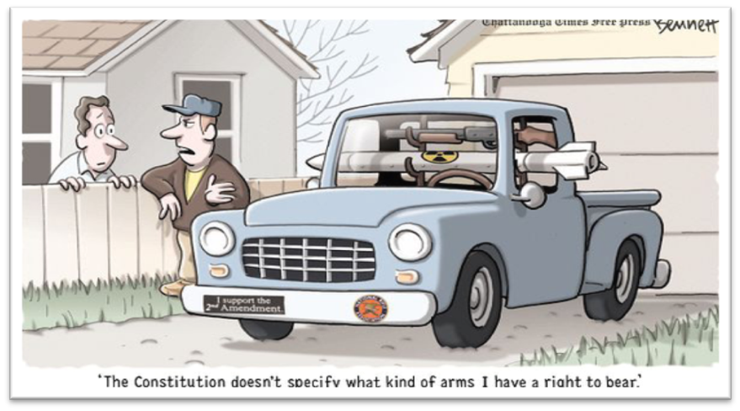
Political Cartoon

Slide 4
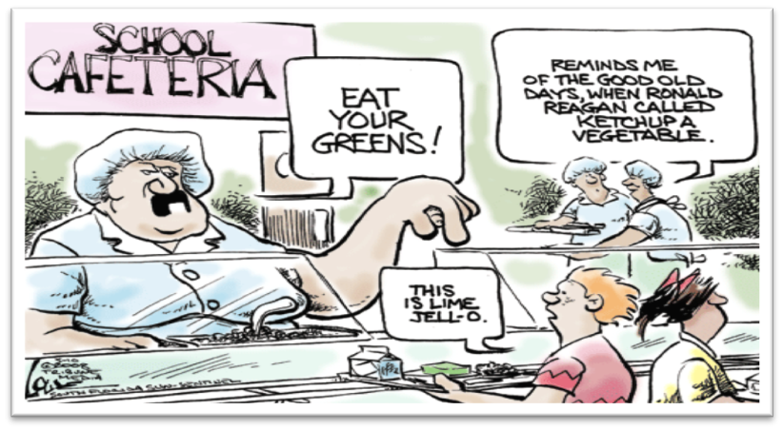
Political Cartoon

Slide 5
Primary Source Excerpt
Document A
There is no security in the system [under the proposed new U.S. Constitution] either for the rights of [people with different ideas] or the liberty of the press . . . The executive and the legislature are so dangerously [combined] that [it should cause people to be alarmed] . . . There is no [system] for [making sure that power does not stay] in the same hands for life.
Source: "Observations on the New Federal Constitution and on the Federal and State Conventions," by Mercy Otis Warren. It originally appeared as a newspaper article in the spring of 1788.

Slide 6
Primary Source Excerpt
Document B
Your [opinion], that our [situation is quickly coming] to a crisis, [agree] with my own ... We have errors to correct. We have probably had too good an opinion of human nature in forming our confederation (i.e. the Articles of Confederation) . . . thirteen [powerful], independent, disunited States are in the habit of . . . refusing [to obey our national Congress] . . . [I pray that we can act in time to prevent the bad things we fear may happen].
Source: A letter written by George Washington to John Jay, dated August 1, 1786. In these lines, Washington is agreeing with Jay’s criticism of the Articles of Confederation.

Slide 7
Primary Source Excerpt
Document C
Let us look and [see] the [problems that exist] in every part of our country . . . the complaints of our farmers . . . the complaints of every class of [people who loan money] . . . the [sad] faces of our working people . . . our ships rotting in our harbors . . . the insults that are [made against America] in every court in Europe . . . View these things, fellow citizens, and then say that we do not require a new, a protecting, and efficient federal [national] government if you can.
Source: The Massachusetts Sentinel, October 20, 1787. (From Voices of America: Readings in American History, Thomas R. Frazier, ed. Boston: Houghton Miflin, 1985, p. 61)

Slide 8
Primary Source Excerpt
Document D
When all government, in little as in great things, shall be drawn to Washington as the Center of all power, it will render powerless the checks provided of one government on another and will become as venal [corruptible] and oppressive as the government from which we separated.
—Thomas Jefferson, 1821

